Slide 1


Harnessing the Value of Transportation System Performance
TRANSPORTATION SYSTEMS MANAGEMENT AND OPERATIONS
Notes:
Background and Overview:
This presentation will demonstrate the value of operations for transportation agencies, with multiple examples of State DOTs that have implemented operations strategies that have resulted in measurable benefits.
This presentation is intended for States and regions to use to share about transportation systems management operations (TSMO) and how it can help improve the transportation system.

Slide 2
Disclaimers
This presentation was created and is being presented by a contractor. The views and opinions expressed in this presentation are the presenter’s and do not necessarily reflect those of the Federal Highway Administration or the U.S. Department of Transportation (USDOT). The contents do not necessarily reflect the official policy of the USDOT.​
​The U.S. Government does not endorse products or manufacturers. Trademarks or manufacturers’ names appear in this presentation only because they are considered essential to the objective of the presentation. They are included for informational purposes only and are not intended to reflect a preference, approval, or endorsement of any one product or entity.​

Slide 3
What is TSMO? (1/2)
Transportation Systems Management and Operations (TSMO)
Originally defined in MAP-21*, Section 1103(a)(30)(A)
  “An integrated set of strategies to optimize the performance of existing infrastructure through the implementation of multimodal and intermodal cross-jurisdictional systems, services, and projects designed to preserve capacity and improve security, safety, and reliability of the transportation system.”
Supported and enabled by Intelligent Transportation Systems (ITS) technologies
* MAP-21 = Moving Ahead for Progress in the 21st Century Act
Notes:
Description of the Slide
Before getting into detailed examples and benefits, it is perhaps worthwhile to define just what is meant by “operations,” or TSMO.
Key Points
Moving Ahead for Progress in the 21st Century Act, or MAP 21 – initially defined “Transportation Systems Management and Operations”
A key phrase in this definition is the notion of “integrated strategies.” The goal of integration is to bring the management and operation of the surface transportation network into a unified whole, thereby making the various transportation modes and facilities perform better and work together.
Safety and reliability are key outcome performance measures.
There are many aspects of integration – for example:
Technical integration in terms of standards and system architectures that support information sharing between ITS-based systems; and
Institutional integration such that operations are mainstreamed into a transportation agency’s institutional framework and corresponding business processes; and also coordination and collaboration between various agencies and jurisdictions in the region to achieve seamless interoperability

Slide 4
What is TSMO? (2/2)
“TSMO is a coordinated approach to managing and operating our roadways as safely and efficiently as possible, focused on maximizing existing infrastructure, addressing the causes of breakdowns in flow, and overall performance of the transportation system. TSMO helps us maximize the safe movement of people and goods across modes with a focus on relatively low-cost, quickly implemented operational improvements within our existing facilities.”
--Scott Marler, Iowa Department of Transportation (DOT) Director
Notes:
Description of the Slide
This slide contains a quote from Scott Marler, Iowa DOT Director, to describe TSMO
Key Points:
First and most important, TSMO is not a passing fad. Iowa DOT Director Mark Lowe summarizes what TSMO means to the agency and its purpose of improving the capacity of existing facilities.
TSMO is about strategies that optimize the performance of infrastructure. Those strategies may include systems and services and their purpose is to preserve capacity and improve security, safety and reliability – making the transportation as good as it can be for moving people and goods from point A to B.
The term TSMO may be relatively new, but the practice of it is not. However, due to increased congestion, improved roadway designs, and advances in technology, the tools of TSMO have evolved significantly over time.
Note: Scott Marler provided this quote and permission to use it for this slide deck.

Slide 5
Why TSMO?
Limited funds
  Agencies looking for ways to face challenges with less funding
Advances in technology
  Transportation agencies can utilize technology and data to solve many operational issues
Changing customer needs and expectations
  Greater demand for accountability in spending public funds, which has created more “performance-based” programs
Better understanding of the causes of congestion
  It’s not just recurring events like rush hour
Notes:
Description of the Slide
We just discussed what TSMO is, but why is it important for transportation agencies?
Key Points
In many other industries—such as airports, factories, and utilities—adding physical capacity is considered only after they have squeezed efficiencies out through better control of supply and demand or by layering on technology elements. The highway industry still has “build projects / expand the system first” legacy thinking built in. We are trying to catch up to other industries who have long recognized the importance of getting the most out of their existing capital investments.
Transportation agencies on the federal, state, and local levels have, for years, been tasked with doing more with limited resources. State DOTs are always looking for innovative, lower cost ways to get people and goods to their destinations more safely and reliably. TSMO can help do that.
Transportation agencies can leverage technology and data to develop solutions to address congestion issues. However, given the advancement in consumer technologies, privately owned mobility services, shared mobility and the availability of more information, the traveling public expects fast, reliable and “smart” transportation.
There is a greater demand for accountability for public officials to ensure that public funds are spent to maximize the performance of the transportation system in the most cost-effective way. This creates a trend toward performance-based programs. The traveling public is seeking relief from unexpected delays in their trips.
Research has shown that while some congestion may be caused by typical morning and evening rush hours, a significant amount comes from non-recurring events, such as crashes, breakdowns, work zones, weather, and special events. There may be opportunities to quickly apply low-cost TSMO improvements that are targeted toward these specific causes to reduce their impacts.

Slide 6
Progression of Operations Related Activities (1/2)
Acronyms:
AASHTO (American Association of State Highway and Transportation Officials
SHRP2 (the Second Strategic Highway Research Program)
STSMO (Subcommittee on Transportation Systems Management and Operations)
NOCoE (National Operations Center of Excellence)
CTSO (Committee on Transportation Systems Operations)
CAT (Cooperative Automated Transportation)
ITSA (Intelligent Transportation Society of America)
ITE (Institute of Transportation Engineers)
USDOT (U.S. Department of Transportation
Notes:
Description of the Slide
This slide shows a continuum of operations-related activities that have taken place in recent years, showing significant advancements in TSMO knowledge, organization, and implementation at a national level.
Key Points:
The Board of Directors Presentation on TSMO in 2012 set the stage to engage state agencies in a new era of operations-focused goals and outcomes
In 2013, the reorganization of AASHTO’s Subcommittee on Transportation Systems Management and Operations (STSMO) elevated operations within AASHTO providing a national venue to organize and learn from one another
In the following years, various partnerships and milestones helped to shape and solidify TSMO efforts nationally, providing a wealth of information and resources to assist DOTs with improving their transportation systems using TSMO strategies. For example:
SHRP2 Reliability research results were becoming available and being implemented in practice through targeted tools, workshops, and training
The National Operations Center of Excellence (NOCoE), a partnership of AASHTO, the Institute of Transportation Engineers (ITE), and ITS America, with support from the Federal Highway Administration (FHWA) was established as a focal point for research findings, resources, lessons learned, and information sharing regarding successful TSMO practices
TSMO now has advanced even further to include emerging technologies, such as connected and automated transportation systems
The Cooperative Automated Transportation (CAT) Coalition serves as a collaborative focal point for federal, state and local government officials, academia, industry and their related associations to address critical program and technical issues associated with the nationwide deployment of connected and automated vehicles on streets and highways.
As seen at the far-right side of this slide, several print and electronic outreach materials produced by AASHTO with support from FHWA, are now available for use by DOT CEOs and managers. I will share more about those materials at the end of the presentation.

Slide 7
Progression of Operations Related Activities (2/2)
Notes:
Description of the Slide:
This slide overlays a progression of the estimated number of TSMO plans that have been developed by State DOTs in the past 5-6 years. While this is not based on a comprehensive review of TSMO plans in place, it does show a steady upward trend over time.
Key Points:
TSMO plans developed by states could include Strategic Plans setting Operations goals and strategies, Program Plans to define internal organizational structures and working relationships; and/or Implementation Plans that outline specific strategies and timelines
This continued progression demonstrates a commitment of agencies to systematically plan for improvements that provide operational and safety benefits with minimal investments compared to simply adding more pavement
The CMM thread from SHRP2 led to States identifying the need for TSMO plans to help create a clearer TSMO program and strategic direction.
These concurrent efforts/developments have synergies to advance and mainstream TSMO

Slide 8
TSMO Strategies and Tactics
Work zone management
Road weather management
Traffic incident management
Freight management
Traveler information
Transit coordination
Special event coordination
Integrated corridor management
Traffic signal management
Ramp metering
Part-time shoulder use
Personal mobility options
Connected and automated transportation readiness
Notes:
Description of the Slide
This slide lists several of the operations strategies that’s have been applied by DOTs and transportation agencies across the country; and in doing so, they have made a substantial positive impact on the safety, mobility, and reliability of the surface transportation network.
Key Points
Operations consists of a wide array of possible strategies and opportunities, from every-day activities to cutting edge solutions and technologies.
Many of these strategies can be applied to both urban and rural environments.
In recent years, personal mobility options such as Uber/Lyft and scooters have emerged and grown in use within the transportation network.
Additionally, states are increasingly deploying infrastructure improvements to facilitate the implementation of connected and automated transportation options.
We will touch on some of these strategies in more detail throughout the presentation, sharing specific benefits that have been measured by DOTs in many of these strategy areas.

Slide 9
TSMO Benefits: Examples from State DOTs
Notes:
The following slides provide evidence of tangible, measurable benefits of TSMO in practices, with several examples from State DOTs.

Slide 10
Summary of State DOT Examples
Delaware DOT – Integrated Transportation Management System
Utah DOT – Connected Vehicle Transit Signal Priority
Missouri DOT – Arterial Management Interface
Washington State DOT – HOV and Express Toll Lanes
Maryland DOT – Coordinated Highways Action Response Team program
Virginia DOT – Weather Variable Speed Limits
Georgia DOT – Incident and Work Zone Management
Arizona DOT – Innovative Signage and Striping
Michigan DOT – Active Traffic Management
Nevada DOT – Traffic Incident Management
Florida DOT – Integrated Corridor Management
Notes:
Description of Slide: summary of DOT examples to follow

Slide 11
Delaware

Slide 12
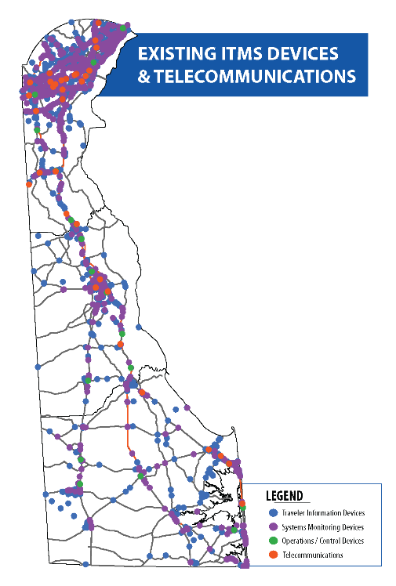
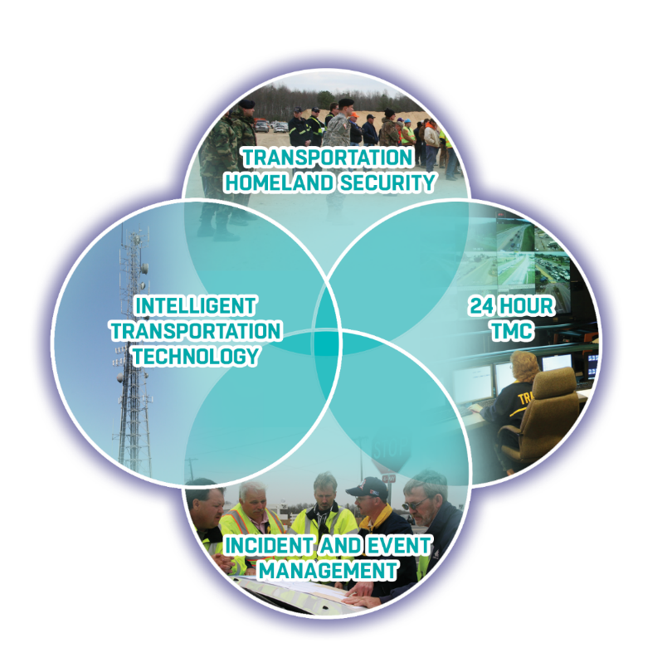
Delaware DOT (DelDOT) – Integrated Transportation Management System (1/3)
DelDOT operates a multifaceted Integrated Transportation Management System (ITMS)
The ITMS provides a robust foundation built on telecommunications, flexibility, and an adaptable system
Transportation Homeland Security
Intelligent Transportation Technology
24-hour TMC
Incident and Event Management
TMC = Transportation Management Center
Image courtesy of DelDOT
Notes:
Description of Slide: Background for Delaware Department of Transportation (DelDOT) multimodal transportation management system known as the Integrated Transportation Management System (ITMS).
Key Points:
ITMS is the technology core of DelDOT’s transportation management program, which began with the publishing of the Integrated Transportation Management Strategic Plan in 1997, and the strategic plan was updated in 2017.
The transportation management program includes the statewide 24 Transportation Management Center (TMC), Transportation Homeland Security, and incident and event management.
To support the statewide ITMS DelDOT is implementing an advanced fiberoptic and licensed wireless telecommunication system.

Slide 13

Delaware DOT (DelDOT) – Integrated Transportation Management System (2/3)
Artificial Intelligence in Transportation
Artificial Intelligence (AI) is used to support comprehensive and timely decision making, since human brains cannot process large data sets.
AI and Machine Learning (AI & ML) will not only help to alert technicians about traffic incidents, it will also make system adjustments in real-time.
Operations will be enhanced by supporting the automation or semi-automation of TMC operations in the near future.
DelDOT is moving toward an adaptable system that can account for changes in capacity and provide real-time solutions.
Image courtesy of DelDOT
Notes:
Description of Slide: The next phase of DelDOT’s transportation management program includes the application of artificial intelligence (AI) and machine learning (ML) based applications and technologies. DelDOT’s goal is to implement a truly adaptive and predictive transportation management system.
Key Points:
1. With literally thousands of inputs and numerous transportation related activities, TMC personnel can not effectively manage today’s and especially the future connected and automated based transportation systems. Artificial Intelligence integrated with Machine Learning is and will increasingly be required to support the management of advanced transportation systems.

Slide 14
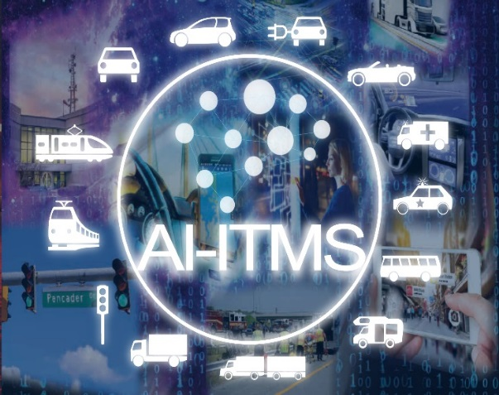
Delaware DOT (DelDOT) – Integrated Transportation Management System (3/3)
AI-ITMS Program was supported by a Federal ATCMTD grant and incorporates:
AI & ML for fast anomaly/inefficiency detection, impact analysis, solution development, deployment and knowledge accumulation.
AI-Traffic Operations & Management Software (AI-TOMS)
Processing live traffic detector data (update every minute) for anomaly detection
24/7 continuous monitoring, instantaneous alert (email, message) and reporting the event
Advanced Transportation and Congestion Management Technologies Deployment (ATCMTD) Grant - $4.9 million FHWA with $4.9 million DelDOT match was awarded to DelDOT in 2019 for the AI-ITMS Deployment Program
Notes:
Description of Slide and Key Points:
Prior to the advertisement of the ATCMTD Grant listed in the slide, DelDOT was working with FHWA on a smaller project to begin the review and implementation of the application of AI and ML technologies into transportation management systems and operations.
At the time of the ATCMTD advertisement with support of FHWA combined with DelDOT funding, the development team had implemented an AI based application that was starting to identify possible incidents and events that were impacting the transportation system in a test area.
DelDOT leadership fully supported the Grant submittal and the continued investment in enhancement and statewide implementation of AI-Traffic Operations and Management Software (AI-TOMS).

Slide 15
Delaware DOT – AI-ITMS Deployment Program
Deployment program includes:
Automatic data visualization and camera video confirmation
Traffic flow prediction
Interface with simulation model for scenario generation and solution evaluation
High-resolution signal controller data collection and processing for near real-time signal performance assessment (every 5 minutes)
Initial deployment ongoing in Urban area, expanding to Connected and Automated Vehicle network
Notes:
Description of Slide: DelDOT, working with partners, has defined three areas to test and implement advanced transportation technologies, procedures and policies including Urban, Rural, and Connected and Automated Vehicles. Urban in the more congested north portion of Delaware to include the I95 corridor. Central part of the state where the TMC is located and Dover the capital of Delaware. The area labeled Rural includes the Delaware Beaches with the associated demands of seasonal traffic.
Key Points:
The AI-ITMS deployment builds off a 20-year investment in the development and implementation of a statewide technology-based transportation management system and program. At the core is a statewide computerized signal system.
For the past 20 years every capital transportation project has been reviewed for the addition/inclusion of ITMS technologies.
There is a dedicated capital transportation program project, Transportation Management Initiatives (TMI)
Transportation management is built into the way DelDOT does business.
Delaware’s transportation system will greatly benefit from this program, through greater efficiency and reliability for users of the system.

Slide 16
Delaware DOT – Connected and Autonomous Technology
Next phase of ITMS involves deployment of DelDOT’s emerging technology products, including:
  Connected Vehicle-enabled Weather Responsive Traffic Management (CV-WRTM)
  Signal Phase and Timing (SPaT) Challenge
  Autonomous Shuttle Deployment
Notes:
Description of Slide: Examples of connected and automated technologies presently being implemented by DelDOT.
Key Points:
As part of the ITMS program, DelDOT reviews and tests the latest advanced transportation related technologies.
DelDOT has equipment at 21 intersections with DSRC based Roadside Units (RSUs) and have equipped a few DelDOT vehicles with On Board Units (OBUs). The RSUs and OBUs are Siemens. Siemens recently contacted DelDOT indicating that their updated RSU will also offer cellular capability, which DelDOT will test.
Approximately two years ago DelDOT, in cooperation with Delaware Transit Corporation, advertised a request for proposals to purchase automated shuttles. The contract was awarded to EasyMile. DelDOT/DTC is presently going through acceptance testing two automated shuttles.

Slide 17
Utah

Slide 18
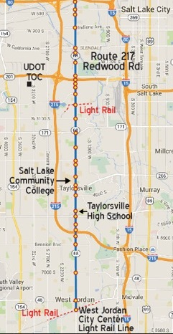
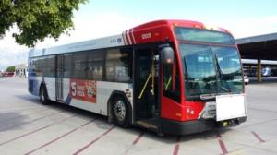
Utah DOT – Connected Vehicle Transit Signal Priority (1/2)
Project includes:
Connected Vehicle (CV) Application of Transit Signal Priority (TSP)
Goal to increase transit reliability (86% to 94%)
Meets the SPaT Challenge
Source: Utah DOT; Presentation by Blaine Leonard and Jamie Mackey, UDOT, at CTSO Working Group on CAV meeting (2019)
Images courtesy of Utah DOT
Notes:
Description of the Slide
Utah DOT is seeing early positive results for a Connected Vehicle project that implements Transit Signal Priority along heavily traveled bus route corridors.
Key Points
The primary mobility goal for the Redwood Road Corridor deployment was to increase transit reliability from 86% to 94%.
The project meets the “SPaT Challenge,” a national challenge to state and local public sector transportation infrastructure owners and operators to achieve deployment of communications infrastructure with Signal Phase and Timing (SPaT) broadcasts in at least one corridor or network (approximately 20 signalized intersections) in each of the 50 states by January 2020.
(NOTE: Results on next slide)

Slide 19
Utah DOT – Connected Vehicle Transit Signal Priority (2/2)
6-7% increase in transit travel time reliability evaluated between February and August 2019
Average Reliability | Southbound PM Peak |  |  | Northbound AM Peak
 | No TSP | TSP | Benefit | No TSP | TSP | Benefit
Along Route | 85% | 91% | +6% | 93% | 99% | +6%
End of Route | 89% | 89% | 0% | 90% | 97% | +7%
Source: Utah DOT; Presentation by Blaine Leonard and Jamie Mackey, UDOT, at CTSO Working Group on CAV meeting (2019)
Chart courtesy of Utah DOT
Notes:
Description of the Slide
This slide shows the average reliability, comparing the use of Transit Signal Priority to No Transit Signal Priority.
Key Points
The evaluation measured a 6-7% increase in transit travel time reliability with transit signal priority implemented.
The results not only demonstrate the potential for improved transit operations but also provide a solid basis for advancements in connected and automated transportation readiness by UDOT.

Slide 20
Missouri

Slide 21
Missouri DOT – Arterial Management Interface (1/2)
Existing St. Louis Advanced Trafﬁc Management System (ATMS)
  Helps ﬁrst responders and affected motorists deal with incidents
Newly developed Arterial Management Interface (AMI)
  Provides ability to quickly determine appropriate signal changes during incidents regardless of working knowledge of the arterial system
Incorporated TSMO Strategies
  Arterial Management
  Traffic Incident Management
Source: Missouri DOT; NOCoE Case Study St. Louis District Arterial Management Interface (AMI)
Notes:
Description of the Slide
The Missouri DOT implemented an improved mechanism to manage signal timing updates during incidents, using an advanced arterial management interface.
Key Points
The Arterial Management Interface (AMI) was added to the St. Louis Advanced Traffic Management System (ATMS) in order to assist traffic operators with determining changes to signals during significant traffic events.
The interface was designed to guide operators through a set of response actions, to select incident locations, view route options, and implement timing plans, regardless of working knowledge of the arterial system.
(NOTE: benefits on next slide)

Slide 22
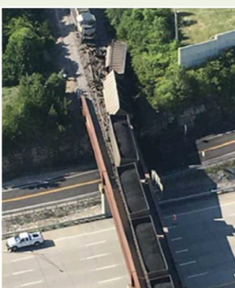
Missouri DOT – Arterial Management Interface (2/2)
Benefits of AMI
Reduced signal change response time from 30 minutes prior to the project to 5 minutes in 2017 after the full project went live in 2017
Example: On August 26, 2017, a train derailment shut down the widest Interstate in St. Louis area
  Within 5 minutes, TMC engineer implemented several pre-programmed signal plans around the closure
Source: Missouri DOT; NOCoE Case Study St. Louis District Arterial Management Interface (AMI)
Notes:
Description of the Slide
Implementation of the AMI reduced signal change response times from 30 minutes to 5 minutes.
Key Points
A prime example of benefits gained from implementing the AMI occurred on August 26, 2017, with a train derailment that shut down the widest interstate in the St. Louis Area at I-55, just south of I-270 in south St. Louis County.
An engineer was on duty at the TMC overseeing an emergency work zone closure in another county when the incident occurred.
The junior engineer, who was unfamiliar with the intricacies of the possible diversion routes around the incident, immediately opened the AMI and, within 5 minutes, implemented several pre-programmed signal plans around the closure.

Slide 23
Washington State

Slide 24
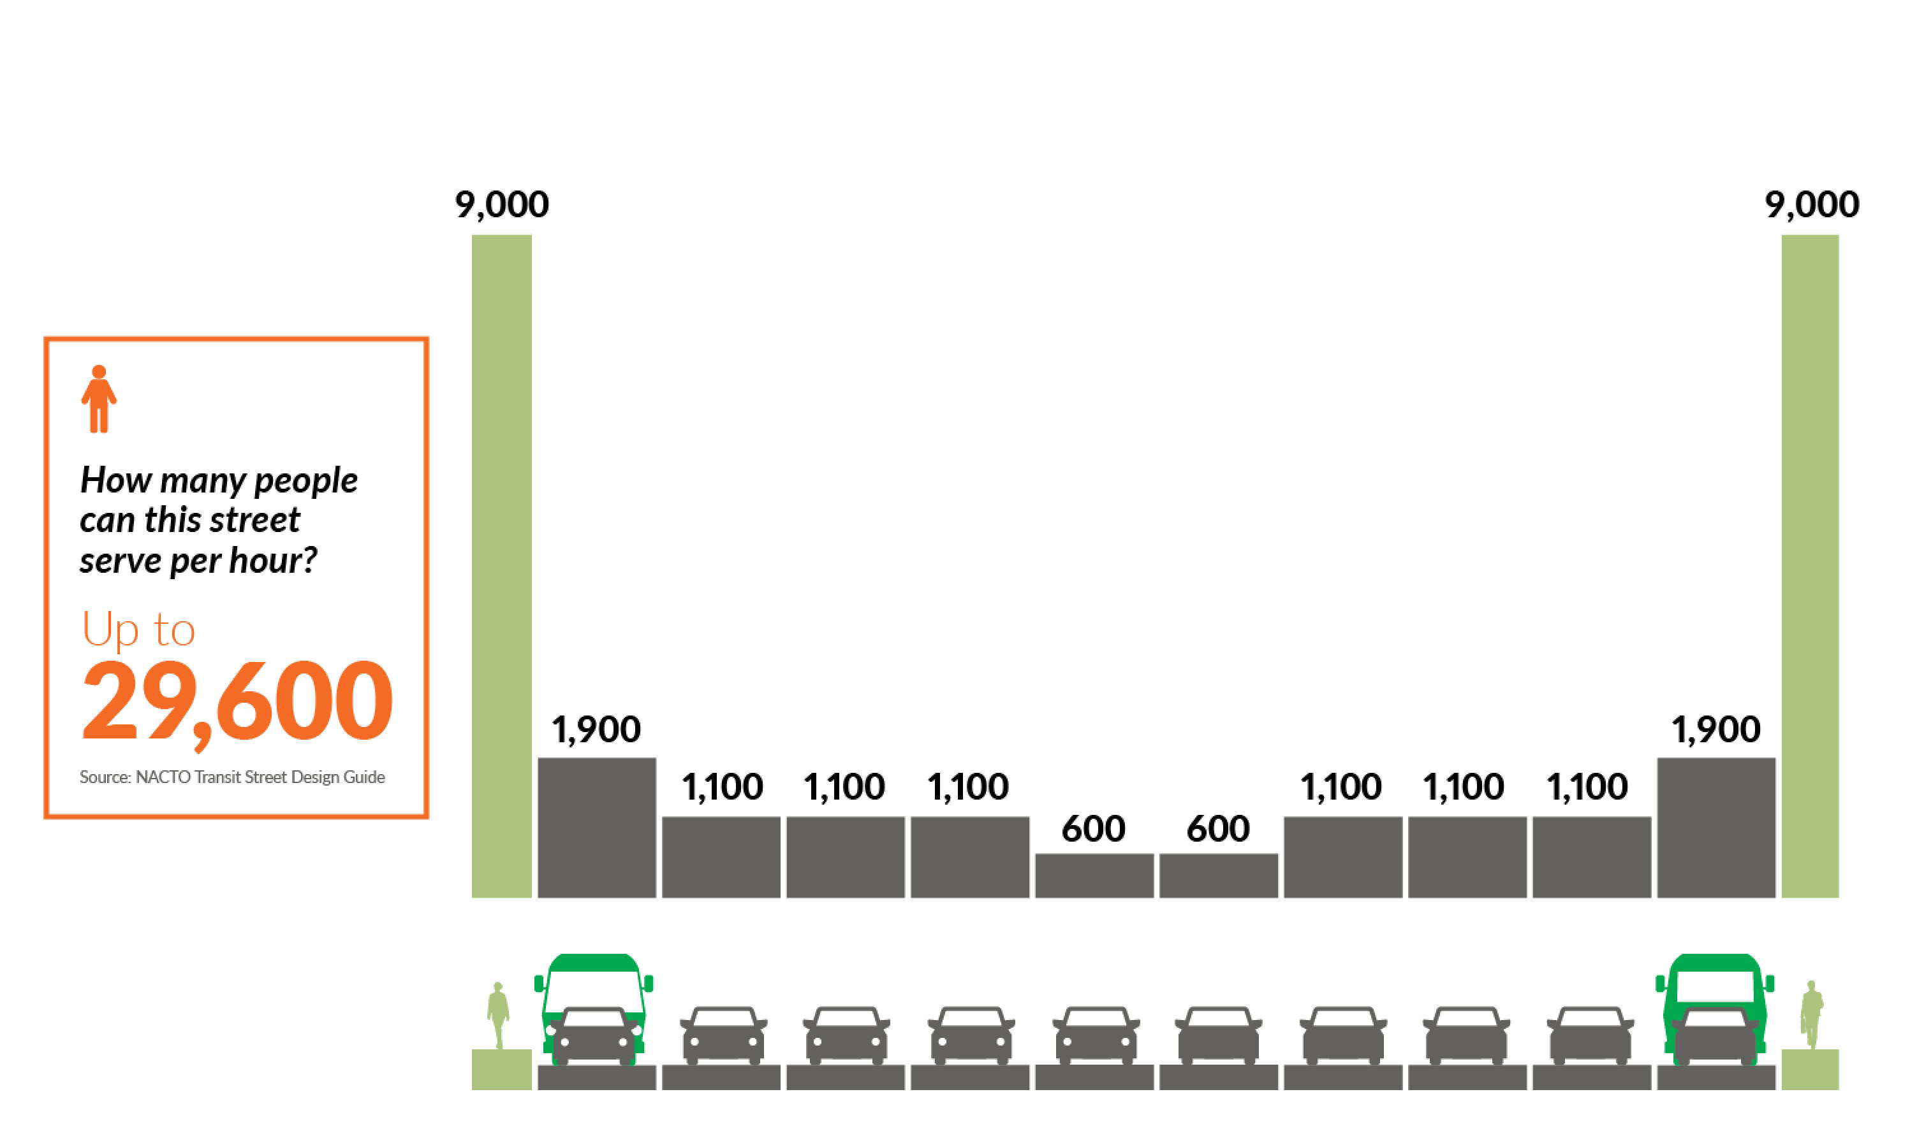
Washington State DOT – High Occupancy Vehicle (HOV) and Express Toll Lanes (1/4)
Sample representation shows how many people can be moved per lane each hour on a typical 10-lane arterial
Source: sample street from NACTO Transit Street Design Guide
Notes:
Description of the Slide
This slide shows a traditional “20th century” way of moving people.
Key Points:
The graphic shows a cross-sectional view of a 10-lane arterial, from sidewalk to sidewalk.
In this traditional configuration, we can move approximately 30,000 people during the peak hour.

Slide 25
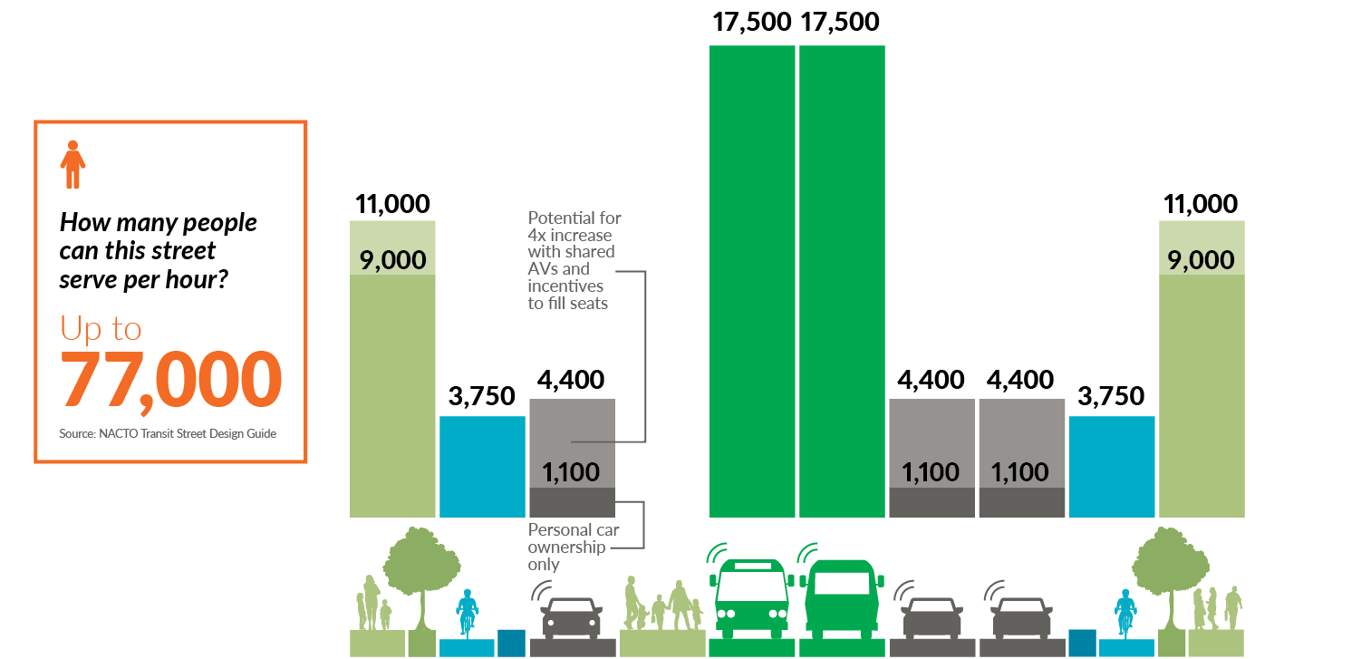
Washington State DOT – HOV and Express Toll Lanes (2/4)
How innovative design and management can move more people
Source: sample street from NACTO Transit Street Design Guide
Notes:
Description of the Slide:
This slide shows a new way to design our transportation system, to move significantly more people in the same space.
Key Points:
As shown in this graphic, applying innovative design and technology improvements, this configuration can move upwards of 80,000 in that same space.
Features include bike lanes, bus lanes, express toll lanes, and personal vehicle lanes with a potential for 4 times capacity increases with ride-sharing and automated vehicles in the future
This is a nice hypothetical diagram that likely doesn’t fit in every community – but many of the Operational (TSMO) strategies are proven, such as the express toll lanes.

Slide 26
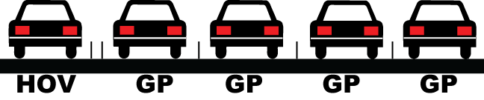

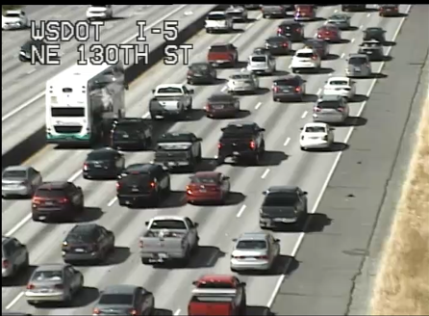
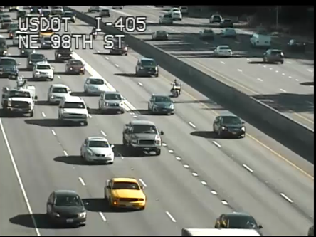
Washington State DOT – HOV and Express Toll Lanes (3/4)
I-5 (Northbound at NE 130th St)
Daily Volume: 105,000
I-405 (Northbound at NE 85th St)
Daily Volume: 107,000
Example of I-5 and I-405 peak hour performance comparison
Acronyms:
HOV: High occupancy vehicle
GP: General purpose
ETL: Express toll lanes
Tuesday, July 12, 2017, 4:50 p.m.
Tuesday, July 25, 2017, 4:30 p.m.
Images courtesy of Washington State DOT
Notes:
Description of the Slide:
NOTE: this slide contains 2 images.
This slide shows a comparison of traffic conditions on I-5 and I-405 during the peak hour.
The image on the left is I-5, the image on the right is I-405.
Key Points:
These two areas (I-5 at 130th and I-405 at 85th) carry approximately the same traffic every day.
They’re the same lane section --five lanes in each direction.
As seen by the color coding on the lanes above the images: I-5 (left) has one HOV lane and 4 general purpose lanes; I-405 (right) has 3 general purpose lanes and 2 express toll lanes.
The same five lanes carrying the same traffic every day, but because I-405 is configured with express toll lanes, as opposed to the one HOV lane on I-5, the overall flow of traffic is significantly better on I-405.

Slide 27
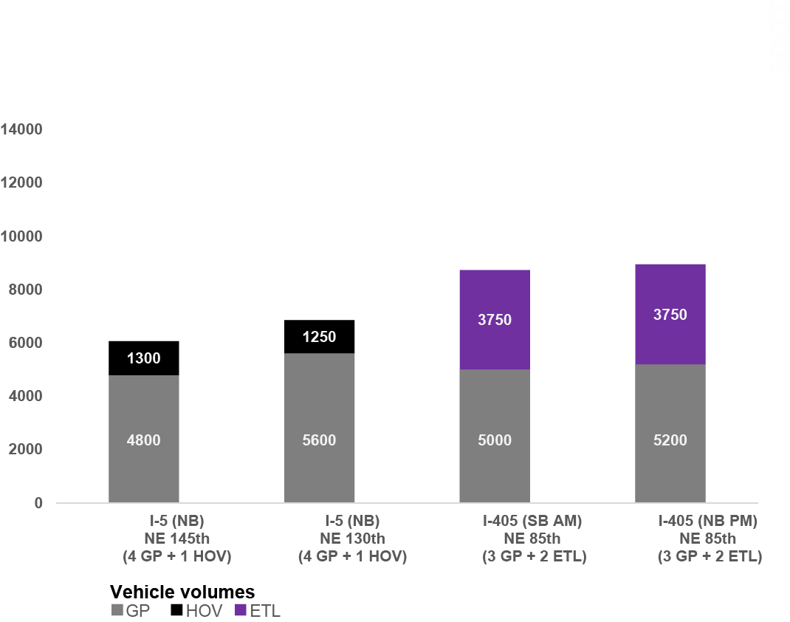
Washington State DOT – HOV and Express Toll Lanes (4/4)
I-405 section with dual express toll lanes moves more vehicles than five-lane I-5 sections with similar daily traffic volumes
Numbers compare before and after project implementation in 2017
Source: WSDOT
Notes:
Description of the Slide:
This slide shows a comparison of traffic volumes on I-5 and I-405 – in the peak periods (AM and PM).
Key Points:
This table shows that the I-405 section with dual express toll lanes moves more vehicles than the five-lane I-5 section, with similar daily traffic volumes.

Slide 28
Maryland

Slide 29
Maryland DOT – CHART
Coordinated Highways Action Response Team (CHART)
Traveler information
Traffic management
Motorist assistance
Statewide operations center
Traffic incident management
In 2016, CHART handled over 135,000 events, saving more than $1.5 billion in delay and fuel costs
Source: Maryland DOT; Presentation by Subrat Mahapatra, MDOT SHA,
Regional Operations Leadership Forum (2018)
Notes:
Description of the Slide
Maryland DOT’s Coordinated Highways Action Response Team (CHART) is a multi-jurisdictional, multi-disciplinary program that provides statewide traffic management services, motorist assistance, traveler information, and traffic incident management services.
Key Points
The critical traffic management function of CHART has expanded beyond the highly traveled Baltimore to Washington DC corridor to a statewide program that handled more than 135,000 events in 2016.
In that same year, MDOT estimated that the activities and outcomes of the CHART Program resulted in a cost savings of more than $1.5 billion, when considering delay and fuel cost savings.
(NOTE: Additional benefits on next slide)

Slide 30
Maryland DOT – CHART and Mobility Program Outcomes
2016 Cost Savings to Customers = $1.5 billion+
  $50 million (capital improvements)
  $1,500 million (CHART)
  $84 million (signal systems and multimodal strategies)
CHART now assists a motorist every 16 minutes on average and manages traffic at a crash/incident every 22 minutes, preventing an estimated 225–250 secondary crashes a year.
Source: Maryland DOT; Presentation by Subrat Mahapatra, MDOT SHA,
Regional Operations Leadership Forum (2018)
Notes:
Description of the Slide:
In addition to the cost savings achieved by CHART, Maryland DOT measures overall mobility program outcomes on a statewide basis.
Key Points
The cost savings to customers from CHART and other mobility outcomes was measured at $1.63 Billion in 2016 (CHART alone accounted for $1.5 billion of that).
As shown in this cost savings breakdown, the total savings were attributed to capital improvements, CHART, and other TMSO-focused approaches that included signal system improvements and multi-modal strategies.

Slide 31
Virginia

Slide 32
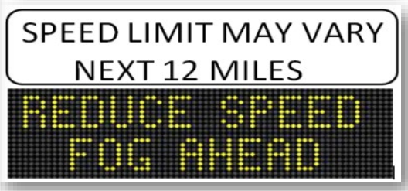
Virginia DOT – Weather Variable Speed Limits (1/3)
Variable Speed Limits (VSL) were deployed on 12-mile section of I-77
Addresses mountainous terrain in southwestern VA
Responds to history of severe, recurring fog events
Virginia DOT; Impacts of the I-77 Variable Speed Limit System on Speed and Crash Characteristics During Low Visibility Conditions (Gonzales and Fontaine, 2018)
Presentation by Mike McPherson, VDOT, NOCoE 2019 Road Weather Management Peer Exchange
Notes:
Description of the Slide
The Virginia DOT deployed Weather Variable Speed Limits (VSL) to improve safety along a 12-mile segment of I-77 with a history of severe recurring fog events and rear-end crashes.
Key Points
This road weather management strategy shows how a TSMO strategy has been successfully deployed to address a specific safety issue in a rural setting.
The VSL system is equipped to detect low visibility conditions and advise drivers of “fog ahead” and reduced speed limits.
(NOTE: Next slide contains additional explanation of the VSL system)

Slide 33
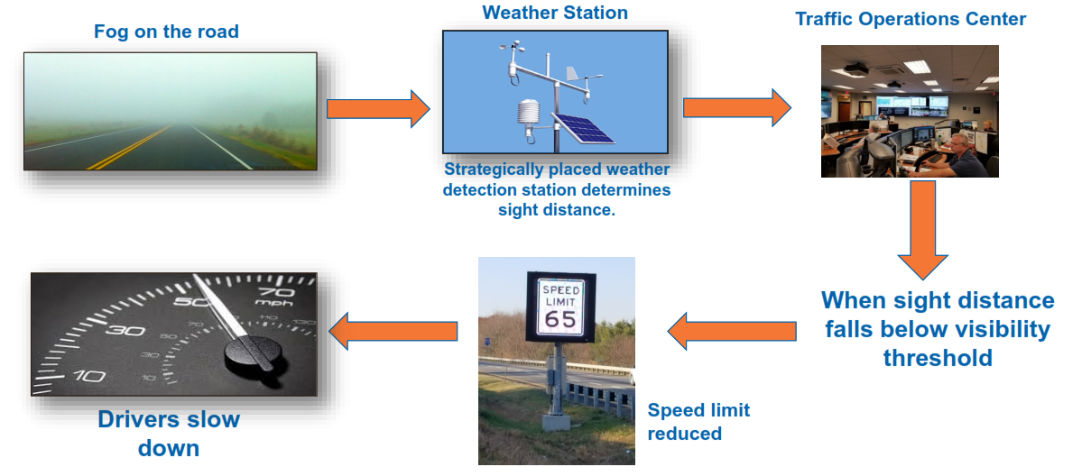
Virginia DOT – Weather Variable Speed Limits (2/3)
Virginia DOT; Impacts of the I-77 Variable Speed Limit System on Speed and Crash Characteristics During Low Visibility Conditions (Gonzales and Fontaine, 2018)
Presentation by Mike McPherson, VDOT, NOCoE 2019 Road Weather Management Peer Exchange
Notes:
Description of the Slide
This slides demonstrates the high-level progression of conditions and steps for implementing the VSL system during a fog event.
Key Points
The system is instrumented with weather stations, strategically placed at locations where historically low visibility conditions occur.
When the sight distance falls below a previously determined threshold, the speed limit is reduced in order to influence driver behavior prior to encountering the foggy conditions.
Crowdsourced reporting can also capture weather activities to support RWIS stations
(NOTE: Next slide contains benefits of VDOT VSL system)

Slide 34
Virginia DOT – Weather Variable Speed Limits (3/3)
Early Indication of Benefits:
  Statistically significant reductions in mean speeds
  Drivers drove closer to the safe speed based on available visibility
  Crash rates during low visibility were less than one-half of pre-VSL activation crash rates
  Travel time reliability increased
Virginia DOT; Impacts of the I-77 Variable Speed Limit System on Speed and Crash Characteristics During Low Visibility Conditions (Gonzales and Fontaine, 2018)
Presentation by Mike McPherson, VDOT, NOCoE 2019 Road Weather Management Peer Exchange
Notes:
Description of the Slide:
Early results show that the VDOT VSL System has been successful, both in terms of influencing driver speeds and resulting in reduced crash rates.
Key Points:
The VSL system evaluation showed statistically significant reductions in mean speeds, with vehicles traveling closer to the safe speed based on available visibility.
With the VSL system in place, crash rates during low visibility dropped to less than one-half of pre-VSL activation crash rates.

Slide 35
Georgia

Slide 36
Georgia DOT – Incident and Work Zone Management (1/2)
March 2017: Response to I-85 bridge collapse in Atlanta
TSMO strategies implemented:
  TMC initial response – service patrols, DMS, social media, website, 511
  TMC long term – traveler information (traffic shifts, detours) and overall coordination
  Contracting incentives for rapid bridge re-construction
  Transit – longer trains, more frequent service
  Traffic signal upgrades, closed-circuit televisions (CCTVs), signal coordination
Source: Georgia DOT; Presentation by John Hibbard, GDOT,
at 2017 AASHTO STSMO Annual Meeting (Sept 2017)
Notes:
Description of the Slide
The 2017 collapse of the northbound I-85 bridge in Atlanta prompted immediate response and long-term actions by the Georgia DOT, to minimize mobility impacts to motorists in the hours and months following the collapse.
Key Points
Multiple, coordinated TSMO strategies were implemented to assist motorists, provide critical up-to-date information, and influence travel behavior.
Initial response efforts included information to motorists via on-road Dynamic Message Signs (DMS), social media, and 511 mechanisms.
Bridge re-construction was accelerated through contracting incentives, resulting in the re-opening of I-85 less than 2 months following the collapse, approximately 5 weeks earlier than the original schedule.
Large TDM effort was also part of the mitigating TSMO strategies
(NOTE: Benefits on the next slide)

Slide 37
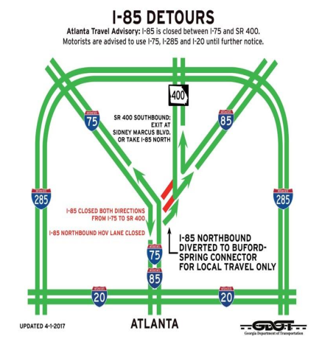
Georgia DOT – Incident and Work Zone Management (2/2)
TSMO strategies with multi-agency coordination resulted in:
  Sharp increases in 511 phone calls, 511 app downloads, website usage
  Changes in traveler behavior
  Overall, 7% reduction in traffic in the region during the 42-day closure period in 2017
Source: Georgia DOT; Presentation by John Hibbard, GDOT,
at 2017 AASHTO STSMO Annual Meeting (Sept 2017)
Notes:
Description of the Slide
The multi-modal, multi-agency approach to managing traffic during the re-construction period resulted in significant travel behavior changes.
Key Points
GDOT experienced sharp increases in traveler information use, including 511 phone calls, website usage, and users accessing the 511 mobile app.
Overall, a 7% reduction in traffic in the region was seen during the closure period, demonstrating effective use of coordinated strategies such as alternate modes (e.g. public transit) and traveler information mechanisms to communicate detour routes and traffic shifts.

Slide 38
Arizona

Slide 39
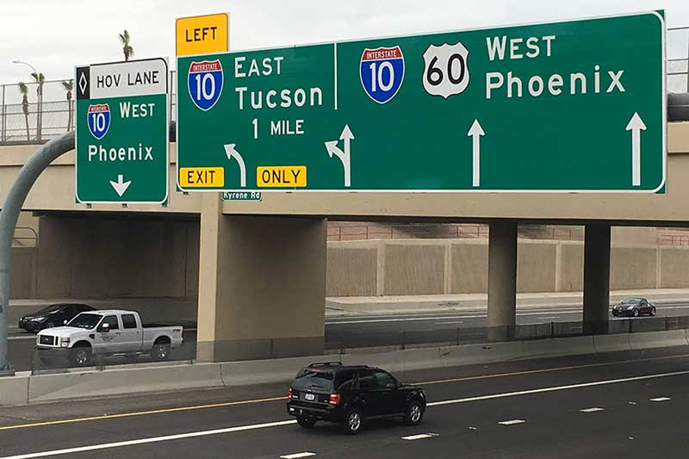
Arizona DOT – Innovative Signage and Striping (1/2)
Arizona DOT (ADOT) redesigned signage and restriped lanes in 2018 to improve clarity, performance, and safety
The two-mile segment where westbound US-60 merges with I-10 in the Phoenix metro area had the highest number of serious and fatal crashes on the ADOT system.
Source: Arizona DOT; website news article (August 2018)
Notes:
Description of the Slide
Arizona DOT TSMO Division identified, engineered, and implemented a redesign that improved clarity for drivers along the 2-mile with the highest number of serious and fatal crashes on the ADOT system. The segment occurs where westbound US-60 merges with I-10 in Phoenix metro area.
Being stuck in rush hour traffic on US 60 westbound was an all too familiar experience for drivers in the Tempe/Phoenix area, with 580 traffic incidents from 2013 to 2017 creating further congestion. Part of the problem centered on a roadway configured to split traffic going eastbound towards Tucson onto a single ramp lane, while westbound traffic merged onto Interstate 10 to Phoenix. Despite proper markings and signage, drivers would continue to find themselves needing to crossover multiple lanes of traffic or, worse, going the wrong way.
Key Points
- The redesign included sign redesign that added clarity for drivers and lane restriping to improve system performance and safety.

Slide 40
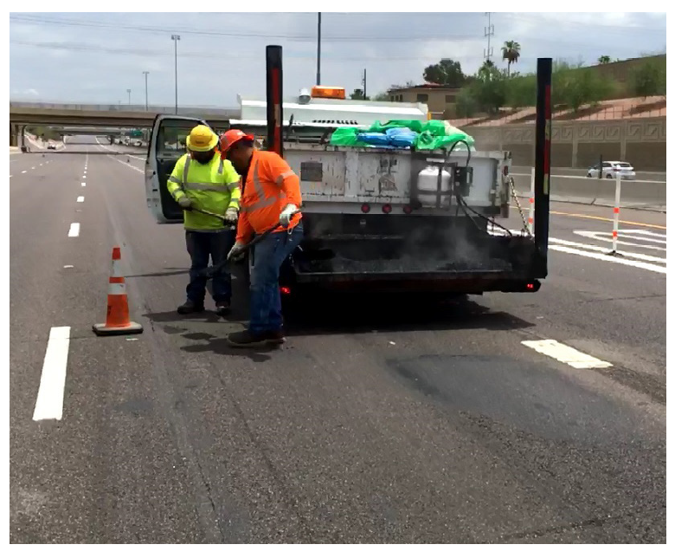
Arizona DOT – Innovative Signage and Striping (2/2)
Within one year, the project resulted in:
  385 fewer crashes
  66% reduction in crashes of all severities
  1,969:1 Benefit-Cost Ratio
**Numbers reflect 12 months before the project to 12 months after project was completed (2018-2019)
Source: Photo from NOCOE Case Study, February 2019
Notes:
Description of the Slide
ADOT’s sign redesign and lane restriping project reduced crashes by 66%.
Key Point
There were 385 fewer clashes of all severities in the 12-months after completion compared to the 12-month period before construction.
The project showed a benefit-cost ratio of 1,969:1 12-months after completion (timeframe is 2018-2019)

Slide 41
Michigan

Slide 42
Michigan DOT – Active Transportation Management (1/2)
Michigan DOT used Active Transportation Management (ATM) strategies on US-23 to dynamically manage issues of:
  Congestion
  Operations
  Incident management
Strategies used include dynamic lane control and shoulder use, variable speed advisories, and queue warning.
Notes:
Description of the Slide
The Michigan DOT used Active Transportation Management (ATM) strategies on US-23 to dynamically manage issues of congestion, operations and incident management.
Key Points
Michigan DOT used strategies such as dynamic lane control and shoulder use, variable speed advisories, and queue warnings to actively manage issues on US-23.

Slide 43
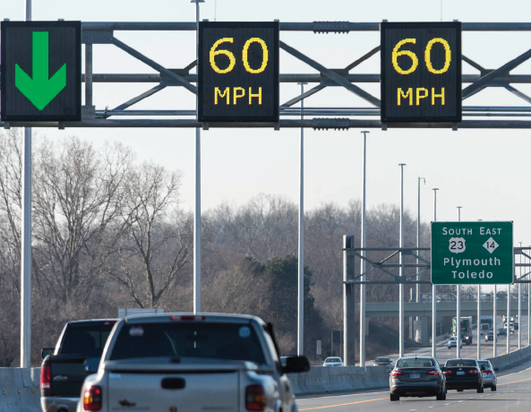
Michigan DOT – Active Transportation Management (2/2)
Since deployment in 2016, commuters now enjoy greater safety and decreased congestion.
ATM strategies increased reliability by up to 56% and improved corridor speeds by up to 19 mph.
Source: Photo from NOCOE Case Study, July 2019
Notes:
Description of the Slide
Michigan DOT’s use of Active Transportation Management strategies improved system reliability and improved corridor speeds.
Key Points
System reliability improved by 56%
Corridor speeds improved by 19mph
Commuters now enjoy greater safety while experiencing more reliable travel times and less time sitting in congestion.

Slide 44
Nevada

Slide 45
Nevada DOT – Traffic Incident Management
Nevada DOT developed a collective platform where all agencies could share real-time incident data to help manage traffic and prevent crashes.
  Real-time data reaches all involved agencies, multi-discipline first responders, and public users
  Platform leverages in-vehicle data and artificial intelligence
12-Minute reduction in incident response times and reduction in secondary crashes in Southern Nevada (from installation in 2017 through May 2019)
Source: NOCOE Case Study, May 2019
Notes:
Description of the Slide
Nevada DOT developed a collective platform where multiple agencies could share real-time incident data to better manage traffic and prevent crashes, resulting in a reduction in incident response times and a reduction in secondary crashes.
Key Points
The platform leverages in-vehicle data and artificial intelligence to help manage traffic and prevent crashes.
The program allows for seamless, real-time sharing of incident information across all involved agencies, multi-discipline first responders, and the public.
Reduced incident response times by 12-minutes
Reduced secondary crashes by pushing out real-time traffic information to drivers, alerting them to an incidents as they occur.

Slide 46
Florida

Slide 47
Florida DOT – Integrated Corridor Management (1/2)
Implementing Integrated Corridor Management (ICM) by meshing freeway operations with arterial operations
2017—Orlando was 2nd fastest growing city and experienced 72 million visitors, according to Visit Orlando
To improve transportation system, Florida DOT implemented ICM at the District 5 Regional Traffic Management Center
Goal: To improve travel time efficiency and reliability and to perform incident management by meshing freeway operations with arterial operations
Notes:
Description of the Slide
Florida DOT implemented ICM by meshing two different operations, seeing multiple benefits.
Key Points
Central Florida has faced a multitude of transportation challenges. Orlando was the second fastest-growing city in the United States in 2017 and according to Visit Orlando, 72 million visitors traveled to Orlando, breaking the record for most visitors to a single U.S. destination.
To improve the transportation system to accommodate this growth and tourism, experts began exploring viable options to maximize existing resources while still prioritizing safety, including implementing Integrated Corridor Management (ICM) at the District 5 Regional Traffic Management Center (RTMC).
The purpose of the D5 ICM program is to improve travel time efficiency, travel time reliability, and to perform incident management throughout the network by meshing freeway operations with arterial operations.

Slide 48
Florida DOT – Integrated Corridor Management (2/2)
How this was done:
  Advanced Traffic Management Systems platforms
  Enabled vehicle detection so data could be collected and used to identify trends
Results:
  Benefit to cost ratio: between 5:1 to 10:1
  Emissions reduced by 3-22% (thanks to effective traffic signal control)
  Dynamic Shoulder Running reduces travel times by up to 25% while proving to have no adverse effect on safety
  Transit Signal Priority improves bus times by 2-15% with minimal impact to side streets, and Adaptive Signal Control cuts delays by 4-40%
*Numbers reflect timeframe between 2017-2019
Source: NOCOE Case Study, April 2019
48
Notes:
Description of the Slide
Florida DOT implemented ICM by meshing two different operations, seeing multiple benefits.
Key Points
The ICM program works to build on successes and searches for new and innovative ways to improve traffic in Central Florida. Timing plans and diversion routes have proven to be effective at maximizing existing resources.
Arterial operations perfectly compliment freeway operations by utilizing Advanced Traffic Management Systems (ATMS) platforms to maximize system efficiency through notifications and coordination with local agencies. The ICM Signal Timing Engineer at the District 5 RTMC worked extensively with the city of Orlando to re-enable vehicle detection so data could be pulled and utilized again.
This allowed data such as travel times, travel time reliability, transit and signal priority and emergency vehicle preemption to be consistently gathered and tracked over time to identify trends and to learn which corridors require adjustments.
Since implementation:
The District 5 ICM program has an estimated benefit-to-cost ratio of 5-10:1.
Thanks to effective traffic signal control, emissions have been reduced by 3-22% and variable speed displays have reduced CO2 emissions by 10-20%.
Dynamic Shoulder Running reduces travel times by up to 25% while proving to have no adverse effect on safety.
Transit Signal Priority improves bus times by 2-15% with minimal impact to side streets, and Adaptive Signal Control reduces overall delays by 4-40%.
FDOT chose to activate their Emergency Shoulder Use Plan as an example of lessons learned from Hurricane Irma, which ravaged Florida in September 2017, displaying the importance of incident management as hundreds of thousands of Floridians evacuated ahead of the disaster.
The program also provides better mobility to the traveling public by providing alternate solutions in the event of freeway congestion or closures, including multi-modal alternatives.

Slide 49
TSMO Philosophy
Get the most out of existing infrastructure
Do more with less
Should be conceptualized in the project planning process and be a part of an agency’s overall strategic planning
Not just about congestion
  TSMO can make infrastructure safer, save money, improve travel experience, enhance productivity, and better connect all modes of transportation along a system
Notes:
Description of the Slide
After seeing these examples, we want to be clear that TSMO isn’t about high-ticket, expensive fixes. It’s about meeting the needs of customers in smarter ways
Key Points
TSMO is a collection of solutions to help transportation agencies get the most out of existing infrastructure, recognizing the fact that we can no longer build our way out of congestion.
TSMO helps transportation agencies do more with less. Lower-cost TSMO options can often be deployed faster than other solutions and with immediate results. Relatively small changes can make big differences on the transportation system.
Operational strategies are especially helpful when conceptualized in the project planning process and an agency’s overall strategic planning. Thinking of TSMO as early as possible allows for greater impact and success.
Utilizing TSMO strategies does not just help with congestion. These operational solutions make our transportation infrastructure safer, save money, improve the travel experience of users, enhance business productivity, and allow transportation agencies to better connect all modes of transportation along a system.

Slide 50
Questions to Consider
What is your State or region currently working on, in light of TSMO strategies and advancements?
How are you balancing technology advancements with operational needs and strategies?
What challenges is your agency facing, relative to congestion and/or integrating TSMO into your agency?
What have been some recent successes?
What have been your experiences integrating TSMO with external partners?
Notes:
Description of the Slide
These questions are directed at the audience to generate discussion.
Key Points
A few questions are shown here for your consideration. Let’s hear from you regarding your State’s or Region’s TSMO advances, successes, and challenges.

Slide 51
For more information, visit:
Federal Highway Administration (FHWA) Office of Operations https://ops.fhwa.dot.gov/index.asp
FHWA “Communicating TSMO” webpage https://ops.fhwa.dot.gov/plan4ops/focus_areas/communicating_tsmo.htm
AASHTO Committee on Transportation Systems Operations https://systemoperations.transportation.org/
National Operations Center of Excellence (NOCoE) https://www.transportationops.org/
NOCoE webpage for making the “Business Case” for TSMO https://transportationops.org/business-case
Notes:
Description of the Slide
The slide includes links with additional information.

