Slide 1
Added Capacity -
HOT Lane Workshop
National Road Pricing Conference
June 4, 2010
Jennifer Tsien, PBS&J
Angela Jacobs, Federal Highway Administration
Notes:
Participants do self introductions

Slide 2
Workshop Purpose
Provide hands-on practice in applying lessons learned and best practice from implemented projects across the country
  Understand the challenges in implementing pricing projects
  Move pricing forward in your area
Notes:
This workshop is intended to be interactive, it is not a lecture format. We will learn the most from our interaction in small groups and discussion during the group reports. Use your own personal experiences and information you have gathered during the conference to contribute to the small group discussion.

Slide 3
Workshop Agenda
Review of Project
Break into groups for exercises
Five subject areas covered
  5-10 minute overview of subject area
  20-25 minutes to complete exercise
  Break for lunch after second round of exercises
Group reports
Notes:
Review of project – instructor gives overview of the hypothetical case study project, information is included in your workbook
Break into groups of 5-6, depending on the number in each scenario
For each subject area the instructor will give an overview of best practices and lessons learned
Each group will have time to answer the questions in the exercises by applying best practices, lessons learned, and information gathered during the conference to the hypothetical project. The exercises are covered in your workbook.
We’ll take a break for a box lunch after the second topic area
At the end, each group will make a report to the class summarizing their results
The workbook contains the case study project, the slides on best practices, and the group exercises.

Slide 4
Subject Areas
Planning
Operations
Design
Funding and Finance
Outreach
No specific order, all have overlapping elements
Notes:
Participant workbook content:
1st tab – project information
2nd tab – group exercise
3rd tab – HOT case studies in one-page format

Slide 5
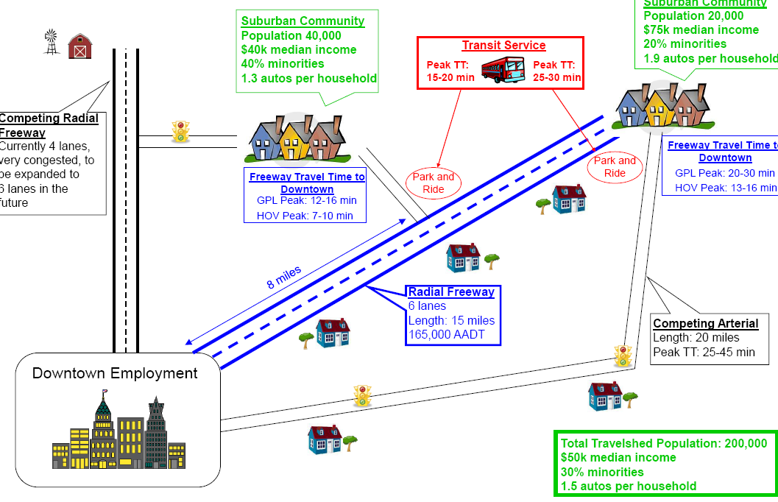
Our Project
Length: 15 miles
6 lanes with full shoulders
165,000 AADT and growing
Peak period speeds as low as 30 mph
Competing Facilities
Arterial servers suburban community at the end of the study corridor
Nearby radial freeway to be expanded in the near future
Transit Facilities
Serves entire corridor
2 Park and Ride lots
Notes:
Length: 15 miles
6 lanes with full shoulders
165,000 AADT and growing
Peak period speeds as low as 30 mph
Competing Facilities
Arterial servers suburban community at the end of the study corridor
Nearby radial freeway to be expanded in the near future
Transit Facilities
Serves entire corridor
2 Park and Ride lots

Slide 6








Suburban Community
Population 20,000
$75k median income
20% minorities
1.9 autos per household
Suburban Community
Population 40,000
$40k median income
40% minorities
1.3 autos per household
Transit Service
Peak TT:
15-20 min
Peak TT:
25-30 min
Competing
Radial
Freeway
Currently 4 lanes, very congested, to be expanded to
6 lanes in the future
Freeway Travel Time to Downtown
Park and Ride
Freeway Travel Time to Downtown
Park and Ride
GPL Peak: 20-30 min
GPL Peak: 12-16 min
Radial Freeway
6 lanes
Length: 15 miles
165,000 AADT
8 miles
Competing Arterial
Length: 20 miles
Peak TT: 25-45 min
Downtown Employment
Total Travelshed Population: 200,000
$50k median income
30% minorities
1.5 autos per household

Slide 7
Project Characteristics
Corridor History
  Congestion worsening
  Downtown businesses seeking alternatives to bring more commuters downtown
  Opposition to capacity improvements on adjacent radial corridor from environmental interests
Corridor demographics
  Varies by sub-area
  Total travelshed population = 200,000
  $50,000 median income
  30% minorities
  1.5 autos per household
Notes:
GP Lane speed 30mph;
Suburban Community A Suburban Community B
Population 40,000 Population 20,000
$40k median income $75K Median income
40% minorities 20% minorities
1.3 autos per household 1.9 autos per household

Slide 8
Project Characteristics
General Purpose Lanes
6 lanes with 10’ shoulders
165,000 AADT and growing
Notes:
Peaking characteristics

Slide 9
Project Characteristics
Project Partners
State DOT
  Owner of lanes and ROW
  Operator of freeway
Transit authority
  Operator of express bus service and park-and-ride facilities
Regional toll authority
  Operates one toll road in region
    Cash and transponder-based electronic tolling
Metropolitan Planning Organization

Slide 10
Project Characteristics
Legal authority – HOT and express allowed by state statute
Regional policies – No policies on toll rate setting, occupancy, etc.
Project partners – state DOT (owner of ROW), transit authority, regional toll authority, state police
Toll authority currently operating one toll road in region with ETC (transponder) and cash
Environmental clearance – FONSI expected

Slide 11
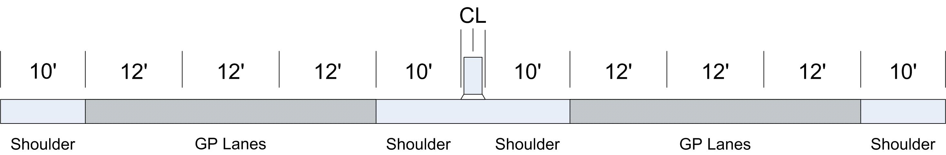
Project Characteristics
Cross section
Total right of way available: 200 feet
Access
  Location and method of access undetermined
Enforcement
  Subject to design and location

Slide 12
Project Characteristics
Estimated project costs
  Capital costs: $ 50,000,000
  Annual operating costs: $ 1,000,000
Available funding
  State is committed to contributing $ 28,000,000
Traffic and revenue studies - none
Revenue sharing potential – Regional toll authority, private partner
Possible funding partners - Regional toll authority, private partner
Notes:
Check estimated costs and add bus volumes
After this slide break into groups of 5-6 people, and divide up topics between groups

Slide 13
Planning
Establish goals and objectives and clearly communicate a vision
Take advantage of opportunities
Maintain flexibility
Engage project partners and encourage agency cooperation
Notes:
Establish goals and objectives and clearly communicate a vision
Projects must have clear objectives and a vision of how to achieve objectives in order to measure success. Determine the goals of the project and how success will be measured.
Take advantage of opportunities
Several successful projects have been the result of taking advantage of opportunities whether, new legislation encouraging innovative partnerships or even popularity of an operating strategy. Projects have typically not been part of a formal long-range planning process.
Maintain flexibility
Decide upfront on priority users and how or what may cause changes in this operating strategy over time. Establishing threshold values will enable operators to easily recognize when a project is not performing as intended. Knowing these threshold values in advance allows operational changes to be more easily implemented. Moreover, incorporating flexibility into the design of the facility may extend the life of the facility because operations can be adjusted as corridor conditions change or community goals change.
Engage project partners and encourage agency cooperation
Successful projects have been the result of cooperative efforts from many agencies. The projects often cross jurisdictional boundaries and may require new institutional arrangements. These agreements should be drafted early in the planning process and should clearly define the roles and responsibilities of all parties. While being clear in responsibilities, the agreements should also contain enough flexibility to provide for unforeseen circumstances. Agency cooperation results in seamlessness to the customer.

Slide 14
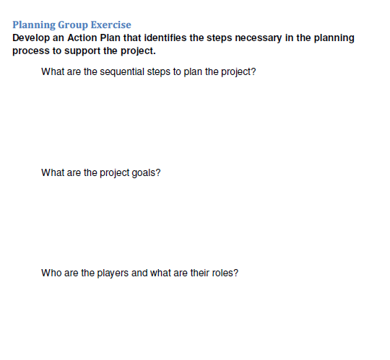
Planning Exercise
Notes:
In particular:
Goals and objectives from perspective of an implementing agency
Other stakeholders?
Institutional arrangements in place and needed
EJ issues
Priority users

Slide 15
Operations
Develop a Concept of Operations to guide the process
Establish Operational Policy
Leverage technology and operational strategies
Implement and maintain stakeholder group
Identify design and legislative impacts of operational goals
Enforcement strategies
Notes:
Develop a Concept of Operations
A concept of operations should be developed that clearly describes the characteristics of the proposed system. This includes the goals and objectives of the facility, operating parameters, policies and constraints that affect the system, and a clear definition of roles and responsibilities of the operating and maintaining agencies.
Establish Operational Policy for the Facility
The operating agency should set a goal for the free flow traffic speed of the proposed facility. Most existing facilities have a goal of exceeding 45 mph for 90% of the peak period. It should be identified whether the goal is to maximize revenue or mobility for the added capacity on the corridor.
Operating hours and occupancy requirements have to be established for the new facility.
Leveraging technology and operational strategies to enhance safety while maximizing mobility along the corridor.
Identify the existing technologies available to implement the HOT lanes. This includes but is not limited to all traditional roadside ITS devices and tolling systems.
In situations where capacity is added to provide HOT lanes within existing right of way, complementary technologies may be implemented that can supplement design constraints and reduce labor demands.
Implement and maintain a stakeholder group to support development, deployment and ongoing operations.
For many agencies, the deployment of HOT lanes is a new facility type to operate. Oftentimes, new partnerships are formed to implement these HOT lanes. A key item for success is the identification and development of operational requirements for the facility. An active stakeholder group enables maximizing the resources of all partner agencies.
Identify any design and legislative impacts that operational goals may affect.
How the facility operates, regarding user groups and any restrictions of the HOT lanes may influence design decisions, operational considerations and have legislative impacts/constraints.
The tolling strategy, whether to maximize revenue or maximize mobility, influences the design criteria, ingress and egress, toll rate setting, operational goals etc. Decision items that have long lead times should be identified as early as possible.
Enforcement strategies
Enforcement is critical to the success of HOT lanes. In order to maintain mobility within the corridor enforcement areas need to be coordinated with stakeholders and

Slide 16
Operations Exercise
Operations Group Exercise
Develop an Action Plan that identifies critical operational issues that need to be addressed to support a successful project.
What are the roles and responsibilities of partner agencies?
How will the facility integrate into existing systems?
What are the appropriate measures of effectiveness and thresholds for performance?
Notes:
Existing toll authority

Slide 17
Design
Identify user groups for the HOT lanes
Provide safe and efficient design
Provide enforcement areas
Communicate to the public at the roadside
Notes:
Identify user group for the HOT lanes.
The design of the HOT lanes is directly dependent upon what vehicle types are allowed to utilize the facility. Are trucks allowed? Transit buses? Depending upon the preferred typical section there are design considerations that must be identified before moving forward.
Provide safe and efficient design while maximizing the ability to add capacity on an existing facility.
Adding capacity by providing HOT lanes is generally done in highly congested urban areas on existing corridors. Due to the right of way constraints there is often a need to evaluate design criteria requirements and the ability to provide a cost feasible solution. Lane and shoulder widths, method of separation, access points, and enforcement areas may all be analyzed. A decision matrix should be identified based upon site specific characteristics and influences to assist in developing the final typical section.
Reduction in criteria may be offset or accompanied by complementary operational strategies. Identifying viable alternatives
Provide enforcement areas.
The ability to manage traffic demand is critical to HOT lanes. Occupancy enforcement is currently being provided at the roadside. A successful design should accommodate either declaration lanes or observation locations for law enforcement, until such time as an automated means of detecting occupancy is widely deployed.
Communicate to the public at the roadside.
There are many challenges to communicating with motorists at the roadside especially within an already congested urban area. The signing plan is a critical element as it must accomplish the ability to convey to motorists the cost of the facility, when the facility is open, how to get in the facility, how to get out of the facility, enforcement, incident management information and even how to obtain general information about the facility. A conceptual signing plan developed early in the project and evaluated iteratively as components are refined is critical to a projects success.

Slide 18
Design Exercise
Design Group Exercise
Develop an action plan that addresses critical design elements.
Identify user group(s) for the HOT lanes.
What is the preferred typical section?
What are the roles and responsibilities of partner agencies?
Notes:
Identify user group(s) for the HOT lanes.
What is the preferred typical section?
What are the roles and responsibilities of partner agencies?
What are the data and analyses needs?
Develop a decision matrix for deviation from design criteria.
Identify design related decisions that can impact facility operations.

Slide 19
Funding and Finance
Consider any and all funding and/or financing mechanisms
Available assistance through federal programs
Stakeholders
Revenue sharing
Notes:
Consider any and all funding and/or financing mechanisms
Successful projects have cobbled together funding packages. There are no straightforward funding strategies. In many instances, financing has been the result of taking advantage of opportunities.
The required funding varies to a large extent from one project to another. For example, some conversions include not only the installation of toll collection zones and increased enforcement (I-15 in San Diego and I-25 in Denver) but also the addition of capacity to the corridor (one HOV lane to two HOV lanes per direction in I-95, Miami), restriping the corridor ( SR 167 in Seattle and I-394 Diamond section) or changing the separation mechanism (double white lines to flexible pylons in I-95, Miami). If FTA funds were used to help construct the facility specific guidelines must be followed or funds must be repaid.
Available assistance through Federal programs
Public agencies interested in implementing and evaluating HOT lane projects are eligible to apply for grants under the Value Pricing Pilot Program (VPPP). VPPP grants have been essential funding source for some HOT lane projects. However, the grant provided to the different projects varies in amount depending on whether the grant is provided for a) the pre-implementation costs (e.g. VPPP grant of $925,000 in I-394 covered planning, outreach and education while the total project cost was $12.9 millions) or b) the project implementation costs (e.g.VPPP grant of $2.8 million out of $ 9.9 million project cost in I-25 and $2 million out of $17.9 million total project cost of SR 167).
Stakeholders
The Federal grant plays an important role in the funding of the HOT lane development. However, the Federal grant is sometimes a part of the total funding required in which case funding is supplemented by other stakeholders of the project which might involve state DOTs, (e.g. Katy, Houston) transit service providers (e.g. Regional Transit District in I-25, Denver ) and toll authorities (HCTRA in Katy, Houston), the gas tax (SR 167 in Seattle) or the private sector (I-394, Minneapolis). In most instances, funding has been cobbled together from several sources. Agreements can be made with the private operators to construct and operate the HOT lane facility and collect the revenues for a certain period of time (SR 91 Express lanes).
Revenue Sharing
The demand for continued funding of a project being implemented in phases also depends on the excess revenue generated by the HOT lane (e.g. I-25 Express Lanes generated revenue exceeding the estimated revenue to cover operations and maintenance; revenue generated in I-394 was half as estimated and I-15 in San Diego generated enough revenue to fund express bus operations).

Slide 20
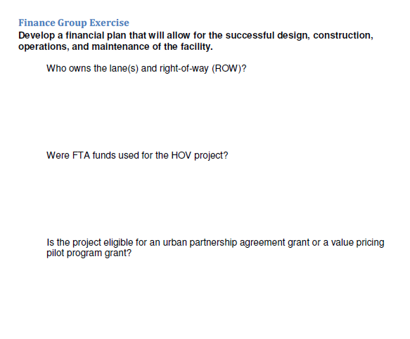
Finance Exercise
Notes:
Who owns the lane(s) and right of way (ROW)?
Would having the private sector operate the facility as a PPP prove beneficial? If yes, how so?
What revenues can be expected from toll paying patrons? Who wants a share of those?
What are the ongoing operation and maintenance costs?
Can/should revenues from fines be used to help finance the facility/enforcement?

Slide 21
Outreach
Identify project champions
Conduct market research and identify issues
Develop clear and concise messages
Communicate project goals
Continue from project development through operations
Create brand awareness
Notes:
Identify project champions
Many projects have benefitted from the support of trusted individuals in the community or state. Project champions, other than the implementing agencies, can lend creditability to the project. Additionally, if enabling legislation is required a project champion that can accomplish this is an indispensible asset.
Conduct market research and identify issues
Market research should be conducted to identify what the issues are that are problematic for the community. This should include research of current HOV and transit users as well as potential users of HOT lanes. This information is crucial to develop materials and messages to educate and inform.
Develop clear and concise messages
The messages that are used to communicate project specifics, including project goals, need to be clear and concise. They must clearly convey what the purpose of the project and the project implementation hopes to achieve.
Communicate project goals
In many communities HOT lanes and pricing are new and complex concepts. The goals that are communicated must resonant with the public. Successful projects clearly articulate the goals of project. The I-15 project in San Diego showed how the project revenues would be used to implement new transit service in the corridor; a service that was desired by the public. Without clearly defining and communicating project goals even potentially successful projects can be killed before implementation because of misunderstanding.
Continue from project development through operations
Projects benefit from continued outreach to the users and general public. It is important to continuously market the project. Market research conducted throughout the life of the project allows agencies to adjust messages as needed to address concerns. The public also needs to be kept aware of how operational changes may occur over the life of a project.
Create brand awareness
In some communities it may be necessary to distinguish a HOT project from other tolling projects in the area. A different brand may be used for this purpose. If this is not the cause, it is still useful to promote project awareness.

Slide 22
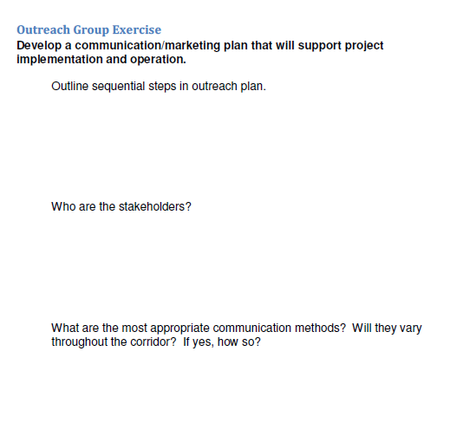
Outreach Exercise
Notes:
Discuss outreach related to NEPA versus outreach related to project marketing
What are sequential steps in the outreach plan?
Who are the stakeholders?
What are the most appropriate communication methods? Will they vary throughout the corridor? If yes, how so?
What messages need to be communicated?
Who are the appropriate messenger(s)?

Slide 23
Breakout Group Reports

