Slide 1
Connecting TSMO and Asset Management
ASSET MANAGEMENT
Presenter Name
Date
Source: Garrett, Flickr, CC.

Slide 2
Disclaimer
The U.S. Government does not endorse products, manufacturers, or outside entities. Trademarks, names, or logos appear in this report only because they are considered essential to the objective of the document. They are included for informational purposes only and are not intended to reflect a preference, approval, or endorsement of any one product or entity.

Slide 3
Executive Summary

Slide 4

Transportation World Is Changing
Limited funds
Advances in technology and growth in its use
Growing use of technology
Customer needs and expectations
Better understanding of causes of congestion
Source: Missouri Department of Transportation Flickr.
Notes:
The transportation landscape is changing, and doing business the way it has been done in the past is no longer effective. For example, previously, congestion issues were primarily addressed by funding major capital projects (such as adding lanes or building new interchanges and roads) to address physical constraints, such as bottlenecks. Operational improvements were typically an afterthought; they were considered after the new infrastructure was already added to the system. Today, transportation agencies are facing trends that create a growing demand for travel with less funding and space to work with. As a result, we can no longer build our way out of congestion.
Trends we see today include:
Limited funds. Transportation agencies on the Federal, State, and local levels have for years been tasked with doing more with limited resources. State departments of transportation (DOT) are always looking for innovative, lower-cost ways to get people and goods to their destinations more safely and reliably.
Advances in technology and growth in its use. Transportation agencies can leverage technology and data to develop solutions to address congestion issues. However, the traveling public expects fast, reliable, and “smart” transportation, given the advancement and growing use of consumer technologies (smartphones, applications, global positioning systems), privately owned mobility services, shared mobility, and the availability of more information.
Changing customer needs and expectations. There is a greater demand for accountability for public officials to ensure that public funds are spent to maximize the performance of the transportation system in the most equitable and cost-effective way. This creates a trend toward “performance-based” programs. The traveling public is seeking relief from unexpected delays in their trips. There is also a greater focus on addressing climate change and offering multimodal transportations options and solutions for the pedestrian, bicyclist, and transit rider.
Better understanding of the causes of congestion. Research has shown that while some congestion may be caused by typical morning and evening rush hours, a significant amount comes from non-recurring events, such as crashes, breakdowns, work zones, weather, and special events.
Source: FHWA, “Addressing the Nation’s Transportation Challenges with Transportation Systems Management and Operations.” Available at: https://ops.fhwa.dot.gov/publications/fhwahop19085/fhwahop19085.pdf
Image Source: https://flic.kr/p/QNwCuy

Slide 5
How Are State Departments of Transportation (DOT) Responding?
Transportation Systems Management and Operations (TSMO):
TSMO can help State DOTs get the most performance out of existing and planned transportation facilities.
TSMO uses strategies, technologies, mobility services, and programs to optimize the safety, mobility, and reliability of the existing and planned transportation system.
TSMO relies on communications systems, sensors, and other technology and equipment.
Asset management is key to the success of TSMO.
Notes:
How are State DOT’s adjusting and responding to these changes?
Transportation systems management and operations (TSMO) is a solution.
The goal here is to get the most performance out of the transportation facilities we already have. TSMO is the use of strategies, technologies, mobility services, and programs to optimize the safety, mobility, and reliability of the existing and planned transportation system.
TSMO relies on communications systems, sensors, and other technology and equipment.
Asset management is necessary for the success of TSMO. Asset management involves operating, maintaining, and improving assets using analysis to identify a sequence of actions to achieve good performance of assets over their life cycle. If assets are properly maintained at the appropriate time, their performance will be better and more reliable. This has a direct impact on the successful implementation of TSMO strategies. Accurate travel times cannot be calculated using malfunctioning and uncalibrated vehicle detectors, and emergency and evacuation messages cannot be posted on non-functional highway advisory radios.

Slide 6
Asset Management and TSMO Have Common Goals and Approaches
Share common goals, such as optimizing performance of existing assets
Use similar processes:
  TSMO focuses on preserving and maximizing mobility and safety
  Asset management focuses on preserving or improving the asset condition
Share a strategic, performance-based approach to monitoring performance and maximize the return on investment
Use of benefit cost (B/C) analysis, life-cycle planning (LCP) and
life-cycle cost analysis (LCCA) as decisionmaking tools
Notes:
TSMO and asset management have similar goals including optimizing the performance of existing assets. TSMO focuses on optimizing mobility, safety and reliability. Asset management focuses on optimizing the performance of assets.
Agencies frequently makes use of benefit cost ratio analysis to measure the effectiveness of TSMO or operational strategies. Agencies can use this B/C analysis to justify strategies selected and corresponding investments. Similarly, agencies can use life cycle planning and life cycle cost analysis to make investment decisions that take into account the asset‘s full life cycle and costs.
Life cycle planning (LCP) is a strategy for managing an asset over its life to achieve a target level of performance while minimizing life cycle costs.
Life cycle cost analysis (LCCA) is a technique for comparing cost alternatives over the life cycle of a project, allowing agencies to minimize life cycle cost.

Slide 7
Why TSMO Is Relevant to
Asset Management (1/3)
TSMO includes hardware, software, equipment, and systems (i.e., assets that need to be managed):
  Operations infrastructure and systems are becoming increasingly prevalent and are vital to efficient, reliable mobility.
  Incorporating TSMO assets into asset management plans and procedures helps improve transportation system performance.
  TSMO experts can provide technical knowledge to plan for routine maintenance and replacement of assets.
Notes:
Implementation of TSMO strategies, which are usually technological in nature, many times require the installation of hardware, equipment, and systems. Examples include installation of dynamic message signs as part of traveler information systems and installation of vehicle detectors as part of a variable speed limit deployment. Both these example deployments help provide for safe, efficient, and reliable mobility.
The principle behind TSMO, similar to Asset Management, is to optimize the use of existing assets. This optimization can result in longer life cycles for assets already in use and help agencies avoid major expenditures related to capacity improvements. Incorporating these TSMO assets into asset management plans is recognition of the critical role these assets play in transportation network management and system performance.
TSMO champions who are familiar with asset specifications and history of device performance can be instrumental in efforts to extend asset lifecycle and can provide the technical knowledge needed to plan for routine maintenance and eventual replacement of devices.

Slide 8
Why TSMO Is Relevant to
Asset Management (2/3)
TSMO can help extend the functional life of facilities and get the most value out of the existing infrastructure:
  Can eliminate or delay the introduction of new roadway infrastructure and reduce the associated asset management burden
Capacity can be seen as an asset (in a general sense) to be managed.
Notes:
The principle behind TSMO, similar to Asset Management, is to optimize the use of existing assets.
Assets that have been maintained and rehabilitated in a timely fashion will perform better and for longer periods of time. Replacement of these assets can thus be delayed, reducing agency expenditures.
Although the definition of an asset in 23 CFR 515 does not include capacity, TSMO and asset management professionals may find it helpful to think of it this way. They may use the analogy of capacity as an asset to help make the business case for TSMO to senior agency leadership who may prioritize asset management.

Slide 9
Why TSMO Is Relevant to
Asset Management (3/3)
State and local agencies benefit by knowing about the current and historical performance of TSMO assets.
An agency can reduce risk by avoiding unreliable technology that has a history of premature failure.
TSMO can help asset managers better address real-time operations by answering questions that help prioritize, coordinate, and facilitate maintenance and project development.
Notes:
Knowledge of TSMO asset performance history and information such as mean time between failures (MTBF) helps agencies make better decisions regarding devices to deploy in the future. TSMO can help asset managers better address assets that matter for real-time operations by answering questions that help prioritize, coordinate, and facilitate maintenance and project development.

Slide 10
Why Asset Management
Is Relevant for TSMO
The ability of TSMO to help achieve an agency’s performance outcomes depends on the effective management of transportation assets:
  Includes both major infrastructure (e.g., roads, bridges) and TSMO-specific assets (e.g., signals, dynamic message signs, managed lane indicators, communications systems, and other technology)
TSMO assets are needed for critical safety and mobility outcomes, and economic competitiveness and regional economic health.
Asset management supports budgeting for life-cycle costs of TSMO assets.
Notes:
Asset management is critical for a successful TSMO program. The ability of TSMO to help achieve an agency’s performance outcomes depends on the effective management of transportation assets. This includes both major infrastructure (e.g., roads, bridges) and TSMO-specific assets (e.g., signals, dynamic message signs, managed lane indicators, communications systems, and other technology). Ramp metering cannot be implemented successfully if multiple vehicle detectors on the freeway are not functioning properly, and lane closure and route detour information cannot be provided to the traveling public if dynamic message signs are not functioning.
TSMO assets are needed for critical safety and mobility outcomes, economic competitiveness, regional economic health, and many other important community goals.
TSMO assets need regular investment to ensure that they are well-maintained and replaced as needed. Asset management supports budgeting for lifecycle costs of TSMO assets. When assets are well maintained and reliable, significant expenditures can be eliminated. Improved management of the transportation network leads to improved customer satisfaction.

Slide 11
Take Action
Include additional assets such as intelligent transportation systems (ITS), traffic signals, and other infrastructure that support TSMO in the transportation asset management plan (TAMP)
Where not included within a TAMP, create a separate ITS asset management process and plan to inventory and document assets
Bring TSMO and agency asset owners together to discuss areas of additional collaboration
Review and update the regional ITS architecture to identify new assets needed to address system gaps
Connect TAMPs and TSMO plans
Notes:
While many Sates have advanced ITS/TSMO asset management practices and programs, many other States are in the beginning stages of identifying program goals, assets they will track, and performance measures they will use to measure the systems. While all States have created TAMPs, few have incorporated ITS/TSMO assets into them. As assets that contribute to system performance, there is value to adding them to TAMPS. TSMO and Asset Management have similar end goals, both parties should discuss the benefits of collaboration and build on synergies.
Reviewing and updating the regional ITS architecture can lead to the identification of new strategies and assets not formerly included.

Slide 12
End of Executive Summary

Slide 13
Presentation Goals
Create awareness of transportation systems management and operations (TSMO) strategies and goals
Demonstrate connections between TSMO and asset management that can lead to:
  Optimized asset conditions
  Optimized transportation network operations
Highlight agency examples of coordination between TSMO and asset management
Address challenges in coordination and potential solutions
Notes:
This presentation discusses TSMO and the many strategies included under the TSMO umbrella. Transportation asset management is also discussed. These two areas share the same goal: to optimize existing resources. This presentation will also highlight examples of agencies implementing asset management principles and practices within their TSMO programs. Also discussed are challenges States may encounter in bridging TSMO and asset management and potential solutions to these challenges.

Slide 14
Presentation Overview
What Is TSMO?
Connecting TSMO and Asset Management Overview
Opportunities for Collaboration
Examples of Collaboration Between TSMO and Asset Management
Overcoming Challenges
Next Steps
Notes:
We begin this presentation by describing transportation systems management and operations, or TSMO.
We’ll then discuss reasons for connecting TSMO and asset management. Then we will identify areas for collaboration and review specific examples.
Next, we will conclude by reviewing the challenges and next steps in connecting TSMO and asset management.

Slide 15
What Is TSMO?

Slide 16
Definition of TSMO
Integrated [set of] strategies to optimize the performance of existing infrastructure through the implementation of multimodal and intermodal, cross-jurisdictional systems, services, and projects designed to preserve capacity and improve security, safety, and reliability of the transportation system.^{1,2}
¹Title 23 of the U.S. Code (USC) § 101 (a)(30)(A) Definitions and Declarations of Policy, 2011
²Federal Highway Administration (FHWA) website: https://ops.fhwa.dot.gov/tsmo/
Notes:
Before going further, it is important to define TSMO for new audiences:
TSMO is an integrated set of strategies to optimize the performance of existing infrastructure through the implementation of multimodal and multi-jurisdictional systems, services, and projects designed to preserve capacity and improve security, safety, and reliability of the transportation system.
The goal here is to get the most performance out of the transportation facilities we already have. TSMO is the use of strategies, technologies, mobility services, and programs to optimize the safety, mobility, and reliability of the existing and planned transportation system.

Slide 17
Characteristics of TSMO
Offers an integrated set of strategies to optimize operational performance of the existing transportation system
Approaches performance from a systems perspective that spans corridors, facilities, jurisdictions, modes, and agencies
Helps agencies balance supply and demand on the system and provide flexible solutions to manage dynamic conditions
Can complement capacity projects, or in some cases can provide lower cost, faster alternatives
Notes:
TSMO is an integrated set of strategies to optimize the operational performance of the existing transportation system.
Note: The definition at the top of the slide is an abridged version of the Federal Highway Administration’s (FHWA) TSMO definition found here: https://ops.fhwa.dot.gov/tsmo and at 23 USC 101 (a) (30).
TSMO approaches performance from a systems perspective.
Spans corridors, facilities, jurisdictions, modes, and agencies
TSMO takes a holistic approach to managing performance that looks beyond a single corridor (e.g., are changes to a specific corridor causing a mobility issue nearby?), jurisdiction (e.g., are management systems coordinated across jurisdictional boundaries?), mode (e.g., are we using all modes optimally to meet our performance goals?), and agency (e.g., how can we improve collaboration with law enforcement or transit agencies to improve performance?).
Helps agencies balance supply and demand on the system and provide flexible solutions to manage dynamic conditions.
Example TSMO strategies include ramp metering, managed lanes, and congestion pricing.
TSMO can complement capacity projects or can provide lower-cost, faster alternatives in some cases.
TSMO seeks to provide lower-cost alternatives to capacity projects when operational strategies may produce equal or better results – or when operational strategies may be able to produce results faster. It does not seek to eliminate capacity projects in cases where a capacity project is the best solution. Rather, TSMO provides agencies with more options.

Slide 18
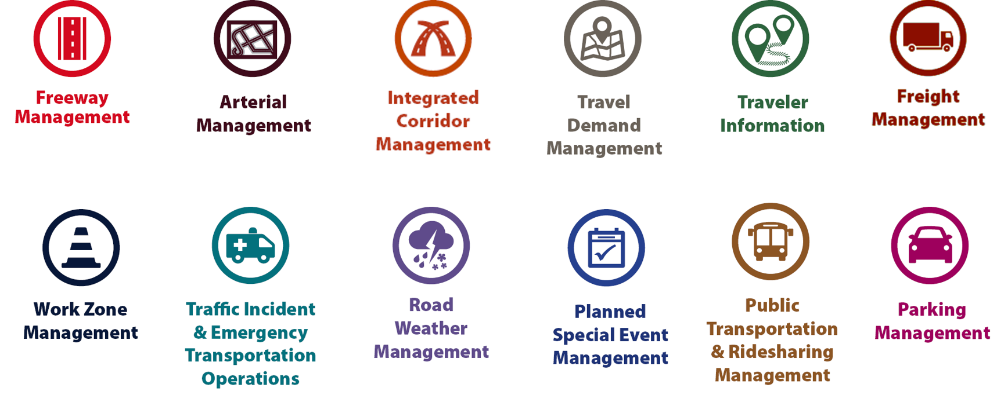
Examples of TSMO Strategies
Source: Federal Highway Administration
Notes:
This slide illustrates the array of operational strategies that fall under the TSMO umbrella that can be used individually or in combination with each other. This list is not exhaustive, but it highlights the key buckets of strategies that are priorities for many agencies.
Examples of other TSMO strategies include:
Traffic signal coordination
Transit signal priority
Special event management
Congestion pricing
Active transportation and demand management
Connected/automated vehicles
Completing multimodal networks
Intelligent transportation systems (ITS) components can support all these TSMO strategies. ITS covers a variety of technologies to monitor, evaluate, and manage transportation systems to enhance efficiency and safety. It should be noted that TSMO does not equate to ITS; many strategies support TSMO that do not involve an ITS component.
TSMO strategies can be categorized into three overarching areas: incident or event management, traffic management, and demand management strategies. The next three slides highlight strategies in each of these areas.

Slide 19
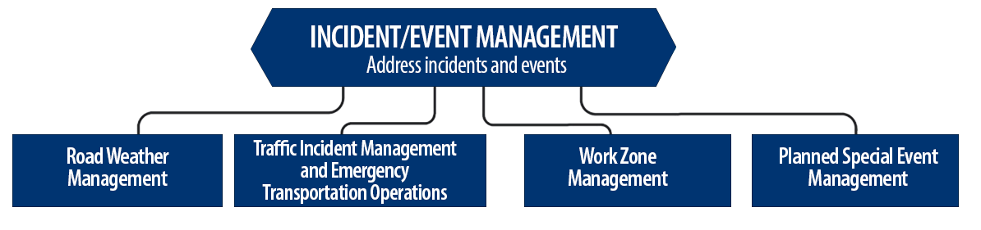
Incident/Event Management Strategies
Source: Federal Highway Administration.
Notes:
Incident and event management includes several strategies that address major sources of travel-time unreliability.
Incident and event management strategies include road weather management, traffic incident management and emergency transportation operations, work zone management, and planned special event management.
Road weather management activities include creating hazardous weather traffic operations response plans, implementing variable speed limits, detecting hazardous weather conditions, disseminating weather and warnings to travelers through dynamic signs and systems, providing emergency truck and parking facilities and emergency parking information, and implementing vehicle restrictions.
Traffic incident management and emergency transportation operations activities include establishing traffic incident management teams, conducting after action reviews, staging tow trucks in strategic areas, providing roadway safety patrols, integrating computer-aided dispatch into transportation management centers, pre-establishing towing service agreements, co-locating dispatching units, developing quick clearance goals, pre-planning detour routes, implementing shoulder running, deploying adaptive ramp metering, providing variable speed limits, implementing dynamic lane-use controls, deploying network surveillance cameras or detectors, implementing incident traffic signal timing plans, enacting legislation, and integrating traffic management centers with law enforcement dispatch and emergency centers.
Work zone management activities include coordinating maintenance and construction activities, implementing queue length detection, deploying network surveillance cameras or detectors, implementing variable speed limits, supporting dynamic lane merging, implementing dynamic lane-use controls, deploying temporary ramp metering, and implementing dynamic warning systems.
Planned special event management activities include activating special event timing plans, deploying adaptive ramp metering, implementing variable speed limits, using hard shoulder running, activating dynamic transit fare reduction, implementing reversible lanes, supporting dynamic lane-use controls, establishing dynamic pricing, deploying network surveillance cameras or detectors, activating dynamic wayfinding, and conducting after action reviews.
Source: FHWA, Integrating Travel Time Reliability into Transportation System Management: Final Technical Memorandum
https://ops.fhwa.dot.gov/publications/fhwahop19035/index.htm

Slide 20
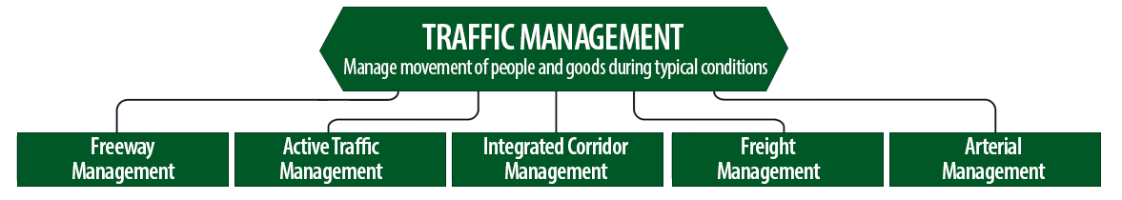
Traffic Management Strategies
Source: Federal Highway Administration.
Notes:
While incident or event management strategies address atypical events that cause travel-time unreliability, traffic management strategies manage the movement of people and goods during everyday conditions. Even during typical conditions, fluctuations in travel demand can lead to unreliable travel conditions. Traffic management strategies allow the transportation network to adapt to unreliability, including variations in travel demand.
Traffic management strategies include freeway management, active traffic management, integrated corridor management, freight management, and arterial management.
Freeway management activities include implementing traffic surveillance cameras or detectors, using high-occupancy lanes, implementing adaptive ramp metering, deploying hard shoulder running, implementing variable speed limits, deploying dynamic lane-use controls, and constructing physical operations improvements such as overpass widening, curve corrections, or adding auxiliary lanes.
Active traffic management activities include adopting adaptive ramp metering, implementing adaptive traffic signal control, using dynamic lane reversal, implementing dynamic lane-use controls, deploying dynamic merge control, implementing temporary shoulder running, using variable speed limits, deploying queue length detection, providing transit signal priority, and implementing dynamic warning signs.
Integrated corridor management activities include implementing network surveillance cameras or detectors, conducting access management and driveway access controls, implementing adaptive ramp metering, deploying adaptive signal control, deploying transit signal priority, installing queue jumping lanes, providing traveler information for alternative modes, and deploying emergency vehicle preemption.
Freight management activities include implementing roadside truck electronic screening and clearance, implementing truck signal priority, using truck parking management systems, installing truck climbing lanes, and implementing freight loading zone policies.
Arterial management activities include installing queue jumping lanes, deploying transit signal priority, supporting emergency vehicle preemption, implementing network surveillance cameras or detectors, implementing access management and driveway access controls, providing enhanced bicycle and pedestrian crossings, establishing a transportation management center, deploying enhanced traffic signal operations, implementing transit-only lanes, implementing truck traffic signal priority, designing for complete streets, adding capacity for critical movements, reducing travel speeds, providing automated enforcement, and conducting operations asset management.
Source: FHWA, Integrating Travel Time Reliability into Transportation System Management: Final Technical Memorandum
https://ops.fhwa.dot.gov/publications/fhwahop19035/index.htm

Slide 21
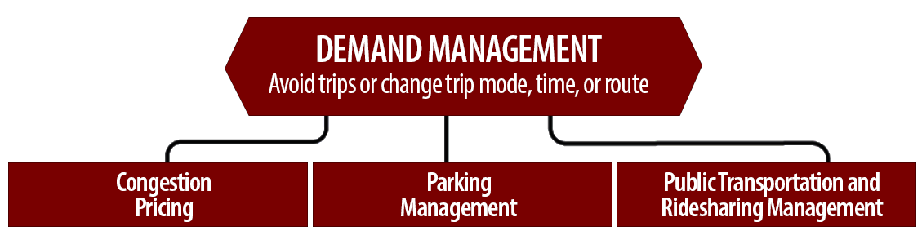
Demand Management Strategies
Source: Federal Highway Administration.
Notes:
Demand management strategies reduce underlying demand by helping travelers avoid trips or change the mode, timing, or route of trips. This makes nonrecurring congestion less likely to occur and improves travel-time reliability.
Demand management strategies include congestion pricing, parking management, and public transportation and rideshare management.
Congestion pricing activities include implementing dynamic pricing, variable pricing by lane, segment, and time of day or day of week; establishing dynamic transit fare reductions; and deploying managed lanes for high occupancy.
Parking management activities include deploying dynamically priced parking; implementing dynamic parking, wayfinding, reservations, and capacity; deploying dynamic overflow transit parking; implementing electronic payment systems and shared-use parking; and providing incentives to use underutilized parking facilities.
Public transportation and ridesharing management activities include implementing dynamic ridesharing, implementing transit signal priority, using queue-jump lanes at signalized intersections, deploying electronic fare collection and integration, and implementing dynamic surveillance and security.
Source: FHWA, Integrating Travel Time Reliability into Transportation System Management: Final Technical Memorandum
https://ops.fhwa.dot.gov/publications/fhwahop19035/index.htm

Slide 22
TSMO Is a “Way of Thinking” That Supports State Departments of Transportation’s (DOTs’) Missions
“We provide safe, reliable and cost-effective transportation options to improve communities and economic vitality for people and businesses.”
Washington State DOT (WSDOT) mission¹
“To provide the best multimodal transportation system for Colorado that most effectively and safely moves people, goods, and information.”
Colorado DOT mission²
¹WSDOT, “Strategic Plan,” https://www.wsdot.wa.gov/about/secretary/strategic-plan/
²Colorado DOT, “Mission, Vision & Values,” https://www.codot.gov/about/mission-and-vision.html
Notes:
TSMO leverages technology, a toolbox of strategies, and engineering solutions to maximize system performance; however, TSMO ultimately involves a way of thinking or a mindset focused on determining the best way to optimize the mobility and reliability of the existing system with limited resources.
TSMO can be thought of as a way of thinking and operating in order to get the most performance out of the transportation network while only building as much as is needed.
The principles of TSMO directly support the missions of many State DOTs, as these examples show.
NOTES:
States can insert their own mission statement here for effect or can leave these in.
Presenters can emphasize the connections between TSMO definition and their specific Mission statement, such as safety, reliability, cost-effective, multimodal, customer’s needs/satisfaction, etc.

Slide 23
TSMO Supports Many
State and Local DOT Goals
Reduced congestion
Smoother and more reliable traffic flow
Improved safety
Cleaner air and less wasted fuel
More efficient use of resources and existing facilities
Increased economic vitality
Improved quality of life
Notes:
Here are some common goals in state and local transportation agencies that TSMO strategies support. This list is not exhaustive, but intended to show that TSMO support a range of mission-critical goals. Examples of how TSMO supports these goals are shown on the next slide.

Slide 24
Example TSMO Strategies That Support Transportation Agency Goals
TSMO Strategies
Goals
Traffic signal coordination, congestion pricing, demand management
Reduced congestion
Manage nonrecurring events (incidents, weather), managed lanes, traveler information
Smoother and more reliable traffic flow
More efficient use of resources and existing facilities
Utilize the full system—coordinate all modes, transit signal priority
Notes:
TSMO strategies that support some common transportation agency goals are shown here. Many of these strategies support more than one goal, but here are some key examples.

Slide 25
TSMO State of the Practice
Application of TSMO has accelerated in agencies across the country over the past 5–10 years
Recognition of TSMO’s value has grown, leading to a variety of approaches for advancing TSMO in agencies. For example:
  Establishing a TSMO division or office
  Formalizing a TSMO program
  Integrating TSMO throughout the agency
  Establishing a TSMO committee
  Identifying TSMO champions or liaisons
  Conducting a TSMO capability maturity model (CMM) self-assessment
  Developing a TSMO program plan
Notes:
TSMO as a more formal discipline has gained momentum in recent years. Recognition of the importance of TSMO has accelerated in the past five to ten years (as of year of publication of this presentation, 2022).
Key focus areas for agencies during this time have been adapting their culture, processes, expertise, and, in some cases, organizational structures to promote TSMO and a more operationally focused mindset. Agencies approach this differently depending on their unique context and needs. Several examples of key strategies agencies have used to advance TSMO within their organizations are shown here.
Central to all of these organizational approaches is 1) strong support from senior leadership, 2) a champion or champions who understand and promote TSMO throughout the agency, and 3) an openness to learning and cooperation among functions or divisions within an agency.
A TSMO capability maturity model self assessment is a framework developed to help agencies evaluate their current capabilities in the area of TSMO and identify steps for improving their TSMO capabilities. The self-assessment can be accessed at: http://aashtotsmoguidance.org/. There are also other capability maturity frameworks that FHWA has developed to support the implementation of TSMO. More can be learned about those frameworks at: https://ops.fhwa.dot.gov/tsmoframeworktool/index.htm.

Slide 26
Resources on TSMO
What Is TSMO? (frequently asked questions) https://ops.fhwa.dot.gov/tsmo
Organizing and Planning for Operations web page https://ops.fhwa.dot.gov/plan4ops
Communicating TSMO web page https://ops.fhwa.dot.gov/plan4ops/focus_areas/communicating_tsmo.htm
National Operations Center of Excellence (NOCoE) website https://www.transportationops.org/
TSMO and Asset Management fact sheet https://ops.fhwa.dot.gov/publications/fhwahop18094.htm
Notes:
While these slides provide a comprehensive, high-level summary of TSMO, participants who are looking for more details and information to share with their staff can visit these virtual resources.

Slide 27
Connecting TSMO and Asset Management Overview

Slide 28
Why TSMO Matters to Asset Management (1/4)
TSMO includes hardware, software, equipment, and systems (i.e., assets that need to be managed):
  Operations infrastructure and systems are becoming increasingly prevalent and are vital to efficient, reliable mobility.
  Incorporating TSMO assets into asset management plans and procedures helps improve transportation system performance.
  TSMO experts can provide technical knowledge to plan for routine maintenance and replacement of assets.
Notes:
Implementation of TSMO strategies, which are usually technological in nature, many times require the installation of hardware, equipment, and systems. Examples include installation of dynamic message signs as part of traveler information systems and installation of vehicle detectors as part of a variable speed limit deployment. Both these example deployments help provide for safe, efficient, and reliable mobility.
The principle behind TSMO, similar to Asset Management, is to optimize the use of existing assets. This optimization can result in longer life cycles for assets already in use and help agencies avoid major expenditures related to capacity improvements. Incorporating these TSMO assets into asset management plans is recognition of the critical role these assets play in transportation network management and system performance.
TSMO champions who are familiar with asset specifications and history of device performance can be instrumental in efforts to extend asset lifecycle and can provide the technical knowledge needed to plan for routine maintenance and eventual replacement of devices.

Slide 29
Why TSMO Matters to Asset Management (2/4)
Several TSMO assets can be included as part of asset management inventories:
  Traffic signals
  Closed-circuit television (CCTV) cameras
  Dynamic message signs (DMS)
  Vehicle detectors
  Ramp meters
  Road weather information systems (RWIS)
  Highway advisory radios
Notes:
As noted on the slide, there are several TSMO assets that can be part of asset management inventory. These include:
Traffic Signals
CCTV cameras
Dynamic message signs
Vehicle detectors
Ramp meters
Road weather information systems
Highway advisory radios
Are there any others that you can think of?

Slide 30
Why TSMO Matters to Asset Management (3/4)
TSMO can help extend the functional life of facilities and get the most value out of the existing infrastructure:
  Can eliminate or delay the introduction of new roadway infrastructure and reduce the associated asset management burden
Capacity can be seen as an asset (in a general sense) to be managed
Notes:
The principle behind TSMO, similar to Asset Management, is to optimize the use of existing assets.
Assets that have been maintained and rehabilitated in a timely fashion will perform better and for longer periods of time. Replacement of these assets can thus be delayed, reducing agency expenditures.
Although the definition of an asset in 23 CFR 515 does not include capacity, TSMO and asset management professionals may find it helpful to think of it this way. They may use the analogy of capacity as an asset to help make the business case for TSMO to senior agency leadership who may prioritize asset management.

Slide 31
Why TSMO Matters to Asset Management (4/4)
State and local agencies benefit by knowing about the current and historical performance of TSMO assets.
An agency can reduce risk by avoiding unreliable technology that has a history of premature failure.
TSMO can help asset managers better address real-time operations by answering questions that help prioritize, coordinate, and facilitate maintenance and project development.
Notes:
Knowledge of TSMO asset performance history and information such as mean time between failures (MTBF) helps agencies make better decisions regarding devices to deploy in the future. TSMO can help asset managers better address assets that matter for real-time operations by answering questions that help prioritize, coordinate, and facilitate maintenance and project development.

Slide 32
Why Asset Management Matters for TSMO
The ability of TSMO to help achieve an agency’s performance outcomes depends on the effective management of transportation assets
  Includes both major infrastructure (e.g., roads, bridges) and TSMO-specific assets (e.g., signals, DMS, managed lane indicators, communications systems, and other technology)
TSMO assets are needed for critical safety and mobility outcomes, and economic competitiveness and regional economic health.
Asset management supports budgeting for life-cycle costs of TSMO assets.
Notes:
Asset management is critical for a successful TSMO program. The ability of TSMO to help achieve an agency’s performance outcomes depends on the effective management of transportation assets. This includes both major infrastructure (e.g., roads, bridges) and TSMO-specific assets (e.g., signals, dynamic message signs, managed lane indicators, communications systems, and other technology). Ramp metering cannot be implemented successfully if multiple vehicle detectors on the freeway are not functioning properly, and lane closure and route detour information cannot be provided to the traveling public if dynamic message signs are not functioning.
TSMO assets are needed for critical safety and mobility outcomes, economic competitiveness, regional economic health, and many other important community goals.
TSMO assets need regular investment to ensure that they are well-maintained and replaced as needed. Asset management supports budgeting for lifecycle costs of TSMO assets. When assets are well maintained and reliable, significant expenditures can be eliminated. Improved management of the transportation network leads to improved customer satisfaction.

Slide 33
Opportunities for Collaboration

Slide 34
TSMO and Asset Management Have Common Goals and Approaches
Share common goals such as optimizing performance of existing assets
Use similar processes:
  TSMO focuses on preserving and maximizing mobility and safety
  Asset management focuses on preserving or improving the asset condition
Share a strategic, performance-based approach to monitoring performance and maximize the return on investment
Use of benefit cost (B/C) analysis, life-cycle planning (LCP) and
life-cycle cost analysis (LCCA) as decisionmaking tools
Notes:
TSMO and asset management have similar goals including optimizing the performance of existing assets. TSMO focuses on optimizing mobility, safety and reliability. Asset management focuses on optimizing the performance of assets.
Agencies frequently makes use of benefit cost ratio analysis to measure the effectiveness of TSMO or operational strategies. Agencies can use this B/C analysis to justify strategies selected and corresponding investments. Similarly, agencies can use life cycle planning and life cycle cost analysis to make investment decisions that take into account the asset‘s full life cycle and costs.
Life cycle planning (LCP) is a strategy for managing an asset over its life to achieve a target level of performance while minimizing life cycle costs.
Life cycle cost analysis (LCCA) is a technique for comparing cost alternatives over the life cycle of a project, allowing agencies to minimize life cycle cost.

Slide 35
Opportunities for Collaboration (1/2)
Areas where asset management and TSMO staff can collaborate include:
Development of transportation asset management plans (TAMPs) that include ITS/TSMO assets
Development of TSMO plans that incorporate asset management
Collaboration with stakeholders on device specifications for systems/projects to ensure interoperability
Notes:
There are several areas where asset management and TSMO staff can collaborate. Some of these opportunities are listed on this slide and the next one.
Opportunities include the development of TAMPs that include ITS/TSMO assets. Increasingly, agency transportation asset management plans (TAMPs) are including TSMO-related assets. Opportunities also include the development of TSMO plans that incorporate asset management, and collaboration with stakeholders on device specifications for systems/projects to ensure interoperability.

Slide 36
Opportunities for Collaboration (2/2)
TSMO programs that are adopting life-cycle planning and risk-based management concepts from asset management to improve their programs
Coordination with all offices involved to ensure life-cycle cost information and planned funding is available to maintain and replace assets when needed
Collaboration with partner agencies and other stakeholders to review and update the intelligent transportations systems (ITS) architecture
Committees and working groups that include both TSMO and asset management participants
Notes:
TSMO programs are also adopting lifecycle planning and risk-based management concepts from asset management to improve their programs. Additional opportunities to collaborate include coordination between several offices to plan funding necessary for routine maintenance of assets and funding the eventual replacement of the assets at the end of their life cycle. Stakeholders from different offices can also collaborate to determine the appropriate technical specifications for devices needed in upcoming projects or deployments. We are also seeing collaborative efforts with the creation of committees and working groups. It would be extremely beneficial to include the unit within the DOT responsible for creation of the TAMP document in these committees and working groups.

Slide 37
Examples of Collaboration Between TSMO and Asset Management

Slide 38
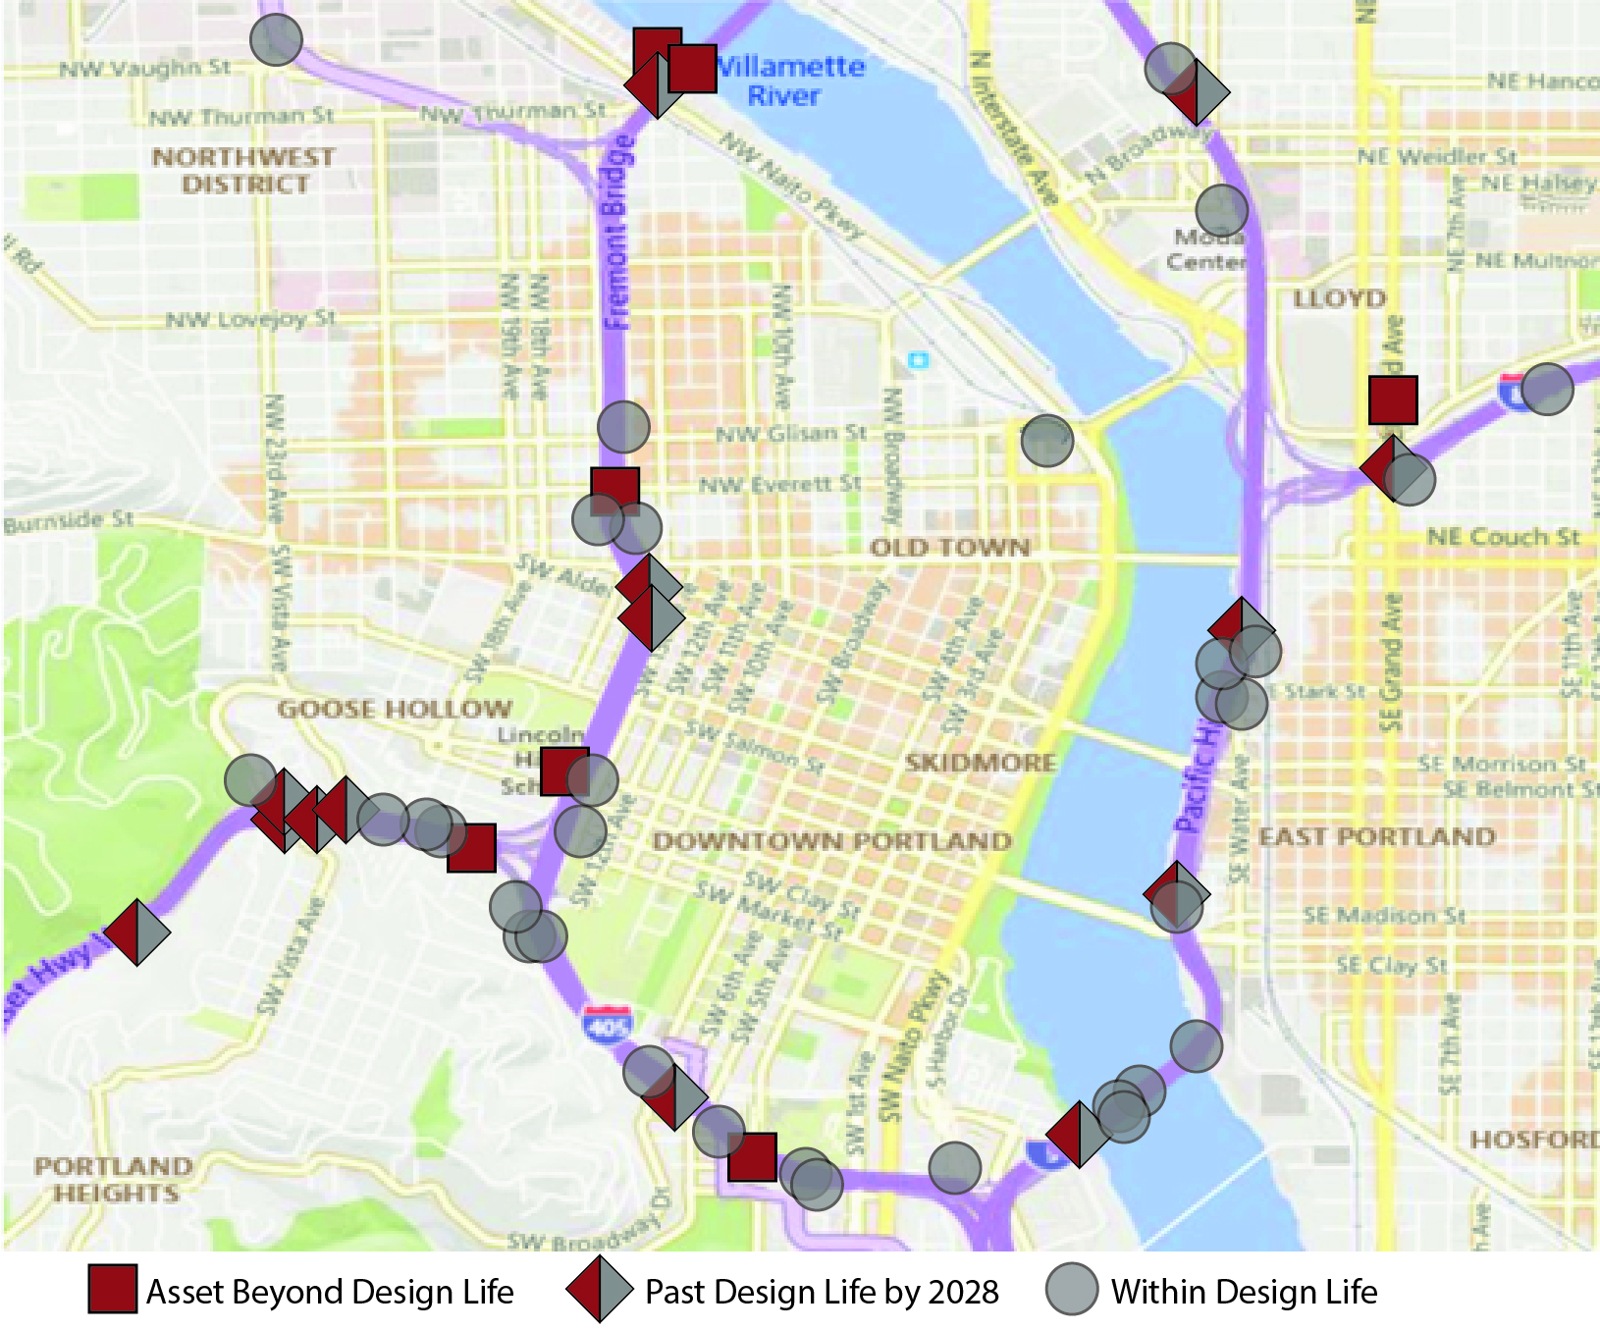
Oregon Department of Transportation (DOT) (1/2)
Developed asset reports to identify project needs and evaluate asset condition trends
Color-coded dots on maps indicate when asset is beyond design life (or will be by 2028)
Oregon Department of Transportation (DOT) Region 1 Portland Metro Area
Source: Adapted from Oregon DOT.
Notes:
Oregon DOT developed asset reports to identify project needs and evaluate asset condition trends. The visual representation of the TSMO asset data has proven helpful to Oregon DOT. They can more easily see asset conditions, which can be an input to future project selection decisions. In the past, Oregon DOT had relied on observational and ad hoc asset assessments which created an inaccurate picture. Using additional data sources allowed them a more complete and accurate assessment of their assets.
Map source: Email from Galen McGill, Oregon DOT.

Slide 39
Oregon Department of Transportation (2/2)
Access to TSMO asset condition data in a visual format has increased awareness of TSMO asset condition and helped the project selection process.
Oregon DOT implemented a traffic signal condition rating with a map-based statewide signal inventory.
Intelligent Transportation Systems Assets Going Beyond Design Life Count: Percentage of All Regions (Partial Table)
CLASS | 2021 | 2022 | 2023 | 2024 | 2025 | 2026
^{Camera—Fixed} | 0% | 0% | 0% | 0% | 0% | 0%
^{Camera—Pan Tilt Zoom} | 31% | 27% | 40% | 49% | 56% | 59%
^{Detector Station—Bluetooth®} | 49% | 64% | 67% | 86% | 56% | 59%
^{Detector Station—Loops} | 100% | 100% | 100% | 100% | 100% | 100%
^{HAR Beacon} | 94% | 94% | 94% | 94% | 100% | 100%
^{HAR Transmitter} | 86% | 86% | 100% | 100% | 100 | 100%
^{Portable—VMS} | 1% | 1% | 2% | 19% | 23% | 24%
^{Ramp Gate} | 0% | 0% | 0% | 0% | 0% | 0%
^{Ramp Meter} | 0% | 0% | 0% | 0% | 0% | 0%
^{RWIS} | 15% | 16% | 16% | 19% | 24% | 25%
Source: Adapted from Oregon Department of Transportation.
Note: VMS = variable message sign; HAR = highway advisory radio; RWIS = road weather information systems
Notes:
Oregon DOT tracks TSMO asset condition in a table format. The table, shown on the slide, lists Oregon’s TSMO asset classes and the percentage of each class that will go beyond the design life from years 2021 to 2028. This supports ODOT’s ability to plan for asset replacement.
They initiated a new traffic signal condition rating methodology. Now, all signals in the State and their condition rating can be viewed on a map.
Source: FHWA, Organizing for TSMO, Case Study 3: Performance Measurement – Making Data-driven Transportation Decisions Using Performance Measures. Available at:
https://ops.fhwa.dot.gov/publications/fhwahop19065/chapter_2.htm

Slide 40
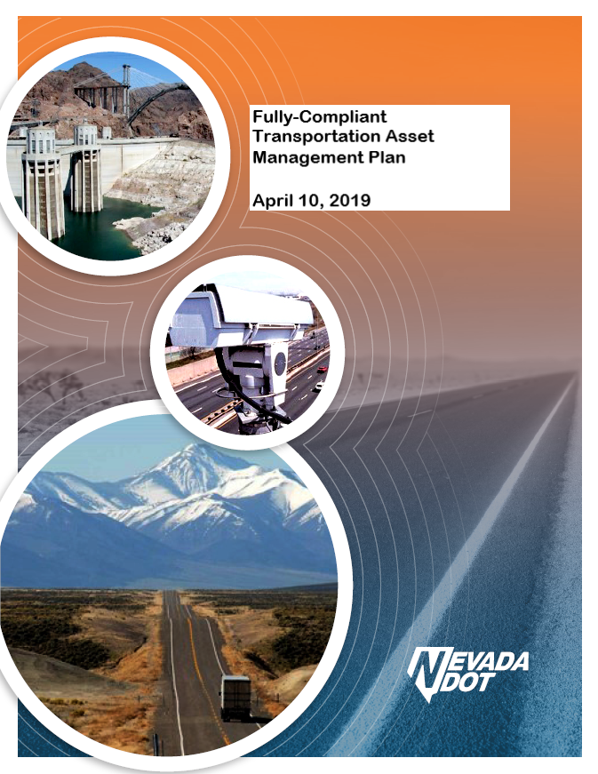
Nevada DOT (NDOT) (1/3)
Nevada is one of a several States that include ITS/TSMO assets in their TAMPs.
NDOT TAMP includes:
  CCTV
  DMS
  Flow detectors
  Ramp meters
  Highway advisory radios
  RWIS
Source: Nevada Department of Transportation, modified by Federal Highway Administration.
Notes:
The Nevada DOT is one of several States that has incorporated ITS/TSMO assets into its TAMP. Nevada DOT incorporated these ITS assets because an assessment performed concluded these assets were a high priority to the department in managing traffic operation. The Nevada TAMP includes a broad range of ITS/TSMO assets such as CCTV cameras, dynamic message signs, and ramp meters.
Source: Nevada DOT. (2019). Fully-Compliant Transportation Asset Management Plan, April 10, 2019. https://www.dot.nv.gov/doing-business/about-ndot/ndot-divisions/operations/maintenance-and-asset-management, last accessed December 8, 2022.

Slide 41
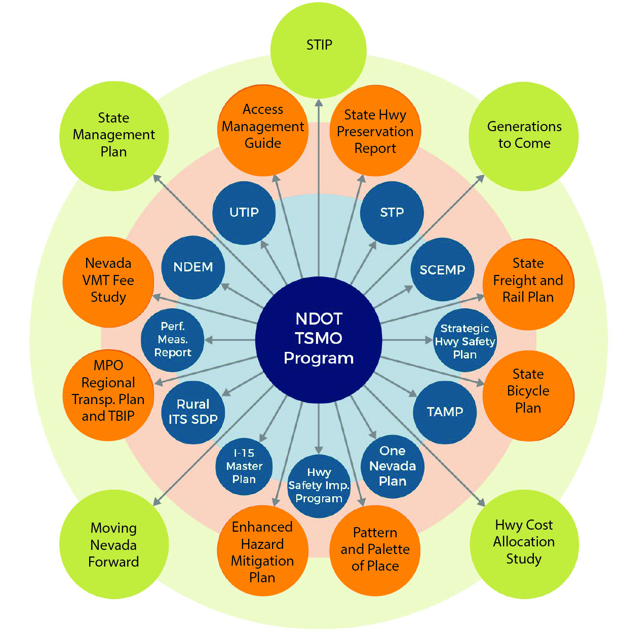
Nevada Department of Transportation (2/3)
“NDOT is implementing a statewide Transportation System Management and Operations (TSMO) program that optimizes system performance of existing infrastructure through integrated, multimodal, and
cross-jurisdictional projects that maintain capacity while improving security, safety, and reliability.”
Nevada Transportation Asset Management Plan, April 10, 2019
Source: Nevada Department of Transportation.
Notes:
TSMO and Asset Management are linked through Nevada DOT’s Transportation Asset Management Plan. The Nevada DOT TSMO program is referenced in the Nevada TAMP.
This figure illustrates the links between the Nevada DOT TSMO program and existing Nevada DOT programs and plans, including the TAMP.
Source: Nevada DOT. (2019). Fully-Compliant Transportation Asset Management Plan, April 10, 2019. https://www.dot.nv.gov/doing-business/about-ndot/ndot-divisions/operations/maintenance-and-asset-management, last accessed December 8, 2022.
Nevada DOT. (2020). NDOT Statewide TSMO Program Plan, January 2020. https://transops.s3.amazonaws.com/uploaded_files/NDOT%20Statewide%20TSMO%20Program%20Plan%202020.pdf, last accessed December 8, 2022.
Note: NDOT = Nevada Department of Transportation, STP = statewide transportation plan, SCEMP = State Comprehensive Emergency Management Plan, TAMP = transportation asset management plan, ITS = intelligent transportation system, NDEM = Nevada Division of Emergency Management, UTIP = unified transportation investment plan, MPO = metropolitan planning organization, TBIP = transportation investment business plan, VMT = vehicle miles traveled, STIP = statewide transportation investment program.

Slide 42
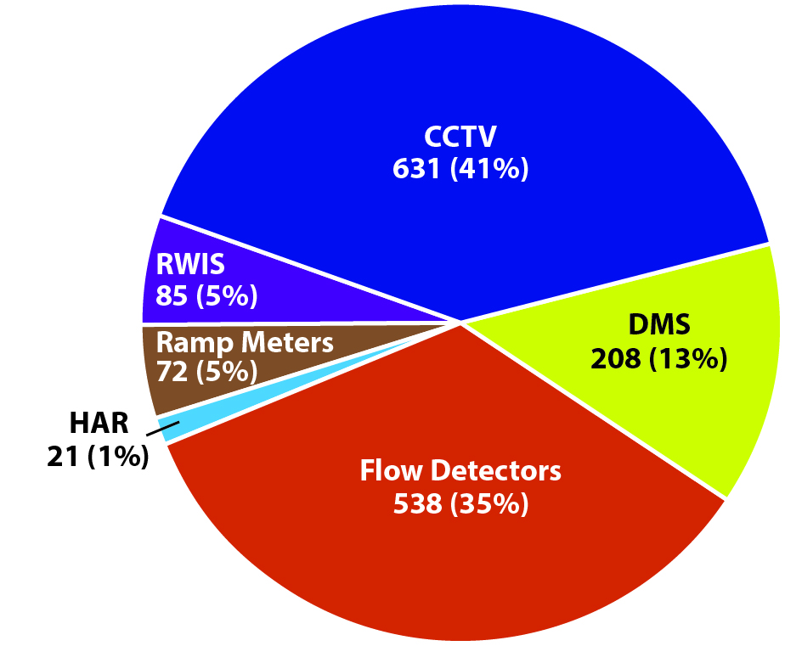
Nevada Department of Transportation (3/3)
NDOT’s TAMP is helping to guide health, LCP, risk-based management, and performance monitoring of the ITS assets based on the State’s transportation priorities.
Source: Nevada Department of Transportation.
Intelligent Transportation System Asset Inventory
Note: CCTV = closed-circuit television, DMS = dynamic message sign, HAR = highway advisory radio, RWIS = road weather information systems
Notes:
As part of the inclusion of ITS/TSMO assets into the TAMP, Nevada had to articulate risk management, life-cycle planning, and performance monitoring plans for these assets. The pie chart on the slide shows the ITS asset inventory that is within Nevada DOT TAMP.
Source: Nevada DOT. (2019). Fully-Compliant Transportation Asset Management Plan, April 10, 2019. https://www.dot.nv.gov/doing-business/about-ndot/ndot-divisions/operations/maintenance-and-asset-management, last accessed December 8, 2022.

Slide 43
Connecticut Department of Transportation (CTDOT) (1/2)
Asset management:
  ITS devices (e.g., CCTVs, variable message signs (VMS), and RWIS) and traffic signals included in the 2022 TAMP
  Working with traffic signal managers to develop a traffic signal management plan
  CTDOT uses age-based replacement strategy but is developing a component-based rating system
  Performance measure defined as state of good repair (SOGR)
  Creates annual highway asset fact sheets
Connecticut Department of Transportation (CTDOT) Transportation Asset Management
Performance Measure
2022 Highway Transportation Asset Management Plan and fact sheets at: https://portal.ct.gov/DOT/Office-of-Engineering/Project-Administration/Asset-Management-Group
Source: CTDOT.
Notes:
Connecticut DOT is one of several State DOTs including TSMO assets in their TAMPs. They are currently using device age as the performance criteria but are developing criteria based on condition of individual components within the traffic system. Additional ITS assets were included in CTDOT”s most recent TAMP in 2022.
Source: CTDOT. 2022 Highway Transportation Asset Management Plan. Available at: https://portal.ct.gov/-/media/DOT/documents/dtam/Transportation-Asset-Management-Plan-FHWA-Certified-9302022.pdf.

Slide 44
Connecticut Department of Transportation (2/2)
As part of its department-wide coordination efforts, CTDOT:
  Formed a Transportation Asset Management (TAM) Steering Committee with representation from across the agency
  Staffed a TAM Group:
    Developing an asset management strategy for each asset (e.g., traffic signals, ITS)
    Designated a TAM staff liaison for each asset
  Designated asset stewards in the CTDOT functional areas (i.e., Traffic Signal Asset Steward is from the Office of Traffic):
    Are the asset’s champion and serve as asset’s primary contact
    Propose SOGR definitions for asset
    Maintain data on inventory and condition—a current snapshot rather than comparisons over time
    Are responsible for compiling and submitting asset performance measure data
  Identified asset working group and it provided technical guidance throughout asset’s life cycle
Notes:
Connecticut DOT has created several committees and working groups as part of the asset management effort. They have four different levels of participation, such as the Transportation Asset Management Steering Committee, the Transportation Asset Management Group, the asset stewards and the asset working group. Each group has a role and responsibilities as part of this task.

Slide 45
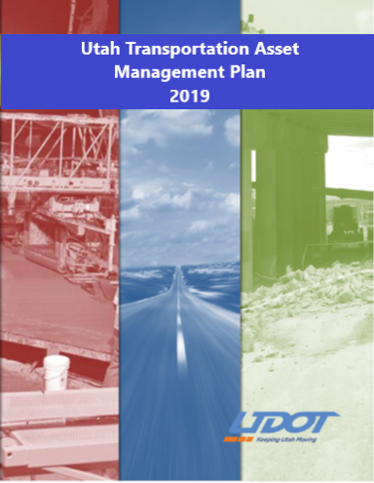
Utah Department of Transportation (UDOT) (1/3)
UDOT’s TAMP includes:
  ITS devices:
    CCTV
    DMS
    Ramp meters
    RWIS
    Highway advisory radios
  Signals
  Pavements
  Bridges
Source: Utah Department of Transportation, modified by the Federal Highway Administration.
Notes:
Utah DOT has included ITS and signal assets in its 2019 TAMP and the program has established performance measures for its assets. The draft 2022 TAMP includes ITS assets such as ramp meters, variable message signs, traffic monitoring stations, CCTV cameras, express lanes systems, road weather information systems, communication switches and other devices, and the supporting infrastructure for these devices. The 2022 TAMP will include all Tier 1 and Tier 2 assets.

Slide 46
Utah Department of Transportation (2/3)
ITS and signals are considered Tier 1 assets in UDOT’s TAMP because of their:
  Higher value
  Higher programmatic risk
  Importance to UDOT’s strategic direction
UDOT performance targets:
  ITS: 95% communications uptime for ITS devices communicating to the traffic operations center
  Signals: 99% of traffic signals have a current condition of good or fair
Notes:
Utah DOT has included ITS and signal assets are included in Utah DOT’s highest tier, Tier 1. This is because of their higher value, higher programmatic risk, and importance to UDOT’s strategic direction.
Utah DOT has asset condition performance targets for ITS and signals, as described on the slide.

Slide 47
Utah Department of Transportation (3/3)
The health of traffic signal systems is tracked through ongoing preventative maintenance and performance monitoring.
UDOT uses a web-based asset inventory and work order system to manage its system.
UDOT has developed life-cycle planning for ITS devices and is in the process of developing life-cycle plans for signal systems.
Notes:
Utah DOT monitors assets in real time and has a maintenance ticketing system in place for repairs.

Slide 48
New Jersey Department of Transportation (NJDOT) (1/2)
NJDOT maintains and operates 2,500+ signalized intersections.
Goals:
  Data-driven method to identify State-managed traffic signal upgrades
  Long-term capital-investment program for funding signalized intersection upgrades over 10+ years and incorporating this into the State Transportation Improvement Program
Notes:
With over 2,500 traffic signals to operate and maintain, NJ DOT wanted to use a data-driven approach to make improvements to their traffic signal system. In addition to a management system, the agency also wanted a create a long-term capital-improvement program that would fund signalized intersection upgrades for a period greater than 10 years.

Slide 49
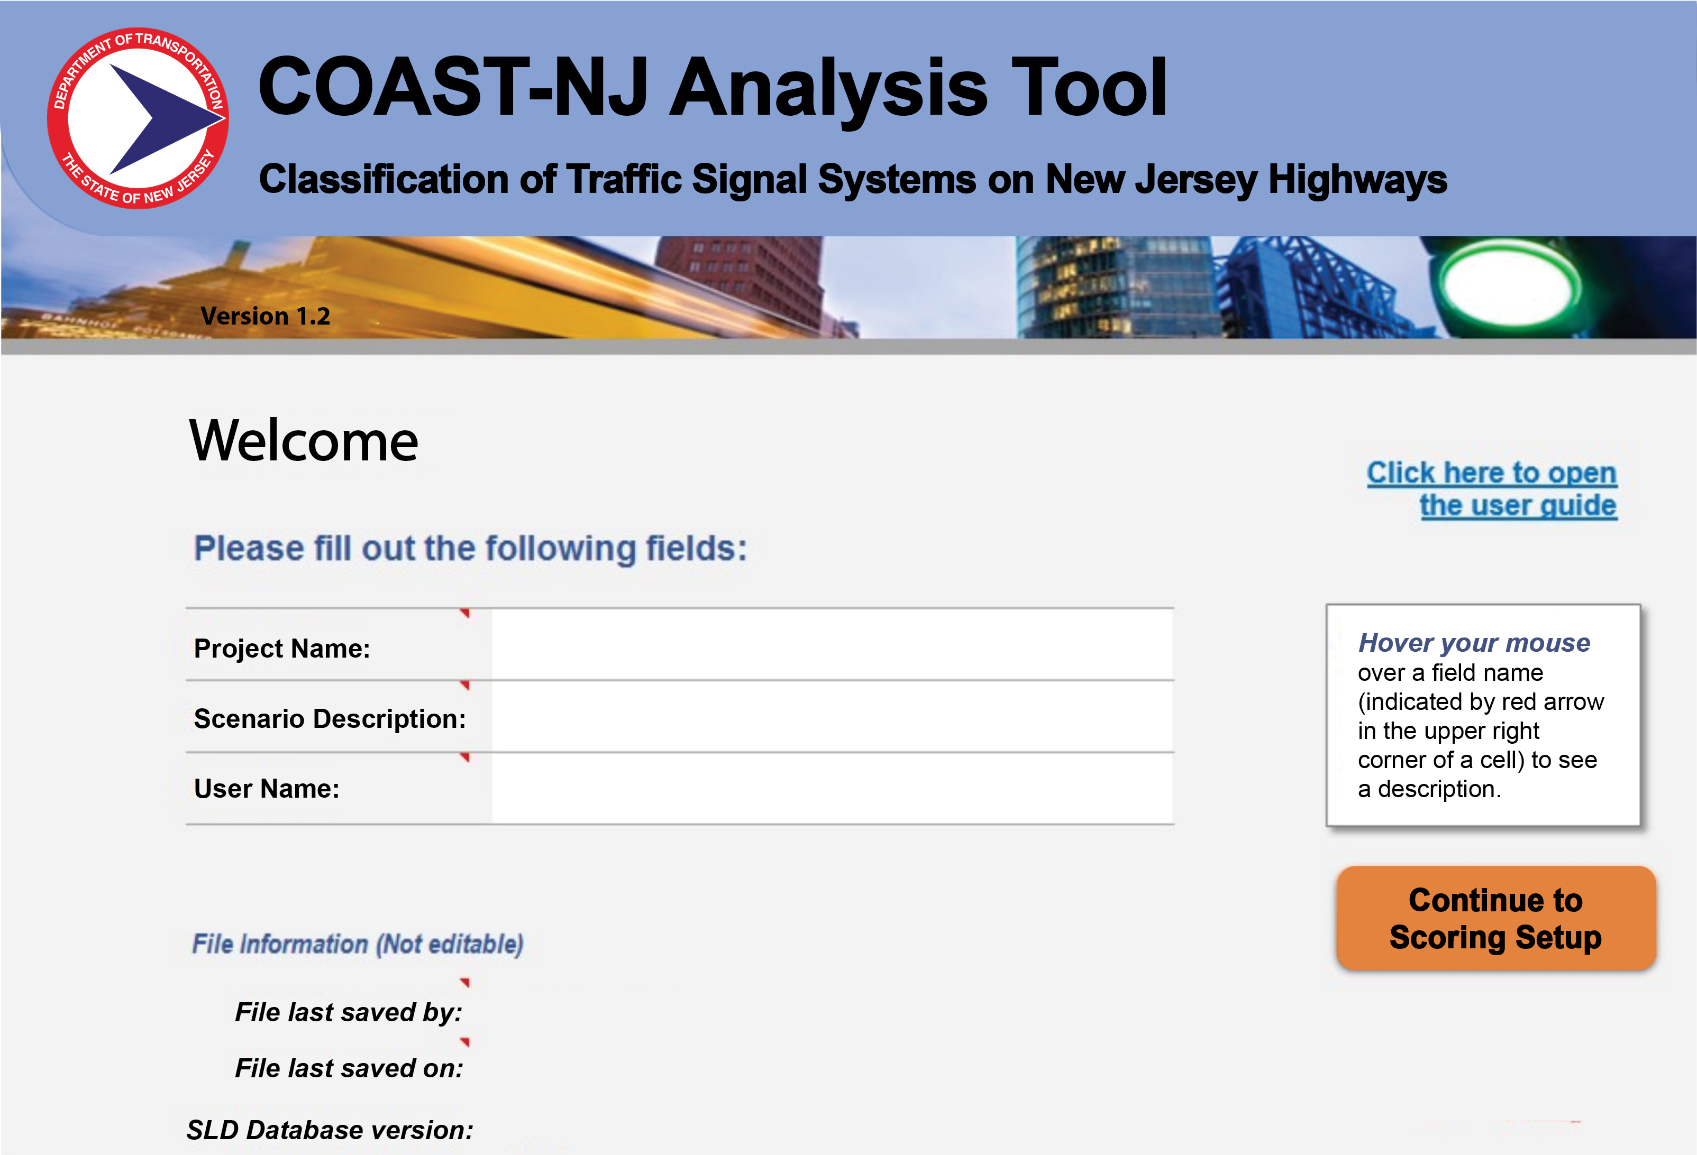
New Jersey Department of Transportation (2/2)
Classification of Arterial System Technology for New Jersey (COAST-NJ) tool prioritizes segments and identifies desired traffic signal upgrades
Signal improvements vary from timing optimization to adaptive system improvements
Improvements to how NJDOT scopes and designs projects to include ITS infrastructure
Source: New Jersey Department of Transportation, modified by the Federal Highway Administration.
Notes:
NJDOT created Classification of Arterial System Technology for New Jersey (COAST-NJ) as a way to make strategic and systematic improvements to their traffic signal system. The COAST-NJ tool provides recommendations for strategic and systematic improvement of NJDOT’s signals. The tool evaluates the highway segments statewide using the same criteria, prioritizes the segments, and recommends the type of signal improvement. Improvements can run the gamut from signal timing changes to adaptive system improvements. These process improvements have provided another benefit, helping with designing future projects that include ITS infrastructure. Image shows a screenshot of the analysis tool.

Slide 50
Minnesota Department of Transportation (1/2)
Created plans that integrate both TSMO and asset management:
  TAMP
  TSMO Strategic Plan
  Asset Management Strategic Implementation Plan (AMSIP)
Examples of ITS and TSMO assets included in the TAMP:
  Traffic monitoring cameras
  DMS
  Signals
  Fiber communication network
Notes:
Minnesota DOT has created several plans that are integrated including a TAMP plan, an asset management plan and TSMO plans. They are one of the States that have included ITS/TSMO assets in their TAMP. Examples of ITS and TSMO Assets in the Minnesota TAMP include:
Traffic monitoring cameras
Dynamic message signs
Signals
Fiber communication network
Source: Minnesota DOT. (July 2022). 2022 Minnesota Transportation Asset Management Plan. https://www.dot.state.mn.us/assetmanagement/tamp.html, last accessed December 12, 2022.

Slide 51
Minnesota Department of Transportation (2/2)
Benchmarked ITS asset conditions, established targets, and calculated investment required to achieve targets
Evaluated risks and developed mitigation strategies to better manage asset health
Portion of Minnesota Transportation Asset Management Plan’s Intelligent Transportation Systems (ITS) Performance Gap Table
ITS SUB ASSET TYPE | CURRENT CONDITION (2020)* | PROJECTED CONDITION IN 2032* | TARGET* | PLANNED INVESTMENT | ADDITIONAL INVESTMENT NEEDED TO REACH TARGETS
Fiber Network Shelters | 1.1% | 27% | 5% | A portion of $15 million | $14 million
Traffic Management System Cabinet | 1.9% | 11% | 7% | A portion of $15 million | $21.5 million
Dynamic Message Signs | 12.2% | 18% | 7% | A portion of $15 million | $53.6 million
Source: Minnesota DOT, 2022 Minnesota Transportation Asset Management Plan, https://www.dot.state.mn.us/assetmanagement/tamp.html
*Percentage of assets approaching or beyond useful service life.
Notes:
Minnesota DOT has benchmarked ITS asset conditions, established targets, and calculated investment required to achieve targets. It has also evaluated risks and developed mitigation strategies to better manage asset health. This slide shows a portion of the condition, targets and investments to achieve targets table for ITS assets in the Minnesota DOT TAMP. As you can see, a significant investments required to bring these ITS assets to the 10-year target.
Source: Minnesota DOT. (July 2022). 2022 Minnesota Transportation Asset Management Plan. https://www.dot.state.mn.us/assetmanagement/tamp.html, last accessed December 12, 2022.

Slide 52
California Department of Transportation (Caltrans) (1/2)
The TAMP considers transportation management systems (TMS) as one of four primary asset classes.
ITS is considered a subset of TMS dedicated to improving the efficiency and safety of the highway system.
Assets in the TAMP include:
  Traffic signals
  Changeable message signs
  RWIS
  Freeway ramp meters
  Traffic monitoring stations
“TMS assets help reduce traveler delay, enhance safety, improve communications, and collect data on traffic behavior. These assets are an integral part of the SHS, performing critical functions that keep people, vehicles and goods moving.”
California Transportation Asset Management Plan Fiscal Years 2021/22–2031/32
Notes:
The California Transportation Asset Management Plan incorporates a variety of assets including TSMO-related assets such as vehicle detection systems, ramp meters, dynamic message signs, fiber-optic lines, and transportation management center software. Transportation management systems (TMS) is one of four primary asset classes in the California DOT (Caltrans) asset management plan. Caltrans uses the term transportation management systems (TMS) to mean a broad class of technology assets on the highway that help to improve operational efficiency and user interaction. ITS is considered a subset of TMS. The Caltrans TAMP recognizes that TMS assets enhance safety, improve communications, and reduce traveler delay, although not all TMS assets are included in the TAMP.
Source: Caltrans. (July 2022). California Transportation Asset Management Plan. https://dot.ca.gov/programs/asset-management/california-transportation-asset-management-plan, last accessed December 12, 2022.

Slide 53
California Department of Transportation (2/2)
Caltrans created a needs assessment approach for assets including some TSMO-related assets.
The approach helps Caltrans define program areas and costs required to achieve condition and performance targets.
Needs Assessment Approach
STEP 1 – Asset Inventory
Establish an asset inventory deficiency level
STEP 2 – Baseline and Projected Condition
Establish the baseline and projected future condition of each asset
STEP 5 – Cost to Close Performance Gaps
STEP 3 – Target Condition
Establish targets to achieve desired state of repair
STEP 4 – Performance Gaps
Perform a gap analysis between the projected and the performance targets
Estimate the cost to close the performance gaps
Adapted from: Caltrans. (July 2022). California Transportation Asset Management Plan. https://dot.ca.gov/programs/asset-management/california-transportation-asset-management-plan
Notes:
Caltrans also has a formal needs assessment approach that is documented in their TAMP. The approach has five steps, as illustrated on the slide. Caltrans first inventories all of its assets on the State highway system. It then establishes the baseline condition for the assets and the projected future condition of each asset. In the third step, Caltrans establishes the targets of desired state of repair or performance. It then conducts a gap analysis between the projected condition of the asset and its target. Finally, in step five, Caltrans estimates how much it will cost to close the gap between projected and target condition or performance. This approach helps Caltrans define program areas and the costs that are required to achieve its condition and performance targets.
Caltrans recognizes that it still has further to go in terms of developing a needs assessment approach or associated funding mechanism for ALL TSMO-related assets. One challenge is a broader understanding and acceptance of what defines a TSMO asset.
Source: Caltrans. (July 2022). California Transportation Asset Management Plan. https://dot.ca.gov/programs/asset-management/california-transportation-asset-management-plan, last accessed December 12, 2022.

Slide 54
Overcoming Challenges

Slide 55
Potential Challenges…and Solutions (1/5)
Challenge: Solutions:
Lack of understanding of ITS asset management and asset life cycle
Manufacturer specifications can be conservative with many assets lasting longer.
States can initiate asset management efforts for TSMO/ITS assets and track data on asset lifespan (or gather data from peers).
With an asset management plan in place, assets can be inventoried and documented, which helps define life cycles.
Notes:
ITS assets are very different from assets normally addressed in asset management efforts, such as pavements and bridges. The life cycles for ITS/TSMO assets are very different and not well documented. A solution to that is having States initiate or continue inventory and documentation efforts for their ITS/TSMO assets. In time, data necessary to determine life cycles will become available. It may also be helpful to gather data from peer agencies using similar systems. Many agencies do not have the data they need to make financial decisions related to maintenance, operations, and replacement of assets. With asset management efforts in place and historical data for devices, States will be able to make better decisions.
Another challenge with TSMO assets is that manufacturer specifications may be fairly conservative, and assets may actually last longer than manufacturer estimates. As with the previous challenge, documenting and inventorying the assets can help define their lifecycle.

Slide 56
Potential Challenges…and Solutions (2/5)
Challenge: Solutions:
Deterioration curves for TSMO assets are not always known ahead of time.
TSMO assets have unique issues with obsolescence due to more rapid technology updates.
Inventorying assets and documenting their performance helps determine life cycles.
Working with manufacturers to understand how long the technology may be supported helps prevent obsolescence.
Notes:
TSMO assets are very different from pavement and bridge assets. Because TSMO assets have a technology focus, their life cycles are shorter than other assets. Unique issues with TSMO asset obsolescence and deterioration curves are not always known ahead of time. By inventorying the TSMO assets and documenting their performance, agencies can help determine their life cycles and use this information in the future.
TSMO assets have unique issues with obsolescence due to more rapid technology updates than traditional transportation infrastructure. Agencies can work with technology manufacturers to better understand how long the technology may be supported (e.g., computer systems can receive manufacturer updates).

Slide 57
Potential Challenges…and Solutions (3/5)
Challenge: Solutions:
Lapses in maintenance
causing downtime of
TSMO-related devices is a risk to DOTs
Confirm leadership’s understanding of and agreement about the importance of these funding efforts
As an option, set aside funding specifically for asset maintenance and operations
Notes:
Many States have difficulty finding funding to properly maintain TSMO assets over time. The recurring nature of these expenses makes maintenance and replacement challenging. As a solution, staff should confirm leadership’s understanding of the importance of funding maintenance for the assets required for TSMO. Optionally, agencies can set aside funding specifically for the maintenance and operations of TSMO-related assets.

Slide 58
Potential Challenges…and Solutions (4/5)
Challenge: Solutions:
ITS and especially signals often have different owners, operators, or maintainers, making traditional asset management (good data collection, performance indicators, life-cycle planning).
Establish a collaborative relationship with maintaining agencies regarding data collection, performance indicators, and performance measures to obtain the information needed for improved asset management
Execute agreements to delineate responsibilities and expectations
Notes:
State DOTs usually own assets but turn over maintenance efforts to other agencies, placing key information outside of the agencies’ domain. In a State or region, ITS assets—and especially signals—often have different owners, operators, or maintainers. This makes managing those assets a challenge. Agencies will need to work collaboratively with the maintaining agencies to keep abreast of maintenance and operations issues of the infrastructure. States can also look to execute agreements with other agencies to define responsibilities and expectations.

Slide 59
Potential Challenges…and Solutions (5/5)
Challenge: Solutions:
Asset management looks at 10-year planning horizons. TSMO’s planning horizon is more immediate.
Infrequent updates to ITS architecture is a challenge to using it as a tool in identifying and tracking TSMO assets.
Adjust asset management plans to better accommodate the timeframe for TSMO assets
Update the regional ITS architecture regularly to identify new assets and track existing ones
Notes:
TSMO assets are more technology focused, so their planning horizon is more immediate. Many devices are already technologically obsolete within the typical 10-year planning window used by asset managers. This timescale is quite a bit shorter than the timescales for other transportation assets. To address this, agencies can adjust their asset management plans to accommodate this timeframe.
The regional ITS architecture is also a useful tool in identifying and tracking TSMO-related assets in a State or region. If it is not updated regularly, it’s difficult to use the regional ITS architecture as intended. By updating it frequently, asset managers and TSMO staff can make the asset management process for TSMO assets more comprehensive and time efficient.

Slide 60
Next Steps

Slide 61
Potential Short-Term Actions
Start discussions between TSMO and asset management working groups
Create or update an inventory of all TSMO assets in the State in preparation for the next update of the TAMP
Establish performance measures and key indicators for TSMO assets
Monitor the performance of TSMO assets in realtime to track device uptime and system performance
Notes:
As an initial step, TSMO and asset management staffs can begin discussions on how to approach managing TSMO assets. Agencies that have not initiated asset management efforts should start, and those already in process can work towards improving inventory and documentation efforts. Agencies can create a comprehensive inventory of TSMO assets in the State in preparation for including TSMO assets in the next update of the TAMP. TSMO and asset management staffs can work together to establish performance measures and key indicators for TSMO assets. Agencies can also begin to track the performance of TSMO assets in real time, including device uptime and system performance.

Slide 62
Potential Long-Term Actions
Update the regional ITS architecture to use as a tool in managing TSMO assets
Include TSMO assets in TAMP and include asset management in TSMO program plans
Actively manage TSMO assets cost efficiently to preserve or improve asset condition and system performance while managing risks
Notes:
Over the next year or more, it will be helpful to update the regional ITS architecture to use as a tool in managing TSMO assets. This will also support including TSMO assets in the next update of the TAMP. Additionally, asset management for TSMO assets should be a consideration in the development of TSMO program plans. Finally, TSMO and asset management staff can work together to actively manage TSMO assets cost efficiently while preserving or improving the condition of those assets and system performance as well as managing risk.

Slide 63
Resources (1/2)
There are dozens of helpful resources on a variety of TSMO topics:
FHWA, “What is TSMO?” (frequency asked questions), https://ops.fhwa.dot.gov/tsmo.htm
FHWA “Organizing and Planning for Operations” website, https://ops.fhwa.dot.gov/plan4ops.htm
Resources on communicating TSMO, and TSMO case studies, https://ops.fhwa.dot.gov/plan4ops/focus_areas/communicating_tsmo.htm
FHWA Office of Asset Management website http://www.fhwa.dot.gov/asset/index.cfm
Notes:
On the slide is a list of resources from FHWA that may be helpful in learning more about TSMO, asset management, and the connection between the two.

Slide 64
Resources (2/2)
FHWA “Asset Management for Operations” website https://ops.fhwa.dot.gov/program_areas/ops-asset-mgmt.htm
TSMO and asset management fact sheet https://ops.fhwa.dot.gov/publications/fhwahop18094
“Applying Transportation Asset Management to Traffic Signals: A Primer”
https://ops.fhwa.dot.gov/publications/fhwahop20048
“Applying Transportation Asset Management to Intelligent Transportation Systems Assets: A Primer”
https://ops.fhwa.dot.gov/publications/fhwahop20047

