Slide 1
Connecting TSMO and Construction Executive summary (ES)
CONSTRUCTION
Presenter Name
Date
Source: @iStock/Getty Image, Plus Tomas_Minas

Slide 2
Executive Summary

Slide 3
Transportation Landscape is Changing (ES)
Growing demand for transportation and deteriorating infrastructure
Challenges to work zone safety and mobility
Advances in technology
Emerging modes
Better data
Evolving customer needs and expectations
Limited funds and tighter budgets
Notes:
Note to presenter: This slide and the next are intended to ground the audience in “why are we here today”. We are here because changes in the context/landscape in which transportation exist have increased the necessity for Transportation Systems Management and Operations (TSMO), and the necessity for all groups to collaborate on operational solutions (only focusing on TSMO and construction staff collaboration here, see the larger series for information on collaboration with other areas).
The transportation landscape is changing, and doing business the way it was done in the past is no longer as effective. The new transportation landscape introduces and enhances opportunities to deploy operational solutions to address transportation challenges. Key changes in the landscape – that is to say, the context in which transportation exists – include:
Growing demand for transportation and deteriorating infrastructure. This will mean increased frequency of construction projects and work zones, which require even greater attention on processes for managing work zones and optimizing construction projects. This area is a key focus for new cross-agency collaboration.
Challenges to work zone safety and mobility. Fatal crashes in work zones have increased. In 2019, there were 762 fatal crashes in work zones, up from an average of 693.7 in the previous 3 years. Truck-involved crashes have also increased from a 3-year average of 206.7 to 247 fatal crashes in 2019. Work zones are also a prime cause of congestion in many areas. (Work zone safety data available at: https://www.workzonesafety.org/crash-information/work-zone-fatal-crashes-fatalities/#national)
Advances in technology. Transportation agencies can leverage new technologies to develop operational solutions to manage congestion, reliability, and safety issues. Key emerging technologies in this space include: connected and “smart” infrastructure; infrastructure-to-vehicle (I2V) communications; and advancements in traveler information systems and delivery method.
Emerging modes. In many cases hand-in-hand with advances in technology, new and emerging modes create a transportation network that is at once more complex and has great potential to improve performance when coupled with the right operational strategies. Key emerging modes in this space include: electric and hybrid vehicles; connected and automated vehicles; ride-hailing and ride-sharing services; and e-scooters.
Better data. Almost all of these new technologies and emerging modes come with large quantities of new data, along with the potential to understand and monitor transportation systems in greater detail and in real-time. This data creates the opportunity to deploy advanced management and operations strategies that we’ll talk about more in this presentation.
Limited funds. Transportation agencies on the Federal, State, and local levels have for years been tasked with doing more with limited resources. State DOTs are always looking for innovative, lower cost ways to get people and goods to their destinations more safely and reliably. Operational solutions often meet this challenge.

Slide 4
How Are State Departments of Transportation (DOT) Responding to the Changes? (ES)
Transportation Systems Management and Operations (TSMO)
TSMO is an integrated set of strategies to optimize the operational performance of the existing transportation system.
TSMO approaches performance from a systems perspective, spanning corridors, jurisdictions, modes, and agencies.
TSMO helps agencies balance supply and demand on the system and provide flexible solutions to manage dynamic conditions.
TSMO can complement capacity projects or, in some cases, can provide lower-cost, faster alternatives.
Notes:
How are State DOT’s adjusting and responding to these changes?
Transportation systems management and operations (TSMO) is a solution.
Transportation systems management and operations (TSMO) is becoming an increasingly popular approach in departments of transportation (DOTs) to make the most of the existing transportation infrastructure. It optimizes system capacity, improves safety, and enhances system performance through strategies that can be applied in the near term for less money than major construction. TSMO shares many goals with maintenance in terms of system preservation and optimizing the operations and safety of the transportation system.
Some elaboration on what is on the slide.
TSMO is an integrated set of strategies to optimize the operational performance of the existing transportation system:
Note: The definition at the top of the slide is an abridged version of the Federal Highway Administration TSMO definition found here: https://ops.fhwa.dot.gov/tsmo
TSMO approaches performance from a systems perspective
It spans corridors, jurisdictions, modes, and agencies
TSMO takes a holistic approach to managing performance that looks beyond a single corridor (i.e., are changes to a specific corridor causing a mobility issue nearby?), jurisdiction (i.e., are management systems coordinated across jurisdictional boundaries?), mode (i.e., are we using all modes optimally to meet our performance goals?), and agency (i.e., how can we improve collaboration with law enforcement or transit agencies to improve performance?)
TSMO helps agencies balance supply and demand on the system and provide flexible solutions to manage dynamic conditions:
Examples include ramp metering, managed lanes, and congestion pricing
TSMO can complement capacity projects or, in some cases, can provide lower-cost, faster alternatives
TSMO seeks to provide lower-cost alternatives to capacity projects when operational strategies may produce equal or better results – or when operational strategies may be able to produce results faster. It does not seek to eliminate capacity projects in cases where a capacity project is the best solution. Rather, TSMO provides agencies with more options

Slide 5
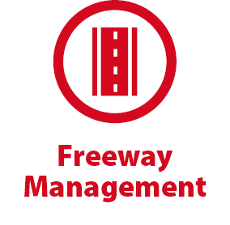
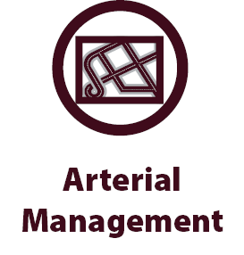
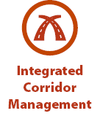



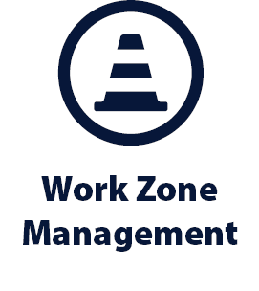
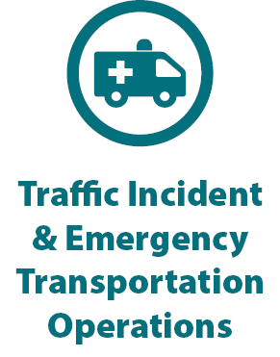
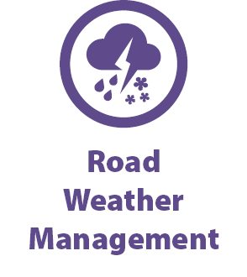

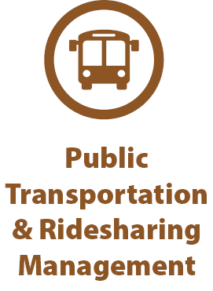
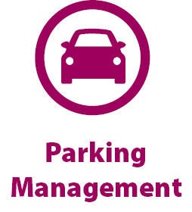
Examples of TSMO Strategies (ES)
Notes:
This slide illustrates the array of operational strategies that fall under the TSMO umbrella that can be used individually or in combination with each other. This list is not exhaustive, but it highlights the key buckets of strategies that are priorities for many agencies.
Examples of other TSMO strategies include:
Traffic signal coordination
Transit signal priority
Special event management
Congestion pricing
Active transportation and demand management
Connected/automated vehicles
Completing multimodal networks

Slide 6
TSMO Supports Many Department of Transportation Goals (ES)
Reduced congestion
Smoother and more reliable traffic flow
Improved safety
Less wasted fuel and cleaner air
Increased economic vitality
Improved quality of life
More efficient use of resources
Notes:
This slide highlights some common DOT goals that TSMO strategies support.

Slide 7
Increased Need to Collaborate (ES)
Construction programs prioritize completing quality projects on time, and within budget. They also value moving people and goods through their work zones safety and efficiently. TSMO can support these aims.
Through collaboration, TSMO and construction programs can help improve:
Timeliness, cost effectiveness, and quality of projects
Safety
Mobility
Public relations
Notes:
Construction programs prioritize completing quality projects on time, and within budget. They also value moving people and goods through their work zones safety and efficiently. TSMO can support these aims.
Through collaboration, TSMO and constructions programs can help improve:
Timeliness, cost effectiveness, and quality of projects. TSMO strategies support reduced congestion, enhanced safety, and public information support work zone safety and the ability of the contractor to meet schedule, budget, and quality objectives for a project by reducing work zone conflicts and allowing equipment and personnel access to the work zone.
Safety of both the traveler and road worker. Many TSMO strategies can help improve safety in and around work zones.
Mobility. Improving mobility for people and goods is a primary aim of TSMO and an end goal of construction. TSMO supports the efficient and safe movement of people and goods in a work zone.
Public relations. TSMO strategies that disseminate timely and accurate traveler information to the public help maintain positive relationships with the public.

Slide 8
How can TSMO Support Construction? (ES)
Strengthen work zone transportation management plans (TMP)
Enhance worker safety with speed monitoring and speed control
Improve traveler safety by smoothing traffic flow and alerting travelers to lane shifts and queues
Reduce congestion to facilitate timely delivery of materials
Monitor traffic and respond quickly to incidents or problems
Reduce impacts of construction through signal timing changes
Support accelerated construction methods
Notes:
Work zones naturally create a disruption in traffic flow, reducing reliability and increasing the risk to safety. TSMO can minimize this disruption by minimizing safety risks and impacts to reliable travel times. Some of the specific benefits that TSMO can offer to construction are:
Work zone TMPs include traffic control, transportation operations, and public information. TSMO offers strategies to support each one of these elements.
Strategies such as speed monitoring, speed control, and traveler information in a work zone can improve driver awareness, increasing worker safety
TSMO strategies can increase mobility and safety by smoothing traffic flow and alerting travelers to lane shifts and queues. TSMO strategies can detect current traffic conditions and dynamically adjust to them using real-time traffic control methods, such as queue-warning systems, dynamic lane merge systems, variable speed limits, lane control signs, and real-time traveler information systems, which have proven highly effective in work zones.
TSMO strategies can support the delivery of necessary construction materials by mitigating congestion.
Traffic management centers (TMCs) can remotely monitor construction activity and travel mobility through multiple work zones simultaneously. This allows TMC operators to quickly and efficiently identify and address incidents or other issues
Traffic incident management (TIM) strategies can provide benefits during construction through expanded motorist assistance patrols, pre-positioned tow and recovery vehicles, and rapid response to incidents near or in the work zone. TIM works to safely and quickly clear incidents and return traffic to its normal flow, reducing congestion and the risks of secondary incidents
Arterial work zones or freeway projects that impact traffic on arterial roadways can benefit from adjusted signal timing during construction to reduce impacts to automobiles, pedestrians, and bicyclists
TSMO strategies support accelerated construction methods that reduce construction time. For example, full closures (in one or both directions) can lead to more efficient project delivery while minimizing extended disruptions to the public. TSMO analytical tools can help assess the feasibility of full closure and evaluate alternate routing. TSMO strategies can also manage congestion and access to enable the timely delivery of materials to the project site.
Although not mentioned on the slide, construction staff often rely on accurate models of congestion and queueing created by work zone or TSMO staff to generate road user costs. These user costs support contract incentives and disincentives for keeping lanes open and early construction completion.
Agencies can also incorporate TSMO into emergency relief activities where traffic solutions and debris removal must be quickly coordinated across the system.

Slide 9
How Can Construction Support TSMO? (ES)
Incorporating TSMO infrastructure and systems in roads and bridges
Setting up work zones to facilitate movement of emergency vehicles and quick clearance of incidents
Coordinating construction schedules and lane closures to manage impacts
Alerting traffic management centers and other sources for traveler information of lane closures, speed changes, and worker presence
Considering delay in work zone planning
Notes:
Construction practices can also support the TSMO goals of safe, efficient, and reliable movement of people and goods. A few ways to achieve this include
Incorporating TSMO infrastructure and systems, such as variable message signs, cameras, fiber-optic cables, in roads and bridges
Setting up work zones to facilitate movement of emergency vehicles and quick clearance of incidents
Coordinating construction schedules and lane closures with other construction projects that may be in the region or corridor to help reduce overall congestion due to work zones. By coordinating with TSMO staff, construction project managers can help with efforts to disseminate information about work zones out to the public.
Alerting traffic management centers and other sources for traveler information of lane closures, speed changes, and worker presence can support managing transportation near and through work zones.
Considering delays in work zone planning to a less congested day, week, or month can help optimize travel.

Slide 10
Areas for Collaboration Between TSMO and Construction (ES)
Developing transportation management plans for work zones
Implementing transportation management strategies ahead of construction (e.g., dynamic lane use)
Disseminating traveler information
Developing travel demand management programs
Identifying fiber or other communications needs
Coordinating multiple construction projects along a corridor or in a region
Coordinating general and ITS contractors
Any other opportunities?
Notes:
There are many areas for TSMO and construction professionals to collaborate. TSMO professionals can provide expertise in developing traffic management plans for the work zone and can support implementing traffic management strategies ahead of the project. For example, variable message signs or lane-use indicators may be installed ahead of construction to disseminate information to travelers. TSMO professionals can also work with the construction team to identify methods for diverting or reducing demand on the facility during construction.
It is also important for construction and TSMO professionals to discuss and plan for any fiber or other utilities that may need to be installed in the road during construction.
TSMO professionals have also helped to coordinate the timing of construction projects across a region to avoid adverse impacts to travelers. Coordinating the timing of overall projects can be challenging and should address coordinating lane closure schedules across projects, as appropriate.
Additionally, the contractor responsible for the large infrastructure project may be different than the one responsible for installing ITS. Coordination ahead and during the construction project will be helpful to avoid any unnecessary delays or costs.
A good approach for collaboration between TSMO and construction is to include TOC/TMC personnel in project meetings and to refer traffic management plans to TSMO personnel for review. This may require allocating TSMO personnel and work hours to monitor and participate in the project throughout construction.
(Ask participants if they agree with the examples provided and if they have any other high-level examples of how TSMO and construction professionals could collaborate.)

Slide 11
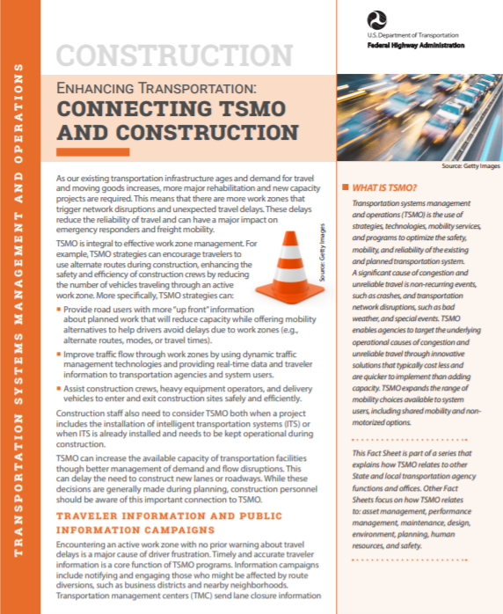
Next Steps (ES)
Bring TSMO and construction leaders together within your agency to identify areas of common interest and mutual objectives.
Find out how TSMO strategies are already supporting construction goals.
Discuss where TSMO can make an even greater impact on construction goals.
Begin joint initiatives to improve operations, safety, and construction.
To learn more: https://ops.fhwa.dot.gov/publications/fhwahop18092/fhwahop18092.pdf
Source: FHWA
Notes:
Bring TSMO and construction leaders together within your agency to identify areas of common interest and mutual objectives. This can build understanding of and appreciation for the priorities, concerns, and issues addressed in both construction and TSMO.
Find out how TSMO strategies are already supporting construction goals. Exploring TSMO strategies together helps personnel from both areas understand and explore the relationship between goals and the ways TSMO strategies can be used to advance those goals.
Discuss where TSMO can make an even greater impact on construction goals. With a better understanding of the needs of project construction, TSMO personnel can look for ways to increase the benefits of incorporating TSMO strategies into construction processes.
Begin joint initiatives to improve operations, safety, and construction.
Note that there are additional resources listed at the end of this presentation, including a fact sheet on connected TSMO and construction which is available at https://ops.fhwa.dot.gov/publications/fhwahop18092.

Slide 12
End of Executive Summary

Slide 13
Goals of the Presentation
Increase awareness and understanding of TSMO
Explore ways TSMO and construction can support each other
Provide examples of coordination between TSMO and construction
Discuss opportunities to enhance collaboration between TSMO and construction personnel
Notes:
This presentation is intended to increase the awareness and understanding of transportation systems management and operations among DOT personnel working in construction. It explores the ways TSMO and construction programs complement each other in terms of shared goals and activities and provides examples of how DOTs have worked together to bring TSMO strategies into construction to enhance safety, access, mobility, and project delivery. The presentation is intended to initiate discussion between TSMO and construction personnel to explore opportunities for enhanced collaboration.

Slide 14
Presentation Overview
What is TSMO?
Connecting TSMO and construction overview
Examples of connecting TSMO and construction
Overcoming challenges to collaboration
Next steps
Notes:
We begin this presentation by describing transportation systems management and operations, or TSMO.
We’ll then discuss reasons for connecting TSMO and maintenance. This will be followed by a review of specific examples.
Finally, we’ll conclude by reviewing the challenges and next steps in connecting TSMO and maintenance.

Slide 15
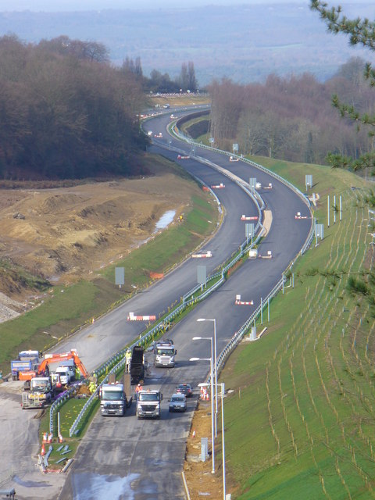
TSMO Can Support Construction Goals
On-schedule projects
Cost effective/on-budget projects
Quality
Work zone safety
Work zone mobility
Public relations and information
Source: FHWA
Notes:
Before we dive into understanding what TSMO is, it’s important to know that TSMO can support many construction goals. It can help keep construction projects on schedule and on budget, and ensure that the project can meet the quality requirements of the agency and public. It also supports work zone safety and mobility and public relations associated with construction work zones or construction phasing. You will see the slide again after we learn more about TSMO so that we can spend time exploring how TSMO supports construction.
This Photo by Unknown Author is licensed under CC BY-SA

Slide 16
What is TSMO?

Slide 17
Definition of TSMO
Integrated [set of] strategies to optimize the performance of existing infrastructure through implementation multimodal and intermodal, cross-jurisdictional systems, services, and projects designed to preserve capacity and improve security, safety, and reliability of the transportation system.*
* Title 23 of the U.S. Code § 101 (a)(30)(A) and FHWA website: https://ops.fhwa.dot.gov/tsmo/
Notes:
Before going further, it is important to define TSMO for new audiences:
TSMO is an integrated set of strategies to optimize the performance of existing infrastructure through the implementation of multimodal and multi-jurisdictional systems, services, and projects designed to preserve capacity and improve security, safety, and reliability of the transportation system.
The goal here is to get the most performance out of the transportation facilities we already have. TSMO is the use of strategies, technologies, mobility services, and programs to optimize the safety, mobility, and reliability of the existing and planned transportation system.

Slide 18
Characteristics of Transportation Systems Management and Operations (TSMO)
Offers an integrated set of strategies to optimize operational performance of the existing transportation system
Approaches performance from a systems perspective:
  Spans corridors, facilities, jurisdictions, modes, and agencies
Helps agencies balance supply and demand on the system and provide flexible solutions to manage dynamic conditions
Can complement capacity projects, or in some cases can provide lower cost, faster alternatives
Notes:
TSMO is an integrated set of strategies to optimize the operational performance of the existing transportation system.
Note: The definition at the top of the slide is an abridged version of the Federal Highway Administration’s (FHWA) TSMO definition found here: https://ops.fhwa.dot.gov/tsmo and at 23 USC 101 (a) (30).
TSMO approaches performance from a systems perspective.
Spans corridors, facilities, jurisdictions, modes, and agencies
TSMO takes a holistic approach to managing performance that looks beyond a single corridor (e.g., are changes to a specific corridor causing a mobility issue nearby?), jurisdiction (e.g., are management systems coordinated across jurisdictional boundaries?), mode (e.g., are we using all modes optimally to meet our performance goals?), and agency (e.g., how can we improve collaboration with law enforcement or transit agencies to improve performance?).
Helps agencies balance supply and demand on the system and provide flexible solutions to manage dynamic conditions.
Example TSMO strategies include ramp metering, managed lanes, and congestion pricing.
TSMO can complement capacity projects or can provide lower-cost, faster alternatives in some cases.
TSMO seeks to provide lower-cost alternatives to capacity projects when operational strategies may produce equal or better results – or when operational strategies may be able to produce results faster. It does not seek to eliminate capacity projects in cases where a capacity project is the best solution. Rather, TSMO provides agencies with more options.

Slide 19
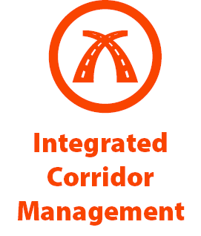
Examples of TSMO Strategies
Source: FHWA.
Notes:
This slide illustrates the array of operational strategies that fall under the TSMO umbrella that can be used individually or in combination with each other. This list is not exhaustive, but it highlights the key buckets of strategies that are priorities for many agencies.
Examples of other TSMO strategies include:
Traffic signal coordination
Transit signal priority
Special event management
Congestion pricing
Active transportation and demand management
Connected/automated vehicles
Completing multimodal networks
Intelligent transportation systems (ITS) components can support all these TSMO strategies. ITS covers a variety of technologies to monitor, evaluate, and manage transportation systems to enhance efficiency and safety. It should be noted that TSMO does not equate to ITS; many strategies support TSMO that do not involve an ITS component.
TSMO strategies can be categorized into three overarching areas: incident or event management, traffic management, and demand management strategies. The next three slides highlight strategies in each of these areas.

Slide 20
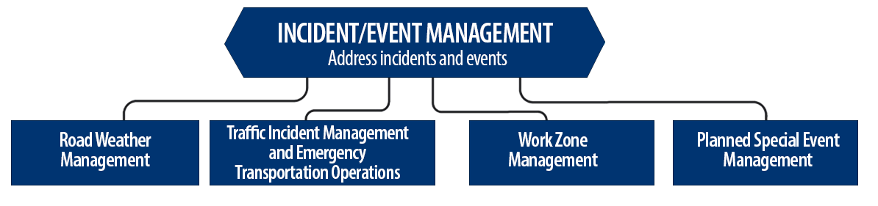
Incident/Event Management Strategies
Source: FHWA.
Notes:
Incident and event management includes several strategies that address major sources of travel-time unreliability.
Incident and event management strategies include road weather management, traffic incident management and emergency transportation operations, work zone management, and planned special event management.
Road weather management activities include creating hazardous weather traffic operations response plans, implementing variable speed limits, detecting hazardous weather conditions, disseminating weather and warnings to travelers through dynamic signs and systems, providing emergency truck and parking facilities and emergency parking information, and implementing vehicle restrictions.
Traffic incident management and emergency transportation operations activities include establishing traffic incident management teams, conducting after action reviews, staging tow trucks in strategic areas, providing roadway safety patrols, integrating computer-aided dispatch into transportation management centers, pre-establishing towing service agreements, co-locating dispatching units, developing quick clearance goals, pre-planning detour routes, implementing shoulder running, deploying adaptive ramp metering, providing variable speed limits, implementing dynamic lane-use controls, deploying network surveillance cameras or detectors, implementing incident traffic signal timing plans, enacting legislation, and integrating traffic management centers with law enforcement dispatch and emergency centers.
Work zone management activities include coordinating maintenance and construction activities, implementing queue length detection, deploying network surveillance cameras or detectors, implementing variable speed limits, supporting dynamic lane merging, implementing dynamic lane-use controls, deploying temporary ramp metering, and implementing dynamic warning systems.
Planned special event management activities include activating special event timing plans, deploying adaptive ramp metering, implementing variable speed limits, using hard shoulder running, activating dynamic transit fare reduction, implementing reversible lanes, supporting dynamic lane-use controls, establishing dynamic pricing, deploying network surveillance cameras or detectors, activating dynamic wayfinding, and conducting after action reviews.
Source: FHWA, Integrating Travel Time Reliability into Transportation System Management: Final Technical Memorandum
https://ops.fhwa.dot.gov/publications/fhwahop19035/index.htm

Slide 21
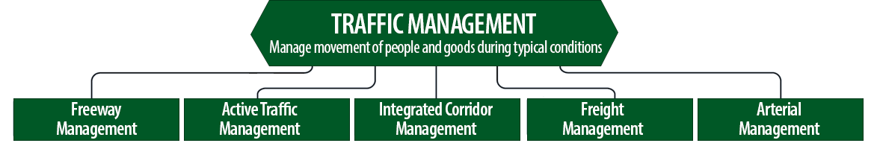
Traffic Management Strategies
Source: FHWA.
Notes:
While incident or event management strategies address atypical events that cause travel-time unreliability, traffic management strategies manage the movement of people and goods during everyday conditions. Even during typical conditions, fluctuations in travel demand can lead to unreliable travel conditions. Traffic management strategies allow the transportation network to adapt to unreliability, including variations in travel demand.
Traffic management strategies include freeway management, active traffic management, integrated corridor management, freight management, and arterial management.
Freeway management activities include implementing traffic surveillance cameras or detectors, using high-occupancy lanes, implementing adaptive ramp metering, deploying hard shoulder running, implementing variable speed limits, deploying dynamic lane-use controls, and constructing physical operations improvements such as overpass widening, curve corrections, or adding auxiliary lanes.
Active traffic management activities include adopting adaptive ramp metering, implementing adaptive traffic signal control, using dynamic lane reversal, implementing dynamic lane-use controls, deploying dynamic merge control, implementing temporary shoulder running, using variable speed limits, deploying queue length detection, providing transit signal priority, and implementing dynamic warning signs.
Integrated corridor management activities include implementing network surveillance cameras or detectors, conducting access management and driveway access controls, implementing adaptive ramp metering, deploying adaptive signal control, deploying transit signal priority, installing queue jumping lanes, providing traveler information for alternative modes, and deploying emergency vehicle preemption.
Freight management activities include implementing roadside truck electronic screening and clearance, implementing truck signal priority, using truck parking management systems, installing truck climbing lanes, and implementing freight loading zone policies.
Arterial management activities include installing queue jumping lanes, deploying transit signal priority, supporting emergency vehicle preemption, implementing network surveillance cameras or detectors, implementing access management and driveway access controls, providing enhanced bicycle and pedestrian crossings, establishing a transportation management center, deploying enhanced traffic signal operations, implementing transit-only lanes, implementing truck traffic signal priority, designing for complete streets, adding capacity for critical movements, reducing travel speeds, providing automated enforcement, and conducting operations asset management.
Source: FHWA, Integrating Travel Time Reliability into Transportation System Management: Final Technical Memorandum
https://ops.fhwa.dot.gov/publications/fhwahop19035/index.htm

Slide 22
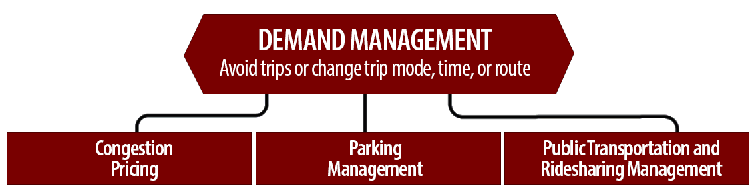
Demand Management Strategies
Source: FHWA.
Notes:
Demand management strategies reduce underlying demand by helping travelers avoid trips or change the mode, timing, or route of trips. This makes nonrecurring congestion less likely to occur and improves travel-time reliability.
Demand management strategies include congestion pricing, parking management, and public transportation and rideshare management.
Congestion pricing activities include implementing dynamic pricing, variable pricing by lane, segment, and time of day or day of week; establishing dynamic transit fare reductions; and deploying managed lanes for high occupancy.
Parking management activities include deploying dynamically priced parking; implementing dynamic parking, wayfinding, reservations, and capacity; deploying dynamic overflow transit parking; implementing electronic payment systems and shared-use parking; and providing incentives to use underutilized parking facilities.
Public transportation and ridesharing management activities include implementing dynamic ridesharing, implementing transit signal priority, using queue-jump lanes at signalized intersections, deploying electronic fare collection and integration, and implementing dynamic surveillance and security.
Source: FHWA, Integrating Travel Time Reliability into Transportation System Management: Final Technical Memorandum
https://ops.fhwa.dot.gov/publications/fhwahop19035/index.htm

Slide 23
TSMO Is a “Way of Thinking” That Supports State Departments of Transportation (DOTs) Missions
“We provide safe, reliable and cost-effective transportation options to improve communities and economic vitality for people and businesses.”
Washington State DOT mission, Our Strategic Plan, https://wsdot.wa.gov/about/secretary-transportation/our-strategic-plan
“To provide the best multi-modal transportation system for Colorado that most effectively and safely moves people, goods, and information.”
Colorado DOT mission, About CDOT, https://www.codot.gov/about/mission-vision
Notes:
TSMO leverages technology, a toolbox of strategies, and engineering solutions to maximize system performance; however, TSMO ultimately involves a way of thinking or a mindset focused on determining the best way to optimize the mobility and reliability of the existing system with limited resources.
TSMO can be thought of as a way of thinking and operating in order to get the most performance out of the transportation network while only building as much as is needed.
The principles of TSMO directly support the missions of many State DOTs, as these examples show.
NOTES:
States can insert their own mission statement here for effect or can leave these in.
Presenters can emphasize the connections between TSMO definition and their specific Mission statement, such as safety, reliability, cost-effective, multimodal, customer’s needs/satisfaction, etc.

Slide 24
TSMO Supports Many State and Local DOT Goals
Reduced congestion
Smoother and more reliable traffic flow
Improved safety
Less wasted fuel and cleaner air
Increased economic vitality
Improved quality of life
More efficient use of resources
Notes:
Here are some common goals in state and local transportation agencies that TSMO strategies support. This list is not exhaustive, but intended to show that TSMO support a range of mission-critical goals. Examples of how TSMO supports these goals are shown on the next slide.

Slide 25
Example TSMO Strategies that Support DOT Goals
TSMO Strategies |  | Goals
Traffic signal coordination, congestion pricing, demand management |  | Reduced congestion
Traveler information, multi-modal coordination, peak-period variable lane use |  | Smoother and more reliable traffic flow
Alternate routes, smart work zones, real-time traffic control, work zone traffic incident management (TIM) |  | Improved traveler and worker safety
Notes:
TSMO strategies that support some common DOT agency goals are shown here. Many of these strategies support more than one goal, but here are some key examples.

Slide 26
TSMO State of the Practice
Application of TSMO has accelerated in agencies across the country over the past 5-10 years
Recognition of TSMO’s value has grown, leading to a variety of approaches for advancing TSMO in agencies. For example:
  Establishing a TSMO division or office
  Formalizing a TSMO program
  Integrating TSMO throughout the agency
  Establishing a TSMO committee
  Identifying TSMO champions or liaisons
  Conducting a TSMO Capability Maturity Model (CMM) self-assessment
  Developing a TSMO program plan
Notes:
TSMO as a more formal discipline has gained momentum in recent years. Recognition of the importance of TSMO has accelerated in the past five to ten years (as of year of publication of this presentation, 2022).
Key focus areas for agencies during this time have been adapting their culture, processes, expertise, and, in some cases, organizational structures to promote TSMO and a more operationally focused mindset. Agencies approach this differently depending on their unique context and needs. Several examples of key strategies agencies have used to advance TSMO within their organizations are shown here.
Central to all of these organizational approaches is 1) strong support from senior leadership, 2) a champion or champions who understand and promote TSMO throughout the agency, and 3) an openness to learning and cooperation among functions or divisions within an agency.
A TSMO capability maturity model self assessment is a framework developed to help agencies evaluate their current capabilities in the area of TSMO and identify steps for improving their TSMO capabilities. The self-assessment can be accessed at: http://aashtotsmoguidance.org/. There are also other capability maturity frameworks that FHWA has developed to support the implementation of TSMO. More can be learned about those frameworks at: https://ops.fhwa.dot.gov/tsmoframeworktool/index.htm.

Slide 27
Resources on TSMO
What is TSMO? (frequently asked questions): https://ops.fhwa.dot.gov/tsmo
Organizing and Planning for Operations web page: https://ops.fhwa.dot.gov/plan4ops
Communicating TSMO web page: https://ops.fhwa.dot.gov/plan4ops/focus_areas/communicating_tsmo.htm
National Operations Center of Excellence (NOCoE) Website: https://www.transportationops.org/
Enhancing Transportation: Connecting TSMO and Construction, Factsheet: https://ops.fhwa.dot.gov/publications/fhwahop18092
Notes:
While these slides provide a comprehensive, high-level summary of TSMO, participants who are looking for more details and information to share with their staff can visit these virtual resources.

Slide 28
Connecting TSMO and Construction Overview

Slide 29
What Is Meant by Construction?
Construction includes:
  Building and delivery of projects
  Work zone safety and mobility
  Construction quality
  Project supervision and staffing
  Construction administration
  Contracting methods
  Utilities
Notes:
This is a list of common construction program elements. It provides a general context for what we are talking about when we use the term construction in this presentation.
Building and delivery of projects. The actual building of a project is the primary focus of construction.
Work zone safety and mobility. Work zone safety, including the safety of workers and the public and the ability to maintain mobility in and around the work zone, is a priority element of transportation facility construction.
Construction quality. Monitoring and delivery of a quality project.
Project supervision and staffing. These are critical aspects that affect project management.
Construction administration brings together key elements of project delivery.
Contracting methods, including alternative methods such as design-build, can facilitate timely and cost-effective project delivery.
Utilities. Coordinating with third-party utilities and other affected parties is critical to project cost and schedule.
Is there anything else to consider when discussing construction?

Slide 30
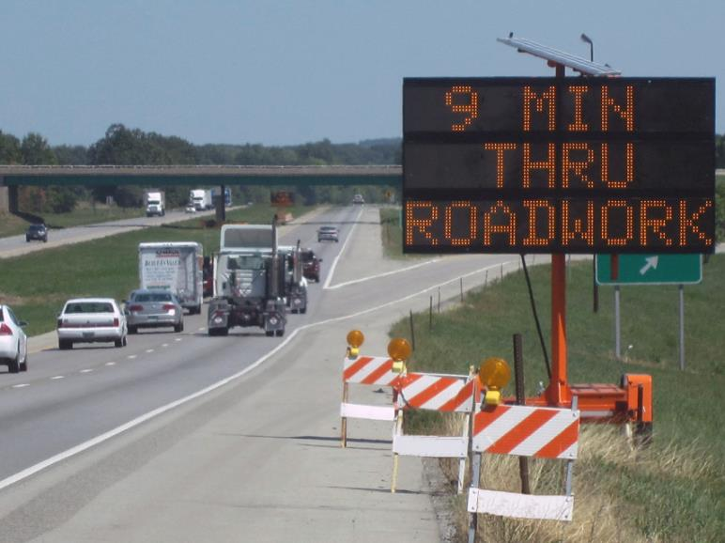
TSMO Strategies that Support Work Zone Safety
Smart work zone traffic control
  Queue detection and warning
  Dynamic lane merge systems
  Variable speed limits
Work zone TIM
Real-time traveler information
Work zone speed management
Intelligent transportation system (ITS) applications (early construction)
Source: FHWA.
Notes:
Here are some examples of TSMO applications that can enhance safety in and through a construction area.
Smart work zone traffic control. Smart work zone systems use computers, sensors, and communications to monitor real-time traffic flow. They are portable and can be moved to meet project needs to monitor and manage traffic through the work zone.
Queue detection and warning systems. Part of a smart work zone system, this application detects work zone-related congestion or slowing and warns drivers in advance of the queue to reduce the occurrence of rear-end crashes.
Dynamic lane-merge systems. This technology monitors real-time traffic at merge points and directs traffic to follow early or late merge strategies through the use of changeable message boards to minimize delay and improve safety.
Variable speed limits. Variable speed limits use dynamic or changeable speed limit signs to apply speed limits in and approaching a work zone based on the conditions and activities in the work zones.
Work zone TIM. Preplanned traffic incident management is used to anticipate incident response needs in the construction area. This includes access to and from the scene, coordination with construction personnel, identification of resources and diversion routes, and other considerations related to incidents in or near the work zone.
Real-time traveler information. Traveler information can be provided through dynamic message boards, 511, websites, and advisory radio to help travelers make informed decisions about travel through or around the work zone.
Work zone speed management. This can include variable speed limits, mentioned above. It can also include automated enforcement using photo radar or drone enforcement, law enforcement personnel assigned to the work zone, and automated speed advisory systems.
Intelligent transportation system (ITS) applications (early construction). One strategy that should be considered to enhance safety and reduce the cost of temporary TSMO applications it to phase ITS and other TSMO applications early in the project to support safety. This might include variable message sign or dynamic lane management that can be used during construction to support detours, incident management, or lane shifts. If the project is the reconstruction of an existing facility with ITS devices, it is important to ensure that these devices remain functional and are maintained throughout construction.
Photo provided by Joe Gregory, FHWA.

Slide 31
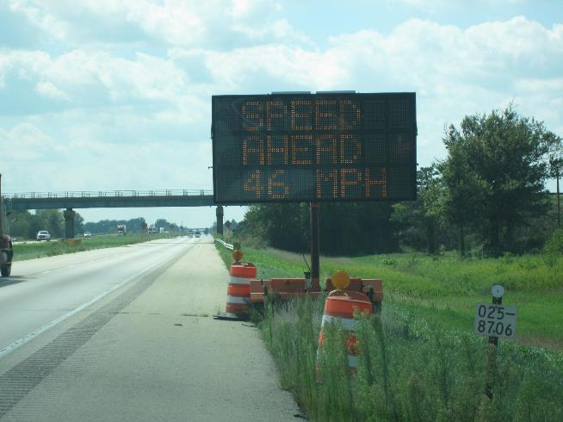
TSMO Strategies that Support Work Zone Mobility
Smart work zones
Work zone TIM
Traveler information about delay and alternate routes
Rideshare programs
Active transportation and demand management
Work zone access control
Regional coordination of construction projects
Source: FHWA.
Notes:
Here are some examples of TSMO applications that can enhance mobility in and through a construction area.
TSMO strategies can be used to encourage travelers to use alternate routes during construction, enhancing mobility and safety by reducing the number of vehicles traveling through an active work zone. TSMO strategies can:
Manage traffic flow through smart work zone systems that monitor traffic in real time and adjust variable speed limits or lane merge strategies to minimize delay.
Manage and clear incidents safely and quickly through work zone traffic incident management plans and strategies.
Provide road users with advance information about planned work that will reduce capacity while offering mobility alternatives to help drivers avoid delays due to work zones (e.g., alternate routes, modes, or travel times)
Support mobility through rideshare programs, which may also reduce traffic through the construction area
Improve traffic flow through work zones by using dynamic traffic management technologies and providing real-time data and traveler information to transportation agencies and system users
Assist construction crews, heavy equipment operators, and delivery vehicles to enter and exit construction sites safely and efficiently
TSMO staff can also help coordinate construction projects across the region to limit disruptions to the public traveling within a region

Slide 32
TSMO Strategies that Support Traveler Information and Public Relations
Communicating early and frequently, using multiple types of media, on changes to road conditions
Sharing construction information with traveler information applications
Requiring construction contractors to provide near-real-time travel-time updates on dynamic message signs (DMS) near work zones
Partnering with local agencies to push automated route notifications to participants of local text message alert systems
Notes:
Here are some examples of TSMO applications that can support traveler information on construction projects.
Construction projects often dedicate staff and resources to public relations and traveler information programs that can be supported by TSMO strategies. Coordination between traffic management centers (TMCs) and project management can leverage existing TSMO applications to support construction-related public information efforts. The effectiveness of the these strategies is enhanced by:
Communicating early and frequently, via multiple types of media, on changes to road conditions such as road or lane closures and speed limit changes. Information can be communicated in advance of changes in traffic control or in real-time using 511 phone information, websites, dynamic message signs, and media updates.
Sharing construction information with traveler information applications. Apps such as Waze or Google Maps are very interested in sharing current traffic control and work zone information with their users. These can be provided to the apps in advance or in real-time.
Requiring construction contractors to provide near-real-time travel time updates on dynamic message signs (DMSs) near work zones. Monitoring and updating traffic information should be specified in contract documents.
Partnering with local agencies to push automated route notifications to participants of local text message alert systems. Partner agencies use different notification systems with different subscribers. Sharing this information across systems extends the dissemination of information to a broader user base.

Slide 33
TSMO Strategies that Support Construction Schedule, Cost, and Quality
Traffic management for accelerated construction methods
TIM
Traffic signal coordination
Freight management
Road weather management
Active transportation and demand management
General and ITS contractor coordination
Notes:
TSMO strategies can support the fundamental goals of on-time, on-budget, and quality construction through effective traffic management, enhanced construction access, and reduced conflicts between system operations and construction. Several TSMO strategies that can support these goals are shown here.
TSMO strategies support accelerated construction methods that reduce construction time. For example, full closures (in one or both directions) can lead to more efficient project delivery while minimizing extended disruptions to the public. TSMO analytical tools can help practitioners assess the feasibility of full closure and evaluate alternate routing. TSMO also supports construction that is not accelerated.
Traffic incident management (TIM) plans are often developed as part of a project’s method of handling traffic. Building on existing TIM programs and plans can be cost effective and can leverage existing relationships between the DOT and response agencies
Working with TSMO and traffic operations personnel to develop project- and construction phase-specific signal coordination plans can support construction access and safety
Freight management may provide opportunities to phase projects more aggressively by limiting lane widths and managing trucks through a project work area
Road weather management supports construction scheduling by providing historic data and predictive weather in the construction area
Managed lanes can be used quickly and safely to close and open lanes in a project work area to support work zone traffic management
Similar to managed lanes, active transportation and demand management applications can support work zone traffic management, closures, detours, and access
Coordinating the deployment of ITS equipment, typically done by a separate contractor, with the general construction contractor is an important strategy in reducing costs and keeping the total project on schedule. ITS to support TSMO strategies should be planned for early in the project

Slide 34
Areas for Collaboration Between TSMO and Construction
Developing transportation management plans for work zones
Implementing transportation management strategies ahead of construction (e.g., dynamic lane use)
Disseminating traveler information
Developing travel demand management program
Identifying fiber or other communications needs
Coordinating multiple construction projects along a corridor or in a region
Coordinating general and ITS contractors
Any other opportunities?
Notes:
There are many areas for TSMO and construction professionals to collaborate. TSMO professionals can provide expertise in developing transportation management plans for the work zone and can support implementing transportation management strategies ahead of the project. New variable message signs or lane use indicators may be installed ahead of the construction to disseminate information to travelers. TSMO professionals can also work with the construction team to identify methods for diverting or reducing demand on the facility during construction.
It is also important for construction and TSMO professionals to discuss and plan for any fiber or other utilities that may need to be installed in the road during construction.
TSMO professionals have also helped to coordinate the timing of construction projects across a region to avoid adverse impacts to travelers. Coordinating the timing of overall projects can be challenging and should address coordinating lane closure schedules across projects as appropriate.
Additionally, the contractor responsible for the large infrastructure project may be different than the one responsible for installing ITS. Coordination both in advance of and during the construction project will be helpful to avoid any unnecessary delays or costs.
A good approach for collaboration between TSMO and construction is to include TOC/TMC personnel in project meetings and to refer traffic management plans to TSMO personnel for review. This may require allocating TSMO personnel and work hours to monitor and participate in the project throughout construction.
(Ask participants if they agree with the examples provided and if they have any other high-level examples of how TSMO and construction professionals could collaborate?)

Slide 35
Integrating TSMO in Construction
Formally include TSMO strategies in construction contracts, agency guidance materials, and other documents
Informally integrate TSMO into construction processes through ad hoc means
Include TSMO personnel in work zone process reviews and work zone transportation management plan development
Include TSMO in project partnering workshops to share the benefits and opportunities of TSMO
Provide TSMO training to construction staff or contractors
Coordinate with ITS vendors to integrate TSMO assets
Notes:
There are several ways to integrate TSMO into construction activities. Those include the bullets below.
Formally including TSMO into the construction process can take the form of including specific strategies in contract documents; work zone standards, plans, and permits; and guidance manuals
Informally including TSMO in construction processes can occur through ad hoc means, such as personal relationships between TSMO and construction personnel or TSMO champions in construction
Integrating TSMO in construction can also mean including TSMO personnel in work zone process reviews and work zone transportation management plan development.
TSMO can be included in project partnering workshops to share the benefits and opportunities of TSMO
TSMO training and specific strategy training, such as TIM training, can be used to support the integration of TSMO in construction. This can be general or project specific
Coordinate with ITS device and software vendors to integrate TSMO assets into construction projects
Although not mentioned on the slide, construction staff often rely on accurate models of congestion and queueing created by work zone or TSMO staff to generate road user costs. These user costs support contract incentives and disincentives for keeping lanes open and early construction completion.
Agencies can also incorporate TSMO into emergency relief activities where traffic solutions and debris removal must be quickly coordinated across the system.
(This would be a good place for interactive discussion on other ideas for integrating TSMO in construction.)

Slide 36
Examples of Connecting TSMO and Construction

Slide 37
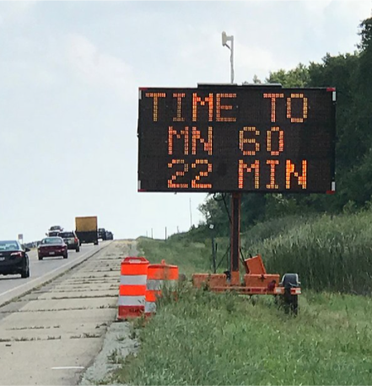
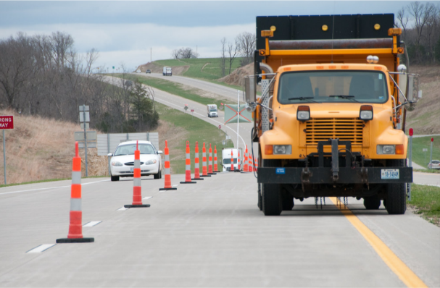
Work Zones and Transportation Management Plans
Geometric strategies
Contract or job special provisions
ITS and smart work zone solutions
Communication
Coordination with other projects, agencies, etc.
Source: Street Smart Rental
Source: Missouri DOT
Notes:
Work zones can trigger network disruptions and unexpected travel delays. These delays reduce the reliability of travel and can have a major impact on emergency responders and freight mobility. Work zones also need to be designed to be as safe as possible for both the workers and the travelling public. TSMO is integral to effective work zone management. This starts with design, when transportation management plans are initially developed…but as construction staff know, these plans often get updated and revised once a project starts to respond to actual and fluctuating conditions.
There are many TSMO strategies that construction staff can consider, such as:
Keep traffic moving safety and smoothly by choosing appropriate work zone strategies: reducing lane closures, using shoulders to maintain number of lanes, alternate routes, or full closures. Keep in mind that bicyclists and pedestrians should also be considered during work zone design; these users should be offered an accessible alternate route. Incorporate pullout areas for law enforcement emergency responders within the work zone.
Consider appropriate provisions, incentives, or disincentives into the contract; this may include restricting work hours, providing bonuses for early completion, or reducing pay for late completion or for not following the contract.
Using ITS and smart work zone solutions, such as dynamic message signs, variable speed limits, dynamic lane-merge systems, queue detection and warning systems, and temporary ramp meters.
Consider other nearby projects and work zones and coordinate strategies as appropriate.
Communicate with appropriate local agencies and entities that the work zone or project will be affecting and involve the traffic management center (TMC) or public affairs teams to inform the public of upcoming work zones.
Communicate and work with other disciplines; for example, traffic engineers may be able to implement alternative signal timing to be used during active work zone periods
This is by no means a complete list; there are many ways TSMO concepts and strategies can be considered and implemented into effective work zone plans.
Photos:
Travel time message sign – Permitted use under: https://creativecommons.org/licenses/by-sa/4.0/
https://en.wikipedia.org/wiki/Smart_work_zone#/media/File:Travel_Time_System.jpg
Truck/work zone – Permitted use under https://creativecommons.org/licenses/by-nc-sa/2.0/.
https://flic.kr/p/9xJBty

Slide 38
Iowa DOT’s Traffic Critical Project (TCP) Program
Program facilitates safety and mobility in construction work zones
Projects are
identified using a TCP checklist, starting with location in a critical roadway
TCP mitigation includes TSMO strategies
Performance measures are used to evaluate safety and delay
Source: Iowa DOT
Notes:
Traffic Critical Project (TCP) Program – The TCP program facilitates safety and mobility at construction work zones. The TCP program supports Iowa DOT’s TSMO strategic goals of safety, reliability, efficiency, convenience, and coordination. The program is included in the “Traffic Control” chapter of Iowa DOT’s Design Manual. This ensures TCP projects are identified during planning and design and that various mitigation strategies are applied. The Design Manual includes a TCP checklist for projects on interstate and primary highways, available at https://iowadot.gov/design/dmanual/09e-01.pdf.
The TCP program was established to facilitate improving safety and mobility in work zones on Iowa highways. The following vision and mission help guide the program:
Vision: Provide safe, reliable, and efficient travel through construction and maintenance work zones throughout Iowa’s highway system.
Mission: Identify and implement traffic management strategies that address safety and mobility challenges encountered in construction and maintenance work zones.
In support of the TSMO strategic goals of safety, reliability, efficiency, convenience, and coordination, the TCP program’s primary goals include:
Identifying upcoming projects during the planning and design stages that have potential to cause significant safety or mobility impacts
Applying various mitigation strategies to address safety and mobility concerns, including quick recovery from traffic incidents or queueing
Evaluating TCP mitigation efforts to determine if they are reliable, timely, and effective
Developing performance measures that can be used to establish safety goals and travel time delay targets in Iowa and applying performance measures to quantify the safety and mobility impacts of the TCP program
Developing support throughout Iowa DOT for the TCP program by establishing easily understood and implementable program procedures

Slide 39
Iowa DOT TCP Strategies
Work zone monitoring system
Queue warning system
Alternate route system
Travel time system
Variable advisory speed system
Truck entering traffic system
Speed feedback system
Portable DMS with radar system
Dynamic late-merge system
Extra law enforcement
Contractor ingress/egress requirements
Maximum allowable delay specifications
Contraflow operations during peak periods
Notes:
The strategies that Iowa DOT includes for consideration with TCP projects include:
Work zone monitoring system
Queue warning system
Alternate route system
Travel time system
Variable advisory speed system
Truck entering traffic system
Speed feedback system
Portable dynamic message sign (DMS) with radar system
Dynamic late-merge system
Extra law enforcement
Contractor ingress/egress requirements
Maximum allowable delay specifications
Contraflow operations during peak periods

Slide 40
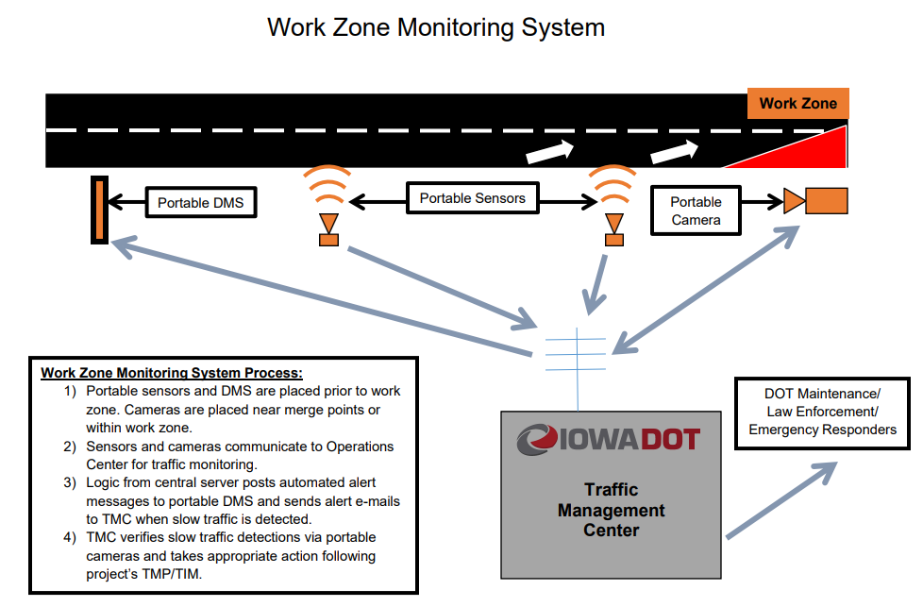
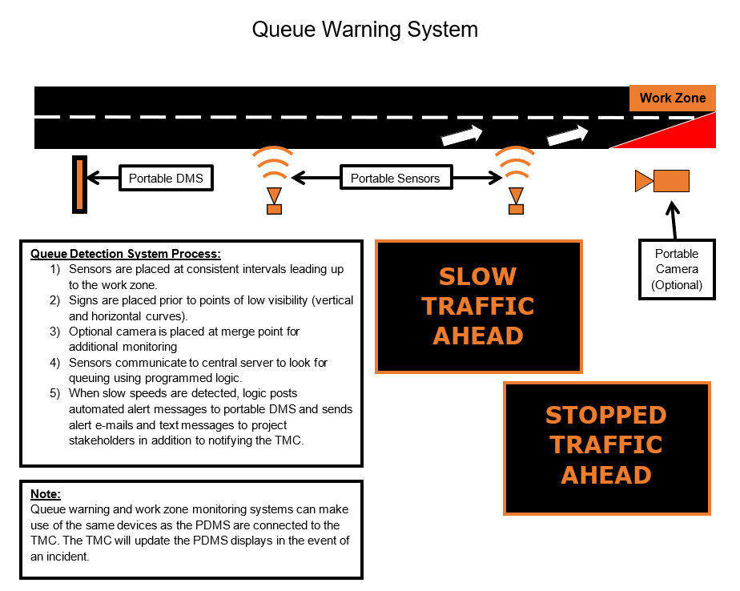
Iowa DOT Intelligent Work Zone Layouts
Source: Iowa DOT
Source: Iowa DOT
Notes:
Iowa DOT provides an overview and diagram for the intelligent work zone strategies used in the TCP program. Here are examples of the overview and layout of two of the systems: work zone monitoring, and queue warning. The text highlights the system process, and the diagram illustrates the layout and application of the system.
In these examples the systems include several devices that work together to achieve the application. In the expanded incident management system, they use a combination of portable DMS, portable traffic detectors, and portable cameras that are integrated with the traffic operations center (TOC). The TOC also coordinates with on-scene law enforcement.
In the queue-warning system diagram, you can see similar devices working to detect the end of the queue and to place warnings on the portable DMS to warn motorists in advance of the end of the queue to slow down.
Additional information on the program can be seen at Iowa DOT Intelligent Work Zones and Traffic Critical Projects (google.com)

Slide 41
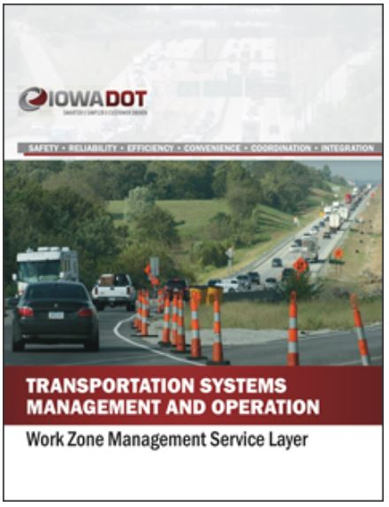
Iowa TSMO Work Zone Service Layer
Identified work zone management objectives for each of the six TSMO goals
Looked at opportunities created by TSMO-based approach
Work zone groups support mobility and safety in work zones
Work zone data and gap analysis
Recommended actions to address gaps
Source: Iowa DOT
Notes:
Iowa DOT’s TSMO Program Plan includes eight service layers. One of the service layers is work zone management. The Work Zone Management Service Layer Plan was completed in 2018 and focuses on the planning and deployment of TSMO strategies to maintain traffic flow and safety through work zones. This applies to both construction and maintenance work zones.
The six TSMO goals are safety, reliability, efficiency, convenience, coordination, and integration.
The plan identified the relationship between work zone management and each of the other seven service layers.
Multiple groups and committees focus on ensuring proper application of temporary traffic control:
Work Zone Traffic Safety Committee
Work Zone Process Review Team
Traffic Critical Projects (TCP) Working Group
Intelligent Work Zone Team
TCPs Mitigation Committee
Specification Committee
Major Projects Group
Roadway Industry Safety Committee
Work Zone Training Group
The plan analyzed current data and monitoring procedures for work zones and completed a gap analysis of work zone management practices across dimensions of TSMO capabilities. This was used to identify specific work zone management initiatives and recommended actions.
The recommended actions are to:
Create a work zone data hub
Determine standard delay in TCP work zones
Hold an annual two-day information-sharing workshop
Create a work zone library
Review the current plan development process and collaboration tools
Transition from managed TCP to in-house TCP

Slide 42
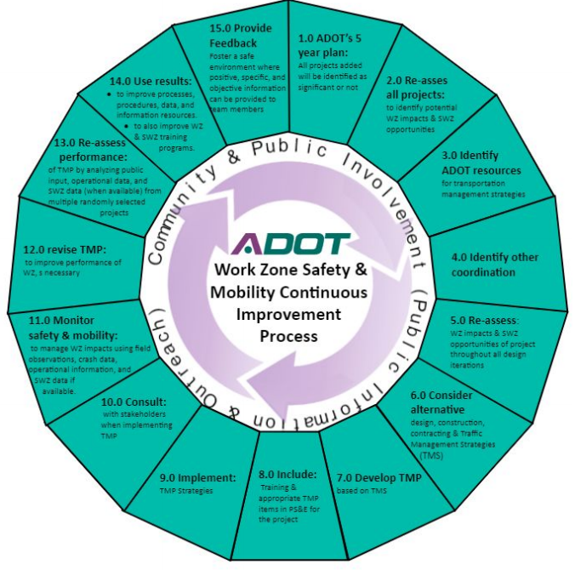
Arizona DOT Work Zone Safety and Mobility
Work Zone Safety and Mobility Committee
Work Zone Safety and Mobility Policy:
  Applies to all construction projects determined to be significant projects
Implementation Guidelines for Work Zone Safety and Mobility
TMP Template for Significant Projects
Source: Arizona DOT
Notes:
The Arizona DOT (ADOT) Work Zone Safety and Mobility Committee, established in 2018, was sponsored by the Deputy Director for Transportation/State Traffic Engineer. It is responsible for continuous improvement of work zone safety and mobility. The committee includes three representatives from the TSMO division. It also includes personnel from planning, project management, communications, environmental, traffic safety, TOC, and many others involved in the project.
The Work Zone Safety and Mobility Policy applies to all construction, maintenance, and procurement projects determined by ADOT to be a significant project as defined in this policy. The ADOT Work Zone Safety and Mobility Policy is available at: https://drive.google.com/file/d/1z3tzYuWAXmOwGQTTDpMviKOzAea1IuNV/view?usp=sharing.
ADOT’s Implement Guidelines for Work Zone Safety and Mobility focus on continuous improvements. The guidelines, which include key activities and tasks associated with construction project work zones and the groups responsible for each within ADOT, is available at: https://azdot.gov/sites/default/files/2019/04/work-zone-safety-and-mobility-implementation.pdf. The figure on the slide shows ADOT’s continuous improvement process for work zone safety and mobility. Activities include reassessing projects for potential wok zone impacts and opportunities for smart work zone tactics, identifying ADOT resources for transportation management strategies, and monitoring safety and mobility within and around the work zone.
ADOT developed a Transportation Management Plan (TMP) Template for Significant Projects. This template has several chapters that focus on TSMO strategies to help manage work zones including motorist information strategies, incident management and enforcement strategies, and stakeholder coordination. The template is available at: https://apps.azdot.gov/files/TSMO/TMP-Template.pdf.

Slide 43

Arizona DOT Work Zone Safety and Mobility Strategies
Motorist information
Incident management and enforcement
Construction TMP strategies
  Limit traffic restrictions
  Examine contract acceleration and construction phasing
Source: @Getty Images
Notes:
ADOT uses several different strategies to manage work zone mobility and safety. These include:
Motorist information strategies such as
Alternate routes and travel time information
Intelligent transportation systems
Corridor or network management strategies, which are intended to optimize traffic flow through the work zone and adjacent roadways.
Public information/public awareness campaign
• Incident Management and Enforcement Strategies
Traffic Operations Center
Emergency Response Team
• Construction TMP Strategies
Limiting traffic restrictions
Environmental strategies
The Arizona Implementation Guidelines for Work Zone Safety and Mobility include:
• Limit traffic restrictions
• Examine contract acceleration and construction phasing
• Communication timing and feedback
• Environmental strategies
See the Guidelines for more information: https://azdot.gov/sites/default/files/media/2021/06/Implementation-Guidelines-for-WZSM-2021.pdf

Slide 44
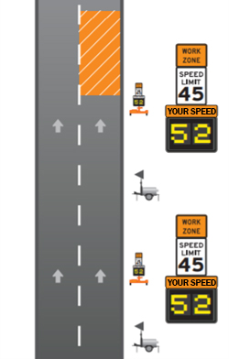
Texas DOT Work Zone Safety Tools
Smart Work Zone Guidelines include using the following temporary systems:
  Queue detection
  Speed monitoring
  Construction equipment alert
  Travel time
  Incident detection and surveillance
  Overheight vehicle warning
Go/No-Go Decision Tool
Automated flagger assistance devices
Temporary rumble strips
Safety contingency funds
Source: Texas DOT Smart Work Zone Guidelines, 2018
Notes:
Texas DOT published Smart Work Zone Guidelines in 2018 to direct the utilization of ITS in work zones to improve safety and mobility. The guidelines support using the following temporary systems:
Queue detection
Speed monitoring
Construction equipment alert
Travel time
Incident detection and surveillance
Overheight vehicle warning
The Texas DOT created a Go/No-Go Decision Tool to assist designers in determining if a specific Smart Work Zone system is needed at a particular location.
Similar to Iowa DOT’s TCP program, the Texas guidelines provide information on the use of each of the strategies. The guideline document covers the Texas DOT’s “recommendations for the basic guidelines for incorporating Intelligent Transportation Systems (ITS) into the TCP for roadway construction projects. These guidelines are intended to clarify what ITS Systems are appropriate for “Smart Work Zones” on TxDOT projects, provide general design and deployment guidance for these systems, and support state-wide work zone ITS standards and specifications.” (TxDOT, https://ftp.dot.state.tx.us/pub/txdot-info/trf/smart-work-zone-guidelines.pdf)
Texas DOT (TxDOT) has also tried automated flagger assistance devices and temporary rumble strips to improve work zone safety.
Work zone safety is important for human flaggers who often work within inches or feet of moving vehicles. In an effort to remove human flaggers from dangerous roadside positions, TxDOT introduced automated flagger assistance devices, which are able to route traffic using various visual cues via remote control, allowing operators to direct traffic from a safe distance. Readily mobile and easily assembled, most units are trailer-mounted, while others can be relocated by hand. The automated flagger assistance devices typically employ a combination of 7-foot-tall Stop/Slow signs, red and yellow lights, movable arms, and reflective materials.
Further enhancing work zone safety are temporary rumble strips designed to alert and refocus distracted or drowsy drivers about the possibility of upcoming traffic congestion. They are less than 1-inch high and look similar to miniature speed bumps. These black, rubbery strips are placed 5 feet apart on the approach to roadway work zones. When motorists drive over them, they sound an audible warning vibration in advance of traffic queues, reminding drivers to slow down and watch for slowing or stopped traffic. These rumble strips are designed for motorists to drive over and will not damage vehicles.
These can be seen in a YouTube video at: https://youtu.be/x-R4kvWUgD8
The Texas DOT has instructed its project engineers to incorporate a contingency fund into their project budgets to handle work zone improvements to address safety concerns that could not be foreseen in the project planning and design stage. Learn more about this at: https://ops.fhwa.dot.gov/publications/fhwahop20009/fhwahop20009.pdf.
The Texas Smart Work Zone Guidelines are available at: https://ftp.dot.state.tx.us/pub/txdot-info/trf/smart-work-zone-guidelines.pdf

Slide 45
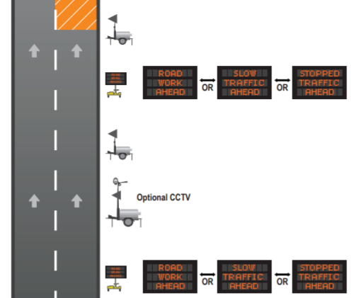
Texas DOT End-of-Queue Warning System
First implemented in 2013
Uses sensors to measure approach speeds
Warns drivers through portable, electronic signs
Implemented to protect motorists and construction workers
Source: Texas DOT Smart Work Zone Guidelines, 2018
Notes:
The advance warning system was first implemented as part of the 96-mile, Central Texas Interstate 35 expansion project that widened the highway from four to six lanes (eight lanes in Temple and Waco) and changed two-way frontage roads into one-way lanes. The application was designed to improve safety in one of the most heavily traveled corridors in the country. Each day, between 55,000 and 115,000 vehicles travel this Interstate 35 corridor, 25 to 35 percent of which are trucks. For more information on the Texas DOT’s end-of-queue warning system, including metrics on the system’s safety benefits, visit
https://www.workzonesafety.org/files/documents/training/courses_programs/rsa_program/RSP_Guidance_Documents_Download/RSP_EndOfQueueWarning_Guidance_Download.pdf
The Texas Smart Work Zone Guidelines are available at: https://ftp.dot.state.tx.us/pub/txdot-info/trf/smart-work-zone-guidelines.pdf

Slide 46

Texas DOT Traffic Management Systems (TMS) in Construction Projects
Texas DOT Chief Engineer issued memo in 2016 to all district engineers
Districts expected to include TMS in new roadway construction projects beginning in early stages of project development planning
TMS include dynamic message signs, closed circuit television (CCTV) cameras, traffic sensors, and communication networks/fiber optic cable.
A 2017 Texas DOT memo outlined TMS objectives and performance metrics for districts
Source: @Getty Images
Notes:
In 2016, the Texas DOT Chief Engineer issued memo to all district engineers stating that it is critical to include traffic management systems (TMS) on new roadway construction projects, beginning at the early stages of project development planning. This was when it was most cost-efficient to include TMS. Texas DOT defines TMS to include variable message signs, closed circuit television (CCTV) cameras, traffic sensors, communication networks that connect field devices to a TMC, and fiber optic cable. Additional TMS include high water detection systems, wrong way driver detection, and other systems that address specific needs. The memo specifically calls out fiber optic cable to be included in construction projects as the recommended communications mode for TMS.
In 2017, the Texas DOT Chief Engineer followed up with another memo regarding statewide procedures for TMS. It outlined expectations for the districts regarding TMS in projects, objectives, and performance metrics. Objectives addressed equipment maintenance and asset management, system coverage and planning for innovation and expansion, incident management, work zone management, communicating with the public through dynamic message signs and media, and implementing strategies to improve traffic flow. Metrics covered TSMO asset operational uptime, incident clearance time, travel time reliability, and TMS system coverage.

Slide 47
Minnesota DOT Work Zone Safety (1/2)
Statewide Work Zone Safety Committee
  Includes representatives from construction, traffic engineering, maintenance, public affairs, and worker safety programs
  Is open to external partners such as local agencies, utilities, and private organizations
  Shares information on best practices and innovations
Innovative initiatives include
  Autonomous truck-mounted attenuator project
  Trucks entering systems
  Left-turn queue-detection system
  Mobile barrier demonstration
  Work zone design for pedestrians and bicycles
  Temporary overhead sign structure
Notes:
Minnesota DOT (MnDOT) hosts a Statewide Work Zone Safety Committee. The committee has met for over 10 years and includes a diverse list of members including MnDOT construction, maintenance, public affairs, utilities, worker safety, and traffic engineering staff. It also includes representatives from law enforcement, counties, municipalities, and private sector engineering firms. The committee meets twice a year to share information on innovations and coordinate best practices to improve work zone safety. Some recent innovative ideas and initiatives include
Autonomous truck-mounted attenuator project
Trucks entering systems
Left-turn queue-detection system
Emergency pull-off detection
Mobile barrier demonstration (example at: https://www.youtube.com/watch?v=o49huQ1UtUA)
Work zone design for pedestrians and bicycles
Colorado DOT is testing and implementing autonomous truck-mounted attenuators. Learn more at: https://www.codot.gov/programs/innovativemobility/mobility-technology/autonomous-vehicles.

Slide 48

Minnesota DOT Work Zone Safety (2/2)
Intelligent Work Zone Toolbox: Guideline for Intelligent Work Zone System Selection:
  Traffic-responsive systems
  Vehicle-responsive systems
  Environment-responsive systems
Source: @Getty Images
Notes:
The Minnesota DOT prepared the Intelligent Work Zone Toolbox as guidance for selecting an appropriate intelligent work zone system for existing work zone traffic issues and to mitigate anticipated issues on scheduled projects. The intelligent work zone system descriptions contained in this toolbox are intended as brainstorming material and should lead to practical solutions to a project’s unique problems.
Intelligent work zone systems may be sorted into three category types based upon detectable stimuli: (1) traffic, (2) vehicle, and (3) environmental. The three categories with their typically associated systems are as follows:
Traffic-Responsive Systems - Collect and respond to average traffic characteristics, such as speed and volume, of a group of vehicles. The systems react to trends of increasing or decreasing values. The combination of these basic systems forms the basis for route management systems (or traveler information systems) by analyzing and reporting information in various ways. These applications may include
Travel time information (trip time or estimated delay)
Speed advisory information
Congestion advisory information
End-of-queue warning
Active zipper merge
Traffic-responsive temporary signals
Temporary ramp metering
Vehicle-Responsive Systems - Collect and respond to individual vehicle characteristics, such as speed, dimensions, and location. When adverse conditions are detected by these systems, motorists need immediate warnings to respond. These applications may include:
Excessive speed warning (including dynamic speed display signs)
Over-dimension warning
Work zone intrusion warning
Construction-vehicle warning
Emergency pull-off detection
Environment-Responsive Systems - Collect and respond to changing non-traffic conditions, including weather or roadway conditions, or working characteristics, such as the presence of workers. These applications include:
Hazardous-condition warnings (flooding, ice, fog, smoke, dust, etc.)
Electronic workers present speed limit
The real-time data collected for any of these systems may be combined, averaged, analyzed for trends, and utilized for several informational uses. For example, data collected for stopped-traffic warnings may be used to control an active zipper-merge system or to calculate change in travel time through a corridor.
The Minnesota IWZ Toolbox is available at: https://www.dot.state.mn.us/trafficeng/workzone/iwz/iwz-toolbox.pdf

Slide 49
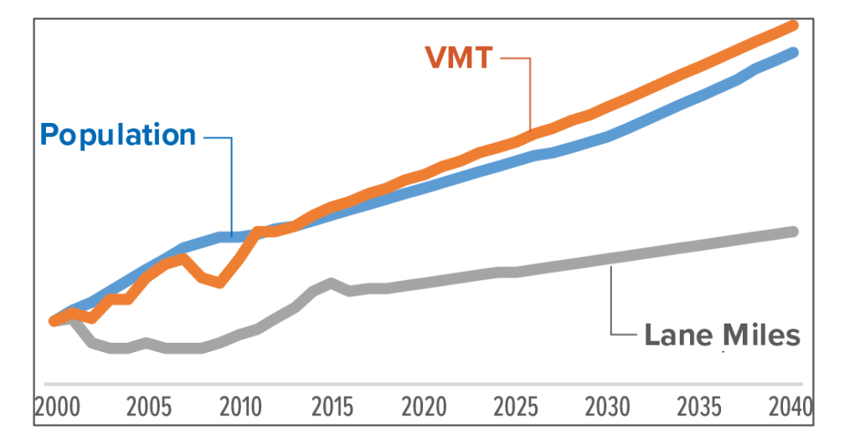
Nevada DOT (NDOT) Incorporating TSMO Construction
NDOT is responsible for construction and maintenance for more than 5000 lane-miles of roadway.
Need for new infrastructure with steep increase in demand
NDOT will require TSMO strategies during construction activities for safe and reliable travel.
NDOT’s TSMO strategies categories
  Mobility
  Incident Management
  Work Zone Management
Source: Nevada DOT
Notes:
The need for new infrastructure is constantly increasing.
To meet with 2040 projected population and vehicle miles traveled needs, NDOT will need more construction, rehabilitation, and capacity improvement projects. NDOT prioritizes limiting the impact of construction activities to maintain reliability and safety. In 2019, NDOT published work zone safety and mobility implementation guide to establish fundamental principles, roles, responsibilities, and procedures for systematically addressing the safety and mobility impacts of work zones.
NDOT categorizes TSMO strategies according to mobility, incident management, and work zone management and plans to use these to maintain traveler and worker safety and reliability during upcoming construction activities.

Slide 50
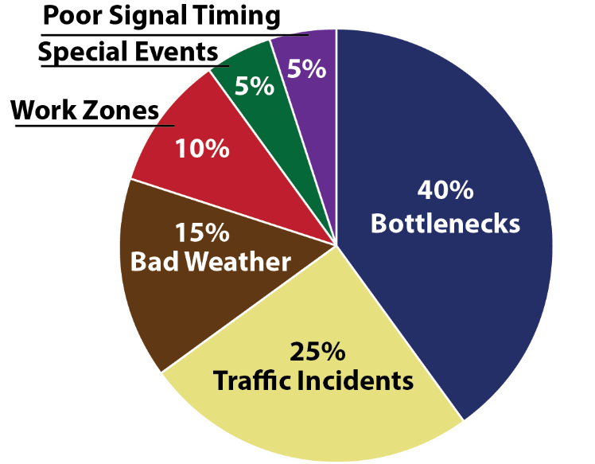
Nevada DOT Construction:
Mobility Strategies
A significant share of congestion is caused by work zones and construction activities.
NDOT identified mobility for all modes as one of its TSMO goals.
NDOT active traffic management systems for Project Neon
  Providing advance warning
  Monitoring traffic
  Collecting data
  Detecting queues
  Harmonizing speeds
Source: Adapted from Nevada DOT
Notes:
Mobility refers to ease with which people, goods and services can travel across the transportation system.
NDOT has identified mobility for all modes as one of its TSMO strategic goals to support safe, efficient and accessible movement of people and goods.
The implementation of active traffic management systems (ATMS) to support mobility and safety during Project Neon is an example of a TSMO mobility strategy in Nevada. Project Neon will widen 3.7 miles of interstate in Las Vegas. This strategy provides the ability to dynamically manage congestion on prevailing traffic conditions by providing advanced warning, monitoring traffic, collecting data, and detecting queues.
For more information on Project Neon, see: http://ndotprojectneon.com/learn/overview/.

Slide 51
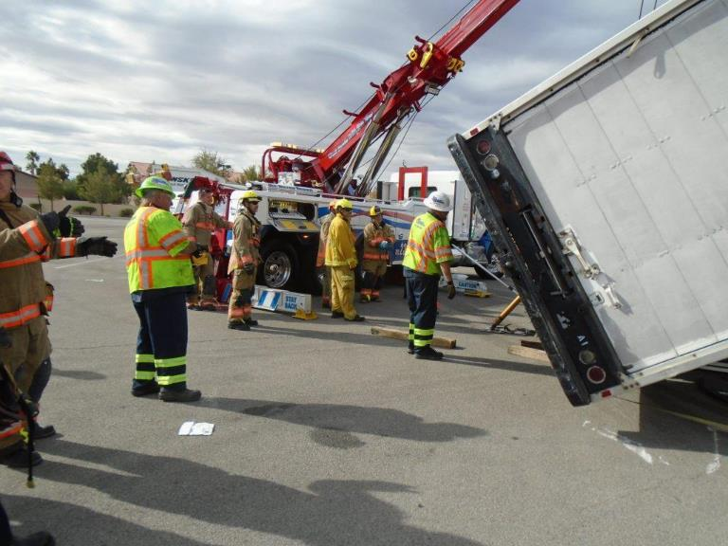
Nevada DOT Construction:
Incident Management
Stationing law enforcement officers within work zones to encourage compliance with work zone speed limits
Implementing portable rumble strips within work zones to alert inattentive drivers to changing roadway conditions
Ensuring coordination among stakeholders through regular construction updates at TIM
coalition meetings
Source: Nevada DOT
Notes:
TSMO strategies can also be applied for incident management in construction zones to reduce response time.
Strategies used in Nevada include law enforcement officers stationed within work zones to encourage compliance with work zone speed limits. Nevada DOT implements portable rumble strips within work zones to alert inattentive drivers.
Nevada DOT also participates in a traffic incident management coalition, which helps to improve safety for first responders, incident victims, and the traveling public while reducing traveler delay. This coalition consists of stakeholders representing law enforcement, tow operators, hazmat specialists, Nevada DOT, paramedics, and emergency personnel.

Slide 52
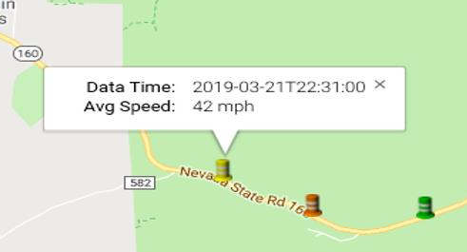
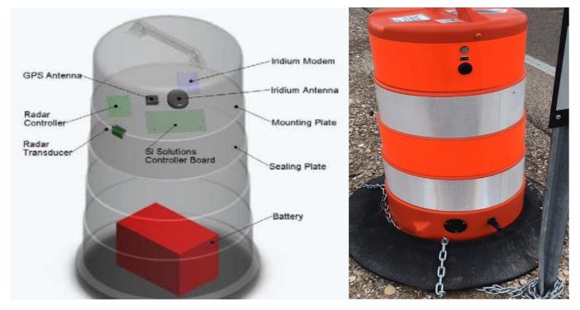
Nevada DOT Construction:
Work Zone Management
NDOT has implemented multiple Smart Work Zone projects within the state.
Example: Deployment on State Route (SR) 160 to address traffic disruptions caused by a widening project
http://www.iconetraffic.com/maps/icone.aspx
Source: Nevada DOT
Source: Nevada DOT
Notes:
Nevada DOT has implemented multiple Smart Work Zone projects. As an example, on State Route (SR) 160 NDOT deployed a queue warning and a dynamic travel time system to provide road users with critical construction information in a timely manner.
The components and attributes included:
Tools to review traveling speeds of traffic
Pre-programmed messages, which update when speed thresholds are reached
Solar battery charging system
Portable components with easy setup
Ability to view live traffic data
Connectivity to crowdsourced traveler information system

Slide 53

Nevada DOT Lane Closure Time Frame
Assesses work zone location to determine lane closure time limits
Limits all lane closure between predetermine times
Imposes liquidated damages on the contractor for non-conformance
Source: @Getty Images
Notes:
Nevada assesses each location depending on the scope of work, speeds, traffic volumes, etc. and makes the determination as to how many lanes need to be kept open, what hours the contractor can work, and whether any traffic control devices can be brought out to the site prior to the hours stipulated.
A typical urban freeway scenario is that no lane closures can occur before the time(s) set, but signs and other devices can be available onsite prior to the lane(s) being closed, with liquidated damages imposed for non-conformance to the working hours.
Rural freeway work has been allowed during daylight hours in various locations based on the same criteria as above when it is determined that daylight hours and volumes are not restrictive enough to warrant mandatory night work. Holidays typically are handled with no work on the day before, during, or after the holiday, unless no lanes are required to be closed; then, it is the contractor’s option to work these days.
Other locations, such as Las Vegas, may have additional restrictions (e.g., directional restrictions where no work can be performed on Thursday/Friday on the lanes coming in to town or no work performed on Sunday/Monday on lanes leaving town) to minimize work zone impacts on the known increase in traffic volumes in any given direction.

Slide 54

Nevada DOT Post-Construction Review
Assesses and documents any issues relating to traffic mobility or safety
Relays this information back to construction, designers, and traffic engineers
Provides helpful feedback and information on TSMO strategy effectiveness during construction
Source: Pixabay
Notes:
Nevada DOT conducts post-construction review assess and document any traffic issues and relay those back to construction personnel, designers, and traffic engineers. These reviews provide helpful feedback and information on the effectiveness of how TSMO strategies support construction. This process is improving the successful implementation of TSMO strategies.
Image source: https://pixabay.com/vectors/circle-repeat-cycle-reload-redo-311551/.

Slide 55

Virginia DOT (VDOT) Lane Closure Management
VDOT uses a lane closure advisory management system (LCAMS)
LCAMS is used:
  To proactively manage and communicate lane closures
  For public awareness through web and 511 system
  To avoid road work scheduling conflicts
  To prioritize work
Source: @Getty Images
Notes:
The Virginia DOT, or VDOT, uses the lane closure advisory management system (LCAMS) to proactively manage and communicate lane closures across the State. The LCMAS information is used for public awareness through the Virginia traffic tool and the 511 system. One of the most important features of LCAMS is its ability to help avoid conflicts when scheduling road work, including maintenance. If two requests for construction or maintenance conflict, the system notifies the two users that there is a conflict and asks them to change dates/time. The system gives preference to high-priority work (i.e., design-build, major structure repair, etc.).

Slide 56
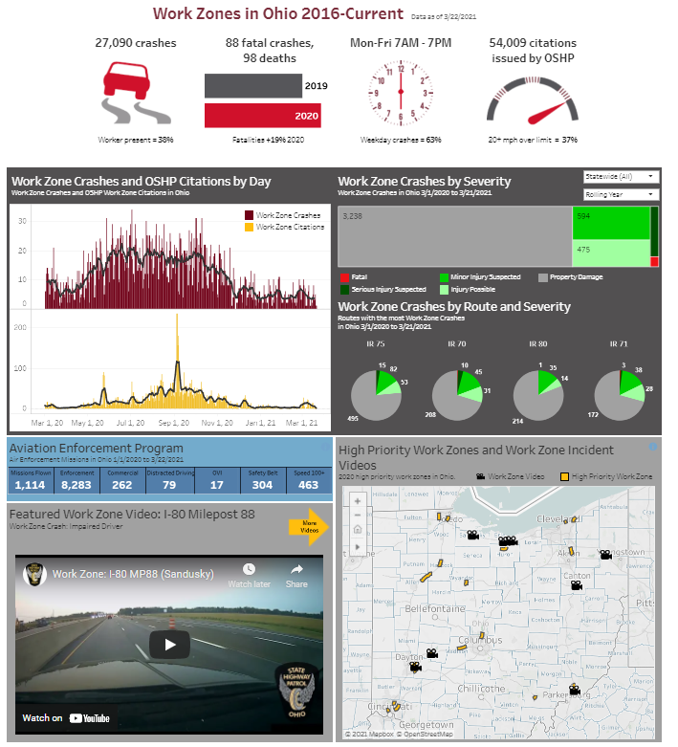
Ohio DOT TSMO and Work Zones
Ohio DOT’s TSMO Plan includes specific work zone objectives:
  Reduce work zone-related crashes
  Reduce work zone-related traffic delays
District TSMO coordinators work with district work zone coordinators
Traffic management center actively monitors work zones
ITS operations support intelligent work zones
Work Zone Dashboard
Source: Ohio DOT
Notes:
Ohio DOT’s TSMO plan includes work zone program objectives:
Reduce work zone-related crashes. The target is to reduce by 1 percent over a 5-year moving average.
Reduce work zone-related traffic delays. The target is to increase no more than 25 percent over preconstruction.
In an effort to curb work zone crashes and further empower the public, the Ohio State Highway Patrol has released a new dashboard devoted to work zone safety. The Work Zone Dashboard is a detailed view of work zones across Ohio and the important work that troopers around the State are doing to make them safer.
The new Work Zone Dashboard is a part of the Ohio Statistics and Analytics for Traffic Safety, which is a series of internal and public-facing dashboards dedicated to exploration, analysis, and visualization of crash data across Ohio. Users of the newest public-facing Work Zone Dashboard have the ability to filter data and find the exact statistics they are looking for while also getting a front-seat view of what troopers do every day in Ohio’s work zones. Users of the dashboard have the ability to look at their own counties and routes, providing flexibility for them to get the exact data they want. An interactive map on the dashboard plots high-priority work zones throughout the State and contains videos of troopers enforcing work zone violations.

Slide 57
Ohio DOT TIM Training
Requires the construction contractor to undergo TIM training on certain projects
Maintains a database of contractors that successfully complete Ohio TIM training
Schedules and holds TIM meetings before construction work begins and before each phase change
  Meetings include Ohio DOT project engineer; contractor TIM contacts; District safety consultant; District work zone traffic manager; District TSMO coordinator; freeway service patrol (if applicable); as well as local fire, police, towing, and emergency medical services.
  Topics of meetings include development of project-specific TIM plans.
Notes:
During maintenance of traffic on certain projects, there is a need for enhanced coordination and planning between the contractor, the project engineer, and the department to effectively implement TIM. Plan Note 642-45 is used to indicate this on the project plans.
Ohio DOT offers Ohio TIM training to contractor personnel and Ohio DOT project engineers on projects and maintains a referenceable database of individual contractor personnel that have successfully completed Ohio TIM training.
Ohio DOT schedules and holds TIM meetings for projects that are using Plan Note 642-45 before construction work begins and before each phase change.
The TIM meetings include Ohio DOT and safety forces that will respond to incidents/crashes on the project. At a minimum, attendees include an Ohio DOT project engineer; contractor TIM contacts; a district safety consultant; a district work zone traffic manager; district TSMO coordinator; freeway service patrol (if applicable); as well as local fire, police, towing, and emergency medical services.
At these meetings, example topics discussed include:
Development of the project-specific TIM plan
Roster of contact information for all possible response personnel
Project-specific work/phasing concerns
Responders concerns
The Ohio DOT Traffic Engineering Manual is available at: https://www.dot.state.oh.us/Divisions/Engineering/Roadway/DesignStandards/traffic/TEM/Pages/default.aspx?View=%7B74197b56-b6ac-4fb5-be04-dccca79cda4d%7D&SortField=FileSizeDisplay&SortDir=Asc
Reference: Ohio DOT’s Traffic Engineering Manual, Part 6 (See 608-2, 640-23, and 642-45)

Slide 58
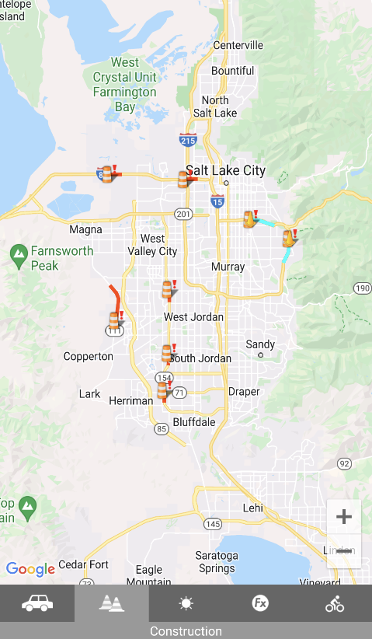
Utah DOT Traffic Smartphone Application
Utah DOT launched UDOT Traffic, a traveler information smartphone application in 2011.
Provides travelers information on construction projects, incidents, real-time congestion, traffic camera feeds, road weather, and road closures
Shows real-time snowplow location, direction, speed, and previous path
Source: Utah DOT
Notes:
The Utah DOT launched the first traffic application developed by a State DOT in 2011. It provides wide-ranging traffic information to help drivers plan their trips. In includes information on construction projects, incidents, real-time congestion, traffic camera feeds, road weather data, and road closures. Utah DOT also added real-time snow plow information including location, direction, speed, and its previous path. This application is an example of connecting construction projects and TSMO through work zone traveler information.
For more information, see https://www.udot.utah.gov/connect/2021/01/29/udot-traffic-app-reaches-1-million-downloads/.

Slide 59
Overcoming Challenges to Collaboration

Slide 60
Potential Challenges to Collaboration
Limited understanding of TSMO benefits to construction
Limited understanding of the cost and complexity of construction by TSMO staff
Limited knowledge of technology applications by contractor
No formal processes for integrating TSMO into contract documents
Organizational silos—limited interactions between construction and TSMO
Minimal data on cost and benefit of TSMO strategies in construction
Notes:
The following presents some of the challenges to collaboration between TSMO and construction:
If there is limited understanding of the benefits of incorporating TSMO concepts into construction practices, there may be resistance to include TSMO personnel and strategies in construction meetings and planning
Without an understanding of the complexities of construction, TSMO personnel may not appreciate why certain strategies may create impacts to the project schedule or budget
Contractors may also have a limited knowledge of TSMO and the technology applications available to enhance the safety and function of a construction site. They may also be resistant to including TSMO technology strategies due to perceived costs or lack of staffing capabilities
A few DOTs have incorporated TSMO in contract documents through inclusion in construction specifications and standard plan notes; however, there are generally limited formal processes for addressing TSMO strategies in contract documents
Traditionally, DOTs have been organized into focused areas, with construction and traffic operations in different divisions or offices, thus limiting interaction and collaboration between these business areas
Without solid data on the costs and benefits of TSMO strategies in construction, it is difficult to make the case for how adding TSMO strategies and technologies can support construction goals
(Ask participants if there are others that would impact collaboration.)

Slide 61
Strategies to Increase Collaboration
Collaborating on projects
TSMO requirements in contract documents
Regular project meetings
Use of TOC/TMC in managing traffic in work zones
Performance goals for traffic management on construction projects
Standing committees on TSMO and construction
Designated TSMO liaison on major projects
Joint participation in project reviews and work zone process reviews
Data on effectiveness of TSMO strategies
Notes:
Project partnering workshop with contractor, DOT construction personnel, and TSMO staff
Include TSMO requirements in contract documents. These may include plan notes, permitting, or phasing requirements
Regular meetings among contractors, project management, and TSMO staff
Coordinate with TMC staff to support active traffic monitoring and management in and around the work zone
Jointly develop policies, processes, and performance standards or goals for work zone traffic management
Standing committees to collaborate on TSMO and construction
This goes beyond individual projects; this is a statewide committee that sets policy and reviews major construction projects
Assign a designated TSMO liaison on major projects
Jointly participate in project reviews and work zone process reviews
Review the process for evaluating traffic issues and develop recommendations
Conduct post-project or post-incident reviews and review at key milestones
Document effectiveness of TSMO strategies in advancing construction priorities
(This would be a good place for interactive discussion on other ideas to support collaboration.)

Slide 62
Next Steps for Connecting TSMO and Construction

Slide 63
Near-Term Opportunities
Start a conversation
Include TSMO staff in construction meetings
Pilot specific TSMO strategies on current projects
Provide TSMO overview to construction personnel
Invite construction staff to TSMO events and training
Include construction personnel in TIM training or committees
Other ideas for collaboration in the near-term?
Notes:
There are several opportunities for near-term collaboration between TSMO and construction staff. These include just starting a conversation or meeting to discuss improving coordination, piloting TSMO strategies on current projects, providing this overview of TSMO to construction personnel, inviting construction staff to TSMO events (and vice versa), and including staff in TIM training or committees.
Start a conversation between TSMO and construction working groups to gain insights into each other’s responsibilities
Include TSMO staff in construction meetings to gain a better understanding of the issues
Pilot specific TSMO strategies on current projects to demonstrate how these can support agency and construction goals
Provide TSMO overview to construction personnel to demonstrate the benefits of TSMO to construction projects
Invite construction staff to TSMO events and training to share ideas and perspectives
Include construction personnel in TIM training or committees. Traffic incident management includes a broad array of disciplines, and construction personnel can add their perspective and gain and understanding of TIM-related issues
What other ideas do you have?

Slide 64
Long-Term Opportunities
Create a standing committee on TSMO in construction
Integrate TSMO in construction standards and manuals
Designate construction liaisons in TSMO
Develop TSMO review process for construction
Monitor and document TSMO strategies in construction
Other ideas for collaboration in the long-term?
Notes:
There are also several opportunities for TSMO and construction staff to collaborate in the long term. These include creating a standing committee, integrating TSMO into construction standards and manuals, identifying liaisons, developing a TSMO review process for construction, and monitoring and documenting TSMO strategies for construction. A TSMO review process would help ensure that TSMO strategies were considered in work zones.
What other ideas can you think of?

Slide 65
Resources
Federal Highway Administration (FHWA), What is TSMO? (frequently asked questions): https://ops.fhwa.dot.gov/tsmo
FHWA, Enhancing Transportation: Connecting TSMO and Construction, Factsheet, 2018: https://ops.fhwa.dot.gov/publications/fhwahop18092
FHWA, Organizing and Planning for Operations web page: https://ops.fhwa.dot.gov/plan4ops
FHWA, Work Zone Management Program web page: https://ops.fhwa.dot.gov/Wz/index.asp
FHWA, Intelligent Transportation Systems (ITS) and Technology web page: https://ops.fhwa.dot.gov/Wz/its/index.htm
FHWA, Transportation Management Plans (TMPs) for Work Zones web page: https://ops.fhwa.dot.gov/wz/resources/tmp_factsheet.htm
FHWA, Transportation Management Plan (TMP) Examples web page: https://ops.fhwa.dot.gov/wz/resources/final_rule/tmp_examples.htm
FHWA, Work Zone Intelligent Transportation Systems Implementation Guide: https://ops.fhwa.dot.gov/publications/fhwahop14008/index.htm
National Work Zone Safety Information Clearinghouse: https://www.workzonesafety.org
Notes:
There are multiple sources of information that can help with your understanding of TSMO and work zones from FHWA.

Slide 66
Thank you!
For more information please contact:
(Speaker Information)
Notes:
Thank you for you participation today.

