Slide 1
Connecting TSMO and the
Natural and Human Environment
Executive summary (ES)
ENVIRONMENT
Presenter Name
Date
FHWA-HOP-22-P011
Source: @Getty Images
Notes:
Photo credit: @Getty Images

Slide 2
Executive Summary

Slide 3
The Transportation Landscape Is Changing (ES)
Advances in technology
Emerging modes
Better data
Evolving customer needs and expectations
Limited funds and tighter budgets
Increasing need to respond to and plan for extreme weather and climate change
Notes:
Changes in the landscape, or context, in which transportation exists have increased the need for transportation systems management and operations (TSMO), and the need for all transportation disciplines to collaborate on operational solutions. Doing business the way it was done in the past is no longer as effective. But the changing landscape also creates opportunities for collaboration and rethinking how we manage the transportation system to improve efficiency, safety, and sustainability. Some of these key changes include:
Advances in technology. Transportation agencies can leverage new technologies to develop operational solutions to manage congestion, reliability, and safety issues. Key emerging technologies in this space include connected and smart infrastructure, infrastructure-to-vehicle communications, and advancements in traveler information systems and delivery methods.
Emerging modes. Emerging modes create a transportation network that is more complex but has great potential to improve performance, when coupled with the right operational strategies. Key emerging modes in this space include electric and hybrid vehicles, connected and automated vehicles (CAV), ride-hailing and ride-sharing services, and e-scooters.
Better data. Almost all of these new technologies and emerging modes come with a lot of new data, with the potential to understand and monitor transportation systems in more detail and in real time. These data create the opportunity to deploy advanced management and operations strategies that we’ll talk about more in this presentation.
Evolving customer needs and expectations. Travelers today expect real-time, accurate traveler information and options for how they travel. They expect to know about delays ahead of time and ways to avoid them.
Limited funds. Transportation agencies on the federal, State, and local levels have for years been tasked with doing more with limited resources. State departments of transportation (DOT) are always looking for innovative, lower-cost ways to get people and goods to their destinations more safely and reliably. Operational solutions often meet this challenge.
Increasing need to respond to and plan for extreme weather and climate change. Increased frequency of extreme weather events and climate change models have highlighted the increased need for the transportation system to be ready to respond to these forces. This area is a key focus for new cross-agency collaboration.

Slide 4
Finding Common Ground between TSMO and the Natural and Human Environment (ES)
Transportation systems management and operations (TSMO) and the natural and human environment share common goals that can be achieved with operational strategies
TSMO and environmental programs seek to:
  Think differently, more holistically
  Enhance versus expanding existing system
  Do more with less
  Leverage new data to plan and operate smarter
Common ground between programs forms a basis for addressing the changing landscape through collaboration
Notes:
The changes on the previous slide create an increased need and increased opportunities for groups across agencies to collaborate on operational strategies (TSMO) to achieve common goals. Here we focus on opportunities for TSMO and environmental programs to collaborate. TSMO and the natural and human environment share common ground that can be used as the basis for addressing the changes through collaboration.
TSMO and environmental programs seek to:
Think differently, more holistically. TSMO and environmental programs take a systemwide approach that is more holistic than, for example, a single bottleneck or corridor, or any single source of a problem. Both disciplines achieve their goals when the whole system, and the environment in which it operates, is performing well.
Enhance existing system vs. expand the system. Both disciplines redirect focus from expanding the current footprint of our transportation system by focusing on operational improvements and improving the sustainability of the system.
Do more with less. All agencies must try to get the most impact out of their funding, and TSMO strategies can help achieve a variety of performance goals. (Note to presenter: this will be covered in more depth later on.)
Leverage new data to plan and operate smarter.

Slide 5
What Is Transportation Systems Management and Operations (TSMO)? (ES)
Offers an integrated set of strategies to optimize operational performance of the existing transportation system
Approaches performance from a systems perspective:
  Spans corridors, facilities, jurisdictions, modes, and agencies
Helps agencies balance supply and demand on the system and provide flexible solutions to manage dynamic conditions
Can complement capacity projects, or in some cases can provide lower cost, faster alternatives
Notes:
Before going further, it is important to define TSMO for new audiences:
TSMO is an integrated set of strategies to optimize the operational performance of the existing transportation system.
Note: The definition at the top of the slide is an abridged version of the Federal Highway Administration’s (FHWA) TSMO definition found here: https://ops.fhwa.dot.gov/tsmo and at 23 USC 101 (a) (30).
TSMO approaches performance from a systems perspective.
Spans corridors, facilities, jurisdictions, modes, and agencies
TSMO takes a holistic approach to managing performance that looks beyond a single corridor (e.g., are changes to a specific corridor causing a mobility issue nearby?), jurisdiction (e.g., are management systems coordinated across jurisdictional boundaries?), mode (e.g., are we using all modes optimally to meet our performance goals?), and agency (e.g., how can we improve collaboration with law enforcement or transit agencies to improve performance?).
Helps agencies balance supply and demand on the system and provide flexible solutions to manage dynamic conditions.
Example TSMO strategies include ramp metering, managed lanes, and congestion pricing.
TSMO can complement capacity projects or can provide lower-cost, faster alternatives in some cases.
TSMO seeks to provide lower-cost alternatives to capacity projects when operational strategies may produce equal or better results – or when operational strategies may be able to produce results faster. It does not seek to eliminate capacity projects in cases where a capacity project is the best solution. Rather, TSMO provides agencies with more options.

Slide 6
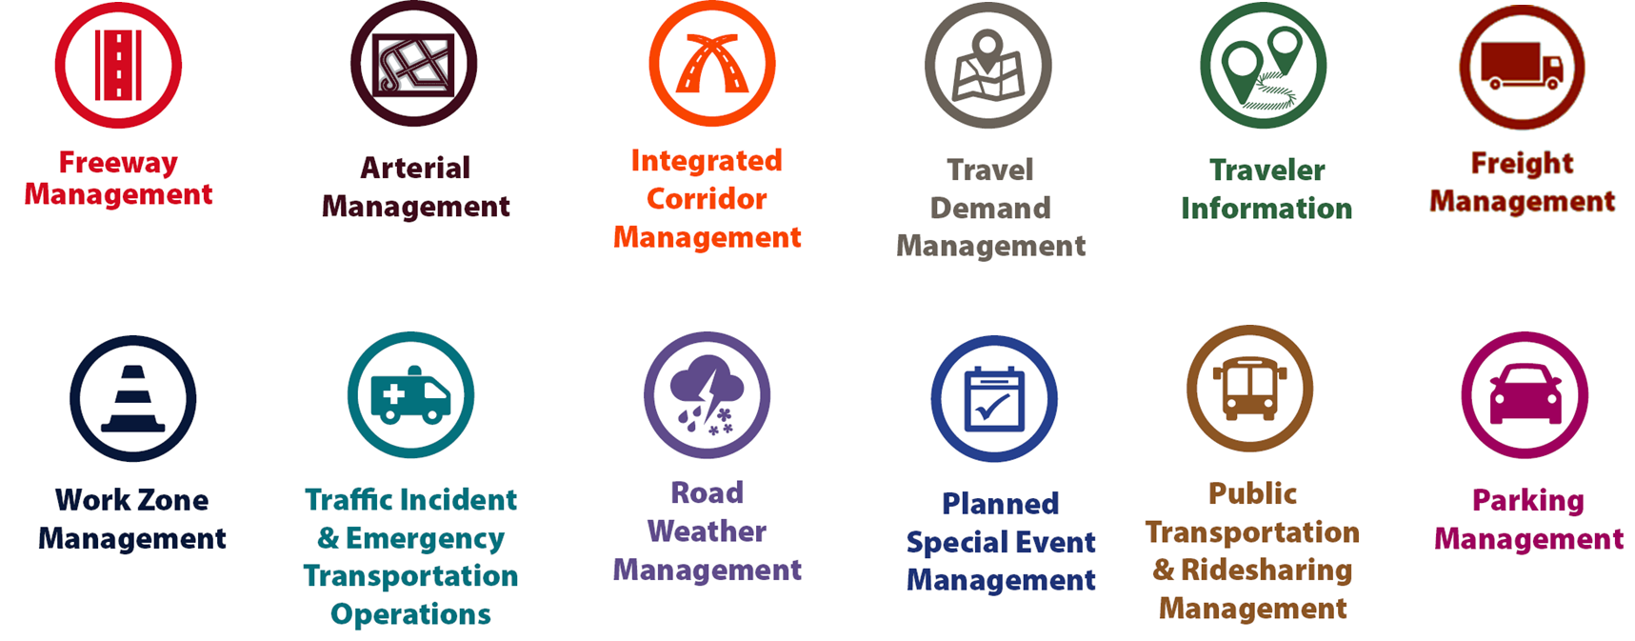
Some Examples of TSMO Strategies (ES)
Notes:
This slide illustrates the array of operational strategies that fall under the TSMO umbrella that can be used individually or in combination with each other. This list is not exhaustive, but it highlights the key buckets of strategies that are priorities for many agencies.
Examples of other TSMO strategies include:
Traffic signal coordination
Transit signal priority
Special event management
Congestion pricing
Active transportation and demand management
Connected/automated vehicles
Completing multimodal networks

Slide 7
What Do We Mean by the “Natural and Human” Environment?
Environmental review during project planning and development
Land, air, and water quality
Built environment, including transportation enhancements like bicycle and pedestrian facilities
Road weather and emergency management
Resilience and sustainability
Climate change management and adaptation
Noise, environmental justice, and livability
Notes:
What is meant by the “natural and human environment” for the purposes of this presentation? A broad view is taken, with the goal of helping find general connections between these two disciplines. This slide shows activities of staff who work in the natural and human environment in a transportation context. This list is not exhaustive, but mean to illustrate the type and range of activities that would fall under our broad view for this presentation.

Slide 8
How Can TSMO Support Environmental Goals? (1/2) (ES)
Environmental goal: manage impacts of extreme weather and climate change
  TSMO strategy: road weather information systems anticipate and quickly respond to extreme weather and communicate to the traveling public (sensors, cameras, geographic information systems [GIS] systems, integrations with weather databases)
Environmental goal: contain pollutants spilled on roads and restore impacted area
  TSMO strategy: traffic incident management programs can train first responders and hazardous materials (HAZMAT) professionals to mitigate impacts of spills
Notes:
Now that we’ve covered what TSMO is, how can it support the goals of staff and programs focused on the human and natural environment? The next four slides shows examples of such goals and the TSMO strategies that could help advance the goals. There are two important points in this example: 1) common TSMO strategies, such as those shown here, are already supporting environmental goals and 2) environmental staff should consider TSMO strategies when planning how to meet their goals.

Slide 9
How Can TSMO Support Environmental Goals? (2/2) (ES)
Environmental goal: reduce greenhouse gas emissions from the transportation system
  TSMO strategy: adaptive traffic signal control can reduce fuel consumption up to 7 percent and emissions up to 6 percent¹
Environmental goal: reduce fuel consumption
  TSMO strategy: connected and automated vehicles (CAV) and speed harmonization could reduce fuel consumption 19–22 percent based on recent modeling²
¹Federal Highway Administration (FHWA), The Role of Transportation Systems Management & Operations in Supporting Livability and Sustainability: A Primer (2012), https://ops.fhwa.dot.gov/publications/fhwahop12004/fhwahop12004.pdf.
²Malikopoulos, Andreas A., et al., Optimal Control for Speed Harmonization (2019), https://www.itskrs.its.dot.gov/node/209123.
Notes:
Now that we’ve covered what TSMO is, how can it support the goals of staff and programs focused on the human and natural environment? This slide shows examples of such goals and the TSMO strategies that could help advance the goals. There are two important points in this example: 1) common TSMO strategies, such as those shown here, are already supporting environmental goals and 2) environmental staff should consider TSMO strategies when planning how to meet their goals.
This slide highlights how connected and automated vehicles (CAV) and speed harmonization could reduce fuel consumption, but the presenter may want to note that there have been studies to show that CAVs may increase vehicle miles traveled.

Slide 10
What are the Mutual Benefits of Collaboration? (ES)
Coordinating TSMO and environmental efforts benefits both programs and allows us to accomplish shared goals more efficiently.
TSMO goals:
Reduce congestion
Leverage all modes to improve mobility
Get more out of existing infrastructure to reduce need for expansion
Safe and quick incident clearance
Environmental goals:
Reduce fuel consumption, improve air quality
Increase use of eco-friendly modes
Preserve natural environments
Minimize damage from incidents involving hazardous materials
Notes:
This slide builds on the past two by adding that collaboration benefits both programs because many TSMO and environmental goals are aligned.

Slide 11
Areas for Collaboration (ES)
Road weather management
Resilience of the transportation system
Congestion management
Sustainable modes of travel
Planning and project development/environmental review
Asset management
Notes:
There are a number of areas where environmental and TSMO staff could collaborate to the benefit of both programs. Here are some key areas for collaboration, which are explored depth in the presentation. Note that not all areas have been fully charted by agencies yet, and some are identified for future collaboration based on aligned goals and the potential for shared activities. Case studies of existing environmental-TSMO collaboration where there has already been activity by transportation agencies are also provided in the full presentation.

Slide 12
Next Steps (ES)
Bring together TSMO and environmental leaders at your agency to identify areas of common interest and mutual objectives
Learn how TSMO strategies already support environmental goals
Discuss where TSMO can make an even greater impact on environmental goals
Begin joint initiatives to improve operations and the environment
Notes:
Additional resources are also listed at the end of this presentation, which may help guide next steps, including a fact sheet on connected TSMO and the environment: https://ops.fhwa.dot.gov/publications/fhwahop18089/index.htm.

Slide 13
For more information:
[Enter contact information.]

Slide 14
End of Executive Summary

Slide 15
Connecting TSMO and the
Natural and Human Environment
ENVIRONMENT
Presenter Name
Date
Source: @Getty Images
Notes:
Photo credit: @Getty Images

Slide 16
Goals of This Presentation
Create awareness of transportation systems management and operations (TSMO) strategies and goals
Demonstrate alignment between TSMO and environment goals
Provide examples of environmental benefits of TSMO
Discuss ways for TSMO and environmental programs to collaborate
  Case studies
  Action items
Notes:
The goals of this presentation are those listed on the slide. The examples of environmental benefits of TSMO in this presentation are based on FHWA listening session with TSMO and environmental staff from agencies across the country.

Slide 17
Presentation Overview
What is TSMO?
Why connect TSMO and the natural and human environment?
Areas of collaboration
Examples of connecting TSMO and the natural and human environment
Overcoming challenges to collaboration
Next steps
Notes:
We begin this presentation by describing transportation systems management and operations, or TSMO.
We’ll then discuss reasons for connecting TSMO and the natural and human environment. We’ll also look at TSMO strategies that have environmental benefits. Then we will identify areas for collaboration and review specific examples.
Next, we’ll conclude by reviewing the challenges and next steps in connecting TSMO and the natural and human environment.

Slide 18
What Is TSMO?

Slide 19
Definition of TSMO
Integrated [set of] strategies to optimize the performance of existing infrastructure through implementation multimodal and intermodal, cross-jurisdictional systems, services, and projects designed to preserve capacity and improve security, safety, and reliability of the transportation system.*
* Title 23 of the U.S. Code § 101 (a)(30)(A) and FHWA website: https://ops.fhwa.dot.gov/tsmo/
Notes:
Before going further, it is important to define TSMO for new audiences:
TSMO is an integrated set of strategies to optimize the performance of existing infrastructure through the implementation of multimodal and multi-jurisdictional systems, services, and projects designed to preserve capacity and improve security, safety, and reliability of the transportation system while minimizing the environmental impact.
The goal here is to get the most performance out of the transportation facilities we already have. TSMO is the use of strategies, technologies, mobility services, and programs to optimize the safety, mobility, and reliability of the existing and planned transportation system.

Slide 20
Characteristics of Transportation Systems Management and Operations (TSMO)
Offers an integrated set of strategies to optimize operational performance of the existing transportation system
Approaches performance from a systems perspective:
  Spans corridors, facilities, jurisdictions, modes, and agencies
Helps agencies balance supply and demand on the system and provide flexible solutions to manage dynamic conditions
Can complement capacity projects, or in some cases can provide lower cost, faster alternatives
Notes:
TSMO is an integrated set of strategies to optimize the operational performance of the existing transportation system.
Note: The definition at the top of the slide is an abridged version of the Federal Highway Administration’s (FHWA) TSMO definition found here: https://ops.fhwa.dot.gov/tsmo and at 23 USC 101 (a) (30).
TSMO approaches performance from a systems perspective.
Spans corridors, facilities, jurisdictions, modes, and agencies
TSMO takes a holistic approach to managing performance that looks beyond a single corridor (e.g., are changes to a specific corridor causing a mobility issue nearby?), jurisdiction (e.g., are management systems coordinated across jurisdictional boundaries?), mode (e.g., are we using all modes optimally to meet our performance goals?), and agency (e.g., how can we improve collaboration with law enforcement or transit agencies to improve performance?).
Helps agencies balance supply and demand on the system and provide flexible solutions to manage dynamic conditions.
Example TSMO strategies include ramp metering, managed lanes, and congestion pricing.
TSMO can complement capacity projects or can provide lower-cost, faster alternatives in some cases.
TSMO seeks to provide lower-cost alternatives to capacity projects when operational strategies may produce equal or better results – or when operational strategies may be able to produce results faster. It does not seek to eliminate capacity projects in cases where a capacity project is the best solution. Rather, TSMO provides agencies with more options.

Slide 21
Examples of TSMO Strategies
Notes:
This slide illustrates the array of operational strategies that fall under the TSMO umbrella that can be used individually or in combination with each other. This list is not exhaustive, but it highlights the key buckets of strategies that are priorities for many agencies.
Examples of other TSMO strategies include:
Traffic signal coordination
Transit signal priority
Special event management
Congestion pricing
Active transportation and demand management
Connected/automated vehicles
Completing multimodal networks
TSMO strategies can be categorized into three overarching areas: incident or event management, traffic management, and demand management strategies. The next three slides highlight strategies in each of these areas.

Slide 22
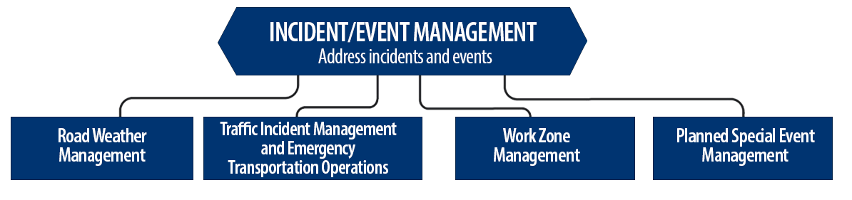
Incident/Event Management Strategies
Source: FHWA.
Notes:
Incident and event management includes several strategies that address major sources of travel-time unreliability.
Incident and event management strategies include road weather management, traffic incident management and emergency transportation operations, work zone management, and planned special event management.
Road weather management activities include creating hazardous weather traffic operations response plans, implementing variable speed limits, detecting hazardous weather conditions, disseminating weather and warnings to travelers through dynamic signs and systems, providing emergency truck and parking facilities and emergency parking information, and implementing vehicle restrictions.
Traffic incident management and emergency transportation operations activities include establishing traffic incident management teams, conducting after action reviews, staging tow trucks in strategic areas, providing roadway safety patrols, integrating computer-aided dispatch into transportation management centers, pre-establishing towing service agreements, co-locating dispatching units, developing quick clearance goals, pre-planning detour routes, implementing shoulder running, deploying adaptive ramp metering, providing variable speed limits, implementing dynamic lane-use controls, deploying network surveillance cameras or detectors, implementing incident traffic signal timing plans, enacting legislation, and integrating traffic management centers with law enforcement dispatch and emergency centers.
Work zone management activities include coordinating maintenance and construction activities, implementing queue length detection, deploying network surveillance cameras or detectors, implementing variable speed limits, supporting dynamic lane merging, implementing dynamic lane-use controls, deploying temporary ramp metering, and implementing dynamic warning systems.
Planned special event management activities include activating special event timing plans, deploying adaptive ramp metering, implementing variable speed limits, using hard shoulder running, activating dynamic transit fare reduction, implementing reversible lanes, supporting dynamic lane-use controls, establishing dynamic pricing, deploying network surveillance cameras or detectors, activating dynamic wayfinding, and conducting after action reviews.
Source: FHWA, Integrating Travel Time Reliability into Transportation System Management: Final Technical Memorandum
https://ops.fhwa.dot.gov/publications/fhwahop19035/index.htm

Slide 23
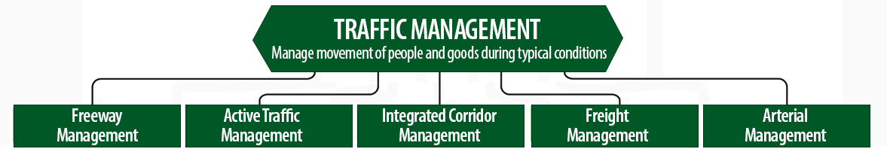
Traffic Management Strategies
Source: FHWA.
Notes:
While incident or event management strategies address atypical events that cause travel-time unreliability, traffic management strategies manage the movement of people and goods during everyday conditions. Even during typical conditions, fluctuations in travel demand can lead to unreliable travel conditions. Traffic management strategies allow the transportation network to adapt to unreliability, including variations in travel demand.
Traffic management strategies include freeway management, active traffic management, integrated corridor management, freight management, and arterial management.
Freeway management activities include implementing traffic surveillance cameras or detectors, using high-occupancy lanes, implementing adaptive ramp metering, deploying hard shoulder running, implementing variable speed limits, deploying dynamic lane-use controls, and constructing physical operations improvements such as overpass widening, curve corrections, or adding auxiliary lanes.
Active traffic management activities include adopting adaptive ramp metering, implementing adaptive traffic signal control, using dynamic lane reversal, implementing dynamic lane-use controls, deploying dynamic merge control, implementing temporary shoulder running, using variable speed limits, deploying queue length detection, providing transit signal priority, and implementing dynamic warning signs.
Integrated corridor management activities include implementing network surveillance cameras or detectors, conducting access management and driveway access controls, implementing adaptive ramp metering, deploying adaptive signal control, deploying transit signal priority, installing queue jumping lanes, providing traveler information for alternative modes, and deploying emergency vehicle preemption.
Freight management activities include implementing roadside truck electronic screening and clearance, implementing truck signal priority, using truck parking management systems, installing truck climbing lanes, and implementing freight loading zone policies.
Arterial management activities include installing queue jumping lanes, deploying transit signal priority, supporting emergency vehicle preemption, implementing network surveillance cameras or detectors, implementing access management and driveway access controls, providing enhanced bicycle and pedestrian crossings, establishing a transportation management center, deploying enhanced traffic signal operations, implementing transit-only lanes, implementing truck traffic signal priority, designing for complete streets, adding capacity for critical movements, reducing travel speeds, providing automated enforcement, and conducting operations asset management.
Source: FHWA, Integrating Travel Time Reliability into Transportation System Management: Final Technical Memorandum
https://ops.fhwa.dot.gov/publications/fhwahop19035/index.htm

Slide 24
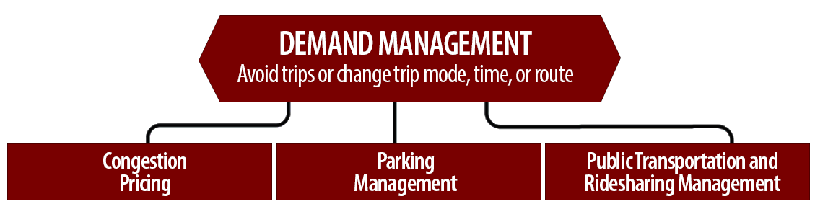
Demand Management Strategies
Source: FHWA.
Notes:
Demand management strategies reduce underlying demand by helping travelers avoid trips or change the mode, timing, or route of trips. This makes nonrecurring congestion less likely to occur and improves travel-time reliability.
Demand management strategies include congestion pricing, parking management, and public transportation and rideshare management.
Congestion pricing activities include implementing dynamic pricing, variable pricing by lane, segment, and time of day or day of week; establishing dynamic transit fare reductions; and deploying managed lanes for high occupancy.
Parking management activities include deploying dynamically priced parking; implementing dynamic parking, wayfinding, reservations, and capacity; deploying dynamic overflow transit parking; implementing electronic payment systems and shared-use parking; and providing incentives to use underutilized parking facilities.
Public transportation and ridesharing management activities include implementing dynamic ridesharing, implementing transit signal priority, using queue-jump lanes at signalized intersections, deploying electronic fare collection and integration, and implementing dynamic surveillance and security.
Source: FHWA, Integrating Travel Time Reliability into Transportation System Management: Final Technical Memorandum
https://ops.fhwa.dot.gov/publications/fhwahop19035/index.htm

Slide 25
TSMO Is a “Way of Thinking” That Supports State Departments of Transportation (DOTs) Missions
“We provide safe, reliable and cost-effective transportation options to improve communities and economic vitality for people and businesses.”
Washington State DOT mission
“To provide the best multi-modal transportation system for Colorado that most effectively and safely moves people, goods, and information.”
Colorado DOT mission
Notes:
TSMO leverages technology, a toolbox of strategies, and engineering solutions to maximize system performance; however, TSMO ultimately involves a way of thinking or a mindset focused on determining the best way to optimize the mobility and reliability of the existing system with limited resources.
TSMO can be thought of as a way of thinking and operating in order to get the most performance out of the transportation network while only building as much as is needed.
The principles of TSMO directly support the missions of many State DOTs, as these examples show.
NOTES:
States can insert their own mission statement here for effect or can leave these in.
Presenters can emphasize the connections between TSMO definition and their specific Mission statement, such as safety, reliability, cost-effective, multimodal, customer’s needs/satisfaction, etc.

Slide 26
TSMO Supports Many State and Local DOT Goals
Reduced congestion
Smoother and more reliable traffic flow
Improved safety
Cleaner air and less wasted fuel
More efficient use of resources and existing facilities
Increased economic vitality
Improved quality of life
Notes:
Here are some common goals in State and local transportation agencies that TSMO strategies support. This list is not exhaustive, but intended to show that TSMO support a range of mission-critical goals. Examples of how TSMO supports these goals are shown on the next slide.

Slide 27
Example TSMO Strategies that Support DOT Goals
TSMO Strategies |  | Goals
Traffic signal coordination, congestion pricing, demand management |  | Reduced congestion
Manage nonrecurring events (incidents, weather), managed lanes, traveler information |  | Smoother and more reliable traffic flow
Utilize the full system – coordinate all modes, transit signal priority |  | More efficient use of resources and existing facilities
Notes:
TSMO strategies that support some common DOT agency goals are shown here. Many of these strategies support more than one goal, but here are some key examples.

Slide 28
TSMO State of the Practice
Application of TSMO has accelerated in agencies across the country over the past 5-10 years
Recognition of TSMO’s value has grown, leading to a variety of approaches for advancing TSMO in agencies. For example:
  Establishing a TSMO division or office
  Formalizing a TSMO program
  Integrating TSMO throughout the agency
  Establishing a TSMO committee
  Identifying TSMO champions or liaisons
  Conducting a TSMO Capability Maturity Model (CMM) self-assessment
  Developing a TSMO program plan
Notes:
TSMO as a more formal discipline has gained momentum in recent years. Recognition of the importance of TSMO has accelerated in the past five to ten years (as of year of publication of this presentation, 2022).
Key focus areas for agencies during this time have been adapting their culture, processes, expertise, and, in some cases, organizational structures to promote TSMO and a more operationally focused mindset. Agencies approach this differently depending on their unique context and needs. Several examples of key strategies agencies have used to advance TSMO within their organizations are shown here.
Central to all of these organizational approaches is 1) strong support from senior leadership, 2) a champion or champions who understand and promote TSMO throughout the agency, and 3) an openness to learning and cooperation among functions or divisions within an agency.
A TSMO capability maturity model self assessment is a framework developed to help agencies evaluate their current capabilities in the area of TSMO and identify steps for improving their TSMO capabilities. The self-assessment can be accessed at: http://aashtotsmoguidance.org/. There are also other capability maturity frameworks that FHWA has developed to support the implementation of TSMO. More can be learned about those frameworks at: https://ops.fhwa.dot.gov/tsmoframeworktool/index.htm.

Slide 29
FHWA Resources on TSMO
What is TSMO? (frequently asked questions), https://ops.fhwa.dot.gov/tsmo
Organizing and Planning for Operations web page, https://ops.fhwa.dot.gov/plan4ops
Communicating TSMO web page, https://ops.fhwa.dot.gov/plan4ops/focus_areas/communicating_tsmo.htm
Connecting TSMO and Environment fact sheet, https://ops.fhwa.dot.gov/publications/fhwahop18089/index.htm
National Operations Center of Excellence (NOCoE) Website, https://www.transportationops.org/
Notes:
While these slides provide a comprehensive, high-level summary of TSMO, participants who are looking for more details and information to share with their staff can visit these virtual resources.
The Connecting TSMO and Environment fact sheet provides a concise summary of the connections between these two disciplines that can be shared as a quick introduction to this topic.

Slide 30
Why Connect TSMO and the Natural and Human Environment?

Slide 31
Transportation Landscape Is Changing
Advances in technology
Emerging modes
Better data
Evolving customer needs and expectations
Limited funds and tighter budgets
Increasing need to respond to and plan for extreme weather and climate change
Notes:
Changes in the landscape, or context, in which transportation exists have increased the need for transportation systems management and operations (TSMO), and the need for all transportation disciplines to collaborate on operational solutions. Doing business the way it was done in the past is no longer as effective. But the changing landscape also creates opportunities for collaboration and rethinking how we manage the transportation system to improve efficiency, safety, and sustainability. Some of these key changes include:
Advances in technology. Transportation agencies can leverage new technologies to develop operational solutions to manage congestion, reliability, and safety issues. Key emerging technologies in this space include connected and smart infrastructure, infrastructure-to-vehicle communications, and advancements in traveler information systems and delivery methods.
Emerging modes. Emerging modes create a transportation network that is more complex but has great potential to improve performance, when coupled with the right operational strategies. Key emerging modes in this space include electric and hybrid vehicles, connected and automated vehicles (CAV), ride-hailing and ride-sharing services, and e-scooters.
Better data. Almost all of these new technologies and emerging modes come with a lot of new data, with the potential to understand and monitor transportation systems in more detail and in real time. These data create the opportunity to deploy advanced management and operations strategies that we’ll talk about more in this presentation.
Evolving customer needs and expectations. Travelers today expect real-time, accurate traveler information and options for how they travel. They expect to know about delays ahead of time and ways to avoid them.
Limited funds. Transportation agencies on the federal, State, and local levels have for years been tasked with doing more with limited resources. State departments of transportation (DOT) are always looking for innovative, lower-cost ways to get people and goods to their destinations more safely and reliably. Operational solutions often meet this challenge.
Increasing need to respond to and plan for extreme weather and climate change. Increased frequency of extreme weather events and climate change models have highlighted the increased need for the transportation system to be ready to respond to these forces. This area is a key focus for new cross-agency collaboration.

Slide 32
Common Ground: TSMO and the Natural and Human Environment
Transportation systems management and operations (TSMO) and the natural and human environment share common goals that can be achieved with operational strategies
TSMO and environmental programs seek to:
  Think differently, more holistically
  Enhance versus expanding existing system
  Do more with less
  Leverage new data to plan and operate smarter
Common ground between programs forms a basis for addressing the changing landscape through collaboration.
Notes:
The changes on the previous slide create an increased need and increased opportunities for groups across agencies to collaborate on operational strategies (TSMO) to achieve common goals. Here we focus on opportunities for TSMO and environmental programs to collaborate. TSMO and the natural and human environment share common ground that can be used as the basis for addressing the changes through collaboration.
TSMO and environmental programs seek to:
Think differently, more holistically. TSMO and environmental programs take a systemwide approach that is more holistic than, for example, a single bottleneck or corridor, or any single source of a problem. Both disciplines achieve their goals when the whole system, and the environment in which it operates, is performing well.
Enhance existing system vs. expand the system. Both disciplines redirect focus from expanding the current footprint of our transportation system by focusing on operational improvements and improving the sustainability of the system.
Do more with less. All agencies must try to get the most impact out of their funding, and TSMO strategies can help achieve a variety of performance goals. (Note to presenter: this will be covered in more depth later on.)
Leverage new data to plan and operate smarter.

Slide 33
How is Collaboration Mutually Beneficial?
Coordinating TSMO and environmental efforts benefits both programs and allows us to accomplish shared goals more efficiently.
TSMO goals:
Reduce congestion
Leverage all modes to improve mobility
Get more out of existing infrastructure to reduce need for expansion
Safe and quick incident clearance
Environmental goals:
Reduce fuel consumption, improve air quality
Increase use of eco-friendly modes
Preserve natural environments
Minimize damage from incidents involving hazardous materials
Notes:
This slide builds on the past two by adding that collaboration benefits both programs because many TSMO and environmental goals are aligned.

Slide 34
What Is Meant by the “Natural and Human” Environment?
Environmental review during project planning and development
Land, air, and water quality
Built environment, including transportation enhancements like bicycle and pedestrian facilities
Road weather and emergency management
Resilience and sustainability
Climate change management and adaptation
Noise, environmental justice, and livability
Notes:
What is meant by the “natural and human environment” for the purposes of this presentation? A broad view is taken, with the goal of helping find general connections between these two disciplines. This slide shows activities of staff who work in the natural and human environment in a transportation context. This list is not exhaustive, but mean to illustrate the type and range of activities that would fall under our broad view for this presentation.

Slide 35
Example Natural and Human Environment Goals
Help projects advance with minimal impact to the environment
Identify emissions impacts of projects and programs
Reduce greenhouse gas emissions from the transportation system
Expand non-single-occupancy vehicle modes
Adapt infrastructure and right-of-way for extreme weather
Manage impacts of extreme weather and climate change
Improve storm water management
Notes:
This is a non-exhaustive list of goals that programs focused on the natural and human environmental may have. The intent here is to provide some specific examples of environmental goals that can be supported by TSMO activities (as shown in the following two slides).

Slide 36
In What Ways can TSMO Support Environmental Goals? (1/2)
Environmental goal: manage impacts of extreme weather and climate change
  TSMO strategy: road weather information systems anticipate and quickly respond to extreme weather and communicate to the traveling public (sensors, cameras, geographic information systems [GIS] systems, integrations with weather databases)
Environmental goal: contain pollutants spilled on roads and restore impacted area
  TSMO strategy: traffic incident management programs can train first responders and hazardous materials (HAZMAT) professionals to mitigate impacts of spills
Notes:
Now that we’ve covered what TSMO is, how can it support the goals of staff and programs focused on the human and natural environment? The next four slides shows examples of such goals and the TSMO strategies that could help advance the goals. There are two important points in this example: 1) common TSMO strategies, such as those shown here, are already supporting environmental goals and 2) environmental staff should consider TSMO strategies when planning how to meet their goals.

Slide 37
In What Ways Can TSMO Support Environmental Goals? (2/2)
Environmental goal: reduce greenhouse gas emissions from the transportation system
  TSMO strategy: adaptive traffic signal control can reduce fuel consumption up to 7 percent and emissions up to 6 percent¹
Environmental goal: reduce fuel consumption
  TSMO strategy: connected and automated vehicles (CAV) and speed harmonization could reduce fuel consumption 19–22 percent based on recent modeling²
¹Federal Highway Administration (FHWA), The Role of Transportation Systems Management & Operations in Supporting Livability and Sustainability: A Primer (2012), https://ops.fhwa.dot.gov/publications/fhwahop12004/fhwahop12004.pdf.
²Malikopoulos, Andreas A., et al., Optimal Control for Speed Harmonization (2019), https://www.itskrs.its.dot.gov/node/209123.
Notes:
Now that we’ve covered what TSMO is, how can it support the goals of staff and programs focused on the human and natural environment? This slide shows examples of such goals and the TSMO strategies that could help advance the goals. There are two important points in this example: 1) common TSMO strategies, such as those shown here, are already supporting environmental goals and 2) environmental staff should consider TSMO strategies when planning how to meet their goals.
This slide highlights how connected and automated vehicles (CAV) and speed harmonization could reduce fuel consumption, but the presenter may want to note that there have been studies to show that CAVs may increase vehicle miles traveled.

Slide 38
Environmental Benefit: Congestion Management
Wide array of TSMO strategies help reduce congestion, fuel consumption, and emissions:
  Integrated corridor management (ICM) strategies such as ramp metering, variable speed limits, transit signal priority, high-occupancy toll lanes (HOT), and high-occupancy vehicle (HOV) lanes
Traffic signal retiming
Smart parking management
Notes:
The next several slides provide some more detailed examples of TSMO strategies that have environmental benefits. Environmental practitioners can consider such TSMO strategies when planning approaches for meeting environmental goals. These slides showcase examples and not all of the TSMO strategies that can support environmental benefits.
A number of TSMO strategies within the larger category of congestion management convey environmental benefits, primarily in reduced fuel consumption and emissions. This is a list of congestion management strategies with proven or potential environmental benefits.
The next three three slides provide relevant research and metrics of the benefits of integrated corridor management, signal retiming, and smart parking.

Slide 39
Example: Integrated Corridor Management
Virginia DOT simulated how a comprehensive ICM program impacts traffic on Interstate 95/395 in Northern Virginia:
  Strategies included variable speed limits, ramp metering, transit signal priority, HOT lanes, HOV lanes, increased transit and parking capacity, and financial strategies (lower fees) for transit
Results showed that a comprehensive ICM program would decrease fuel usage by 33–34 percent*
* “A multi-modal ICM strategy designed for the I-95/I-395 corridor has potential to reduce fuel consumption 33 to 34 percent,” ITS Deployment Evaluation, Intelligent Transportation Systems Joint Program Office (2014), https://www.itskrs.its.dot.gov/its/benecost.nsf/ID/f57dd413d253aa7185257d1d00671f5f
Notes:
A comprehensive integrated corridor management (ICM) program is one example of a TSMO strategy for congestion management with significant environmental benefits. Capturing these environmental benefits across disciplines can benefit the planning and performance of both programs.

Slide 40

Example: Signal Retiming
A typical signal timing project in Portland, Oregon, saves more than 300 metric tons of carbon dioxide (CO2) per year per retimed traffic signal
Retiming 50 intersections in Fort Meyers and Bonita Springs, Florida, saved an estimated 21,200 liters of fuel per day and reduced vehicle emissions by 19 percent
Signal retiming seven intersections along a corridor in Allegheny County, Pennsylvania, reduced an estimated 75,709 gallons of fuel and 7,606 kilograms of pollutant emissions
Source: iStockphoto.
Notes:
Signal retiming is a second example of a TSMO strategy for congestion management with significant environmental benefits. Capturing these environmental benefits across disciplines can benefit the planning and performance of both programs.
Oregon Metro, 2010 Regional Transportation Systems Management and Operations Plan, June 2010, https://www.oregonmetro.gov/regional-transportation-plan; https://www.itskrs.its.dot.gov/its/benecost.nsf/ID/56d8c4668f1a07c685257db3006c652a.
ITS International, Benefits of Florida's Traffic Signal Retiming, October 1, 2012, http://www.itsinternational.com/categories/utc/features/benefits-of-floridas-traffic-signal-retiming/; https://www.itskrs.its.dot.gov/its/benecost.nsf/ID/f848872558b9e32685257d6b006ec2bf.
Southwestern Pennsylvania Commission, Robinson, Town Centre Boulevard/Summit Drive Park SINC Project Summary, August 31, 2011, http://www.spcregion.org/pdf/signals/projsum/RobinsonSummit.pdf; https://www.itskrs.its.dot.gov/its/benecost.nsf/ID/8e93d525264e274e85257910000fa7a4.

Slide 41
Example: Smart Parking Management
Smart parking management and systems reduce travel and congestion while vehicles search for parking
SFpark is a smart parking system in San Francisco that provided drivers with real-time information about available parking spaces
From 2009 to 2013, SFpark decreased time spent searching for parking by 43 percent*:
  Resulted in a corresponding 30-percent decrease in CO2 emissions among vehicles searching for parking
  The program continues today**
* Marcin Maroszek, “SFpark Project Proves Smart Parking System Efficiency,” GPS Business News, 2014, http://www.gpsbusinessnews.com/SFpark-Project-Proves-Smart-Parking-System-Efficiency_a5199.html
** https://www.sfmta.com/demand-responsive-parking-pricing
Notes:
Smart parking systems are a third example of a TSMO strategy for congestion management with significant environmental benefits. Capturing these environmental benefits across disciplines can benefit the planning and performance of both programs.

Slide 42
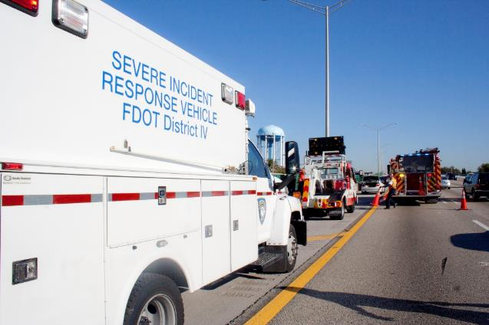
Environmental Benefit: Incident Management
Mitigate impacts of incidents involving hazardous materials and pollutants:
  Incident management trainings with first responders
  Quick clearance program and incentives
  Send appropriate level of response to incident
  Reroute traffic with real-time information to reduce congestion
Source: Florida DOT.
Notes:
Incident management programs are another example of a category of TSMO strategies with environmental benefits. While such activities may not require a lot of coordination from environmental staff, it is good to know that such activities offer environmental benefits, specifically mitigating the impact of incidents involving hazardous materials.
Need permission from FDOT to reuse photo.

Slide 43
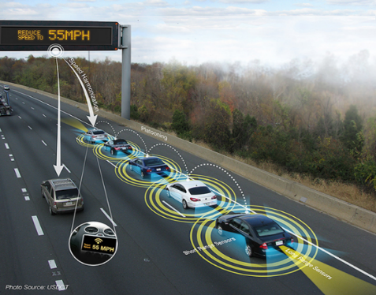
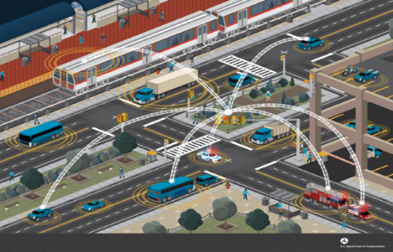
Environmental Benefit: CAVs
Recent modeling has demonstrated large potential fuel savings from CAV technology
CAV and speed harmonization application could*:
  Reduce fuel consumption 19–22 percent
  Improve travel times 26–30 percent
* Source: https://www.itskrs.its.dot.gov/node/209123
Source: U.S. Department of Transportation
Notes:
CAV technology is a significant emerging area for TSMO professionals. CAV technology can be leveraged to implement many TSMO strategies, (e.g., variable speed limits and speed harmonization) and with expected additional benefits for fuel savings, travel time savings, and safety. Environmental practitioners can benefit from coordinating with TSMO staff on how CAV technology can help achieve environmental goals. One caveat is that several studies have estimated that CAVs may increase vehicle miles traveled.
Image source: U.S. Department of Transportation. https://www.its.dot.gov/communications/its_images.htm

Slide 44
TSMO Benefits from Collaborating with Environmental Staff
TSMO is most successful when staff across the whole agency collaborate on operational solutions
Example: TSMO programs are affected by climate change and extreme weather*, which can cause:
  Loss of roadway capacity and alternate routes
  Increased safety risks
  Loss of situational awareness
  Accelerated infrastructure deterioration
* FHWA, Climate Change Adaptation Guide for Transportation Systems Management, Operations, and Maintenance (2015), https://ops.fhwa.dot.gov/publications/fhwahop15026/fhwahop15026.pdf
Notes:
Collaboration between the two disciplines in mutually beneficial. Collaborating with environmental staff also helps support TSMO goals, such as those shown here.
This slide focuses on examples of climate change programs and extreme weather management, but the benefits to TSMO go well beyond this. As another example, environmental efforts to promote a variety of travels modes and to harmonize and link different modes would have benefits for TSMO programs looking to optimize mobility without building significant new infrastructure.

Slide 45
Areas for Collaboration
Notes:
This section highlights key areas where TSMO and environmental staff have successfully collaborated with each other, or where there is high potential for benefits of such a collaboration.
Note that this section is intended to present all these areas together in a comprehensive overview. The next section (Examples of Collaboration between TSMO and the Natural and Human Environment) presents examples from these areas where existing collaboration has been documented.

Slide 46
Areas for Collaboration Overview
Road weather management
Climate change readiness and resiliency
Demand management
Sustainable modes of travel
Planning and project development
Asset management
Environmental review
Notes:
These are key areas where TSMO and environmental staff have successfully collaborated with each other, or where there is high potential for mutual benefits from such a collaboration.
Note that this section is intended to present all these areas together in a comprehensive overview. The next section (Examples of Collaboration between TSMO and the Natural and Human Environment) presents examples from these areas where existing collaboration has been documented. Not all areas have been fully charted by all agencies because of the emerging nature of both TSMO and cross-agency collaboration around TSMO.

Slide 47
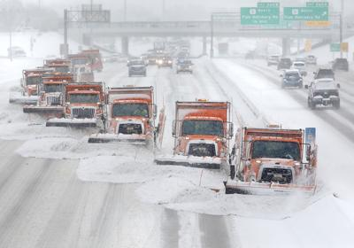
Road Weather Management
Coordinate planning, mitigation, and
response to adverse weather events
Share road weather information systems resources for proactive storm management
Optimize road treatments ahead of winter weather
Prevent infrastructure and environmental degradation in areas with repeat weather problems (e.g., damage and erosion from repeat flooding)
Source: Wisconsin DOT
Notes:
Road weather management is a key category of TSMO activities where collaboration with environmental staff can enhance the environmental benefits of these strategies.
TSMO programs often have some systems and strategies in place for responding to weather events to mitigate negative effects to safety, mobility, and reliability. Environmental staff and TSMO staff may be able to share or co-invest in these systems to extend their use toward the impacts of adverse weather events that may be in the purview of environmental staff.
TSMO programs often have road weather information systems in place to inform such strategies and to proactively manage the agency’s storm response. Environmental staff and TSMO staff may be able to extend the use of these systems toward the impacts of extreme weather events.
TSMO programs may have strategies in place to optimize road treatments, such as applying materials before a winter storm, in order to increase resource use and labor efficiency. These same strategies may confer environmental benefits by minimizing the amount of salt and other chemicals that may run off into the surrounding environment.
TSMO and environmental staff may be able to resolve recurring infrastructure damage as a result of repeat weather. For example, flood-prone areas of the transportation system may cause operational issues, such as delays and safety hazards, and environmental issues, such as soil erosion and runoff.
Photo: Wisconsin DOT (via Joe Gregory, FHWA, with permission)

Slide 48
Climate Change Readiness and Resiliency
Jointly conduct a climate change vulnerability assessment for agency assets and goals
Adapt existing infrastructure for climate change risks
Champion climate change mitigation measures to protect human and natural resources and to reduce future strain on operations
Identify and implement ways to increase resiliency of essential systems
Form an agency resiliency working group to tackle these issues
Notes:
Climate change and increasingly severe weather patterns pose threats to the environment and transportation systems and infrastructure. Environmental staff and TSMO staff can join forces behind this common threat to advance assessments, solutions, and planning to improve their agency’s climate change readiness and the resiliency of their systems. This slides presents a handful of such actions.

Slide 49
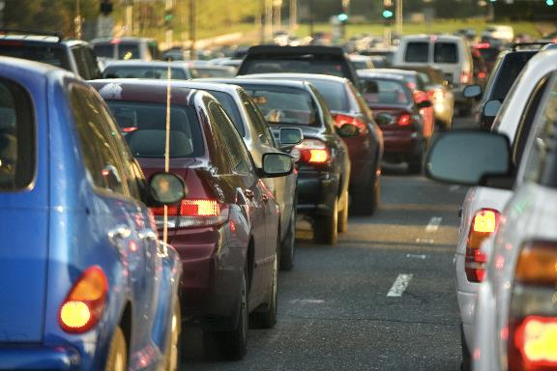
Demand Management
Collaborate on TSMO strategies for demand management needs:
  Active transportation and demand management: dynamic programs to shift travelers from peak travel times and routes to alternative modes
  Congestion pricing: surcharge for high-demand congested roads; many cities outside the United States (London, smaller city centers*) have found success with congestion pricing to manage emissions and mobility
Source: @Getty Images
Notes:
Demand management is a great example of an area of overlap between TSMO and environmental efforts. TSMO practitioners may try to implement demand management strategies, such active transportation and demand management or congestion pricing, to reduce congestion by facilitating or incentivizing travelers to shift their travel away from peak times, routes, and modes. By reducing demand and congestion, and therefore idling, these strategies often convey environmental benefits by reducing emissions.
Gettyimages
Credit:
Jung Getty
Creative #:
939485148
Wikipedia, Congestion Pricing, Roads, https://en.wikipedia.org/wiki/Congestion_pricing#Roads

Slide 50
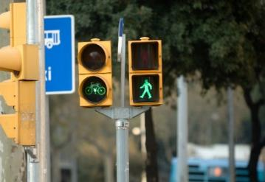

Sustainable Modes of Travel
Improve bicycle and pedestrian infrastructure for greater safety and to promote these modes
Champion advancements in transit systems to improve reliability, travel times, and traveler experience:
  Transit signal priority; transit system traveler information
Improve pedestrian, bicycle, and rail crossings for greater safety and better traveler experience
Integrate different modes to create complete trips
Champion a multimodal approach to performance goals
Source: @Getty Images, iStock
Notes:
Promoting sustainable modes of travel is an excellent avenue to advance environmental and TSMO goals. Converting vehicle trips to bicycle, pedestrian, or transit trips generally has positive environmental impacts by reducing emissions. But environmental practitioners may not always have the benefits of these strategies to their TSMO counterparts at the front of their minds. TSMO programs seek to improve the overall mobility, reliability, efficiency, and safety of the whole transportation system – and leveraging all modes of travel is crucial to achieving this. In addition, TSMO practitioners want to make sure the systems and infrastructure for sustainable modes of travel are safe and efficient. This slide lists a handful of strategies that TSMO and environmental staff may want to collaborate on to promote sustainable modes and ensure their safety and efficiency. In addition to improving the infrastructure and systems supporting each mode, practitioners can collaborate to help integrate or link different modes (creating “complete trips”) to help create additional safe and efficient options for a variety of travel needs.
Photos from:
http://www.istockphoto.com/photo/traffic-lights-gm182244240-11295121?st=_p_traffic%20signal%20bike%20safety
iStock/stevenallan
http://www.istockphoto.com/photo/father-and-son-enjoying-bus-journey-together-gm466672809-33778206
iStock/monkeybusinessimages

Slide 51
Planning and Project Development
Long-term planning:
  Ensure infrastructure and land use plans take into account forecasts for climate change, extreme weather, technological advancements, and sustainable modes
Scenario planning:
  Spearhead scenario planning to better prepare for uncertainties in environmental and technological trends
Self-evaluation tools:
  Facilitate agency evaluations that promote environmental and operational focus; for example, FHWA’s Infrastructure Voluntary Evaluation Sustainability Tool (INVEST) includes a management and operations module
Notes:
Planning is a foundational area to all aspects of a transportation agency’s work. By collaborating at this stage, environmental and TSMO practitioners can help direct the agency toward low-cost operational solutions with relatively high safety, mobility, and environmental payoffs. Environmental and TSMO practitioners can especially find common ground in planning for the impacts of climate change, extreme weather, and technological advancements (including improvements and proliferation of CAVs, electric vehicles, and intelligent transportation infrastructure). Agencies may want to adapt traditional investment strategies to prepare for these impacts, such as improving infrastructure resiliency, investing in systems to manage the effects of climate change and extreme weather, and adapting long-term capital projects to reflect expected advancement and penetration rates of new technologies.

Slide 52
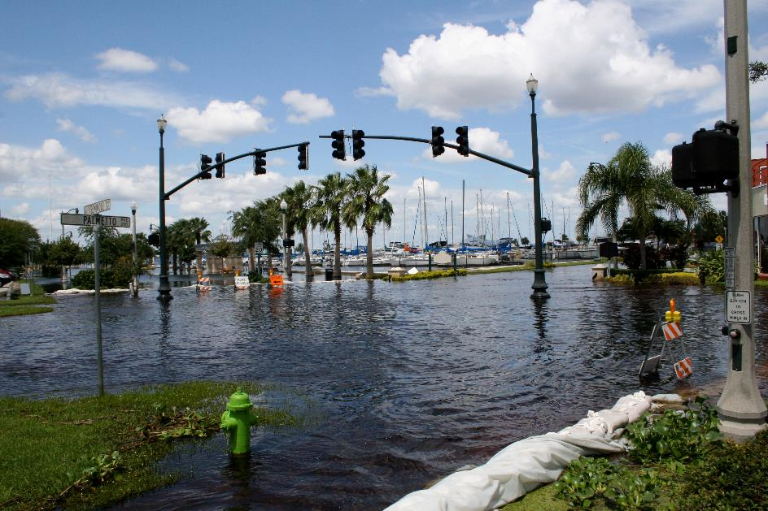
Asset Management
Incorporate resilience/vulnerability to extreme weather and climate change into TSMO asset management practices
Source: @Getty Images
Notes:
Asset management is an area where there has already been some collaboration between TSMO and environmental staff. The next section provides a couple examples. However, in general, environmental and TSMO staff can collaborate to add assessments of infrastructure’s resilience or vulnerability to the impacts of extreme weather and climate change into routine asset management practices.
Credit: Getty images djjohn Creative #: 122006897

Slide 53
Environmental Review
Raise awareness of TSMO alternatives to capacity projects
  TSMO projects typically have high benefit/cost ratios, are relatively quick to implement, and can reduce environmental review needs
TSMO projects are often considered categorical exclusions in the National Environmental Policy Act (NEPA) review process
A categorical exclusion shortens review and permits quicker implementation than traditional expansion projects
Some TSMO strategies may still require an environmental review
“NEPA Classes of Action,” Environmental Review Toolkit, FHWA,
https://www.environment.fhwa.dot.gov/nepa/classes_of_action.aspx#ce
Notes:
TSMO can often be looked upon favorably in environmental review processes. TSMO projects typically have high benefit/cost ratios, are relatively quick to implement, and can reduce environmental review needs. They also can often be considered categorical exclusions in the National Environmental Policy Act (NEPA) review process, which can help speed up the process.
This is true only as long as there are no unusual circumstances that could potentially cause environmental impact and therefore affect the NEPA class of action. For example, adding part-time shoulder use to a road that is otherwise not being expanded may move traffic closer to sensitive noise receptors and could require environmental review. Still, many TSMO strategies can potentially qualify as categorical exclusions, and both environmental staff and TSMO staff can benefit from awareness of this potential.

Slide 54
Examples of Connecting TSMO and the Natural and Human Environment
Notes:
This section presents examples of connecting TSMO and the natural and human environment through collaboration between environmental and TSMO staff. Note that not all areas have documented cases of collaboration, and therefore do not have examples in this section. However, they still present high potential for collaboration. Also, not all examples of collaboration will have direct benefits for both. The win-win may be reached as part of a broader relationship rather than a single effort in which both parties get a benefit.

Slide 55
Natural Hazards Information System: Arizona DOT
GIS dashboard to prepare for and respond to fires, mud slides, or other natural hazards
  GIS includes layers of road mile posts, forest coverage, hydrology and debris flow, risk modeling from the U.S. Geological Survey, and National Weather Service radar
Warns transportation management centers, environmental staff, and TSMO staff of hazardous conditions on the roads
Supports better operations decisions to send out crews to prepare or respond to events
Provides enhanced information on how natural hazards impact the roadways, travel, and safety
Notes:
This case study came from a listening session with TSMO and environmental practitioners in support of this project. Arizona DOT developed this GIS dashboard with the U.S. Geological Survey and National Weather Service.
This is an example of environmental staff and TSMO staff using a shared resource to improve their coordination and their agency’s overall decision-making and response in the face of hazardous weather events. It also provides direct benefits to each discipline. For TSMO staff, it supports better decision-making regarding when DOT sends out crews to prepare or respond to events. For environmental staff, it provides enhanced information on how natural hazards impact the roadways, travel, and safety.

Slide 56
Dust Storm Management: Arizona DOT
Environment and TSMO coordinated to develop a dust storm detection and management system
Deployed in 2020 along 10 miles of I-10 between Phoenix and Tucson
Includes weather radar system, visibility detectors, variable speed limit signs, closed-circuit cameras, and overhead message boards
Rapidly tells drivers to slow down for safety when windblown dust reduces visibility
Improves safety and mobility during dust storms
Provides information on how dust storms impact roadway conditions and the traveling public
https://azdot.gov/adot-news/first-its-kind-dust-detection-and-warning-system-set-monsoon
Notes:
Arizona’s DOT’s dust storm detection and management system is another example of environmental staff and TSMO staff collaborating on a shared resource to improve the agency’s ability to safely and efficiently manage their transportation systems during hazardous weather events. This project was funded in part by a Federal FASTLANE grant

Slide 57
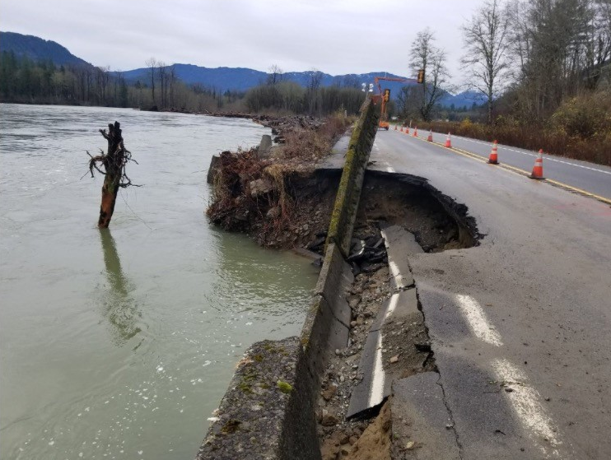
Climate Impacts Vulnerability Assessment: Washington State DOT
Through workshops, Washington State DOT assessed the vulnerability of its assets to climate change
Assessment revealed areas (mountains, riversides) where assets were generally vulnerable
Found co-benefits of from improvements made for other purposes (e.g., fish passage and storm water retrofits)
Established a process that connects climate vulnerability to asset management, planning, and TSMO
Source: Washington State DOT
https://wsdot.wa.gov/sites/default/files/2021-10/Climate-Impact-AssessmentforFHWA-12-2011.pdf
Notes:
Washington State DOT conducted an assessment of how vulnerable their assets were to climate change (2011 – qualitative statewide study). These assessments revealed areas where assets were generally vulnerable, such as mountains and riversides. It also revealed a pattern that assets that had been enhanced for other purposes, such as seismic retrofits, showed decreased vulnerability to climate change. The assessment established a process for tying in climate change vulnerability to asset management, maintenance, and planning for infrastructure resiliency. TSMO has a vested stake in all of these activities, given TSMO’s goal of getting the most of out existing infrastructure.
Source of photo: Provided by Washington State DOT, Carol Lee Roalkvam and Karin Landsberg, to Joe Gregory, FHWA, for use in presentation.

Slide 58

Climate Impacts Vulnerability Assessment
FHWA’s Climate Change Adaptation Guide for Transportation Systems Management, Operations, and Maintenance provides a framework and matrix to help agencies quickly assess their vulnerabilities and risks
Getting Started: Desktop Vulnerability/Risk Assessment Checklist
Determine desired outcome of vulnerability/risk assessment – vulnerability vs. risk, qualitative vs. quantitative.
Identify “wish list” of projected climate data (based on what climate impacts are relevant).
Collect historical climate data for those variables/event types.
  Possible sources include Road Weather Information Systems (RWIS), National Weather Service, agency weather data providers.
Collect data on projected changes in those variables/event types.
  See Federal Highway Administration (FHWA) Virtual Framework for data sources.
Source: FHWA
Notes:
This slide highlights an FHWA guide for agencies that want to conduct their own climate change vulnerability assessment. Available at:
https://ops.fhwa.dot.gov/publications/fhwahop15026/fhwahop15026.pdf

Slide 59
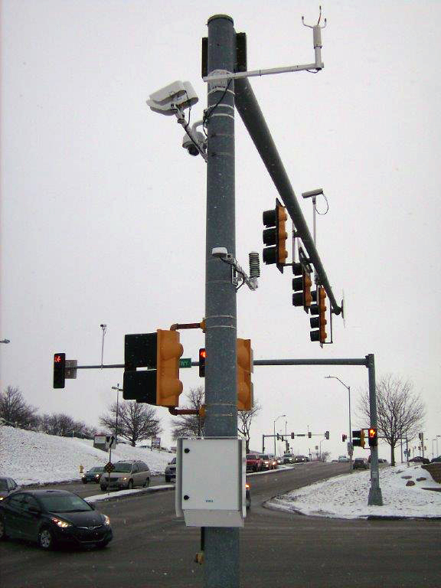
Road Weather Management Solutions: West Des Moines, Iowa
Leveraged multiple technologies to enhance winter maintenance:
  Road weather information systems, infrared sensors for pavement friction determination, automatic vehicle location, mobile sensors on plows and other vehicles, software for snowplow route optimization, maintenance decision support system
Environmental benefits include reduced chloride application by 30 percent and fuel consumption from route optimization
Roads were cleared more efficiently
Source: West Des Moines Public Services
Notes:
This case study highlights TSMO road weather strategies with significant environmental benefits.
For more information: https://ops.fhwa.dot.gov/publications/fhwahop18075/index.htm
Photo provided by Bret Hodne, West Des Moines Public Services, Iowa to Joe Gregory, FHWA, for use in this presentation.

Slide 60

E-Scooter Operations: Santa Monica, California
Arrival of unsanctioned e-scooters in 2018 created safety and mobility issues in Santa Monica’s multimodal system
Santa Monica launched a shared mobility services pilot
Survey revealed e-scooter users decreased their car trips by 50 percent and increased walking or transit trips by 18 percent and 16 percent
City worked to address safety challenges associated with e-scooters
Leverages the full transportation system by diversifying modes
Source: @Getty Images
https://www.fhwa.dot.gov/livability/case_studies/santa_monica/
Notes:
The shared mobility services pilot did these specific things:
Set limits on the number of e-scooters per company
Established requirements and policies for operating (e.g., data sharing, customer service, 2-hour response time for blocking right-of-ways)
Created designated e-scooter drop zones
This case study is a great example of a local initiative that environmental and TSMO staff could collaborate on to create benefits for both disciplines. For TSMO staff, it helps leverage the full transportation system to improve mobility while working to mitigate the unintentional negative externalities, such as scooters blocking walkways. For environmental staff, the e-scooters help increase the city’s share of trips taken with sustainable modes. The city worked to address safety challenges surrounding e-scooters through public education and signage including a video focused on safe e-scooter use and designated no-ride zones.
Credit: Getty Images, Extreme Media, Creative #: 1140589430

Slide 61

Climate Office and TSMO Program Coordination: Oregon DOT
Created a Climate Office in 2020 to focus on greenhouse gas reduction and climate change adaptation
Developing a plan to identify actions for reducing greenhouse gases
Oregon DOT’s TSMO program is coordinating with the Climate Office on actions related to transportation systems operations
Statewide Transportation Strategy for reducing greenhouse gases includes “Operations and Technology” as a key strategy (e.g., advanced signal timing, ramp metering, incident management, real-time traveler information)
Source: @Getty Images
Notes:
While there were no documented results of this effort at the time of this presentation’s publication (2021), Oregon DOT’s Climate Office is an example of TSMO and environmental staff collaborating on planning at a high level in the agency.
https://www.oregon.gov/odot/Programs/Pages/Climate-Office.aspx#:~:text=The%20mission%20of%20the%20ODOT,of%20climate%20and%20extreme%20weather
Image Credit: Getty Images, RobinOlimb, Creative #: 514643946

Slide 62

Multiple Connections between TSMO and Environment: New Jersey DOT
As part of Transportation Asset Management Plan process, the Division of Environmental Resources and TSMO program identify areas where recurring, weather-related repairs are needed (e.g., flooding) to prevent road closures
Developed a Resiliency Working Group with Environment, TSMO, another DOT units to map New Jersey DOT’s path to resilience
Project scoping process combines input from Environment, TSMO, and other disciplines for each project
Source: @Getty Images
Notes:
New Jersey DOT provides a number of examples of TSMO and environmental staff coordinating that touch the areas for collaboration identified in this presentation. These include traffic incident management and spill containment, asset management and environmental vulnerability, improving transportation system resiliency, and planning.
Image Credit:
RobinOlimb
Creative #:
514463078
License type:
Royalty-free

Slide 63
FHWA’s INVEST
INVEST is a web-based self-evaluation tool
Designed to help agencies assess and advance projects that are environmentally, economically, and socially sustainable
TSMO projects can be assessed through the operations and maintenance (OM) module
Many agencies have used the INVEST OM module to evaluate and improve environmental sustainability through TSMO
https://www.sustainablehighways.org
Notes:
FHWA’s INVEST tool is a resources for agencies looking to increase collaboration between TSMO and environmental programs. The next two slides provide case studies of agencies that have used INVEST to improve collaboration between the two disciplines.

Slide 64
INVEST Case Study: Utah DOT
Used the INVEST OM module to evaluate sustainability of OM programs
Produced specific actions for advancing sustainability though OM and for integrating sustainability into daily culture:
  Produce proactive bridge management system, improve traffic signal operations, and incorporate LIDAR data into pavement management system
After implementing recommendations, Utah DOT has seen improved air quality, safety, economic benefits, and pavement service life, as well as reduced fuel usage, and crashes
https://www.sustainablehighways.org/779/22/utah-dot-saving-money-and-improving-operations-and-maintenance-with-invest.html
Notes:
Utah DOT is another example of an agency that used INVEST to evaluate the sustainability of its OM systems, many of which are relevant to TSMO. Utah saw benefits related to the environment (e.g., improved air quality, reduced fuel usage) and TSMO (e.g., improved safety and traffic signal operations).
Additional case studies on how the INVEST OM evaluation has improved sustainability through TSMO can be found at: https://www.sustainablehighways.org/779/case-studies.html

Slide 65
Overcoming Challenges to Collaboration

Slide 66
Potential Challenges…and Solutions (1/5)
Challenge
Solutions
Limited awareness and understanding of TSMO among environmental staff, and even among programs with current direct ties to TSMO work
Many agencies are already working to increase TSMO awareness. Your TSMO program/champion may be able to help:
  Establishing lunch and learns and working groups
Resources to help assess and advance TSMO activities:
  https://ops.fhwa.dot.gov/plan4ops
Notes:
It is not uncommon for DOT staff to have a limited awareness of TSMO, especially because TSMO is relatively new. This is gradually changing thanks in part to education campaigns conducted by agencies around the county and by the U.S. Department of Transportation (USDOT). Practitioners may want to see if their agency has already started work on such an education campaign. Alternatively, if they are piloting TSMO education at their agency, FHWA has compiled a number of resources to help.

Slide 67
Potential Challenges…and Solutions (2/5)
Challenge
Solutions
Starting to collaborate can temporarily add work – why do it?
TSMO can help reach environmental goals and create a greater impact than working alone
Resources on making the business case for TSMO:
  Benefit-cost resources (https://www.itskrs.its.dot.gov/benefits/goals/energy-environment)
Notes:
At the beginning, collaboration can initially add more work for staff, even though it can potentially save and resources down the line. It is important to convey the benefits of any new initiative to get all needed parties on board. This presentation is one resource to make the case to environmental staff and TSMO staff. The linked resources in this presentation can also help. In addition, USDOT has a searchable database of compiled research on intelligent transportation system benefits, many of which are TSMO strategies, with a dedicated category to environmental and energy benefits. This can be useful to provide additional numbers on how TSMO can provide environmental benefits.

Slide 68
Potential Challenges…and Solutions (3/5)
Challenge
Solutions
TSMO professionals not familiar with environmental review requirements and processes
Educate staff before upcoming round of projects
Designate a liaison between TSMO and environmental staff
Rotational assignments between the two groups
FHWA environmental review resources
Notes:
This challenge was brought up during the listening session with agency staff, to inform this presentation. Staff outside the environmental program not always familiar with the environmental review process, sequence, timeline, and requirements. This education gap can be a barrier to new collaborations.
For the “FHWA environmental review resources” solution, FHWA has two resources that may be of particular help:
FHWA Environmental Review Toolkit: https://www.environment.fhwa.dot.gov/
Federal-aid Essentials Videos on Environment: https://www.fhwa.dot.gov/federal-aidessentials/catmod.cfm?category=environm

Slide 69
Potential Challenges…and Solutions (4/5)
Challenge
Solutions
TSMO professionals not familiar with environmental needs and processes
Share the resources in this presentation with TSMO staff
Organize an event or lunch and learn with TSMO staff to educate on environmental priorities
Notes:
While many TSMO strategies offer environmental benefits, TSMO staff may not be closely familiar with the needs and processes of their agency’s environmental program. All of the resources linked in this presentation can work to educate both TSMO and environmental staff on the needs of the other discipline. Additionally, setting up a dedicated time where TSMO staff (and potentially other staff, too) can learn about their environmental program’s priorities and processes can help facilitate this awareness building.

Slide 70
Potential Challenges…and Solutions (5/5)
Challenge
Solutions
Improving mobility can induce demand and longer trips, leading to more miles traveled; how do we address any such impacts of TSMO strategies?
This is another reason why collaboration between TSMO and environmental staff is important
TSMO and environmental staff can collaborate to select the best TSMO strategy to mitigate this, or select other strategies to counteract induced demand
Notes:
Some practitioners express concern that efforts to reduce congestion, improve mobility, and reduce travel times will induce demand, leading to more trips and miles traveled. While induced demand is an important phenomenon to continue researching and monitoring, it should not be a barrier to collaboration. The goal of TSMO is to improve mobility, reliability, and safety—as opposed to a goal of increasing miles traveled. It is important for TSMO and environmental staff to work together to consider the concern of induced demand along with their broader assessment of the transportation system’s challenges and potential solutions. Collaboration between disciplines will help the agency find the best strategies for improving overall system performance.

Slide 71
Next Steps

Slide 72
Potential Short-Term Actions
Start a conversation!
  https://ops.fhwa.dot.gov/plan4ops/focus_areas/communicating_tsmo.htm
Conduct a TSMO and climate change vulnerability/risk assessment
  https://ops.fhwa.dot.gov/publications/fhwahop15026/fhwahop15026.pdf
Facilitate continuing education and collaboration among TSMO and environmental staff
  Lunch and learns, working groups, email distribution group for key updates from both sides
Notes:
This slide presents a few short-term actions that agencies can take to jump start collaboration between environmental and TSMO staff. Note that the climate change vulnerability/risk assessment tool is covered on slide 55.

Slide 73
Potential Long-Term Actions
Form an agency resiliency working group to champion efforts at the nexus of environment and TSMO work:
  Asset management and extreme weather/climate change
  Overall resiliency/redundancy of essential systems
  Promoting and leveraging sustainable transportation modes for greater system performance
  Long-term planning and scenario planning for climate change and technology advancement
Notes:
For longer-term actions, agencies may find it beneficial to establish a working group to champion efforts at the nexus of these two disciplines. This group can evaluate, direct, and monitor the wide variety of actions in this presentation that staff may want to consider.

Slide 74
FHWA Resources
Transportation Systems Management and Operations in Smart Connected Communities: https://ops.fhwa.dot.gov/publications/fhwahop19004/fhwahop19004.pdf
Role of Transportation Systems Management and Operations in Supporting Livability and Sustainability: https://ops.fhwa.dot.gov/publications/fhwahop12004/fhwahop12004.pdf
Climate Change Adaptation Guide for Transportation Systems Management, Operations, and Maintenance: https://ops.fhwa.dot.gov/publications/fhwahop15026/
Connecting TSMO and Environment fact sheet: https://ops.fhwa.dot.gov/publications/fhwahop18089/index.htm
Notes:
These FHWA resources discuss how TSMO and environmental staff can work together, and they provide best practices and case studies from previous collaborations.

Slide 75
Thank you!
For more information please contact:
[Enter contact information.]

