Slide 1
Connecting TSMO and
Planning
PLANNING
Presenter Name
Date
Source: Getty Images
Notes:
This presentation is about how we can work together by connecting transportation system management and operations, or TSMO, with planning to improve transportation system performance now and in the future.

Slide 2
Disclaimer
The U.S. Government does not endorse products, manufacturers, or outside entities. Trademarks, names, or logos appear in this presentation only because they are considered essential to the objective of the document. They are included for informational purposes only and are not intended to reflect a preference, approval, or endorsement of any one product or entity.

Slide 3
Executive Summary
Notes:
This Executive Summary is intended for senior agency leadership and others who make investment decisions regarding transportation facilities and the way they are operated.
We begin with an overview of some of the many changes that are affecting the way we plan and manage transportation systems throughout both States and local jurisdictions.

Slide 4

Transportation Landscape Is Changing
Limited funds
Advances in technology
Customer needs and expectations
Better understanding of causes of congestion
Increased emphasis on performance-based planning and programming
Source: Missouri Department of Transportation Flickr
Notes:
The transportation landscape is changing, and doing business the way it has been done in the past is no longer effective. For example, previously, congestion issues were primarily addressed by funding major capital projects (adding lanes or building new interchanges and roads) to address physical constraints, such as bottlenecks. Operational improvements were typically an afterthought—considered after the new infrastructure was already added to the system. Today, transportation agencies are facing trends that create a growing demand for travel with less funding and space to work with. As a result, we can no longer build our way out of congestion.
Trends we see today include:
Limited funds. Transportation agencies on the Federal, State, and local levels have for years been tasked with doing more with limited resources. State departments of transportation (DOT) are always looking for innovative, lower-cost ways to get people and goods to their destinations more safely and reliably.
Advances in technology. Transportation agencies can leverage technology and data to develop solutions to address congestion issues. However, the traveling public expects fast, reliable, and “smart” transportation, given the advancement in consumer technologies (e.g., smartphones, apps, Global Positioning System (GPS)), privately owned mobility services (e.g., Uber, Lyft), shared mobility, and the availability of more information.
Changing customer needs and expectations. There is a greater demand for accountability for public officials to ensure that public funds are spent to maximize the performance of the transportation system in the most cost-effective way. This creates a trend toward “performance-based” programs. The traveling public is seeking relief from unexpected delays in their trips. There is also a greater focus on offering multimodal transportation options and solutions for the pedestrian, bicyclist, and transit rider.
Better understanding of the causes of congestion. Research has shown that while some congestion may be caused by typical morning and evening rush hours, a significant amount comes from non-recurring events, such as crashes, breakdowns, work zones, weather, and special events.
Increased emphasis on performance-based planning and programming. Transportation planning and programming decisions are increasingly based on data and performance measures.
(Source: https://ops.fhwa.dot.gov/publications/fhwahop19085/fhwahop19085.pdf)
Image – Modot flickr -https://flic.kr/p/QNwCuy

Slide 5
How Are Transportation Organizations Responding?
Transportation Systems Management and Operations (TSMO)
Agencies are using TSMO strategies, technologies, mobility services, and programs to benefit the safety, mobility, and reliability of the existing and planned transportation system.
State and local departments of transportation (DOTs) and metropolitan planning organizations (MPOs) are incorporating TSMO objectives and strategies in planning documents to facilitate TSMO implementation and achieve goals.
States and MPOs are facilitating collaboration among planners and operators from multiple jurisdictions and local agencies.
Planners can use TSMO to address changes in the transportation landscape and advance the transportation system performance.
Notes:
How are transportation organizations such as State and local DOTs and MPOs adjusting and responding to these changes?
Transportation systems management and operations (TSMO) is a solution.
The goal here is to get the most performance out of the transportation facilities we already have. TSMO is the use of strategies, technologies, mobility services, and programs to optimize the safety, mobility, and reliability of the existing and planned transportation system.
Planners can use TSMO to address changes to the transportation landscape and advance transportation system performance.

Slide 6
TSMO Is a “Way of Thinking” That Supports State Departments of Transportation (DOTs) Missions
“We provide safe, reliable, and cost-effective transportation options to improve communities and economic vitality for people and businesses.”
Washington State DOT mission¹
“To provide the best multimodal transportation system for Colorado that most effectively and safely moves people, goods, and information.”
Colorado DOT mission²
¹Washington State DOT, “Our Strategic Plan,” https://www.wsdot.wa.gov/about/secretary/strategic-plan/
²Colorado DOT, “Mission, Vision & Values,” https://www.codot.gov/about/mission-and-vision.html
Notes:
TSMO leverages technology, a toolbox of strategies, and engineering solutions to maximize system performance; however, TSMO ultimately involves a way of thinking or a mindset focused on determining the best way to optimize the mobility and reliability of the existing system with limited resources.
TSMO can be thought of as a way of thinking and operating in order to get the most performance out of the transportation network while only building as much as is needed.
The principles of TSMO directly support the missions of many State DOTs, as these examples show.
NOTES:
States can insert their own mission statement here for effect or can leave these in.
Presenters can emphasize the connections between TSMO definition and their specific Mission statement, such as safety, reliability, cost-effective, multimodal, customer’s needs/satisfaction, etc.

Slide 7
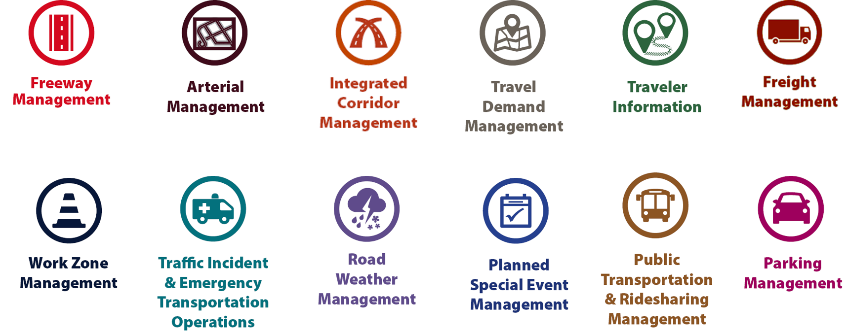
Examples of TSMO Strategies
Source: Federal Highway Administration.
Notes:
This slide illustrates the array of operational strategies that fall under the TSMO umbrella that can be used individually or in combination with each other. This list is not exhaustive, but it highlights the key buckets of strategies that are priorities for many agencies.
Examples of other TSMO strategies include:
Traffic signal coordination
Transit signal priority
Special event management
Congestion pricing
Active transportation and demand management
Connected/automated vehicles
Completing multimodal networks
Intelligent transportation systems (ITS) components can support all these TSMO strategies. ITS covers a variety of technologies to monitor, evaluate, and manage transportation systems to enhance efficiency and safety. It should be noted that TSMO does not equate to ITS; many strategies support TSMO that do not involve an ITS component. TSMO efforts often mean that agencies will have new partners, new stakeholders, and new technology procurements that will benefit from a more formalized way of doing business.
TSMO strategies can be categorized into three overarching areas: incident or event management, traffic management, and demand management strategies. The next three slides highlight strategies in each of these areas.

Slide 8
Why TSMO Is Relevant for Planning
Offers opportunities to help achieve desired outcomes and performance targets for mobility, reliability, and safety in the near term at lower cost
Enables planners to identify strategies for the short-term planning horizon (3–5 years) and for inclusion in the congestion management process (CMP)
Helps planners identify mobility needs and solutions that may complement, replace, or defer larger capacity-adding projects
Provides operational performance data to support planning
Notes:
Why does TSMO matter to planners? How can planners benefit from connections to TSMO?
TSMO can offer opportunities to achieve desired outcomes more quickly and at lower cost than most capacity expansion projects. TSMO can help planners identify mobility needs and solutions that may complement, replace, or defer larger capacity-adding projects. TSMO also helps planners identify strategies for the short-term planning horizon and for inclusion in the CMP.
TSMO can provide data and analysis that can focus attention on the most urgent immediate needs and longer term issues where existing infrastructure will be inadequate to accommodate projected demand.
TSMO can provide real-time and archived data to assess how well system performance targets are being met.

Slide 9
Why Planning Is Relevant for TSMO
Planning can integrate near-term operations objectives and needs into longer term planning priorities.
Engaging with planners can lead to consideration of TSMO strategies for funding and identification of possible funding sources.
When introduced early in planning, cost-effective TSMO strategies can be considered for inclusion in major capital projects.
Planners can help identify how TSMO can be considered along with or as alternatives to capacity expansion projects.
The CMP can be used to identify operational performance issues, needs, and TSMO strategies and projects.
Notes:
Why does transportation planning matter to operators? How can operators benefit from connections to planning?
When operators work with planners, they can give greater visibility to TSMO strategies early in the planning process and integrate them into near-term plans, including obtaining funding for TSMO projects that address regional needs as reflected in operations objectives. TSMO projects often offer lower-cost, more quickly implemented alternatives to major capital investments, but they need to be introduced during planning to ensure that they receive consideration. Other objectives and priorities may include adding TSMO assets in to asset management activities, such as signals and ITS.
TSMO strategies may be eligible for funding from multiple sources when included in plans and funding programs. Planners can help operators identify which funding sources may apply for their projects or services.
The congestion management process (CMP) provides another opportunity for operational performance issues, needs and TSMO strategies and projects to be both introduced to planners and included in plans and funding programs.

Slide 10
How Can TSMO Support Planning?
Developing operations-related goals, objectives, and performance measures for use in plans
Connecting broad outcome-related objectives to more specific operational performance objectives that can be achieved through TSMO
Creating innovative institutional arrangements that share resources, provide mutual assistance, agree on interoperability standards, and share real-time and archived data
Providing data that can help agencies identify needs (e.g., bottlenecks) and recommending TSMO strategies that can address those needs
Notes:
TSMO strategies can support planning in several ways.
TSMO staff can help create operations-related goals, objectives, and performance measures.
Increased emphasis on system reliability suggests that planners consider including reliability-oriented objectives and performance measures for travelers and goods movement.
Operators typically have data and technology infrastructure needed to support the development of these objectives and measures and to monitor system reliability performance.
TSMO staff can help connect outcome-related objectives to more specific operational performance objectives that can be achieved through TSMO.
States and MPOs can identify unreliable roadway segments and the TSMO strategies to be included in long-range plans, short-term corridor plans, and transportation improvement programs/state transportation improvement programs that will address those segments.
Working together, planners and operators can create innovative institutional arrangements that share resources, provide mutual assistance, agree on interoperability standards, and share real-time and archived data.
Operators can also provide data to planners that can help agencies identify needs and recommend TSMO strategies to meet those needs.

Slide 11
How TSMO Connects to Planning
TSMO can support each step in the transportation planning process
Sources: Federal Highway Administration and Federal Transit Administration
Notes:
TSMO offers opportunities to connect with planning throughout the transportation planning process at both the State and local levels. The “connection” begins with getting the right players to the table to develop goals and objectives and then providing data and analysis to identify deficiencies and candidate strategies for addressing deficiencies.
TSMO practitioners can offer innovative strategies that many planners may not consider as alternatives to capacity expansion, and they can work with planners to evaluate and select the most cost-effective options for addressing deficiencies and leveraging new opportunities for improving transportation system performance.
The “key” to the connection is collaboration between planners and TSMO staff to establish, encourage, and support institutional arrangements and joint processes where both groups share ideas and information throughout the planning process. Each of the following factors plays a role in furthering the connection between TSMO strategies and planning:
Stakeholders: Engage operating agencies, operating committees, and operations stakeholders
Goals: Engage operations managers in developing goals and objectives for TSMO
Criteria: Include measures for network reliability and flexibility based on archived data
Deficiencies: Evaluate deficiencies for systems management and interagency coordination
Alternatives: Involve operations experts in developing systems management alternatives
Selection: Involve operations experts in evaluating management and operations strategies.

Slide 12
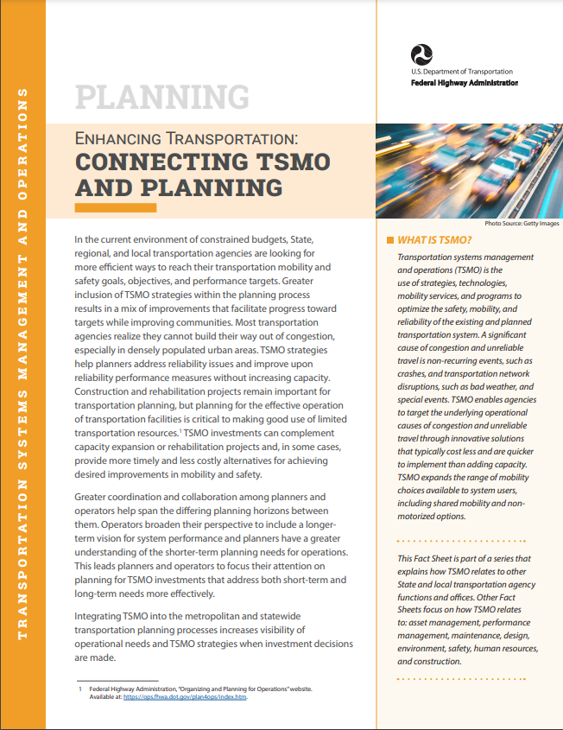
Next Steps
Bring TSMO and planning leaders together to identify areas of common interest and mutual objectives.
Find out how TSMO strategies are already supporting planning goals.
Discuss where TSMO can make an even greater impact on planning goals.
Begin joint efforts to improve the TSMO and planning connection.
Consider developing a regional concept for transportation operations (RCTO) to plan for operations.
To learn more: https://ops.fhwa.dot.gov/publications/fhwahop18096
Source: Federal Highway Administration
Notes:
How do you get started?
The first step is to gain senior leadership support and bring TMSO and planning leaders together to identify and confirm common goals.
In many cases, state DOTs and MPOs are already using TSMO strategies to support planning – find out where and who is involved. Find ways to leverage current joint efforts to achieve planning goals.
Consider developing a regional concept of transportation operations (RCTO). To find out more about the RCTO, participants can go to https://ops.fhwa.dot.gov/plan4ops/focus_areas/trans_ops.htm. Could you
Consult other resources to learn more about successful collaborations between planning and TSMO, including the FHWA fact sheet on “Connecting TSMO and Planning.”

Slide 13
Thank you for your attention!
For more information please contact:
(Insert speaker contact information)

Slide 14
End of Executive Summary
Notes:
To learn more about how TSMO and Planning can be connected and have been connected, you can attend a more comprehensive presentation on this topic.

Slide 15
Goals of This Presentation
Create awareness of transportation systems management and operations (TSMO) strategies and goals
Demonstrate alignment between TSMO and planning goals
Provide examples of how TSMO can benefit planning activities and vice versa
Discuss ways for TSMO and planning to collaborate and connect
Notes:
This presentation is intended to introduce planners to TSMO-related goals and strategies, including showing how TSMO goals align with planning goals.
The presentation provides real-world examples where State DOTs and MPOs are connecting TSMO and planning to their mutual benefit. It also offers suggestions on how TSMO and planning can collaborate effectively.

Slide 16
Presentation Overview
What is TSMO?
Why connect TSMO and planning?
Opportunities for collaboration
Examples of coordination between TSMO and planning
Overcoming challenges
Next steps for connecting TSMO and planning
Notes:
We begin this presentation with a brief discussion of what transportation systems management and operations, or TSMO, is.
We’ll then discuss reasons for connecting TSMO and planning and opportunities for closer collaboration between these two functions within State DOTs, MPOs, and other transportation-related organizations.
Next, we’ll review some examples of how several DOTs, MPOs, and other entities are connecting TSMO and planning to achieve their objectives for the transportation system. We will conclude by reviewing the challenges and next steps in connecting TSMO and planning.

Slide 17
What Is TSMO?
Notes:
Transportation systems management and operations, or TSMO, can help! So, what is TSMO anyway? Let’s take a look…

Slide 18
Definition of TSMO
Integrated [set of] strategies to optimize the performance of existing infrastructure through the implementation of multimodal and intermodal, cross-jurisdictional systems, services, and projects designed to preserve capacity and improve security, safety, and reliability of the transportation system.^{1,2}
¹GovInfo. 2012. Definitions and Declarations of Policy, Title 23 of the U.S. Code § 101 (a)(30)(A), Washington, DC, obtained from: https://www.govinfo.gov/app/details/USCODE-2011-title23/USCODE-2011-title23-chap1-sec101.
²Federal Highway Administration (FHWA). n.d. “What Is TSMO?” (website). https://ops.fhwa.dot.gov/tsmo/, last accessed January 20, 2023.
Notes:
Before going further, it is important to define TSMO for new audiences:
TSMO is an integrated set of strategies to optimize the performance of existing infrastructure through the implementation of multimodal and multi-jurisdictional systems, services, and projects designed to preserve capacity and improve security, safety, and reliability of the transportation system.
The goal here is to get the most performance out of the transportation facilities we already have. TSMO is the use of strategies, technologies, mobility services, and programs to optimize the safety, mobility, and reliability of the existing and planned transportation system.

Slide 19
Characteristics of TSMO
Offers an integrated set of strategies to optimize operational performance of the existing transportation system
Approaches performance from a systems perspective that spans corridors, facilities, jurisdictions, modes, and agencies
Helps agencies balance supply and demand on the system and provide flexible solutions to manage dynamic conditions
Complements capacity projects, or in some cases provides lower cost, faster alternatives
Notes:
TSMO is an integrated set of strategies to optimize the operational performance of the existing transportation system.
Note: The definition at the top of the slide is an abridged version of the Federal Highway Administration’s (FHWA) TSMO definition found here: https://ops.fhwa.dot.gov/tsmo and at 23 USC 101 (a) (30).
TSMO approaches performance from a systems perspective.
Spans corridors, facilities, jurisdictions, modes, and agencies
TSMO takes a holistic approach to managing performance that looks beyond a single corridor (e.g., are changes to a specific corridor causing a mobility issue nearby?), jurisdiction (e.g., are management systems coordinated across jurisdictional boundaries?), mode (e.g., are we using all modes optimally to meet our performance goals?), and agency (e.g., how can we improve collaboration with law enforcement or transit agencies to improve performance?).
Helps agencies balance supply and demand on the system and provide flexible solutions to manage dynamic conditions.
Example TSMO strategies include ramp metering, managed lanes, and congestion pricing.
TSMO can complement capacity projects, or in some cases can provide lower cost, faster alternatives.
TSMO can complement capacity projects or can provide lower-cost, faster alternatives in some cases.
TSMO seeks to provide lower-cost alternatives to capacity projects when operational strategies may produce equal or better results – or when operational strategies may be able to produce results faster. It does not seek to eliminate capacity projects in cases where a capacity project is the best solution. Rather, TSMO provides agencies with more options.

Slide 20
TSMO Strategy Examples
Source: Federal Highway Administration
Notes:
This slide illustrates the array of operational strategies that fall under the TSMO umbrella that can be used individually or in combination with each other. This list is not exhaustive, but it highlights the key buckets of strategies that are priorities for many agencies.
Examples of other TSMO strategies include:
Traffic signal coordination
Transit signal priority
Special event management
Congestion pricing
Active transportation and demand management
Connected/automated vehicles
Completing multimodal networks
Intelligent transportation systems (ITS) components can support all these TSMO strategies. ITS covers a variety of technologies to monitor, evaluate, and manage transportation systems to enhance efficiency and safety. It should be noted that TSMO does not equate to ITS; many strategies support TSMO that do not involve an ITS component.
TSMO strategies can be categorized into three overarching areas: incident or event management, traffic management, and demand management strategies. The next three slides highlight strategies in each of these areas.

Slide 21
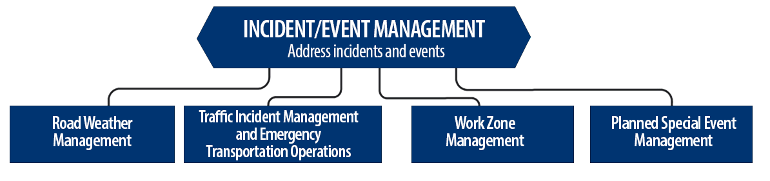
Incident/Event Management Strategies
Source: Federal Highway Administration.
Notes:
Incident and event management includes several strategies that address major sources of travel-time unreliability.
Incident and event management strategies include road weather management, traffic incident management and emergency transportation operations, work zone management, and planned special event management.
Road weather management activities include creating hazardous weather traffic operations response plans, implementing variable speed limits, detecting hazardous weather conditions, disseminating weather and warnings to travelers through dynamic signs and systems, providing emergency truck and parking facilities and emergency parking information, and implementing vehicle restrictions.
Traffic incident management and emergency transportation operations activities include establishing traffic incident management teams, conducting after action reviews, staging tow trucks in strategic areas, providing roadway safety patrols, integrating computer-aided dispatch into transportation management centers, pre-establishing towing service agreements, co-locating dispatching units, developing quick clearance goals, pre-planning detour routes, implementing shoulder running, deploying adaptive ramp metering, providing variable speed limits, implementing dynamic lane-use controls, deploying network surveillance cameras or detectors, implementing incident traffic signal timing plans, enacting legislation, and integrating traffic management centers with law enforcement dispatch and emergency centers.
Work zone management activities include coordinating maintenance and construction activities, implementing queue length detection, deploying network surveillance cameras or detectors, implementing variable speed limits, supporting dynamic lane merging, implementing dynamic lane-use controls, deploying temporary ramp metering, and implementing dynamic warning systems.
Planned special event management activities include activating special event timing plans, deploying adaptive ramp metering, implementing variable speed limits, using hard shoulder running, activating dynamic transit fare reduction, implementing reversible lanes, supporting dynamic lane-use controls, establishing dynamic pricing, deploying network surveillance cameras or detectors, activating dynamic wayfinding, and conducting after action reviews.
Source: FHWA, Integrating Travel Time Reliability into Transportation System Management: Final Technical Memorandum
https://ops.fhwa.dot.gov/publications/fhwahop19035/index.htm

Slide 22
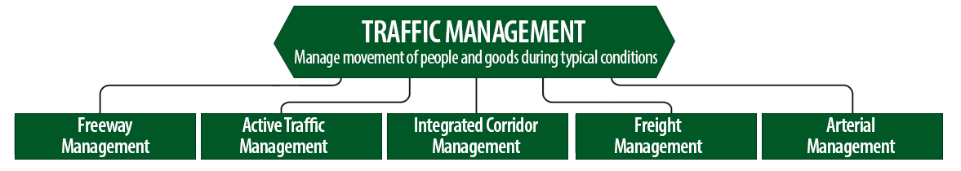
Traffic Management Strategies
Source: Federal Highway Administration.
Notes:
While incident or event management strategies address atypical events that cause travel-time unreliability, traffic management strategies manage the movement of people and goods during everyday conditions. Even during typical conditions, fluctuations in travel demand can lead to unreliable travel conditions. Traffic management strategies allow the transportation network to adapt to unreliability, including variations in travel demand.
Traffic management strategies include freeway management, active traffic management, integrated corridor management, freight management, and arterial management.
Freeway management activities include implementing traffic surveillance cameras or detectors, using high-occupancy lanes, implementing adaptive ramp metering, deploying hard shoulder running, implementing variable speed limits, deploying dynamic lane-use controls, and constructing physical operations improvements such as overpass widening, curve corrections, or adding auxiliary lanes.
Active traffic management activities include adopting adaptive ramp metering, implementing adaptive traffic signal control, using dynamic lane reversal, implementing dynamic lane-use controls, deploying dynamic merge control, implementing temporary shoulder running, using variable speed limits, deploying queue length detection, providing transit signal priority, and implementing dynamic warning signs.
Integrated corridor management activities include implementing network surveillance cameras or detectors, conducting access management and driveway access controls, implementing adaptive ramp metering, deploying adaptive signal control, deploying transit signal priority, installing queue jumping lanes, providing traveler information for alternative modes, and deploying emergency vehicle preemption.
Freight management activities include implementing roadside truck electronic screening and clearance, implementing truck signal priority, using truck parking management systems, installing truck climbing lanes, and implementing freight loading zone policies.
Arterial management activities include installing queue jumping lanes, deploying transit signal priority, supporting emergency vehicle preemption, implementing network surveillance cameras or detectors, implementing access management and driveway access controls, providing enhanced bicycle and pedestrian crossings, establishing a transportation management center, deploying enhanced traffic signal operations, implementing transit-only lanes, implementing truck traffic signal priority, designing for complete streets, adding capacity for critical movements, reducing travel speeds, providing automated enforcement, and conducting operations asset management.
Source: FHWA, Integrating Travel Time Reliability into Transportation System Management: Final Technical Memorandum
https://ops.fhwa.dot.gov/publications/fhwahop19035/index.htm

Slide 23
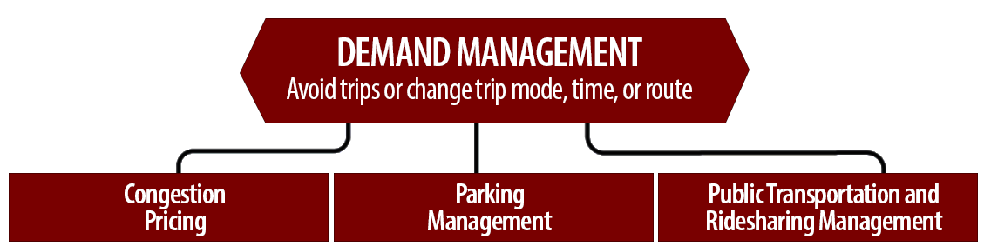
Demand Management Strategies
Source: Federal Highway Administration.
Notes:
Demand management strategies reduce underlying demand by helping travelers avoid trips or change the mode, timing, or route of trips. This makes nonrecurring congestion less likely to occur and improves travel-time reliability.
Demand management strategies include congestion pricing, parking management, and public transportation and rideshare management.
Congestion pricing activities include implementing dynamic pricing, variable pricing by lane, segment, and time of day or day of week; establishing dynamic transit fare reductions; and deploying managed lanes for high occupancy.
Parking management activities include deploying dynamically priced parking; implementing dynamic parking, wayfinding, reservations, and capacity; deploying dynamic overflow transit parking; implementing electronic payment systems and shared-use parking; and providing incentives to use underutilized parking facilities.
Public transportation and ridesharing management activities include implementing dynamic ridesharing, implementing transit signal priority, using queue-jump lanes at signalized intersections, deploying electronic fare collection and integration, and implementing dynamic surveillance and security.
Source: FHWA, Integrating Travel Time Reliability into Transportation System Management: Final Technical Memorandum
https://ops.fhwa.dot.gov/publications/fhwahop19035/index.htm

Slide 24
TSMO Is a “Way of Thinking” That Supports State Departments of Transportation (DOTs) Missions
“We provide safe, reliable, and cost-effective transportation options to improve communities and economic vitality for people and businesses.”
Washington State DOT (WSDOT) mission¹
“To provide the best multimodal transportation system for Colorado that most effectively and safely moves people, goods, and information.”
Colorado DOT (CDOT) mission²
¹ WSDOT. n.d. “Strategic Plan” (web page). https://www.wsdot.wa.gov/about/secretary/strategic-plan/, last accessed January 20, 2023.
² CDOT. 2022.“About CDOT: Mission, Vision & Values” (web page). https://www.codot.gov/about/mission-and-vision.html, last accessed January 20, 2023.
Notes:
TSMO leverages technology, a toolbox of strategies, and engineering solutions to maximize system performance; however, TSMO ultimately involves a way of thinking or a mindset focused on determining the best way to optimize the mobility and reliability of the existing system with limited resources.
TSMO can be thought of as a way of thinking and operating in order to get the most performance out of the transportation network while only building as much as is needed.
The principles of TSMO directly support the missions of many State DOTs, as these examples show.
NOTES:
States can insert their own mission statement here for effect or can leave these in.
Presenters can emphasize the connections between TSMO definition and their specific Mission statement, such as safety, reliability, cost-effective, multimodal, customer’s needs/satisfaction, etc.

Slide 25
TSMO Supports Many State and Local DOT Goals
Reduced congestion
Smoother and more reliable traffic flow
Improved safety
Cleaner air and less wasted fuel
More efficient use of resources and existing facilities
Increased economic vitality
Improved quality of life
Notes:
Here are some common goals in state and local transportation agencies that TSMO strategies support. This list is not exhaustive, but intended to show that TSMO support a range of mission-critical goals. Examples of how TSMO supports these goals are shown on the next slide.

Slide 26
Example TSMO Strategies That Support Transportation Agency Goals
TSMO Strategies |  | Goals
Traffic signal coordination, congestion pricing, demand management |  | Reduced congestion
Manage nonrecurring events (incidents, weather), managed lanes, traveler information |  | Smoother and more reliable traffic flow
Utilize the full system—coordinate all modes, transit signal priority |  | More efficient use of resources and existing facilities
Notes:
TSMO strategies that support some common transportation agency goals are shown here. Many of these strategies support more than one goal, but here are some key examples.

Slide 27
TSMO State of the Practice
Application of TSMO has accelerated in agencies across the country over the past 5–10 years
Recognition of TSMO’s value has grown, leading to a variety of approaches for advancing TSMO in agencies. For example:
  Establishing a TSMO division or office
  Formalizing a TSMO program
  Integrating TSMO throughout the agency
  Establishing a TSMO committee
  Collaborating with other agencies on TSMO activities
  Identifying TSMO champions or liaisons
  Conducting a TSMO capability maturity model (CMM) self-assessment
  Developing a TSMO program plan
Notes:
TSMO as a more formal discipline has gained momentum in recent years. Recognition of the importance of TSMO has accelerated in the past five to ten years (as of year of publication of this presentation, 2022).
Key focus areas for agencies during this time have been adapting their culture, processes, expertise, and, in some cases, organizational structures to promote TSMO and a more operationally focused mindset. Agencies approach this differently depending on their unique context and needs. Several examples of key strategies agencies have used to advance TSMO within their organizations are shown here.
Central to all of these organizational approaches is 1) strong support from senior leadership, 2) a champion or champions who understand and promote TSMO throughout the agency, and 3) an openness to learning and cooperation among functions or divisions within an agency. Collaboration with other agencies on TSMO activities is also a key component of advancing TSMO.
A TSMO capability maturity model self assessment is a framework developed to help agencies evaluate their current capabilities in the area of TSMO and identify steps for improving their TSMO capabilities. The self-assessment can be accessed at: http://aashtotsmoguidance.org/. There are also other capability maturity frameworks that FHWA has developed to support the implementation of TSMO. More can be learned about those frameworks at: https://ops.fhwa.dot.gov/tsmoframeworktool/index.htm.

Slide 28
Resources on TSMO
FHWA. n.d. “What Is TSMO?” (web page). https://ops.fhwa.dot.gov/tsmo, last accessed January 19, 2023.
FHWA. n.d. “Organizing and Planning for Operations” (web page). https://ops.fhwa.dot.gov/plan4ops, last accessed January 19, 2023.
FHWA. n.d. “Communicating TSMO” (web page). https://ops.fhwa.dot.gov/plan4ops/focus_areas/communicating_tsmo.htm, last accessed January 19, 2023.
National Operations Center of Excellence (NOCoE). 2022. “National Operations Center of Excellence” (website). https://www.transportationops.org/, last accessed January 19, 2023.
Notes:
While these slides provide a comprehensive, high-level summary of TSMO, participants who are looking for more details and information to share with their staff can visit these virtual resources.

Slide 29
Why Connect TSMO and Planning?
Notes:
Now that you have a better understanding of TSMO and how TSMO strategies can help achieve goals, let’s look as how TSMO related to planning specifically.
First, let’s take a look at how the transportation world is changing and will continue to change over the next several decades…

Slide 30
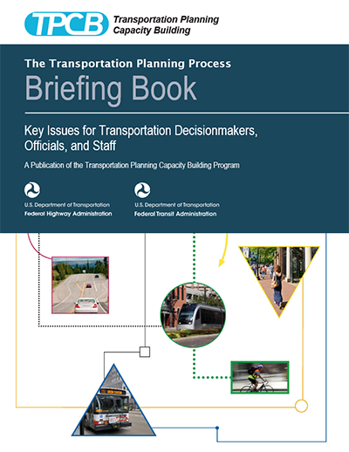
What Is Meant by Planning?
“A cooperative, performance-driven process by which long and short-range transportation improvement priorities are determined.”
Source: FHWA and Federal Transit Authority (FTA), The Transportation Planning Process Briefing Book, 2015.
Source: Federal Highway Administration and Federal Transit Administration
Notes:
The joint FHWA/FTA 2015 publication referenced here defines planning as a process that is
Cooperative
Performance-driven
Cognizant of the need for both long- and short-range improvement
Capable of setting priorities for improvements and related investments
The transportation planning process is illustrated on the next slide.

Slide 31
The Transportation Planning Process
Starts with vision and goals
Top-down (objectives driven)
Bottom-up (feedback informed)
Long- and short-term options
Analysis-/evaluation-based priorities
Focus on system performance
Resource constraints
Sources: Federal Highway Administration and Federal Transit Administration
Notes:
The transportation planning process is both “top-down” and “bottom-up,” is driven by and agreed-upon vision for the State or region, and is informed by feedback from system users and other information that identifies both issues and opportunities.
The planning process uses data, modeling, and other means to identify deficiencies and to evaluate candidate strategies for improving system performance.
All of this is accomplished within resource constraints based on the amount of funding available, the eligibility of the funds for various investments, and the matching requirements to use the funds.

Slide 32

Transportation World Is Changing
Limited funds
Advances in technology, data, computing power, and analytics
Customer needs and expectations:
  Greater demand for accountability
  Multimodal transportation options
Better understanding of causes of congestion
Source: Missouri Department of Transportation Flickr
Notes:
The transportation world is changing, and doing business the way it has been done in the past is no longer effective. For example, previously, congestion issues were primarily addressed by funding major capital projects (adding lanes or building new interchanges and roads) to address physical constraints, such as bottlenecks. Operational improvements were typically an afterthought—considered after the new infrastructure was already added to the system. Today, transportation agencies are facing trends that create a growing demand for travel with less funding and space to work with. As a result, we can no longer build our way out of congestion.
Trends we see today include:
Limited funds. Transportation agencies on the Federal, State, and local levels have for years been tasked with doing more with limited resources. State departments of transportation (DOT) are always looking for innovative, lower-cost ways to get people and goods to their destinations more safely and reliably.
Advances in technology, data, computing power, and analytics. Transportation agencies can leverage technology and data to develop solutions to address congestion issues. However, the traveling public expects fast, reliable, and “smart” transportation, given the advancement in consumer technologies (e.g., smartphones, apps, Global Positioning System (GPS)), privately owned mobility services (e.g., Uber, Lyft), shared mobility, and the availability of more information. More data is available in near real-time to drive operations decisions.
Changing customer needs and expectations. There is a greater demand for accountability for public officials to ensure that public funds are spent to maximize the performance of the transportation system in the most cost-effective way. This creates a trend toward “performance-based” programs. The traveling public is seeking relief from unexpected delays in their trips. There is also a greater focus on offering multimodal transportation options and solutions for the pedestrian, bicyclist, and transit rider.
Better understanding of the causes of congestion. Research has shown that while some congestion may be caused by typical morning and evening rush hours, a significant amount comes from non-recurring events, such as crashes, breakdowns, work zones, weather, and special events.
(Source: https://ops.fhwa.dot.gov/publications/fhwahop19085/fhwahop19085.pdf)
Image – Modot flickr -https://flic.kr/p/QNwCuy

Slide 33

Moving Ahead
Doing more with less
Maximizing existing infrastructure; using what you have
Thinking differently, holistically, and big picture
Planning, collaborating, evaluating, and repeating
Source: Unsplash
Notes:
State DOTs and other public agencies are making a transformational shift in the way they conduct business moving forward by:
• Doing more with less
• Maximizing operational capacity of existing infrastructure
• Changing organizational culture/mindset
Other points to make:
State DOTs are increasingly realizing the importance to plan, think ahead, and think big picture; for example, planning for complete, systemwide multimodal networks and considering transportation equity and environmental impacts.
To be successful, disciplines are collaborating and working together moe
Collaboration/solutions also include other stakeholders outside the DOT
Photo - https://unsplash.com/photos/Yy6aBfhOwJc

Slide 34
TSMO Is a Solution
DOTs and MPOs consider TSMO strategies in transportation plans in order to improve performance of existing and planned transportation facilities.
MPOs are facilitating collaboration among planners and operators from multiple jurisdictions to develop operations objectives and identify TSMO strategies.
Agencies include TSMO strategies, technologies, mobility services, and programs to optimize the safety, mobility, and reliability of existing and planned transportation system.
Planners can use TSMO to address changes in the transportation landscape and advance the transportation system performance.
Notes:
Transportation systems management and operations (TSMO) is a solution.
The goal here is to get the most performance out of the transportation facilities we already have. TSMO is the use of strategies, technologies, mobility services, and programs to optimize the safety, mobility, and reliability of the existing and planned transportation system.
In many metropolitan areas, MPOs are often the ideal entity for bringing planners and operators together to collaborate on strategies for improving transportation system performance, focusing in particular on TSMO strategies that can produce near-term improvements at much lower cost than major capital investments. Local agencies, which often have limited funding, can adopt TSMO strategies that improve system performance, particularly when working with other agencies and jurisdiction to achieve agreed-upon regional objectives for the transportation system.
Planners can use TSMO when planning new facilities and improvements in existing facilities to address the changes in the transportation landscape and move forward.

Slide 35
TSMO and Planning Can Accomplish Shared Goals
A performance-based approach to transportation planning requires focusing on mobility-oriented outcomes rather than on building and maintaining capacity—and this requires planners and operators to work together toward common objectives.
Notes:
Where TSMO and planning intersect is that they are both focused on mobility outcomes rather than building and maintaining capacity.
By working together – “connecting” – planners can take full advantage of the TSMO’s contributions to achieving shared goals and common objectives, including how TSMO strategies can complement new capacity when they are “baked into” the solution from the start.

Slide 36
Change Creates New Opportunities to Collaborate and Achieve Common Goals
TSMO and the planning process share common goals
Both TSMO and planning programs seek to:
  Think differently, more holistically
  Enhance existing systems versus expanding the system
  Do more with less
  Leverage new data to plan and operate smarter
Notes:
In summary – TSMO and the planning process share common goals and, therefore, “connecting” can benefit both TSMO and planning as they both seek improvements in transportation system performance.
Both TSMO and planning embrace a “new way of thinking” – more holistic, more systemic; both seek to enhance existing investments in infrastructure by managing it more efficiently; both must “do more with less” now and in the future.
TSMO can help by offering strategies for improving transportation system performance and by providing data to support investment decisions.

Slide 37
Why TSMO Matters for Planning
Offers opportunities to help achieve desired outcomes and performance targets for mobility, reliability, and safety in the near term at lower cost
Enables planners to identify strategies for the short-term planning horizon (3–5 years) and for inclusion in the CMP
Can help planners identify mobility needs and solutions that may complement, replace, or defer larger capacity-adding projects
Can provide operational performance data to support planning
Notes:
Why does TSMO matter to planners? How can planners benefit from connections to TSMO?
TSMO can offer opportunities to achieve desired outcomes more quickly and at lower cost than most capacity expansion projects. TSMO can help planners identify mobility needs and solutions that may complement, replace, or defer larger capacity-adding projects. TSMO also helps planners identify strategies for the short-term planning horizon and for inclusion in the CMP.
TSMO can provide data and analysis that can focus attention on the most urgent immediate needs and longer term issues where existing infrastructure will be inadequate to accommodate projected demand.
TSMO can provide real-time and archived data to assess how well system performance targets are being met. Importantly, TSMO strategies can help MPOs and State DOTs meet performance targets.

Slide 38
Why Planning Matters for TSMO
Planning can integrate near-term operations objectives and needs into longer term planning priorities.
Engaging with planners can lead to consideration of TSMO strategies for funding and identification of possible funding sources.
When introduced early in planning, cost-effective TSMO strategies can be considered for inclusion in major capital projects.
Planners can help identify how TSMO can be considered along with or as alternatives to capacity expansion projects.
The CMP can be used to identify operational performance issues, needs, and TSMO strategies and projects.
Notes:
Why does transportation planning matter to operators? How can operators benefit from connections to planning?
When operators work with planners, they can give greater visibility to TSMO strategies early in the planning process and integrate them into near-term plans, including obtaining funding for TSMO projects that address regional needs as reflected in operations objectives. TSMO projects often offer lower-cost, more quickly implemented alternatives to major capital investments, but they need to be introduced during planning to ensure that they receive consideration.
TSMO strategies may be eligible for funding from multiple sources when included in plans and funding programs. Planners can help operators identify which funding sources may apply for their projects or services.
The congestion management process (CMP) provides another opportunity for operational performance issues, needs and TSMO strategies and projects to be both introduced to planners and included in plans and funding programs.

Slide 39
Opportunities for Collaboration
Notes:
Now let’s look at some specific ways for connecting TSMO and planning.

Slide 40
How Can TSMO Support Planning? (1/2)
Developing operations-related goals, objectives, and performance measures for use in plans
Connecting broad outcome-related objectives to more specific operational performance objectives that drive State, metropolitan, corridor, and subarea strategies
Creating innovative institutional arrangements that share resources, provide mutual assistance, agree on interoperability standards, and share real-time and archived data
Identifying gaps in the enabling technology of the transportation system and potential solutions using the regional intelligent transportation systems (ITS) architecture to support regional and State planning goals
Notes:
Common goals, objectives, performance measures for mobility
Increased emphasis on system reliability suggests that planners consider including reliability-oriented objectives and performance measures for travelers and goods movement.
Operators typically have the data and technology infrastructure needed to support the development of these objectives and measures and to monitor system reliability performance.
Connect outcome-related objectives to more specific objectives that drive State, metropolitan, corridor, and subarea planning and operations.
States and MPOs can identify unreliable roadway segments and the TSMO strategies to be included in long-range plans, short-term corridor plans, and transportation improvement programs/state transportation improvement programs that will address those segments.
Working together, planners and operators can create innovative institutional arrangements that share resources, provide mutual assistance, agree on interoperability standards, and share real-time and archived data.
The regional ITS architecture can be used to guide planning, especially as it relates to deploying TSMO strategies for improving transportation system performance and identifying gaps in the underlying technology that enables transportation (e.g., fiber, cameras, sensors).

Slide 41
How Can TSMO Support Planning? (2/2)
Using the congestion management process to include a wider variety of operators and planners in discussions about nonrecurring congestion and travel-time reliability
Providing data that can identify needs (e.g., bottlenecks), recommending TSMO strategies that can address those needs, and coordinating to share and jointly procure data that benefit both areas
Participating in freight mobility planning
Expanding the set of solutions to include TSMO during scenario planning
Notes:
The discussions and analysis required by the congestion management process offer an opportunity to include a wider variety of operators and planners in discussions about non-recurring congestion and travel time reliability.
Operators routinely collect data that can help identify needs (e.g., bottlenecks) and also recommend TSMO strategies that can address those needs (e.g., managed lanes, service patrols, real-time traveler information, incident response teams, transportation management centers).
The multimodal perspective that TSMO brings can also help with freight mobility planning for both long haul goods movement and urban goods delivery, including both truck parking and curbside management.
TSMO is another solution that planners can consider during scenario planning.

Slide 42
How TSMO Can Connect to Planning
TSMO can support each step in the transportation planning process.
Sources: Federal Highway Administration and Federal Transit Administration
Notes:
TSMO offers opportunities to connect with planning throughout the transportation planning process at both the State and local levels. The “connection” begins with getting the right players to the table to develop goals and objectives and then providing data and analysis to identify deficiencies and candidate strategies for addressing deficiencies.
TSMO practitioners can offer innovative strategies that many planners may not consider as alternatives to capacity expansion, and they can work with planners to evaluate and select the most cost-effective options for addressing deficiencies and leveraging new opportunities for improving transportation system performance.
The “key” to the connection is collaboration between planners and TSMO staff to establish, encourage, and support institutional arrangements and joint processes where both groups share ideas and information throughout the planning process. Each of the following factors plays a role in furthering the connection between TSMO strategies and planning:
Stakeholders: Engage operating agencies, operating committees, and operations stakeholders
Goals: Engage operations managers in developing goals and objectives for M&O
Criteria: Include measures for network reliability and flexibility based on archived data
Deficiencies: Evaluate deficiencies for systems management and interagency coordination
Alternatives: Involve operations experts in developing systems management alternatives
Selection: Involve operations experts in evaluating management and operations strategies.

Slide 43
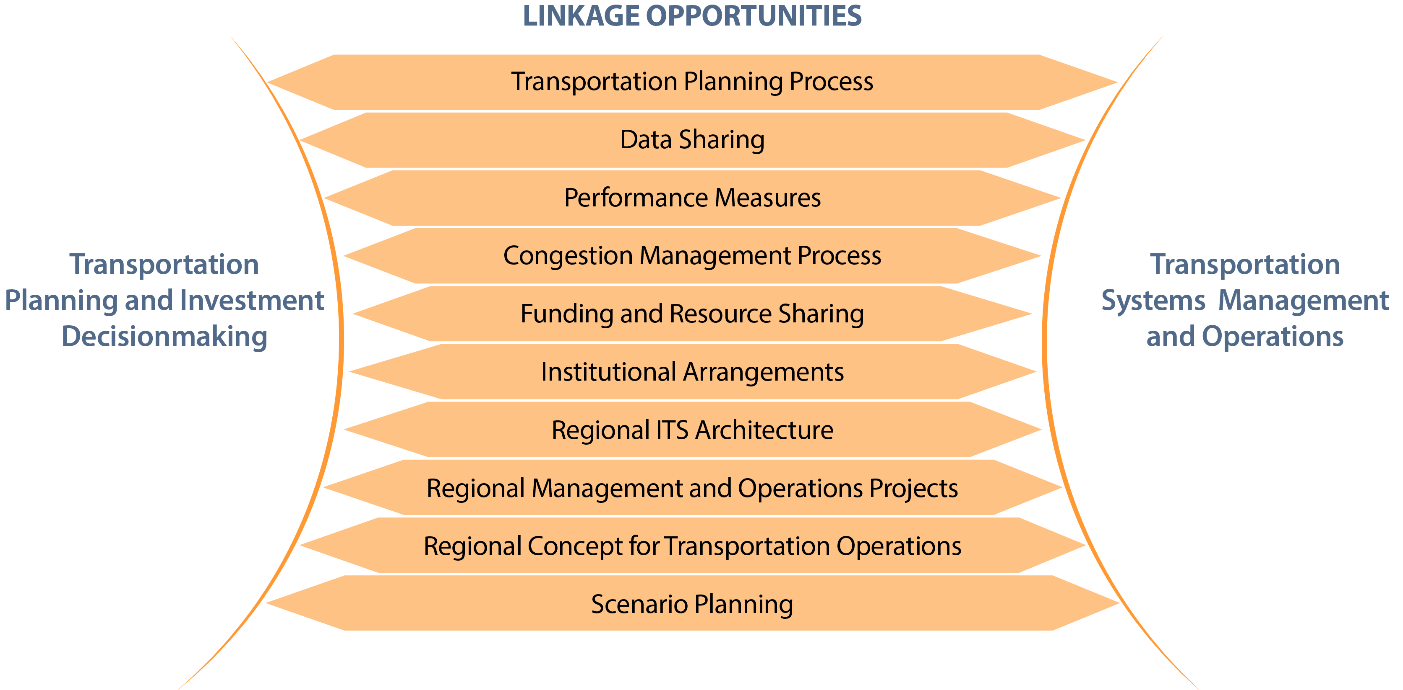
Opportunities for Connecting Planning and TSMO
ITS – Intelligent Transportation Systems
Source: Adapted from FHWA, Getting More by Working Together—Opportunities for Linking Planning and Operations (https://ops.fhwa.dot.gov/publications/lpo_ref_guide/)
Notes:
The referenced FHWA guide highlights how existing relationships between planning and TSMO can be strengthened and new ones encouraged, and how opportunities for greater coordination and collaboration can be developed. It emphasizes the important role that both planners and TSMO staff have to play in building stronger connections and the benefits of these relationships.
The guide describes specific opportunities for improving connections between planning and operations. These opportunities are derived from an extensive review of the literature and interviews with nearly 30 transportation professionals who represent planning and operations at all levels of government.
Based on the collective, practical experiences of these professionals, this guide describes the following linkage opportunities:
The Transportation Planning Process
Data Sharing
Performance Measures
Congestion Management Process
Funding and Resource Sharing
Institutional Arrangements
Regional Intelligent Transportation Systems (ITS) Architecture
Regional Management and Operations Projects
Regional Concept for Transportation Operations
Scenario Planning
Four specific example are presented in the following slides: 1) using archived operations data to identify needs and deficiencies, 2) using scenario planning to identify operations strategies that can help achieve shared goals and objectives, 3) using the congestion management process to bring operations into planning, and 4) a regional ITS architecture. An additional example of TSMO program planning is also presented.
We’ll look first at archived operations data . . .

Slide 44
Using Archived Operations Data for Transportation Planning (1/3)
Traditionally, data for planning come from manual collection techniques and model output
Archived operations data:
  Help transportation planners solve problems and make evidence-based decisions
  Include traffic, transit, bike, pedestrian, construction, and weather information
  Include incident or event information entered into electronic logs by transportation or public safety personnel
See https://ops.fhwa.dot.gov/publications/fhwahop16082/index.htm for information on using archived data in planning
Notes:
Most planning organizations have access to summary data and a collection of models that can be used to approximate both travel demand and capacity limitations.
Archived operations data is captured at high resolution (e.g., by hour/minute and roadway segments) and can help pinpoint specific deficiencies in the existing transportation system. It also include multimodal information and information about related events (e.g., weather, special events, work zones, incidents) along with the resulting delays caused by these events. The archived data can also identify troublesome intersections, poor signal timing, and delays caused by roadway features (e.g., lack of turning lanes).
These data can guide planning and TSMO staff in identifying critical needs in the State or regional transportation network and suggest possible strategies for either reducing demand or gaining capacity from the existing infrastructure.

Slide 45
Using Archived Operations Data for Transportation Planning (2/3)
Archived data are:
Usually collected in realtime
Collected by intelligent transportation system (ITS) infrastructure
Collected by devices including in-pavement inductive loop detectors, radar detectors, remote traffic microwave sensors (RTMS), wireless technology, or other unique identifier tag readers
Notes:
The major advantage of archived data is that they are collected in realtime and can be aggregated and disaggregated as needed to support analysis and evaluation. In addition, operations data are typically collected through ITS and other technology so that they avoid the need for observation or traffic counting during what may be atypical periods. The range of collection methods includes both fixed devices and data collected from vehicles, bicycles, and pedestrians as they move through the system.

Slide 46
Using Archived Operations Data for Transportation Planning (3/3)
Archived operations data include:
Traffic volume, speed, class, and occupancy from point and probe data sources
Event, work zone, and incident information
Weather data
Device operational status
Managed lane status
Surveillance video
Transit alerts
Automated vehicle location (AVL)
Signal status
Signal timing plans
Computer-aided dispatch (CAD) information
Static, descriptive information
Decision-support response plans
Parking data
Travel time
Freight movements
Origin-destination data
Routing data
Notes:
The types of data that can be captured and archived are many and varied, as shown on this and the next slide. Note that some come from installed devices (e.g., cameras, road-weather information systems (RWIS), in-road sensors) and others come from vehicles, including public agency fleets (e.g., motorist assistance patrols, snowplows, maintenance vehicles).
Some data come from participating private sector data collectors who capture and make the data available to State and local agencies; some are provided by organizations that collect data on behalf of their members and then remove identifying information before making it available to public agencies (e.g., truck movement and truck parking data).
The “bottom line” is that the archived operations data that TSMO can provide to planners can help both TSMO and Planning identify deficiencies and potential improvements that help achieve their collective objectives.
Scenario Planning provide another opportunity for “connecting” TSMO and Planning. Let’s look at that approach next . . .

Slide 47
Integrating TSMO and Planning Through Scenario Planning
Uses alternative narratives about the future to make more informed decisions and plans:
Community values and desires
What do we want to happen?
Current trends
What is likely to happen?
Emerging trends, uncertainty
What could happen?
Are values changing? Fully representative? Competing?
What obstacles and opportunities do we have to achieve given what is expected?
What issues and opportunities do we have to achieve given uncertainty or changing trends?
Notes:
Scenario planning is an approach to planning that uses alternate narratives of plausible futures to play out decisions in an effort to make more informed choices and create plans for the future.
From a TSMO perspective, a future state or condition might include narratives that prompt planners and stakeholders to consider what kind of TSMO response might be appropriate to different types (or frequency) of significant weather events, a future that assumes a more significant shift in traveler behavior to non-auto modes, or a future where 30 percent of the vehicles on the road are essentially "driverless."
Considering scenarios like these can result in identifying new technology or data needs, new technology investments, more communication and coordination across emergency response stakeholders, new multimodal TSMO strategies, and other insights that can be factored into both short- and long-term TSMO plans and programs.
Scenario planning helps participants to consider the "what-ifs" of tomorrow, whether those are desirable or undesirable states. The simple task of imagining a different future can help challenge the status quo and encourage creative thinking, which can lead to developing more thoughtful and resilient plans.
Scenarios are developed to enable participants to test out possible decisions, analyze their impacts given the conditions in each scenario, and come to an agreement on a preferred course of action.

Slide 48
Integrating TSMO and Planning Through Scenario Planning—Regional Approach
Identify key community values and goals to better define operations objectives
Examine different TSMO strategies to achieve those objectives
Outcomes can include:
  New or refined operations objectives in regional long-range transportation plans (LRTP)
  Strategies for a regional concept for transportation operations
  Specific investment packages to achieve operations objectives
48
Notes:
Regional Scenario Planning Opportunities
Scenario planning can support identifying key community values and goals to better define operations objectives.
It can also help regional planning partners examine different TSMO strategies to achieve those objectives.
The outcomes of scenario planning can include:
New or refined operations objectives in regional LRTP
Strategies for a Regional Concept for Transportation Operations
Specific investment packages to achieve operations objectives

Slide 49
Integrating TSMO and Planning through Scenario Planning – Statewide Approach
Examine uncertainties relative to fiscal conditions or significant shifts in travel demand or behavior
Help reach consensus on statewide priorities when there are competing goals for use of statewide system
Outcomes can include transportation management center planning, work zone management plans, or statewide freight mobility plans
49
Notes:
Statewide Scenario Planning Opportunities
Scenario planning can also help examine uncertainties relative to physical conditions or significant shifts in travel demand or behavior. It can help reach consensus on statewide priorities.
Outcome areas can include the following:
Transportation Management Center (TMC) Planning
Help to examine different staffing, technology investments and TSMO strategies needed to achieve objectives
Help to establish cross-agency coordination and communication strategies
Help identify best public sector technology investments given changing private sector technology options
Work Zone Management Plans
Help bring together diverse constituencies to identify best transportation management plan for given project
Statewide Freight Mobility Plan
Help address uncertainties and issues beyond state control relative to trade flows
Provides a framework for engaging broad constituencies representing public and private freight and goods movement

Slide 50
Integrating TSMO and Planning through Scenario Planning Steps (1/2)
The scenario planning process, with connections to TSMO (steps 1–3):
1. How should we get started?
Work plan
Operations stakeholder group
Focal issues
Driving Forces
2. Where are we now?
Baseline information on trends
Current performance
Institutional context
3. Where do we want to go?
Draft operations goals, objectives, performance measures
Performance targets
Key local factors
50
Notes:
The FHWA primer, Advancing TSMO through Scenario Planning, offers a 6-step structure for scenario planning that aligns well with traditional transportation planning processes. The guidebook focuses primarily on how to apply scenario planning on a regional scale; however, these same phases and steps can be applied to statewide, corridor-level, or neighborhood-level approaches and across short- or long-term planning horizons.
Per FHWA, these are suggested phases, but each location using scenario planning has unique situations, and these phases can be adjusted to fit each community's individual needs. For example, some communities might be much further along in their data collection efforts and could skip Phase 2.
Phase 1. The leaders of the scenario planning effort bring together a broad set of relevant stakeholders and scope the effort.
Phase 2. Practitioners establish the baseline information and data needed to identify 10-, 20-, or 50-year trends and other information relevant to revealing insights into travel demand, economic drivers, and other important factors that could influence system-wide transportation dynamics.
Phase 3. Building upon their understanding of the existing public policy context and future trends, the leaders of the scenario planning effort work with the stakeholders to identify values, goals, and priorities.
Source: FHWA, Advancing Transportation Systems Management and Operations through Scenario Planning, https://ops.fhwa.dot.gov/publications/fhwahop16016/ch3.htm

Slide 51
Integrating TSMO and Planning through Scenario Planning Steps (2/2)
The scenario planning process, with connections to TSMO (steps 4–6):
4. What could the future look like?
Scenarios
TSMO strategies or policies
5. What impacts will scenarios have?
Estimated impacts of TSMO strategies or policies for each scenario
6. How will we reach our desired future?
Action plan
TSMO projects and programs
51
Notes:
Phase 4. The scenario planning leaders guide stakeholders in creating different narratives or scenarios for the future, e.g.; 5-, 10-, 20-, or 30-year projections. These projections are driven by the public policy goals, objectives, and values identified during Phase 3 to define a desirable future or futures that take into account "what-if" conditions that could arise outside of the public policy level of influence (e.g., inclement weather, new technology, significant financial or economic shifts). This phase also includes the development of a set of measures or key indicators that can provide quantitative and qualitative analysis for scenario comparisons. Following the development of scenarios, strategies necessary to bring about each potential future must be identified.
Phase 5. The relative impacts of each scenario are compared and analyzed based on a pre-determined set of indicators or performance measures.
Phase 6. The scenario planning process concludes with stakeholders crafting a preferred vision, strategies to accomplish the vision, and performance measures to track progress in achieving that vision.
Source: FHWA, Advancing Transportation Systems Management and Operations through Scenario Planning, https://ops.fhwa.dot.gov/publications/fhwahop16016/ch3.htm

Slide 52
Congestion Management Process
The congestion management process (CMP) is:
  A systematic approach for managing congestion
  Required in metropolitan areas with populations exceeding 200,000
  Integrated into the metropolitan transportation planning process
The CMP is an opportunity for planners and operators to work together on monitoring system performance and developing objectives, performance measures, and strategies related to improving operations through TSMO
For more information, see FHWA’s “Organizing and Planning for Operations” web page on the CMP: https://ops.fhwa.dot.gov/plan4ops/focus_areas/cmp.htm
Notes:
The congestion management process (CMP) is a systematic approach for managing congestion. It is required in metropolitan areas with populations exceeding 200,000, known as Transportation Management Areas (TMAs). The CMP is led by the region’s MPO and integrated into the metropolitan transportation planning process. The CMP uses a performance-based approach to planning for congestion management. Since TSMO strategies are prime candidates for mitigating congestion, the CMP is a natural opportunity for planners and operators to connect. They may work together on monitoring system performance and developing objectives, performance measures, and strategies related to improving operations through TSMO.
For more information, see FHWA’s Organizing and Planning for Operation’s web page on the CMP: https://ops.fhwa.dot.gov/plan4ops/focus_areas/cmp.htm. The FHWA’s Office of Planning, Environment, and Realty maintains a web page in the CMP as well: https://www.fhwa.dot.gov/planning/congestion_management_process/.

Slide 53
Regional Intelligent Transportation Systems Architecture
A regional ITS architecture is a “framework for ensuring institutional agreement and technical integration for the implementation of ITS projects or groups of projects in a particular region.”¹
Regional ITS architecture can connect planning and TSMO through:
  Orienting the architecture to reflect the goals and objectives of the region (or State)
  Using the needs and services identified during the architecture update to inform TSMO elements of the transportation plan
  Considering the sequence of projects from the ITS architecture for funding consideration in the Transportation Improvement Program (TIP) or State Transportation Improvement Program (STIP)
  Ensuring that information flows defined in the architecture are maintained with new projects
¹U.S. Department of Transportation, FHWA, Regional ITS Architecture Guidance Document, FHWA-HOP-06-112, 2006. Available at: https://ops.fhwa.dot.gov/publications/regitsarchguide/index.htm, last accessed February 12, 2023.
Notes:
A regional ITS architecture is a “framework for ensuring institutional agreement and technical integration for the implementation of ITS projects or groups of projects in a particular region.”¹
The regional ITS architecture includes an inventory of ITS for the region, a stakeholder list, user needs, functional requirements, services, interfaces, standards, planning objectives or strategies, roles and responsibilities, agreements, and projects.
The regional ITS architecture can connect planning and TSMO through:
Orienting the architecture to reflect the goals and objectives of the region (or State)
Using the needs and services identified during the architecture update to inform TSMO elements of the transportation plan
Considering the sequence of projects from the ITS architecture for funding consideration in the TIP or STIP
Ensuring that information flows defined in the architecture are maintained with new projects.
More information available at: FHWA. 2012. Applying a Regional ITS Architecture to Support Planning for Operations: A Primer, Report No. FHWA-HOP-12-001. Available at: https://ops.fhwa.dot.gov/publications/fhwahop12001/, last accessed February 12, 2023.
¹U.S. Department of Transportation, FHWA, Regional ITS Architecture Guidance Document, FHWA-HOP-06-112, 2006. Available at: https://ops.fhwa.dot.gov/publications/regitsarchguide/index.htm, last accessed February 12, 2013.

Slide 54
TSMO Program Plan
A TSMO program plan outlines the strategic, programmatic, and tactical visions for TSMO and the steps needed to achieve them.
Planners and operators can collaborate in developing and updating a TSMO program plan.
A TSMO program plan and the transportation planning process can be linked regarding TSMO-oriented goals, objectives, performance measures, and TSMO projects or services.
Planners can support the development of a TSMO program plan by applying their skills and knowledge in stakeholder engagement and overall plan development.
For more information, see FHWA’s “Organizing and Planning for Operations” web page on TSMO program plans: https://ops.fhwa.dot.gov/plan4ops/tsmo_plans.htm.
Notes:
A TSMO program plan outlines the strategic, programmatic, and tactical visions for TSMO and the steps needed to achieve them. It helps to formalize a TSMO program within an agency.
Planners and operators can (and often do) collaborate in developing and updating a TSMO program plan.
Through their collaboration, a TSMO program plan and the transportation planning process can be linked regarding TSMO-oriented goals, objectives, performance measures, and TSMO projects or services.
Planners can also support the development of a TSMO program plan by applying their skills and knowledge in stakeholder engagement and overall plan development.
For more information, see FHWA’s Organizing and Planning for Operation’s web page on TSMO program plans: https://ops.fhwa.dot.gov/plan4ops/tsmo_plans.htm.

Slide 55
Examples of Coordination Between TSMO and Planning
Notes:
Now that we understand what TSMO is and the “why” and “how” TSMO and planning can connect, let’s look at some examples of how various State DOTs, MPOs, and local agencies are connecting TSMO and planning.

Slide 56
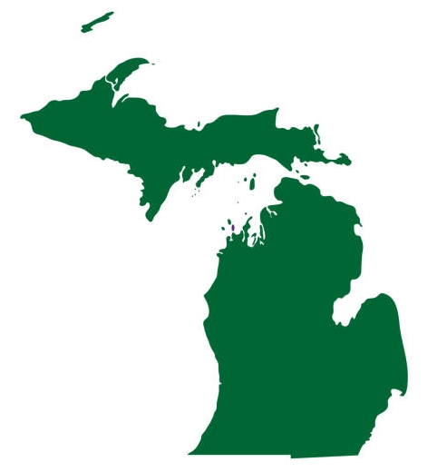
Coordination Between TSMO and Planning (1/2)
Statewide Congestion Management Group
“. . . formed as a result of a 2015 peer exchange, and in preparation for the upcoming rulemaking under MAP-21 [Moving Ahead for Progress in the 21st Century Act]¹. This group includes representatives from MDOT Planning and Operations, as well as MPO and transit agencies. Its focus is on the integration of performance-based principles in planning, operations, safety, and asset management, and the coordination of TPM [transportation performance management] with our various planning partners.”
— Michigan DOT (MDOT)
Source: Getty Images
¹Public Law number (112–141)
Notes:
Michigan’s DOT formed a Statewide Congestion Management Group that brings planners and operations together. Its focus is on the integration of performance-based principles in planning, operations, safety, and asset management, and the coordination of TPM with various planning partners.

Slide 57


Coordination Between TSMO and Planning (2/2)
“Our multimodal Planning and Data Division is a fundamental member of our TSMO Program Planning Council, the group that guides the development and implementation of our statewide TSMO plan.”
—Washington State DOT
“Traffic Operations and Long-Range Planning established work groups with MPOs/Local Planning agencies to facilitate the goal-setting process for
MAP-21 PM3 [third performance measure rule] requirements.”
—Tennessee DOT
Source: Getty Images
Source: Getty Images
Notes:
Both Washington and Tennessee have found that bringing planners and operators together enhances planning for both groups and helps set goals for meeting performance management requirements. Again, the key is bringing these groups together to set goals and identify needs collaboratively.

Slide 58
Michigan Department of Transportation
Developed Statewide Operations Project Program to address the need for operations projects
Previously operations funding had to come out of Michigan DOT’s Road Rehabilitation and Reconstruction Program as an “extra.”
Created a process and funding specifically for operations projects
Review and score potential operations projects by an Operations Steering Committee before an annual selection
Operations Steering Committee included representation from Michigan DOT’s operations, ITS, safety, signals, geometrics, and planning units.
Notes:
The Statewide Operations Project Program “was created to have a program to address operations projects. We struggled for a long time because operations funding had to come out of R&R [Road Rehabilitation and Reconstruction Program], as an extra. So, we created a process and funding specifically for operations projects. Now all submitted operations projects are all evaluated together by an Operations Steering Committee that reviews and scores them before they are selected annually. The Operations Steering Committee includes representation from our Operations Unit, ITS, safety, signals, geometrics, and planning.”
- Michigan DOT in 2021 email to FHWA project representative.

Slide 59

Ohio Department of Transportation (ODOT)
Traffic Operation Assessment Systems Tool (TOAST)
Interactive spreadsheet that identifies operations needs and prioritizes projects:
  Districts apply for TSMO funding to address issues identified with TOAST through a $5 million annual budget dedicated to TSMO projects.
  Project Initiation Package requires project managers to address specific TSMO considerations at the start of projects.
  Project managers must indicate whether a project area is a hot spot in TOAST.
Additional information on ODOT’s TOAST is available at Traffic Operation Assessment Systems Tool (TOAST) | Ohio Department of Transportation
Source: Getty Images
Notes:
Ohio DOT’s TOAST tool helps the agency identify needs and prioritize operations projects, thus making operations projects more visible in the planning process. Districts apply for funding form the $5 million dedicated annual TSMO budget. TSMO projects are still eligible for Ohio’s traditional fundings programs. The budget was intended to fill the gaps and allow for projects that may not fully meet the criteria (or are not prioritized) of other funding programs.
TOAST’s Project Initiation Package brings operations projects under consideration early in the planning process.
Requiring Project Managers to indicated whether a project are is a “hot spot” in TOAST makes these project more likely to be accepted and funded from the pool of funding dedicated to TSMO projects.

Slide 60
Washington State Department of Transportation
Corridor Sketch Initiative:
Led by the Multimodal Planning and Data Division
TSMO-first look at 300 corridors and identifies where congestion challenges are likely
Narrows focus to identify near-term operations and demand management strategies
Initial results support planning and analysis scoping to identify investments for the corridor
Additional information available at: https://www.wsdot.wa.gov/planning/corridor-sketch-initiative
Source: Washington State DOT
Notes:
Washington State DOT’s (WSDOT) Corridor Sketch Initiative is a set of planning activities that engages the agency's partners to determine the context and performance of state highway corridors and identify high-level strategies for addressing performance gaps.
The initiative complements and supports regional planning processes around the State.
Each Corridor Sketch Summary is divided into four sections covering corridor context, highlights and performance, strategies, and access to additional information. If a corridor has any congestion performance gaps, there will also be a Mobility Assessment, which details the specific corridor segments where those gaps occur and potential strategies for addressing traffic congestion.
The sections of each Corridor Sketch Summary labeled “What’s Working Well” and “What Needs to Change” collectively summarize WSDOT’s assessment of the most important performance aspects of the corridor. These may include noteworthy performance information or any information that stood out within the criteria used to assess corridors. For example, this section may include weight restrictions on roadways and bridges, investments made, or information on local wildlife affected.
Image source: Washington State DOT. 2017. User Guide for Corridor Sketch Summaries. Available at: https://wsdot.wa.gov/sites/default/files/2017/06/30/CSS-UserGuide.pdf.

Slide 61
Pennsylvania Department of Transportation
TSMO Guidebook Series:
TSMO Program Plan recommends developing a TSMO guidebook series for project planning, operations, maintenance, and delivery.
Series has four parts addressing various lifecycle phases. The first part has been completed to strengthen and connect planning processes and TSMO.
Additional information: https://www.penndot.gov/ProjectAndPrograms/operations/Documents/PA%20TSMO%20Program%20Plan.pdf and http://www.dot.state.pa.us/public/PubsForms/Publications/PUB%20851.pdf
Source: Pennsylvania DOT
Notes:
According to Part 1 of PennDOT’s TSMO Guidebook:
Planning seeks to strengthen and provide a clear connection between planning processes such as CMP, long-range transportation plan, regional operations plan, and the transportation improvement program (TIP). Both standalone TSMO projects as well as the implementation of TSMO solutions in other projects will benefit from a strong connection to the TIP and, as a result, can be prioritized during project planning.
The audience for the Guidebook includes the professionals responsible for transportation planning and operations within the State working for or on behalf of PennDOT, Metropolitan Planning Organizations (MPOs), Rural Planning Organizations (RPOs), or local municipalities. It is intended that these stakeholders use this guidance document throughout the development and implementation of their transportation operations plans and programs.
Image source: Pennsylvania Department of Transportation. Transportation Systems Management and Operations (TSMO) Guidebook Part I: Planning, PUB 851 (9 – 18). Available at: http://www.dot.state.pa.us/public/PubsForms/Publications/PUB%20851.pdf.

Slide 62

Maryland Department of Transportation (MDOT) State Highway Administration (SHA) (1/2)
TSMO directive and TSMO program objectives:
July 2020 TSMO directive instructs SHA employees to mainstream TSMO throughout the SHA including planning
Objectives:
  Develop integrated approach to implementing
  multimodal systems and services
  Maximize facility efficiency
  Address capacity limitations via collaboration
  Promote TSMO integration
  Incorporate principles into all activities
Source: Getty Images
Notes:
Maryland DOT’s (MDOT) priority is to maximize the service potential of Maryland’s transportation systems. Like most transportation plans, the goals are projects or initiatives which the agency believes are worthy of further development.
The creation of a TSMO Master Plan is one of the three objectives supporting the Business Process and Collaboration Goal.
The primary purpose of the TSMO Master Plan is to present, describe, and promote a collection of TSMO systems. A TSMO system is comprised of one or more roadways owned and/or operated by MDOT whose traffic conditions could be improved through a coordinated set of TSMO projects. The publication of this information will support MDOTs TSMO program by communicating performance metrics, illustrating the application of novel techniques, and serving as a starting point for further technical innovation.
From https://roads.maryland.gov/OPPEN/TSMO_Master_Plan.pdf

Slide 63
Maryland Department of Transportation (MDOT) State Highway Administration (SHA) (2/2)
TSMO Master Plan identifies TSMO goals, objectives, and strategies
First goal: business processes and collaboration, with objectives to incorporate TSMO across policies, programs, and practices; institutionalize a TSMO plan; promote TSMO mainstreaming across all levels within and outside MDOT SHA
Source: Maryland DOT State Highway Administration
For more information about MDOT SHA’s TSMO Master Plan: https://roads.maryland.gov/OPPEN/TSMO_Master_Plan.pdf
Notes:
MDOT SHA’s TSMO Master Plan presents a consistent vision for intelligent transportation systems (ITS) deployment in the State of Maryland. Unlike most visioning plans, TSMO uses a “System of Systems” approach in its evaluation, recommendations, and overall project development.
This framework results in evaluation of transportation systems that integrate various disciplines and transportation modes as opposed to individual highway corridors. This approach allows TSMO practitioners to better understand the links between various transportation modes and highway corridors within each system and ensures that recommendations do not simply shift the problems elsewhere.
The TSMO Master Plan is divided into organized in two parts. The first is the overall Master Plan, which identified 17 transportation systems within the State and presents the evaluation methodology and overall recommendations. The second part is the TSMO Strategic Deployment, which focuses on developing the program to advance the recommendations from the TSMO Master Plan and supporting projects and initiatives to maintain and expand current MDOT SHA capabilities.
From https://roads.maryland.gov/OPPEN/TSMO_Master_Plan.pdf

Slide 64

Maricopa County (AZ) Department of Transportation (MCDOT)
Updated MCDOT long-range plan and ensuring TSMO is included in the project list
Does all-inclusive, short-term and long-term plans
“It is about communication and talking about what is going on in the data and how we can create better solutions. We do a good job communicating about what can be done.”
Source: Getty Images
Notes:
Maricopa County has adopted a policy of creating single, all-inclusive plans that cover both the short-term and long-term. By combining all candidate projects into a single list, TSMO projects get greater visibility and can be evaluated in combination with or as an alternative to capacity expansion plans, which are generally more costly and require more time to implement.
Note that a representative from Maricopa County DOT says that “It is all about communication.” This is a recurring theme throughout all these examples.

Slide 65

New Jersey Department of Transportation (1/2)
Complete Team is a collaborative construct between New Jersey’s planners and operators whose mission is to “move people and goods more efficiently” by facilitating better linkages between regional transportation planning, investment decisionmaking, and TSMO.
Source: 2016-04-06 14.02 DVRPC _ NJDOT Complete Team Initiative (NOCOE MPO Series).mp4 webinar hosted by the NOCoE
Source: Getty Images
Notes:
Complete Team Meetings
NJDOT holds complete team meetings on Federal primers and has quarterly meetings (ongoing since 2014) with all partners – traffic operations, planning, data, freight, transit, MPOs, and our Federal partners.
NJDOT collaborates for all the aspects of the planning process so when new things must be addressed (e.g., PM3 targets in 2018) they assemble the partners together and, because of complete team meetings, the process is already in place, making it is easy to come together.
NJDOT invites everyone to quarterly meetings and they present what they are doing in their departments/divisions. This has helped the department fine tune the projects and data needed.
Every time NJDOT begins a planning project, they collaborate with traffic operations to ensure that they know what is going on in their projects currently. Planners know what operators are working on—signal improvements, corridors, etc.—and get the data. If there is a TSMO project going on, they wait for that project to be implemented to see the “before and after” analysis to determine if there is improvement or not and if further work is required.

Slide 66
New Jersey Department of Transportation (2/2)
Six linkage goals:
More comprehensive, integrated transportation planning process
Consistent, comprehensive data sharing and information exchange
Cooperative performance measure development/use
Cohesive, comprehensive use of New Jersey congestion management system and MPO’s CMP
New Jersey ITS Architecture Update development and support
Robust, effective ITS Strategic Deployment Plan
Source: 2016-04-06 14.02 DVRPC _ NJDOT Complete Team Initiative (NOCOE MPO Series).mp4 webinar hosted by the NOCoE
Notes:
These six linkage goals provide the “glue” that makes “complete teams” work. The goals encourage collaboration and cooperation throughout the planning process and include data sharing as well as collaboration in developing and applying performance measures.

Slide 67

Nevada Department of Transportation (1/5)
TSMO Evaluation Tool:
Criteria established for the evaluation tool and definitions aligned with the One Nevada Transportation Plan
Long-range plans and documents reviewed for unified strategic direction in development and utilization of this tool
After 2019 workshops, integrating the tool into the Traffic Operations Division business processes
Source: Getty Images
Notes:
As part of the State’s TSMO program, Nevada DOT (NDOT) has developed and planned for integration of TSMO business processes, procedures and tools into the DOT’s project planning. One example of the newly developed business processes is the NDOT TSMO Evaluation Tool. The tool has been developed to evaluate all DOT projects at the scoping level to identify opportunities for integrating TSMO solutions and address operational challenges. This tool enables NDOT to maximize the integration of TSMO in the development/initiation phase of every project, ensuring TSMO and associated strategies are formally considered and evaluated.

Slide 68
Nevada Department of Transportation (2/5)
TSMO Evaluation Tool:
Traffic Operations Division uses the evaluation tool to integrate TSMO and share results
After discussions with districts, Traffic Operations Division prioritizes projects and allocates resources based on a systematic needs assessment and the recommendations developed as part of the project evaluation
Criteria include the NDOT TSMO Strategic Goals: enhancing safety, preserving infrastructure, optimizing mobility, fostering sustainability, enhancing reliability, optimizing customer service, and enhancing collaboration
Notes:
NDOT TSMO Evaluation Tool utilizes the TSMO Strategic goals and objectives as the project scoping evaluation framework.
The tool includes an individual tab and a list of questions for the project to be evaluated against each strategic goal.
The evaluation process begins with Level 1 Analysis. The evaluator will review and respond to the questions listed on each tab and will provide comments and recommendations for TSMO integration accordingly.
Some questions within Level 1 Analysis are designed in a manner that may trigger a requirement of a Level 2 Analysis based on the evaluator’s response.
In this case, the tool will automatically enable the Level 2 Analysis and questions within the specific tab. To further streamline the evaluation process, NDOT has also developed predefined recommendations for some questions.

Slide 69
Nevada Department of Transportation (3/5)
TSMO is integrated into the Nevada DOT Planning Division activities through:
Nevada DOT Strategic Plan (2020) goals:
    Goal 1: Safety first
    Goal 3: Efficiently operate and maintain the State transportation system
    Goal 6: Consistent and effective data management
Nevada to Everything (NV2X) Office of Innovation
Performance measurement and system monitoring
Notes:
Nevada DOT representatives report that the Nevada DOT Planning Division plays a critical role in shaping the State’s current and future transportation system, given the division’s wide scope of responsibilities and relevance to TSMO. Planning is the first and foremost step in any project followed by design, construction. and maintenance.
The Nevada DOT Strategic Plan, the NV2X (Nevada to Everything) Office of Innovation, and performance measurement and system monitoring are just a few examples of Planning Division’s efforts that integrate TSMO.
Nevada DOT’s Strategic Plan establishes the department’s strategic goals and strategic objectives. The strategic objectives describe how Nevada DOT will make progress toward achieving the strategic goals. Some of the strategic goals that are most closely aligned to TSMO are shown on the slide.
The next slides include details on NV2X Office of Innovation, and performance measurement and system monitoring.

Slide 70
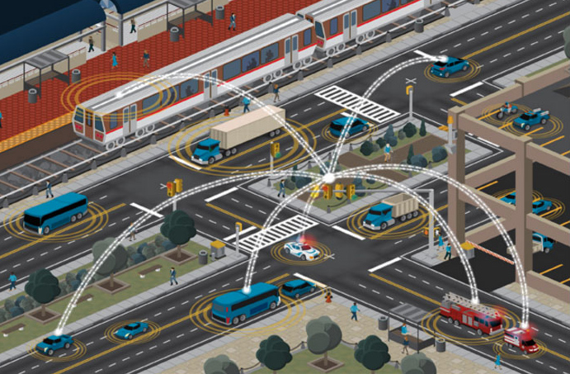
Nevada Department of Transportation (4/5)
The NV2X Office is planning for and preparing a transportation system that is ready to take advantage of emerging connected vehicle technologies.
NV2X’s focus is on helping to develop of a broad strategy for implementing and integrating emerging transportation technologies.
Source: United States Department of Transportation Intelligent Transport Systems Joint Program Office.
Notes:
The NV2X (Nevada to Everything) Office of Innovation is planning for and preparing a transportation system that is ready to take advantage of emerging connected vehicle technologies. NV2X’s focus is on helping to develop of a broad strategy for implementing and integrating emerging transportation technologies.

Slide 71
Nevada Department of Transportation (5/5)
Performance Measurement and System Monitoring:
Developed several trackable performance measures linked to specific projects:
  Intended to ensure that all projects are aligned to the State’s overall
  goals
Developed decision support tools, such as performance dashboards and real-time analytics reporting tools:
  Intended to support further collaboration with stakeholders and help make informed decisions
Notes:
Performance Measurement and System Monitoring:
NDOT has developed several trackable performance measures that are linked to specific projects to ensure that all projects are aligned to the state’s overall goals.
Development of decision support tools, such as performance dashboards and real-time analytics reporting tools, will further collaboration with stakeholders and help make informed decisions.

Slide 72
Overcoming Challenges
Notes:
Connecting TSMO and Planning is a logical and appealing approach to integrated planning to improve transportation system performance. However, it requires diligence, commitment, and follow up to avoid slipping back into silos of activity. Some of the challenges and ways to overcome them are shown in the next two slides.

Slide 73
Challenges (1/2)
Challenges to Overcome | Overcoming Challenges
Comparing TSMO to traditional strategies | Analytical tools and integrated project prioritization processes
Encouraging field offices and traffic engineering branch to look at TSMO solutions | Collaboration strategies that engage partners and stakeholders early in decisionmaking
Obtaining buy-off on new strategies with community and stakeholders | Evidence-based evaluation against widely accepted criteria; tailored outreach and communications to key stakeholders
Notes:
One of the challenges that TSMO projects have faced is that of comparing them to traditional capacity expansion projects. Capacity expansion projects may be appealing because the analysis can show reductions in delay; however, these projects are generally expensive and time consuming, both in project development and implementation.
TSMO projects can “buy back” capacity that has been lost to incidents, inclement weather, work zones, and special events through better management and operation of the system. Keep in mind that TSMO is not meant to replace all capacity projects; rather, it offers feasible alternatives when capacity expansion is either not possible or requires considerably more time and funding than is available.
Analytical tools that model potential improvements through TSMO strategies and processes that integrate the prioritization process can give TSMO projects greater visibility. This can also serve to support collaboration strategies, such as cross-functional “complete teams,” liaisons, and solid analysis can help provide evidence-based results that can be used to communicate with stakeholders and the public.

Slide 74
Challenges (2/2)
Challenges to Overcome | Overcoming Challenges
Not leaving anyone out; networking inside agency to keep communications open | Integrated planning processes (e.g., Complete Teams) to obtain input from all disciplines and perspectives
Sharing data, including buying big data to share with other divisions | Demonstrate value of capturing, acquiring, and sharing data to identify investment needs and opportunities
Conducting outreach to planners to get them involved with self-assessing TSMO capabilities | Holding CMM or similar workshops to identify needed institutional arrangements, processes, and resources
Notes:
Integrated planning processes that use complete teams or similar collaboration methods can ensure that all of the key players are engaged in the planning process.
Data sharing may be threatening to some parties, but if data can be obtained and shared with other disciplines, it can both inform decisionmaking and help to build trust and engagement.
Lastly, FHWA offers workshops, primers, and other resources that can bring planners and TSMO/operations staff together to learn more about the benefits and approaches to collaboration and connections.

Slide 75
Next Steps for Connecting TSMO and Planning
Notes:
Now that we know what we want, how do we get started?

Slide 76
Potential Short-Term Actions
Start a conversation between planning and TSMO staff
Set up multidisciplinary teams for projects
Coordinate an informal training or presentation session between planners and operators to increase awareness of planning’s role in TSMO
Browse the FHWA and NOCoE websites and applicable webinars relating to TSMO:
  FHWA, “What Is TSMO?”: https://ops.fhwa.dot.gov/tsmo/
  NOCoE: https://www.transportationops.org/
Notes:
How can you get started with connecting TSMO and Planning? This slide has some ideas such as just beginning the conversation through an informational meeting, setting up multidisciplinary teams to guide project decisions so that both planning and operations perspectives are included, and coordinating an informal training session that includes planners and operators to raise awareness of planning’s role in TSMO. Planners and operators can learn more by browsing the informational materials from FHWA or NOCoE.
What are other short-terms actions you can think of to better connect TSMO and Planning in your agency?

Slide 77
Potential Long-Term Actions
Update planning manuals, guidance, and practices (e.g., a TIP preparation guide, project prioritization criteria) to integrate TSMO concepts and strategies
Consider updating TSMO documents to include planning processes and opportunities for TSMO to engage with planning
Institute a more formal training program for planners that includes TSMO concepts and strategies
Jointly develop a TSMO program plan
Collaborate on goals, objectives, and needs identification for the update of the State or metropolitan transportation plan
Consider updating alternatives analysis processes to specifically screen for the potential for TSMO options to address the issue
Notes:
Over the long-term, you may be interested in ways to formalize the connections between TSMO and planning through a variety of activities:
Update planning manuals, guidance, and practices (e.g., a TIP preparation guide, project prioritization criteria) to integrate TSMO concepts and strategies
Update TSMO documents to include planning processes and opportunities for more engagement with planning
Institute a more formal training program for planners that includes TSMO concepts and strategies, such as a TSMO bootcamp for new employees
Jointly develop a TSMO program plan to identify the direction and processes for a TSMO program
Updating project prioritization processes and criteria to fit with TSMO?
Collaborate on goals, objectives, and needs identification for the update of the State or metropolitan transportation plan so that TSMO is incorporated
Consider updating alternatives analysis processes to specifically screen for the potential for TSMO options to address the issue
Any other ideas?

Slide 78
Resources
FHWA, Enhancing Transportation: Connecting TSMO and Planning, https://ops.fhwa.dot.gov/publications/fhwahop18096
FHWA, Getting More by Working Together—Opportunities for Linking Planning and Operations, https://ops.fhwa.dot.gov/publications/lpo_ref_guide
FHWA, Advancing Transportation Systems Management and Operations through Scenario Planning, https://ops.fhwa.dot.gov/publications/fhwahop16016/ch3.htm
FHWA, Applying Archived Operations Data in Transportation Planning: A Primer, https://ops.fhwa.dot.gov/publications/fhwahop16082
FHWA, Advancing Metropolitan Planning for Operations: The Building Blocks of a Model Transportation Plan Incorporating Operations—A Desk Reference, https://ops.fhwa.dot.gov/publications/fhwahop10027
Transportation Research Board Second Strategic Highway Research Program Reliability Project S2-L05-RR-2: Guide to Incorporating Reliability Performance Measures into the Transportation Planning and Programming Processes, http://www.trb.org/Main/Blurbs/168855.aspx.
Notes:
You are not alone. FHWA and NOCoE have multiple resources to help! This slide has the names and web locations for FHWA and the Transportation Research Board websites and informational materials that can provide you a deeper understanding of how Planning and TSMO can be connected. The Fact Sheet provides a snapshot of how and why to connect. Additional resources provide assistance and examples of how TSMO and planning can work together more effectively to achieve common goals.

Slide 79
Thank you!
For more information please contact:
(Insert speaker contact information)

