Slide 1
Connecting TSMO and Freight
FREIGHT
Presenter Name
Date
Notes:
This presentation is intended to provide an overview of how transportation systems management and operations (TSMO) and freight interact and can be mutually beneficial. It begins with an executive summary and proceeds into a more complete discussion of these two areas and how they can work together to provide a safe, reliable, secure transportation system that serves the freight community as well as other system users.

Slide 2
Disclaimer
The U.S. Government does not endorse products or manufacturers. Trademarks or manufacturers’ names appear in this presentation only because they are considered essential to the objective of the presentation. They are included for informational purposes only and are not intended to reflect a preference, approval, or endorsement of any one product or entity.

Slide 3
Executive Summary
Notes:
The Executive Summary provides an overview and may be of interest to senior agency leadership and others with an interest in how TSMO and freight work together.

Slide 4
The Transportation Landscape Is Changing
Global and interconnected economy and associated supply chains
More data that is more precise, more accurate, and more timely (logistics, routing, and analytics that exploit real-time data)
More online ordering and deliveries to retail and consumers
Increased focus on shipper/carrier travel-time reliability
Evolving customer needs and expectations (same-day delivery)
Limited funds and tighter State and local transportation budgets
Advances in technology (vehicles, connected and smart infrastructure, communications and tracking)
More options and connections through multimodal and intermodal transport systems
Notes:
The transportation world is changing as we become more connected globally and more interdependent as observed in everything from the effects of disruptions in intermodal cargo movements at seaports to lack of access to semiconductors produced abroad that are required in manufacturing new vehicles.
At the same time the increase in access to real-time data on a global scale enables more effective planning and real-time decision making based on advanced analytics, resulting in more timely delivers to both retail outlets and consumers—including, in many cases, same day or overnight deliveries.
These factors result in increased focus on travel-time reliability as a means for improving productivity, reducing required inventory, and meeting shipper and consumer expectations.
At the same time, State and local transportation agencies face competition for limited funds for meeting transportation needs. Advances in technology enable these agencies to make more effective use of available technology that facilitates more efficient mobility that is both safe and reliable, including on-board technologies and those that help transportation operators manage the transportation system more effectively.
The result is a transportation system that offers more options and connections for both system users and system operator that depend on and manage the multimodal and intermodal transportation system.

Slide 5
Goods Movement Is Important to Local, Regional, and National Economies
Urban goods movement increasingly important to local economy (retail and home delivery)
Employment generator for manufacturers, shippers, carriers, and retailers
Long-haul carriers sensitive to delays and related costs caused by weather, road work, incidents, and recurring congestion
Dependence on time-certain delivery to maintain production schedules and related commitments
Notes:
Goods movement is and always has been an important part of the transportation system and local, regional, national economies.
Freight is an economic engine that generates employment for carriers and drivers and also for the manufacturers, shippers, and retailers that depend on reliable goods movement to sustain their businesses.
Consumers have come to expect timely delivery of goods and well-stocked shelves at retailers and manufacturers, and shippers expect on-time deliveries so they can maintain raw materials and retail products on the shelves without carrying excessive inventories.
Carriers need to know travel times so they can plan use of their fleets and drivers to optimize revenue miles and minimize the “buffer” time they build in to account for congestion-related and non-recurring delays that make travel times less reliable.

Slide 6
Demand for Goods Movement Is Growing, Especially on Highways!
Trucks carry most of the tonnage and value of freight in the United States—67% of total domestic tonnage—and freight truck traffic is projected to increase dramatically.
Truck travel is projected to increase 60% between 2015 and 2045, from 311 million to 488 million vehicle miles per day.
Segments with more than 8,500 trucks per day and where trucks are at least 25% of total traffic are estimated to grow from 6,229 miles in 2015 to 12,729 miles in 2045, an increase of 104%.
Source: U.S. Department of Transportation, Bureau of Transportation Statistics. “Freight Facts and Figures.”
Notes:
The Bureau of Transportation Statistics (BTS) predicts 60% growth in truck vehicle miles traveled between 2015 and 2045 and the density of truck traffic on heavily used roadways is predicted to increase even more. This means more congestion, more emissions, more concerns about safety, and more demands on transportation systems that are already at capacity.
Source: U.S. Department of Transportation, Bureau of Transportation Statistics, Freight Facts and Figures. Available at: https://data.bts.gov/stories/s/45xw-qksz.

Slide 7
Travel-Time Reliability Is Critical to Carriers and Shippers . . .
Shippers and carriers have difficulty hiring, training, and retaining enough drivers, which can contribute to delivery delays.
Travel time is critical to carriers and shippers because they value travel time at $25 to $200 per hour (depending on the product being carried).*
The value of travel time (VOT) ranges from $12.80 to $283 per shipment hour, and the average value is $37 per shipment hour.*
Carriers and shippers value travel-time reliability at between $51 and $290 per shipment hour, with the average value of reliability (VOR) being $55 per shipment hour.*
This indicates that freight shippers valued travel-time reliability 1.5 times as much as travel-time savings.
*Source: 2019. Does Travel Time Reliability Matter? Report No. FHWA-HOP-19-062. https://ops.fhwa.dot.gov/publications/fhwahop19062/.
Notes:
In addition to the effects of predicted growth in truck traffic, freight carriers and shippers face challenges in attracting and retaining drivers, which makes efficient use of drivers’ time even more important. Unreliable travel times mean that drivers must “build in” buffer times to avoid delivery delays, leading to more non-productive time when drivers arrive early and have to wait for their delivery windows. These delays and waiting times result in lost productivity and added cost to carriers, shippers, and, ultimately, to consumers.

Slide 8
Long-Haul Freight Truck-Miles Traveled Continue to Grow
Freight truck traffic on the National Highway System is projected to increase dramatically.
Changes in Freight Flow for Trucks
Flow Period | Values in Million Dollars 2017 | Values in Million Dollars 2050 | Ton-Miles in Million 2017 | Ton-Miles in Million 2050
Annual | 13,689,920 | 26,023,174 | 2,396,577 | 3,930,687
Daily | 37,507 | 71,296 | 6,566 | 10,769
Based on the Freight Analysis Framework Version 5 (FAF5): Available at: https://faf.ornl.gov/faf5/.
Notes:
FHWA and the Bureau of Transportation Statistics' Freight Analysis Framework illustrates this growth in goods movement by trucks. This table shows the increase in the value of freight and the ton-miles traveled in millions on the National Highway System from 2017 to 2050. This growth will contribute to increased congestion and energy consumption and, possibly, poorer air quality UNLESS we take steps to improve travel-time reliability so that delays are minimized.

Slide 9
And the Impact of Unreliable Travel Times Is Significant . . .
Delays force businesses to increase inventories by as much as 5 to 15 percent.
In the chemical industry, up to one-third of inventory is in transit at any point, so a decrease in reliability increases wait time, dead freight, and overall production costs in the industry.
Unreliable travel times mean firms are less able to ship and receive goods within specified timeframes, directly impacting customer satisfaction and overall profitability.
Source: 2019. Does Travel Time Reliability Matter? Report No. FHWA-HOP-19-062. https://ops.fhwa.dot.gov/publications/fhwahop19062/.
Notes:
Unreliable travel times mean shippers, manufacturers, distribution centers, and retailers carry higher inventories to offset delivery delays. Additionally, with longer travel times (including the “buffer” times added to travel times, more inventory is in transit, resulting in additional capital tied up in the in-transit inventory—a cost that is ultimately passed on to consumers.

Slide 10
Public Sector (Agencies/Communities) Priorities Regarding Freight
Size/weight enforcement
Hours of service compliance
Curb management (pickup/delivery)
Truck parking
Economic development
Work zone design/management
Infrastructure protection (pavement, bridge strikes, and overweight vehicles on bridges)
Freight planning
Safety
Air quality
Noise abatement
Community impact
Lane management
Congestion management
Roadside weather information
Incident management
Oversize/overweight permits
Notes:
The growth in freight volume leads to different but interconnected and intersecting priorities on freight for public and private stakeholders. The priorities overlap to some degree and differ to some degree both in content and level of importance.
For the public sector: planning, management, and operation of the infrastructure and related activities needed to promote safe, legal, and efficient flow of goods; freight planning integrates goods movement into the local or regional transportation system
Note: There are concerns not only from bridge impact from truck weight but also bridge strikes due to oversized loads.

Slide 11
Private Sector (Shippers/Carriers) Priorities Regarding Freight
Logistics
Safety (drivers and others, loss of cargo, damage to equipment, and liability)
Cargo security
Driver hiring and retention
Hours of service compliance
Equipment condition and maintenance
In-vehicle visibility
Supply chain management
Operating efficiency
Efficient intermodal transfers
On-time delivery
Travel-time reliability
Competitive advantage
Parking/loading/unloading
Automated oversize/overweight permits
Notes:
Private sector interests overlap with public sector interest but include additional concerns:
For the private sector: safe, legal, and efficient movement of goods or raw material to meet customer demands; includes shippers, carriers, third-party logistics, intermodal transfer points, and warehousing and distribution centers
Note: Regarding safety and security of cargo, a truck crash could kill/injure the driver and others, plus damage equipment and cause delay/loss of cargo.

Slide 12
What Is Transportation Systems Management and Operations (TSMO)?
A set of strategies to maximize the operational performance of the existing transportation system
Approaches performance from a systems perspective that spans corridors, jurisdictions, modes, and agencies
Helps agencies balance supply and demand on the system and provide flexible solutions to manage dynamic conditions
Can complement capacity projects or provide lower cost, faster alternatives in some cases
Notes:
What can TSMO do to address freight needs and concerns? First let’s review what we mean by TSMO.
Federal code (23 USC 101 (a) (30)) defines TSMO as “an integrated set of strategies to optimize the performance of infrastructure through the implementation of multimodal and multi-jurisdictional systems, services, and projects designed to preserve capacity and improve security, safety, and reliability of the transportation system while minimizing the environmental impact.”
The goal is to get the most performance out of the transportation facilities we already have. TSMO is the use of strategies, technologies, mobility services, and programs to optimize the safety, mobility, and reliability of the existing and planned transportation system.
Importantly, TSMO approaches transportation from a systems perspective—across geographic and political boundaries as well as among different agencies.
TSMO does not necessarily replace capacity-expansion projects but can offer lower cost alternatives and also complement capacity-expansion projects when considered early in the project planning and development process.

Slide 13
Intersections Between TSMO and Freight
Road weather, work zone, and incident information and multijurisdictional coordination to manage delay
Work zone design and detours
Truck-specific traveler information (e.g., weather, size/weight restrictions, detours)
Signal delay/priority for heavy vehicles
Truck routing for fastest travel time and compliance with route restrictions and bridge capacity
Truck size/weight enforcement
Lane management
Truck queue management at intermodal facilities and ports
Truck travel-time reliability
Safe, secure truck parking
Urban goods movement/curb space management
Safety/crash avoidance/incident response and clearance
Notes:
Here are several areas where TSMO and freight intersect.
Ask participants if they agree with the examples provided and if they have any other high-level examples of how TSMO and freight intersect?

Slide 14
Freight and TSMO Goals Are Connected
Coordinating TSMO and freight efforts accomplishes shared goals more efficiently. Accomplishing freight goals can support TSMO goals and vice versa.
TSMO Goals | Freight Goals
Reduce congestion | Improve travel-time reliability and on-time delivery to maximize efficiency and minimize costs
Leverage all modes to improve mobility and safety | Avoid conflicts between light and heavy vehicles; improve intermodal connections
Improve availability of and access to facilities | Provide safe, secure truck parking, curb management, and more accurate and relevant real-time information
Safe and quick incident clearance | Minimize delays due to incidents; quick response for hazardous materials (HAZMAT) mitigation
Notes:
Note that many TSMO goals are shared with goods movement—and these freight goals are good for all travelers and consumers as well as for goods movers.

Slide 15
How Can TSMO Support Freight Goals? (1/2)
Freight goal: Improve truck travel-time reliability:
TSMO strategies: Real-time, truck-specific traveler information; lane management; incident clearance; road weather management; work zone management; truck size and weight enforcement—weigh station bypass
Freight goal: Improve safety by separating light and heavy vehicles:
TSMO strategies: Dedicated lanes, restricted lanes, signal delay/priority
Freight goal: Improve intermodal connections:
TSMO strategies: Freight advanced traveler information systems, dynamic freight routing based on real-time traffic conditions, terminal queue status and wait times
Notes:
More specifically, here are some freight goals and TSMO strategies that can directly contribute to helping achieve the freight goals.
Better freight-specific information can improve truck travel-time reliability.
Queue management and ports and intermodal transfer points can reduce delay and congestion and improve air quality; managed lane strategies can de-conflict or separate light and heavy vehicles.

Slide 16
How Can TSMO Support Freight Goals? (2/2)
Freight goal: Safe, secure truck parking, more accurate and relevant real-time information:
TSMO strategies: Truck parking information and management systems, road weather information systems, early access to truck-specific traveler information for use in route and schedule planning (e.g., parking availability/reservations, size/weight restricted routes)
Freight goal: Minimize delays due to incidents:
TSMO strategies: Traffic management centers with freeway monitoring, incident response teams, HAZMAT cleanup teams, motorist assist patrols, prepositioned tow and recovery, restricted/dedicated lanes
Notes:
Accurate information regarding truck parking can ensure that drivers know where they can find safe, secure parking.
HAZMAT cleanup teams and rapid incident response and clearance teams can minimize delay due to incidents.

Slide 17
Collaboration Opportunities
Areas where freight and TSMO staff can work together and capture benefits from collaboration:
Coordinated statewide freight planning and programming
Road weather management
Congestion management
Dedicated/restricted lanes
Truck size and weight enforcement
Oversize/overweight permits
Truck-specific traveler information (e.g., parking)
Truck parking information and management systems
Work zone design and management
Traffic signal delay/priority
Urban goods delivery
Notes:
There are multiple opportunities for collaboration between TSMO and freight where both can achieve real benefits to goods movement and, more generally, transportation system performance.
Note that not all areas listed here. Selected case studies of existing freight and TSMO collaboration are provided in the complete presentation.

Slide 18
Take Action
Bring TSMO and freight leaders together within your agency to identify areas of common interest and mutual objectives
Find out how TSMO strategies are already supporting freight goals
Discuss how freight goals can be better supported by TSMO
Begin joint initiatives to improve goods movement and operations
Notes:
What’s next?
Start by convening TSMO and freight leaders to begin discussions about common interests and mutual objectives, identify where these activities are already working together, and determine where greater impacts can be achieved.
Look for joint initiatives that can improve operations and goods movement and begin integrating them into project plans and current operations.

Slide 19
Thank you for Your Attention!
For more information please contact:
[INSERT CONTACT INFORMATION]

Slide 20
End of Executive Summary

Slide 21
Goals of This Presentation
Create awareness of TSMO and freight strategies and goals
Demonstrate alignment between TSMO and freight strategies and goals:
Drawing from research and interviews with freight management and operations staff from agencies across the country
Provide examples of benefits of TSMO to freight management and operations
Discuss ways for freight and TSMO programs to collaborate:
Case studies
Action items
Notes:
This presentation is intended to provide an overview of how freight and transportation systems management and operations (TSMO) interact and can be mutually beneficial. It contains a discussion of these two areas and how they can work together to provide a safe, reliable, secure transportation system that serves the freight community as well as other system users.
With this background and context, here’s what we’ll discuss:
What TSMO is all about – strategies and goals
How TSMO and freight are related and align around common goals
Examples of TSMO benefits to freight management and operations
Case studies of freight and TSMO collaboration

Slide 22
Presentation Overview
What is TSMO?
What is Freight?
Connecting TSMO and Freight Overview
Opportunities for Collaboration
Examples of Coordination Between TSMO and Freight
Overcoming Challenges
Where Do We Go From Here?
Notes:
We begin this presentation by describing transportation systems management and operations, or TSMO.
We’ll then discuss reasons for connecting TSMO and freight. This will be followed by a review of specific examples.
Finally, we’ll conclude by reviewing the challenges and next steps in connecting TSMO and freight.

Slide 23
Transportation Landscape Is Changing
Global and interconnected economy and associated supply chains
More data that is more precise, more accurate, and more timely (logistics, routing, and analytics that exploit real-time data)
More online ordering and deliveries to retail and consumers
Increased focus on shipper/carrier travel-time reliability
Evolving customer needs and expectations (same-day delivery)
Limited funds and tighter State and local transportation budgets
Advances in technology (vehicles, connected and smart infrastructure, communications and tracking)
More options and connections through multimodal and intermodal transport systems
Notes:
The transportation world is changing as we become more connected globally and more interdependent as observed in everything from the effects of disruptions in intermodal cargo movements at seaports to lack of access to semiconductors produced abroad that are required in manufacturing new vehicles.
At the same time the increase in access to real-time data on a global scale enables more effective planning and real-time decision making based on advanced analytics, resulting in more timely delivers to both retail outlets and consumers—including, in many cases, same day or overnight deliveries.
These factors result in increased focus on travel-time reliability as a means for improving productivity, reducing required inventory, and meeting shipper and consumer expectations.
At the same time, State and local transportation agencies face competition for limited funds for meeting transportation needs. Advances in technology enable these agencies to make more effective use of available technology that facilitates more efficient mobility that is both safe and reliable, including on-board technologies and those that help transportation operators manage the transportation system more effectively.
The result is a transportation system that offers more options and connections for both system users and system operator that depend on and manage the multimodal and intermodal transportation system.

Slide 24
Goods Movement: Important to Local, Regional, and National Economies
Urban goods movement increasingly important to local economy (retail and home delivery)
Employment generator for manufacturers, shippers, carriers, and retailers
Long-haul carriers sensitive to delays and related costs caused by weather, road work, incidents, and recurring congestion
Dependence on time-certain delivery to maintain production schedules and related commitments
Notes:
Goods movement is and always has been an important part of the transportation system and local, regional, national economies.
Freight is an economic engine that generates employment for carriers and drivers and also for the manufacturers, shippers, and retailers that depend on reliable goods movement to sustain their businesses.
Consumers have come to expect timely delivery of goods and well-stocked shelves at retailers and manufacturers, and shippers expect on-time deliveries so they can maintain raw materials and retail products on the shelves without carrying excessive inventories.
Carriers need to know travel times so they can plan use of their fleets and drivers to optimize revenue miles and minimize the “buffer” time they build in to account for congestion-related and non-recurring delays that make travel times less reliable.

Slide 25
Demand for Goods Movement Is Growing, Especially on Highways
Trucks carry most of the tonnage and value of freight in the United States—67% of total domestic tonnage—and freight truck traffic is projected to increase dramatically.
Truck travel is projected to increase 60% between 2015 and 2045, from 311 million to 488 million vehicle miles per day.
Segments with more than 8,500 trucks per day and where trucks are at least 25% of total traffic are estimated to grow from 6,229 miles in 2015 to 12,729 miles in 2045, an increase of 104%.
Source: U.S. Department of Transportation, Bureau of Transportation Statistics. “Freight Facts and Figures”
Notes:
The Bureau of Transportation Statistics (BTS) predicts 60% growth in truck vehicle miles traveled between 2015 and 2045 and the density of truck traffic on heavily used roadways is predicted to increase even more. This means more congestion, more emissions, more concerns about safety, and more demands on transportation systems that are already at capacity.
Source: U.S. Department of Transportation, Bureau of Transportation Statistics, Freight Facts and Figures. Available at: https://data.bts.gov/stories/s/45xw-qksz.

Slide 26
Long-Haul Freight Truck-Miles Traveled Continue To Grow
Freight truck traffic on the National Highway System is projected to increase dramatically.
Changes in Freight Flow for Trucks
Flow Period | Values in Million Dollars 2017 | Values in Million Dollars 2050 | Ton-Miles in Million 2017 | Ton-Miles in Million 2050
Annual | 13,689,920 | 26,023,174 | 2,396,577 | 3,930,687
Daily | 37,507 | 71,296 | 6,566 | 10,769
Based on the Freight Analysis Framework Version 5 (FAF5): Available at: https://faf.ornl.gov/faf5/.
Notes:
FHWA and the Bureau of Transportation Statistics' Freight Analysis Framework illustrates this growth in goods movement by trucks. This table shows the increase in the value of freight and the ton-miles traveled in millions on the National Highway System from 2017 to 2050. This growth will contribute to increased congestion and energy consumption and, possibly, poorer air quality UNLESS we take steps to improve travel-time reliability so that delays are minimized.

Slide 27
Travel-Time Reliability Is Critical to Carriers and Shippers
Shippers and carriers have difficulty hiring, training, and retaining enough drivers, which can contribute to delivery delays.
Travel time is critical to carriers and shippers because they value travel time at $25 to $200 per hour (depending on the product being carried).*
The value of travel time (VOT) ranges from $12.80 to $283 per shipment hour, and the average value is $37 per shipment hour.*
Carriers and shippers value travel-time reliability at between $51 and $290 per shipment hour, with the average value of reliability (VOR) being $55 per shipment hour.*
This indicates that freight shippers valued travel-time reliability 1.5 times as much as travel-time savings.
*Source: 2019. Does Travel Time Reliability Matter? Report No. FHWA-HOP-19-062. https://ops.fhwa.dot.gov/publications/fhwahop19062/.
Notes:
In addition to the effects of predicted growth in truck traffic, freight carriers and shippers face challenges in attracting and retaining drivers, which makes efficient use of drivers’ time even more important. Unreliable travel times mean that drivers must “build in” buffer times to avoid delivery delays, leading to more non-productive time when drivers arrive early and have to wait for their delivery windows. These delays and waiting times result in lost productivity and added cost to carriers, shippers, and, ultimately, to consumers.

Slide 28
And the Impact of Unreliable Travel Times Is Significant
Delays force businesses to increase inventories by as much as 5 to 15 percent.
In the chemical industry, up to one-third of inventory is in transit at any point, so a decrease in reliability increases wait time, dead freight, and overall production costs in the industry.
Unreliable travel times mean firms are less able to ship and receive goods within specified timeframes, directly impacting customer satisfaction and overall profitability.
Source: 2019. Does Travel Time Reliability Matter? Report No. FHWA-HOP-19-062. https://ops.fhwa.dot.gov/publications/fhwahop19062/.
Notes:
Unreliable travel times mean shippers, manufacturers, distribution centers, and retailers carry higher inventories to offset delivery delays. Additionally, with longer travel times (including the “buffer” times added to travel times, more inventory is in transit, resulting in additional capital tied up in the in-transit inventory—a cost that is ultimately passed on to consumers.

Slide 29
Public Sector (Agencies/Communities) Freight Priorities
Size/weight enforcement
Hours of service compliance
Curb management (pickup/delivery)
Truck parking
Economic development
Work zone design/management
Infrastructure protection (pavement, bridge strikes, and overweight vehicles on bridges)
Freight planning
Safety
Air quality
Noise abatement
Community impact
Lane management
Congestion management
Roadside weather information
Incident management
Oversize/overweight permits
Notes:
The growth in freight volume leads to different but interconnected and intersecting priorities on freight for public and private stakeholders. The priorities overlap to some degree and differ to some degree both in content and level of importance.
For the public sector: planning, management, and operation of the infrastructure and related activities needed to promote safe, legal, and efficient flow of goods; freight planning integrates goods movement into the local or regional transportation system
Note: There are concerns not only from bridge impact from truck weight but also bridge strikes due to oversized loads.

Slide 30
Private Sector (Shippers/Carriers) Freight Priorities
Logistics
Safety (drivers and others, loss of cargo, damage to equipment, and liability)
Cargo security
Driver hiring and retention
Hours of service compliance
Equipment condition and maintenance
In-vehicle visibility
Supply chain management
Operating efficiency
Efficient intermodal transfers
On-time delivery
Travel-time reliability
Competitive advantage
Parking/loading/unloading
Automated oversize/overweight permits
Notes:
Private sector interests overlap with public sector interest but include additional concerns:
For the private sector: safe, legal, and efficient movement of goods or raw material to meet customer demands; includes shippers, carriers, third-party logistics, intermodal transfer points, and warehousing and distribution centers
Note: Regarding safety and security of cargo, a truck crash could kill/injure the driver and others, plus damage equipment and cause delay/loss of cargo.

Slide 31
What Is TSMO?
Notes:
Let’s begin by describing TSMO . . .

Slide 32
Definition of TSMO
Integrated [set of] strategies to optimize the performance of existing infrastructure through implementation multimodal and intermodal, cross-jurisdictional systems, services, and projects designed to preserve capacity and improve security, safety, and reliability of the transportation system.*,**
*Title 23 of the U.S. Code § 101 (a)(30)(A) Definitions and Declarations of Policy
**FHWA. (website). https://ops.fhwa.dot.gov/tsmo/
Notes:
Before going further, it is important to define TSMO for new audiences:
TSMO is an integrated set of strategies to optimize the performance of existing infrastructure through the implementation of multimodal and multi-jurisdictional systems, services, and projects designed to preserve capacity and improve security, safety, and reliability of the transportation system.
The goal here is to get the most performance out of the transportation facilities we already have. TSMO is the use of strategies, technologies, mobility services, and programs to optimize the safety, mobility, and reliability of the existing and planned transportation system.

Slide 33
Characteristics of Transportation Systems Management and Operations (TSMO)
Offers an integrated set of strategies to optimize operational performance of the existing transportation system
Approaches performance from a systems perspective that spans corridors, jurisdictions, modes, and agencies
Helps agencies balance supply and demand on the system and provide flexible solutions to manage dynamic conditions
Can complement capacity projects, or in some cases can provide lower cost, faster alternatives
Notes:
TSMO is an integrated set of strategies to optimize the operational performance of the existing transportation system.
Note: The definition at the top of the slide is an abridged version of the Federal Highway Administration’s (FHWA) TSMO definition found here: https://ops.fhwa.dot.gov/tsmo and at 23 USC 101 (a) (30).
TSMO approaches performance from a systems perspective.
Spans corridors, facilities, jurisdictions, modes, and agencies
TSMO takes a holistic approach to managing performance that looks beyond a single corridor (e.g., are changes to a specific corridor causing a mobility issue nearby?), jurisdiction (e.g., are management systems coordinated across jurisdictional boundaries?), mode (e.g., are we using all modes optimally to meet our performance goals?), and agency (e.g., how can we improve collaboration with law enforcement or transit agencies to improve performance?).
Helps agencies balance supply and demand on the system and provide flexible solutions to manage dynamic conditions.
Example TSMO strategies include ramp metering, managed lanes, and congestion pricing.
TSMO can complement capacity projects or can provide lower-cost, faster alternatives in some cases.
TSMO seeks to provide lower-cost alternatives to capacity projects when operational strategies may produce equal or better results – or when operational strategies may be able to produce results faster. It does not seek to eliminate capacity projects in cases where a capacity project is the best solution. Rather, TSMO provides agencies with more options.

Slide 34
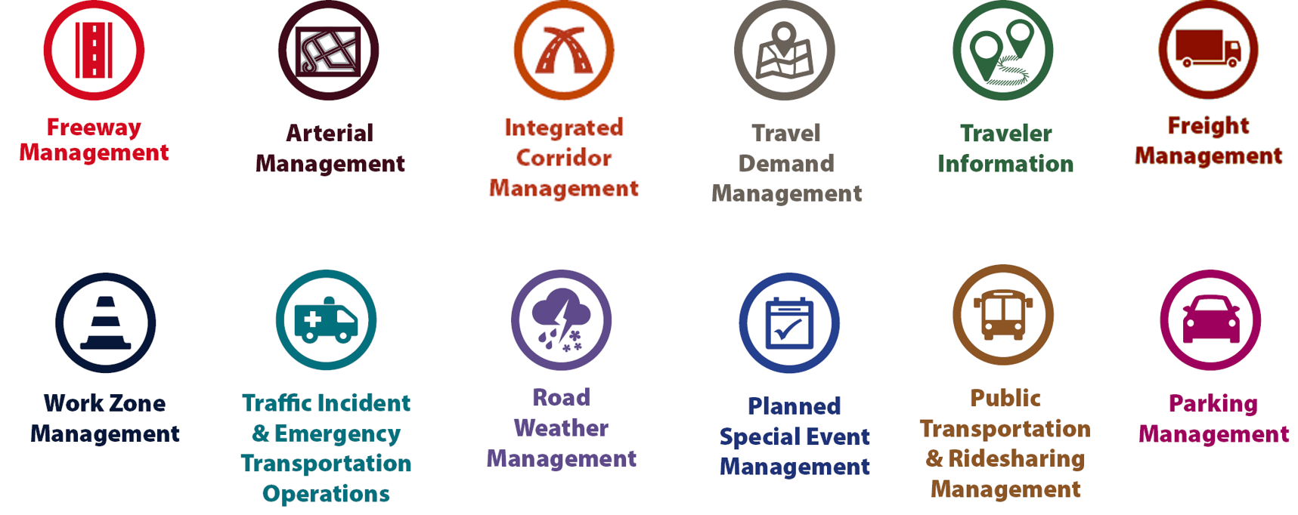
Examples of TSMO Strategies
Notes:
This slide illustrates the array of operational strategies that fall under the TSMO umbrella that can be used individually or in combination with each other. This list is not exhaustive, but it highlights the key buckets of strategies that are priorities for many agencies.
Examples of other TSMO strategies include:
Traffic signal coordination
Transit signal priority
Special event management
Congestion pricing
Active transportation and demand management
Connected/automated vehicles
Completing multimodal networks
Intelligent transportation systems (ITS) components can support all these TSMO strategies. ITS covers a variety of technologies to monitor, evaluate, and manage transportation systems to enhance efficiency and safety. It should be noted that TSMO does not equate to ITS; many strategies support TSMO that do not involve an ITS component.
TSMO strategies can be categorized into three overarching areas: incident or event management, traffic management, and demand management strategies. The next three slides highlight strategies in each of these areas.

Slide 35
Incident/Event Management Strategies
Source: Federal Highway Administration.
Notes:
Incident and event management includes several strategies that address major sources of travel-time unreliability.
Incident and event management strategies include road weather management, traffic incident management and emergency transportation operations, work zone management, and planned special event management.
Road weather management activities include creating hazardous weather traffic operations response plans, implementing variable speed limits, detecting hazardous weather conditions, disseminating weather and warnings to travelers through dynamic signs and systems, providing emergency truck and parking facilities and emergency parking information, and implementing vehicle restrictions.
Traffic incident management and emergency transportation operations activities include establishing traffic incident management teams, conducting after action reviews, staging tow trucks in strategic areas, providing roadway safety patrols, integrating computer-aided dispatch into transportation management centers, pre-establishing towing service agreements, co-locating dispatching units, developing quick clearance goals, pre-planning detour routes, implementing shoulder running, deploying adaptive ramp metering, providing variable speed limits, implementing dynamic lane-use controls, deploying network surveillance cameras or detectors, implementing incident traffic signal timing plans, enacting legislation, and integrating traffic management centers with law enforcement dispatch and emergency centers.
Work zone management activities include coordinating maintenance and construction activities, implementing queue length detection, deploying network surveillance cameras or detectors, implementing variable speed limits, supporting dynamic lane merging, implementing dynamic lane-use controls, deploying temporary ramp metering, and implementing dynamic warning systems.
Planned special event management activities include activating special event timing plans, deploying adaptive ramp metering, implementing variable speed limits, using hard shoulder running, activating dynamic transit fare reduction, implementing reversible lanes, supporting dynamic lane-use controls, establishing dynamic pricing, deploying network surveillance cameras or detectors, activating dynamic wayfinding, and conducting after action reviews.
Source: FHWA, Integrating Travel Time Reliability into Transportation System Management: Final Technical Memorandum
https://ops.fhwa.dot.gov/publications/fhwahop19035/index.htm

Slide 36
Traffic Management Strategies
Source: Federal Highway Administration.
Notes:
While incident or event management strategies address atypical events that cause travel-time unreliability, traffic management strategies manage the movement of people and goods during everyday conditions. Even during typical conditions, fluctuations in travel demand can lead to unreliable travel conditions. Traffic management strategies allow the transportation network to adapt to unreliability, including variations in travel demand.
Traffic management strategies include freeway management, active traffic management, integrated corridor management, freight management, and arterial management.
Freeway management activities include implementing traffic surveillance cameras or detectors, using high-occupancy lanes, implementing adaptive ramp metering, deploying hard shoulder running, implementing variable speed limits, deploying dynamic lane-use controls, and constructing physical operations improvements such as overpass widening, curve corrections, or adding auxiliary lanes.
Active traffic management activities include adopting adaptive ramp metering, implementing adaptive traffic signal control, using dynamic lane reversal, implementing dynamic lane-use controls, deploying dynamic merge control, implementing temporary shoulder running, using variable speed limits, deploying queue length detection, providing transit signal priority, and implementing dynamic warning signs.
Integrated corridor management activities include implementing network surveillance cameras or detectors, conducting access management and driveway access controls, implementing adaptive ramp metering, deploying adaptive signal control, deploying transit signal priority, installing queue jumping lanes, providing traveler information for alternative modes, and deploying emergency vehicle preemption.
Freight management activities include implementing roadside truck electronic screening and clearance, implementing truck signal priority, using truck parking management systems, installing truck climbing lanes, and implementing freight loading zone policies.
Arterial management activities include installing queue jumping lanes, deploying transit signal priority, supporting emergency vehicle preemption, implementing network surveillance cameras or detectors, implementing access management and driveway access controls, providing enhanced bicycle and pedestrian crossings, establishing a transportation management center, deploying enhanced traffic signal operations, implementing transit-only lanes, implementing truck traffic signal priority, designing for complete streets, adding capacity for critical movements, reducing travel speeds, providing automated enforcement, and conducting operations asset management.
Source: FHWA, Integrating Travel Time Reliability into Transportation System Management: Final Technical Memorandum
https://ops.fhwa.dot.gov/publications/fhwahop19035/index.htm

Slide 37
Demand Management Strategies
Source: Federal Highway Administration.
Notes:
Demand management strategies reduce underlying demand by helping travelers avoid trips or change the mode, timing, or route of trips. This makes nonrecurring congestion less likely to occur and improves travel-time reliability.
Demand management strategies include congestion pricing, parking management, and public transportation and rideshare management.
Congestion pricing activities include implementing dynamic pricing, variable pricing by lane, segment, and time of day or day of week; establishing dynamic transit fare reductions; and deploying managed lanes for high occupancy.
Parking management activities include deploying dynamically priced parking; implementing dynamic parking, wayfinding, reservations, and capacity; deploying dynamic overflow transit parking; implementing electronic payment systems and shared-use parking; and providing incentives to use underutilized parking facilities.
Public transportation and ridesharing management activities include implementing dynamic ridesharing, implementing transit signal priority, using queue-jump lanes at signalized intersections, deploying electronic fare collection and integration, and implementing dynamic surveillance and security.
Source: FHWA, Integrating Travel Time Reliability into Transportation System Management: Final Technical Memorandum
https://ops.fhwa.dot.gov/publications/fhwahop19035/index.htm

Slide 38
TSMO Is a “Way of Thinking” That Supports State Departments of Transportation’s (DOTs’) Missions
“We provide safe, reliable and cost-effective transportation options to improve communities and economic vitality for people and businesses.”
Washington State DOT (WSDOT) mission¹
“To provide the best multi-modal transportation system for Colorado that most effectively and safely moves people, goods, and information.”
Colorado DOT mission²
¹WSDOT. “Our Strategic Plan”. https://www.wsdot.wa.gov/about/secretary/strategic-plan/
²Colorado DOT. “Mission, Vision & Values”. https://www.codot.gov/about/mission-and-vision.html
Notes:
TSMO leverages technology, a toolbox of strategies, and engineering solutions to maximize system performance; however, TSMO ultimately involves a way of thinking or a mindset focused on determining the best way to optimize the mobility and reliability of the existing system with limited resources.
TSMO can be thought of as a way of thinking and operating in order to get the most performance out of the transportation network while only building as much as is needed.
The principles of TSMO directly support the missions of many State DOTs, as these examples show.
NOTES:
States can insert their own mission statement here for effect or can leave these in.
Presenters can emphasize the connections between TSMO definition and their specific Mission statement, such as safety, reliability, cost-effective, multimodal, customer’s needs/satisfaction, etc.

Slide 39
TSMO Supports Many State and Local DOT Goals
Reduced congestion
Smoother and more reliable traffic flow
Improved safety
Cleaner air and less wasted fuel
More efficient use of resources and existing facilities
Increased economic vitality
Improved quality of life
Notes:
Here are some common goals in state and local transportation agencies that TSMO strategies support. This list is not exhaustive but intended to show that TSMO support a range of mission-critical goals. Examples of how TSMO supports these goals are shown on the next slide.

Slide 40
Example TSMO Strategies That Support Transportation Agency Goals
TSMO Strategies |  | Goals
Traffic signal coordination, congestion pricing, demand management |  | Reduced congestion
Manage nonrecurring events (incidents, weather), managed lanes, traveler information |  | Smoother and more reliable traffic flow
Utilize the full system—coordinate all modes, transit signal priority |  | More efficient use of resources and existing facilities
Notes:
TSMO strategies that support some common transportation agency goals are shown here. Many of these strategies support more than one goal, but here are some key examples.

Slide 41
TSMO State of the Practice
Application of TSMO has accelerated in agencies across the country over the past 5–10 years
Recognition of TSMO’s value has grown, leading to a variety of approaches for advancing TSMO in agencies. For example:
Establishing a TSMO division or office
Formalizing a TSMO program
Integrating TSMO throughout the agency
Establishing a TSMO committee
Identifying TSMO champions or liaisons
Conducting a TSMO capability maturity model (CMM) self-assessment
Developing a TSMO program plan
Notes:
TSMO as a more formal discipline has gained momentum in recent years. Recognition of the importance of TSMO has accelerated in the past five to ten years (as of year of publication of this presentation, 2022).
Key focus areas for agencies during this time have been adapting their culture, processes, expertise, and, in some cases, organizational structures to promote TSMO and a more operationally focused mindset. Agencies approach this differently depending on their unique context and needs. Several examples of key strategies agencies have used to advance TSMO within their organizations are shown here.
Central to all of these organizational approaches is 1) strong support from senior leadership, 2) a champion or champions who understand and promote TSMO throughout the agency, and 3) an openness to learning and cooperation among functions or divisions within an agency.
A TSMO capability maturity model self assessment is a framework developed to help agencies evaluate their current capabilities in the area of TSMO and identify steps for improving their TSMO capabilities. The self-assessment can be accessed at: http://aashtotsmoguidance.org/. There are also other capability maturity frameworks that FHWA has developed to support the implementation of TSMO. More can be learned about those frameworks at: https://ops.fhwa.dot.gov/tsmoframeworktool/index.htm.

Slide 42
Resources on TSMO
What is TSMO? (frequently asked questions) https://ops.fhwa.dot.gov/tsmo
Organizing and Planning for Operations web page https://ops.fhwa.dot.gov/plan4ops
Communicating TSMO web page https://ops.fhwa.dot.gov/plan4ops/focus_areas/communicating_tsmo.htm
National Operations Center of Excellence (NOCoE) website https://www.transportationops.org/
Enhancing Transportation: Connecting TSMO and Maintenance fact sheet, https://ops.fhwa.dot.gov/publications/fhwahop18090/index.htm
Notes:
While these slides provide a comprehensive, high-level summary of TSMO, participants who are looking for more details and information to share with their staff can visit these virtual resources.

Slide 43
What Is Freight?

Slide 44
What Do We Mean by Freight?
Freight is “merchandise or commodities that are moved by a mode of transportation, such as a truck, ship, aircraft, pipeline, or train.”¹
Freight operations include all functions needed to support the movement of cargo by air, highway, marine, pipeline, and rail modes of transportation, including the interconnection of such modes.²
¹FHWA. 2018. Status of the Nation’s Highways, Bridges, and Transit: Conditions and Performance: 23rd Edition: Part III: Highway Freight Transportation https://www.fhwa.dot.gov/policy/23cpr/chap11.cfm
²Adapted from: Michigan DOT. “Maritime and Port Facility Assistance Office” (web page). https://www.michigan.gov/mdot/0,4616,7-151-9621_68051---,00.html
Notes:
This description of freight encompasses both freight—the product or goods being transported—and freight operations, which are the functions and infrastructure required to support moving the cargo. These functions include public- and private-sector activities.

Slide 45
Example Freight Goals
Safety
On-time pickup and delivery
Infrastructure preservation
Efficient fuel consumption
Reliable travel times
Safe and secure parking
Cargo security
Efficient operations
Notes:
Shippers, carriers, vehicle operators, manufacturers, and retailers need reliable and secure delivery of goods to operate businesses that deliver products and services to consumers.
These entities are also major contributors to a regional economy and need a transportation system that is efficient, safe, and reliable. While their goals are not all the same, they are complementary and mutually beneficial. The more efficiently a motor carrier operates, the better that carrier can compensate drivers while offering competitive rates to customers.
Shippers (manufacturers, retailers, etc.) need on-time pickup and delivery to keep their businesses operating and to minimize their inventory carrying costs.

Slide 46
Example: WSDOT—Freight Transportation
“The state’s multimodal freight transportation system allows business in Washington to effectively compete in regional and global markets.
Freight transportation is critical to supporting and growing jobs, more regional domestic product, as well as ensuring residents have the goods they need in their daily lives.”
WSDOT. “Freight Plans” (website). https://wsdot.wa.gov/construction-planning/statewide-plans/freight-plans
Notes:
State DOTs recognize the importance of freight transportation to their economies, as illustrated by this statement from the Washington State DOT freight planning website at: https://wsdot.wa.gov/construction-planning/statewide-plans/freight-plans.

Slide 47
Example: Florida DOT Freight and Rail Office
“The Freight and Rail Office (FRO) enhances Florida’s economy and communities.
FRO is committed to providing quality transportation networks that drive commerce, bringing freight into your everyday life.
Florida DOT. “Freight and Rail Office” (web page). https://www.fdot.gov/rail/
Notes:
Similarly, the stated goals of Florida DOT note in particular the importance of freight transportation to the State’s economy and residents’ quality of life.

Slide 48
What Do Freight Staff at a State DOT or Metropolitan Planning Organization (MPO) Do?
Identify projects and policies that complement TSMO but on a longer timeline and with a focus on modal freight connections
Advise decisionmakers on public- and private-sector freight issues
Work on freight performance, analyzing baseline freight travel and future conditions/barriers to freight movement
Maintain the freight plan, move freight improvements forward, and maintain communication with the freight community
Develop freight performance measures and targets; identify freight projects and prioritize how to spend national freight funds
Improve freight movement on the road network and to other modes
Fulfill Federal requirements for freight funding
Source: FHWA listening session with State DOT and MPO freight staff representatives, February 24, 2021.
Notes:
During a 2021 FHWA listening session with TSMO and freight office staff, participants cited what they actually do to support freight management and operations within their States. Note that these functions range from identifying projects and policies that improve traffic flow to developing freight-specific plans and related performance measures that seek to improve freight movement on the road network.
Additionally, these offices respond to Federal requirements for plans and data that support regional and national freight programs:
Create oversize/overweight enforcement and activity plans
Monitor and report freight flows
Create freight plans and investment plans
Coordinate on freight-related projects intra-agency, interagency, and with the private sector

Slide 49
Connecting TSMO and Freight Overview
Notes:
With this background on freight and TSMO, it may be obvious why they should be connected, but let’s look at some of these reasons more closely.

Slide 50
Freight and TSMO Goals and Priorities That Overlap
Real-time information to commercial vehicle community about roadway network disruptions
Incident management strategies to clear commercial motor vehicle crashes
Sharing oversize/overweight (OS/OW) permit requirements with traveler information systems
Travel time and planning time reliability, safety, and communications
Congestion management and freight traffic routing
Managing OS/OW vehicles
Responding to crashes and disasters
Operating delivery vehicles and large trucks in urban areas
Long-range plan for incorporating TSMO into regional investment packages, including TSMO strategies to maximize regional movement of freight
Source: FHWA listening session with State DOT and MPO freight staff representatives, February 24, 2021.
Notes:
The 2021 FHWA listening session participants also identified specific areas where freight and TSMO goals and priorities overlap. Some of these goals and priorities deal with providing accurate and timely information to travelers, including freight-specific information (e.g., truck parking availability, route restrictions, etc.). Others deal with efficient enforcement methods that relieve safe and legal carriers from unnecessary delays.

Slide 51
Intersections of TSMO and Freight
Road weather, work zone, and incident information and multijurisdictional coordination to manage delay
Work zone design and detours
Truck-specific traveler information (e.g., weather, size/weight restrictions, detours)
Signal delay/priority for heavy vehicles
Truck routing for fastest travel time and compliance with route restrictions and bridge capacity
Truck size/weight enforcement
Lane management
Truck queue management at intermodal facilities and ports
Truck travel-time reliability
Safe, secure truck parking
Urban goods movement/curb space management
Safety/crash avoidance/incident response and clearance
Notes:
Here are several areas where TSMO and freight intersect.
A note on the first bullet: The main issues related to work zones is that work zones often have truck lane restrictions because temporary lanes may be narrower than standard lanes and may also require detours that have size/weight restrictions. Additionally, work zones typically require access or egress for trucks delivering or removing materials to or from work zones.
NOTE: Ask participants if they agree with the examples provided and if they have any other high-level examples of how TSMO and freight intersect.

Slide 52
TSMO Can Support Freight Goals (1/2)
Freight goal: Improve truck travel-time reliability:
TSMO strategies: Real-time, truck-specific traveler information; lane management; incident clearance; road weather management; work zone management; truck size and weight enforcement—weigh station bypass
Freight goal: Improve safety by separating light and heavy vehicles:
TSMO strategies: Dedicated lanes, restricted lanes, signal delay/priority
Freight goal: Improve intermodal connections:
TSMO strategies: Freight advanced traveler information systems, dynamic freight routing based on real-time traffic conditions, terminal queue status and wait times
Notes:
More specifically, here are some freight goals and TSMO strategies that can directly contribute to helping achieve the freight goals.
Better freight-specific information can improve truck travel-time reliability.
Queue management and ports and intermodal transfer points can reduce delay and congestion and improve air quality; managed lane strategies can separate light and heavy vehicles.

Slide 53
TSMO Can Support Freight Goals (2/2)
Freight goal: Safe, secure truck parking, more accurate and relevant real-time information:
TSMO strategies: Truck parking information and management systems, road weather information systems, early access to truck-specific traveler information for use in route and schedule planning (e.g., parking availability/reservations, size/weight restricted routes)
Freight goal: Minimize delays due to incidents:
TSMO strategies: Traffic management centers with freeway monitoring, incident response teams, HAZMAT cleanup teams, motorist assist patrols, prepositioned tow and recovery, restricted/dedicated lanes
Notes:
Accurate information regarding truck parking can ensure that drivers know where they can find safe, secure parking.
HAZMAT cleanup teams and rapid incident response and clearance teams can minimize delay due to incidents.

Slide 54
Opportunities for Collaboration

Slide 55
TSMO and Freight Goals Are Connected
Coordinating TSMO and freight efforts accomplishes shared goals more efficiently. Accomplishing freight goals can support TSMO goals and vice versa.
TSMO Goals | Freight Goals
Reduce congestion | Improve travel-time reliability and on-time delivery to maximize efficiency and minimize costs
Leverage all modes to improve mobility and safety | Avoid conflicts between light and heavy vehicles; improve intermodal connections
Improve availability of and access to facilities | Provide safe, secure truck parking, curb management and more accurate and relevant real-time information
Safe and quick incident clearance | Minimize delays due to incidents; quick response for hazardous materials (HAZMAT) mitigation
Notes:
Note that many TSMO goals are shared with goods movement—and these freight goals are good for all travelers and consumers as well as for goods movers.

Slide 56
Change Creates New Opportunities To Collaborate
TSMO and freight programs both seek to:
Enhance existing system versus expand the system
Do more with less by investing in low-cost, near-term improvements that can enhance freight mobility and safety
Leverage new data to plan and operate smarter through real-time information dissemination and evidenced-based planning and investments in freight management and operations
Maximize the efficiency and effectiveness of the transportation system through collaborative planning, programming, and design for TSMO that focuses on freight mobility needs
Notes:
State DOTs and other public agencies must make a transformational shift in the way they conduct business moving forward:
• Do more with less
• Maximize operational capacity of existing infrastructure
• Change organizational culture/mindset
Other points to make:
It’s increasingly important for State DOT’s to plan, think ahead, and think big picture.
Disciplines must collaborate and work together even more.
Collaboration/solutions must also include other stakeholders outside the DOT.

Slide 57
Collaboration Opportunities for Freight and TSMO
Areas where freight and TSMO staff can work together and capture new benefits from collaboration include:
Coordinated State freight plan development
Road weather management
Congestion management
Work zone design and management
Truck-specific traveler information
Truck parking information and management systems
Dedicated/restricted lanes
Traffic signal delay/priority
Urban goods delivery
Truck size and weight enforcement
Oversize/overweight permits
Notes:
There are multiple opportunities for collaboration between TSMO and freight where both can achieve real benefits to goods movement and, more generally, transportation system performance.
Note that not all areas are listed here. Selected case studies highlighting existing freight and TSMO collaborations are provided in the next section.

Slide 58
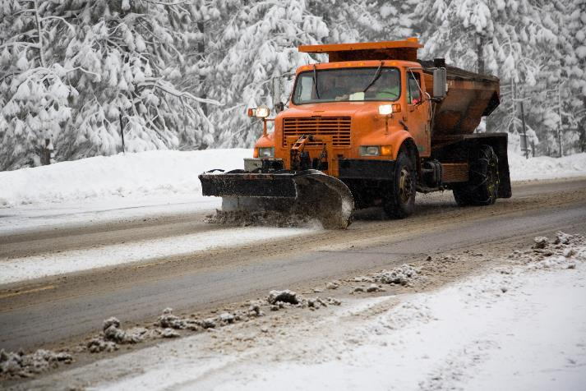
Road Weather Management
Coordinate planning, mitigation, and response to all weather events
Identify and communicate freight-specific road closures and freight-friendly alternative routes
Share road weather information system resources for proactive storm management and freight route and schedule planning
Optimize road treatments ahead of winter weather
Prevent infrastructure and environmental degradation in areas with repeat weather problems (e.g., damage and erosion from repeat flooding)
Source: Getty Images.
Notes:
Weather conditions can have a serious effect on goods movement, whether winter storms with snow and ice, draught conditions that result in wildfires, heavy rains that produce flooding and mudslides, or extreme events with high winds and rainfall.
Road weather management can assist freight movements by providing advance warning of impending weather conditions across multiple States as well as real-time road conditions such as road closures. Additionally, road weather management includes optimizing treatments ahead of winter weather and managing snow removal to facilitate travel on major roadways.
Freight-specific road weather management requires advance planning and collaboration between TSMO and freight management (agencies, carriers, shippers) so that carriers can anticipate and plan for potential road closures and use advance information to notify shippers of potential delays or use alternative modes for transport.

Slide 59
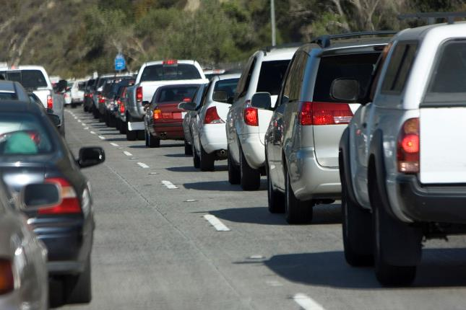
Congestion Management: Managing Demand
Congestion pricing/time of day restrictions (e.g., off-hours delivery)
Active transportation and demand management (signals, lane controls)
Dedicated/restricted lanes to avoid heavy/light vehicle conflicts
Truck parking and related information systems that align with high volume pickup/delivery locations
Source: Getty Images.
Notes:
Congestion management covers wide-ranging TSMO activities, including demand management, to reduce vehicular demand on congested roadways by either shifting demand through pricing or restricting access based on vehicle occupancy.
Active transportation/demand management can use real-time signal controls (including truck signal priority) to reduce congestion due to slow starts at controlled intersections and to assign speed controls based on congestion levels and travel demand.
Additionally, lane management strategies that separate heavy vehicles from passenger cars can reduce conflicts that result from speed variations and driver behavior.
Parking near major pickup and delivery locations as well as availability information can reduce the miles heavy vehicles must travel to find parking prior to scheduled pickup and delivery time slots. This requires collaboration with local land-use plans and with local businesses (e.g., truck stops) affected by additional truck parking access.
Credit: MCCAIG, Getty Images. Creative # 172932219.

Slide 60
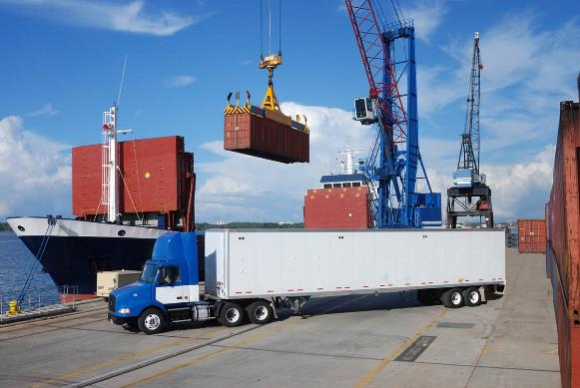
Congestion Management: Highways, Ports, Intermodal Transfer Points
Consider eligible TSMO projects to reduce freight congestion for Congestion Mitigation Air Quality program funds and Federal grants
Collaborate to identify high benefit/cost ratio TSMO strategies to reduce freight congestion and emissions as part of the congestion management process (CMP)*
Source: Getty Images.
Electronic screening and electronic toll collection to reduce delays at weigh stations and on toll roads
Provide real-time traffic conditions (incidents, weather, wait time) at or near intermodal transfer points, e.g., Freight Advanced Traveler Information System
*Additional resources on TSMO and CMPs: https://ops.fhwa.dot.gov/plan4ops/focus_areas/cmp.htm
Notes:
In ports and intermodal transfer points, queue management strategies can enable drivers to schedule pickup and drop-off times to reduce waiting at facility gates.
Freight and TSMO stakeholders can consider eligible TSMO projects to reduce freight congestion for Congestion Mitigation Air Quality program funds and Federal grants.
TSMO staff can work with both local and regional carriers and shippers as well as local jurisdictions to identify appropriate high benefit/cost ratio strategies for managing demand to the advantage of both freight carriers and private vehicles and also with the local community. Off-hours pickup and delivery can relieve peak hour congestion, but it can result in noise and emissions during early morning or late night, which may be opposed by nearby neighborhoods.
Electronic screening can reduce delays and improve safety on freeways by allowing safe and legal carriers and vehicles to bypass weigh stations.
TSMO staff, freight planners, carriers/shippers, and port authorities can collaborate to identify effective strategies that provide real-time information to carriers and shippers for use in route and schedule planning to avoid excessive delays due to high demand, weather, incidents, long queues and wait times, etc. The Freight Advanced Traveler Information System (FRATIS) used at ports includes dynamic route planning with real-time traffic conditions, incident alerts, work zones, road closures, routing for HAZMAT and oversize/overweight, weather data, terminal queue status and wait times, and real-time speed data. (Slide 51 is an example of this.)
Credit: choicegraphx
Creative #: 98154502
License type: Royalty-free
Collection: E+
Release info: No release required

Slide 61
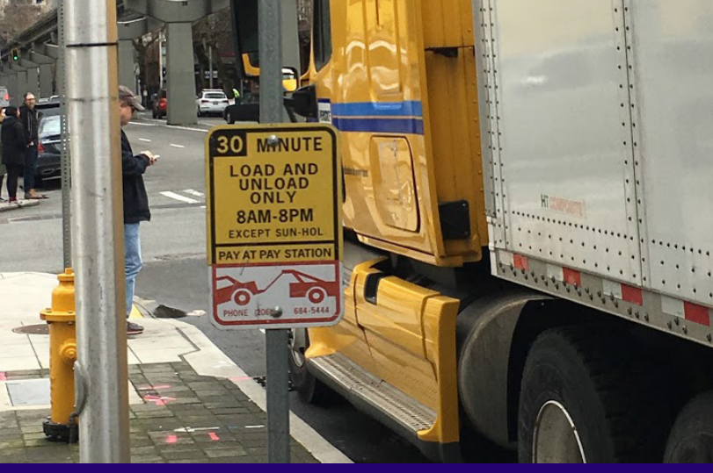
Urban Goods Delivery
Off-peak delivery to avoid congestion and conflicts with other vehicles
Dedicated loading/unloading zones to facilitate urban delivery without blocking travel lanes
Safe and secure parking while waiting for scheduled pickup and delivery times
Designated distribution/collection centers to consolidate deliveries to minimize trips and travel time
Source: Barb Ivanov, University of Washington College of Engineering, Supply Chain Transportation & Logistics Center.
Notes:
Urban goods delivery is complex in many congested central business districts. It also brings commercial vehicles into residential areas on roads that may not have been designed to accommodate the growing volume of heavy vehicles engaged in residential local delivery. Curb management is a growing concern, and TSMO strategies for shifting deliveries to off-peak and providing loading/unloading zones during designated hours can avoid lane blockages due to double parked delivery vehicles.
Additionally, some communities look for ways to reduce the number of heavy trucks entering central business districts and residential areas by transferring goods to small delivery trucks and vans that create fewer conflicts with other traffic.
Image source document: https://depts.washington.edu/sctlctr/sites/default/files/research_pub_files/SCTL_Final_50_Feet-of-Urban-Goods-Delivery-ExecSummary.pdf. 2017.

Slide 62
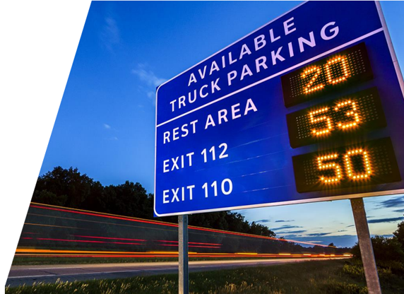
Truck Parking
Real-time data sharing for parking availability and multijurisdictional coordination
Real-time truck parking information availability notification (511, dynamic message signs, smartphone applications)
Truck parking reservation systems
Safe and secure truck parking on highways and near destinations
Source: “Inside the MAASTO Truck Parking Info Management Project.” Webinar from I–95 Corridor Coalition, March 13, 2020.
Notes:
Safe and secure truck parking continues to be a major concern to drivers. Hours of service regulations require drivers to limit driving hours, but without available parking, drivers are forced to park illegally on the roadway or in unsafe areas.
Additionally, time-certain delivery schedules require drivers to “buffer” their expected travel time to allow for unanticipated delays. They often arrive earlier than their scheduled pickup or delivery window and need a place to wait for their designated time slot. Knowing about truck parking availability well in advance of the expiration of their hours of service, or their arrival at their destination, can enable drivers to plan stops to optimize their trips.
TSMO champions need to advocate for more and more convenient truck parking so that drivers do not park illegally (typically on exit/entry ramps to rest areas or other illegal areas that affect traffic flow). Trucks parked on the side of the road become a crash hazard for other drivers. With most parking at night, low visibility creates an even greater hazard.
Illegal parking can create bottlenecks where freeway traffic slows to avoid trucks parked near traffic lanes. Also, convenient parking reduces the need for trucks to drive to more distant parking areas. Parking information enables truck drivers to plan their stop time based on available hours of service remaining and distance to available parking.
Photo source document: https://tetcoalition.org/wp-content/uploads/2015/02/MAASTO-Webinar-I-95CC-Slides-2020-03-13-post-mtg.pdf

Slide 63
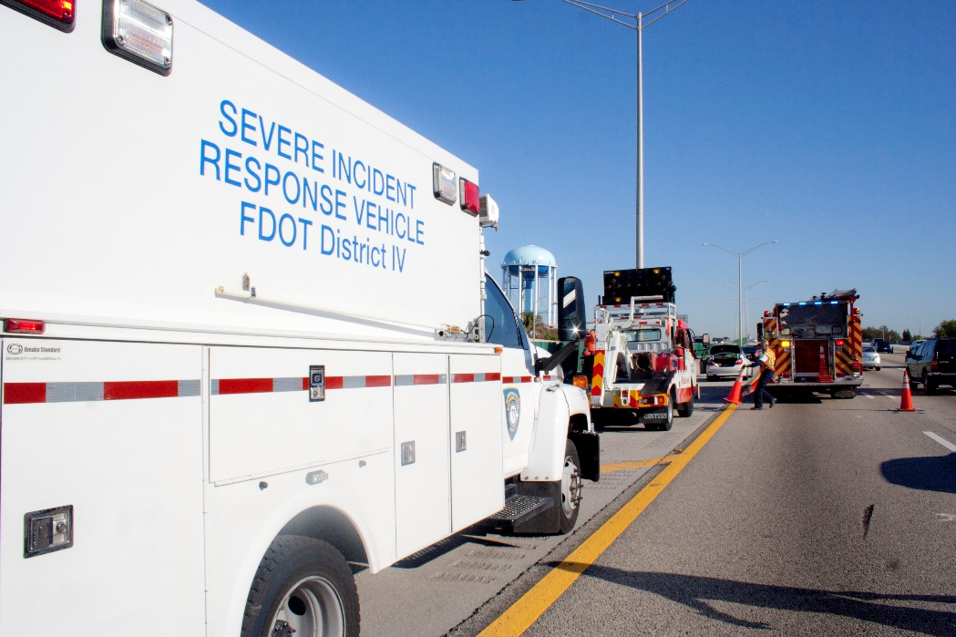
Traffic Incident Management
Mitigate impacts of incidents involving hazardous materials and pollutants
Incident management training with first responders
Quick clearance programs and incentives to detect and respond to incidents and reopen travel lanes as quickly as possible
Prepositioned tow and recovery during peak periods to clear travel lanes safely, quickly and readily available heavy towers
Source: Florida Department of Transportation.
Notes:
Incident management is important to freight, regardless of whether a heavy vehicle is involved. Rapid detection, response, and clearance is key to restoring traffic flows and avoiding secondary incidents that result in further delays. When heavy vehicles are involved, incidents can also result in HAZMAT spills, either due to hazardous cargo or fuel spillage. Rapid HAZMAT cleanup is an important component of incident management, and TSMO strategies can help ensure the appropriate equipment and properly trained personnel are available to respond to the incident.
Finally, during peak periods where recurring congestion is already common, or at bridges and tunnels where an incident can result in major delays, pre-positioning tow and recovery service can expedite detection and response to incidents. Having heavy towers readily available through an approved list or other mechanism supports quick clearance of trucks.

Slide 64
Freight Signal Priority (FSP)
Goal is to reduce stops and delays, increase freight travel-time reliability, and enhance intersection safety
Makes sense for:
Corridors that are important freight routes
Approach to traffic signal is uphill
Approach to traffic signal is downhill
Strategy benefits:
Improves safety—reduces collisions at intersections
Reduces congestion—keeps trucks moving through a green light
Reduces road maintenance—limits stop-and-go conditions and related pavement damage due to friction
Reduces emissions
Source: https://tsmowa.org/category/signal-operations/freight-or-truck-signal-priority.
Notes:
Jurisdictions and agencies are considering freight signal priority (FPO) as a strategy to reduce delays that result from the time it takes heavy vehicles to accelerate and decelerate at signalized intersections. FSP detects an approaching heavy vehicle and delays the green signal long enough for the vehicle to pass through the intersection before turning yellow and red. This avoids fuel consumption, emissions, delay, and roadway damage that occurs when heavy vehicle must quickly stop and then accelerate after the signal changes. This is especially true for signalized intersection on a hill where acceleration requires more energy when on the uphill slope and deceleration requires downshifting and heavy breaking on the downhill slope.

Slide 65
Examples of Coordination Between TSMO and Freight
Notes:
Now let’s look at a few examples of how TSMO and freight are actually working together to improve system performance and goods movement.

Slide 66
Iowa DOT Council Bluffs Interstate “Getting You There” —Heavy Trucks and Work Zone Management
Construction ingress/egress included in traffic operations plan for intelligent work zones
Road closures are scheduled/restricted based on sensor data
Intelligent work zone sensors detect queues and truck egress from work zones
511 system informs commercial vehicle drivers of restrictions, axle load limits, parking areas, and weigh stations
511 system provides detailed information regarding lane closures/restrictions and size/weight limits.
Information available to drivers using Iowa 511 truck mobile app
Notes:
Source: Tara Kramer, CBIS Traffic Manager, “Heavy Trucks in Works Zones”, Getting You There – Council Bluffs Interstate, available at https://www.workzonesafety.org/files/documents/training/webinar/large_truck_wz_webinar-Kramer.pdf
The Iowa DOT’s “Getting You There” project for the Council Bluffs Interstate provides tailored information for heavy trucks that enter and depart work zones.
The “Getting You There” Transportation Management Plan includes Traffic Control Plans that include
Goals and objectives
Traffic control plan
Traffic Operations Plan, including
Intelligent Work Zones
Traffic Incident Management
Public Information Plan
The Traffic Control Plan uses sensor data to determine work restrictions based on daily and hourly traffic volumes with some short-duration closures for construction events that require closures (e.g., bridge beam placement).
Intelligent work zone devices are located to detect traffic queues and truck egress from work zones.
Cost of the IWZ devices is approximately $6,500 for initial deployment and $50/day operational cost.
The 511 website and mobile app consolidates all information regarding work zones and other information relevant to commercial vehicles including lane restrictions, weigh stations, axle limits, rest areas, and weather warnings.
TSMO and Freight Connection:
Work zone design and detours
Truck-specific traveler information (e.g., weather, size/weight restrictions, detours)
Iowa DOT developed a process and integrated it into its Design Manual in March 2019 to determine which types of highway projects require additional work zone management. Criteria to prioritize projects as Traffic Critical Projects includes annual average daily traffic over 15,000 or 11,000 with 20% trucks. This is applied to work zones programmatically. For more information, see: https://transportationops.org/case-studies/iowa%E2%80%99s-comprehensive-work-zone-program.

Slide 67
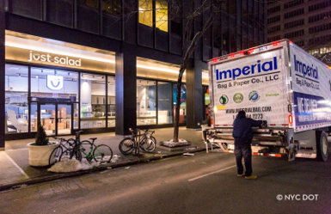
Off-Hour Deliveries in New York City (NYC) (1/2)
Increasing demand on the NYC transportation system has caused congestion, less economic productivity, and lower quality of life.
NYC DOT partnered with Rensselaer Polytechnic Institute to implement an Off-Hour Delivery (OHD) pilot program from 2007 to 2010, funded by the USDOT.
The OHD program, now permanent, shifts deliveries to the off-hours (7 p.m.–6 a.m.) and has expanded to 1,100 locations citywide (as of April 2022).
A local retailer, a program participant, conducts off-hour deliveries.
Source: New York City Department of Transportation.
Source: “Off-Hours Deliveries: New York City DOT” https://ohdnyc.com/.
Notes:
NYC and other cities seek to relieve peak period congestion as well as lane blockage due to delivery during peak periods by encouraging off-hour (or off-peak) deliveries in congested urban areas.
Benefits include more certainty on truck arrival times, reduced delivery cost, less congestion, cleaner air, safer streets, improved truck utilization, fewer parking problems, and reduced transit time. The pilot study is well documented in a report on https://ohdnyc.com/sites/default/files/business-admin-files/Home/ohd-final-report.pdf.
The website includes a tool kit and other resources for implementing off-hours delivery programs.
TSMO and Freight Connection: Urban goods movement/curb space management

Slide 68
Off-Hour Deliveries in New York City (NYC) (2/2)
NYC DOT seeks to continue collaborating with freight, retail, and food sectors to educate businesses on the benefits of moving deliveries to the off-hour period, such as reduced road conflicts and increased efficiency and reliability of deliveries, and the importance of protecting residents and visitors from noise intrusion.
The agency is exploring several incentives to help companies investigate and ultimately move to off-hour deliveries.
A local retailer, a program participant, conducts off-hour deliveries.
Source: New York City Department of Transportation.
Source: The City of New York. 2022. “Off-Hours Deliveries: New York City DOT” (web page). https://ohdnyc.com/, last accessed December 28, 2022.
Notes:
NYC and other cities seek to relieve peak period congestion as well as lane blockage due to delivery during peak periods by encouraging off-hour (or off-peak) deliveries in congested urban areas.
Benefits include more certainty on truck arrival times, reduced delivery cost, less congestion, cleaner air, safer streets, improved truck utilization, fewer parking problems, and reduced transit time. The pilot study is well documented in a report on https://ohdnyc.com/sites/default/files/business-admin-files/Home/ohd-final-report.pdf.
The website includes a tool kit and other resources for implementing off-hours delivery programs.
TSMO and Freight Connection: Urban goods movement/curb space management

Slide 69
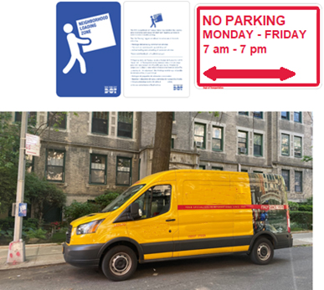
Neighborhood Loading Zones in NYC
Shift in e-commerce increased demand on freight deliveries and ride-hailing services
Increased need for dedicated loading space in residential neighborhoods.
NYCDOT launched in 2019 the Neighborhood Loading Zone (NLZ) program to provide curb space for:
Package deliveries by commercial vehicles
Taxi and car service pickup and dropoff
Active loading and unloading of personal vehicles
As of April 2022, NYCDOT installed 185 loading zones within 20 community board boundaries citywide, with a goal of 800 zones by 2026.
NLZs average up to 600 vehicles per space per month, dwelling for about 26 minutes at a time
Saw up to a 70%-reduction in double-parking
A local delivery service uses a neighborhood loading zone to conduct
deliveries in Queens.
Source: New York City Department of Transportation.
Source: The City of New York. “Neighborhood Loading Zones” https://nyc.gov/nlz.
Notes:
The transformative shift in e-commerce and the resulting demand on freight deliveries due to COVID-19, as well as the increase in TNCs (ridesharing), required NYCDOT to find creative approaches to accommodate the increased need for dedicated loading space in residential neighborhoods.
Launched in 2019, the Neighborhood Loading Zone (NLZ) Program aims to reduce double parking on narrow residential streets by providing space at the curb for activities such as:
Package deliveries by commercial vehicles
Taxi and car service pick-up and drop-off
Active loading and unloading of personal vehicles
They allow for expeditious pick up and drop off of personal vehicles, taxi/TNCs and of course, package deliveries.
As of April 2022, DOT has installed 185 loading zones within 20 community board boundaries city-wide.
Most NLZs have high utilization; specifically, corridors with the highest NLZ use averaged 600 vehicles per space per month for about 26 minutes at a given time. NLZs can average up to 600 vehicles per space per month, dwelling for about 26 minutes at a time. Surveyed locations saw up to a 70% reduction in double-parking (Effectiveness and use level depends on block level placement of the NLZs).
Goals: additional zones in 1-2 neighborhoods/year in each Borough (based on community input), 800 zones by 2026
TSMO and Freight Connection: Urban goods movement/curb space management
Photos and images provided by New York City DOT.

Slide 70
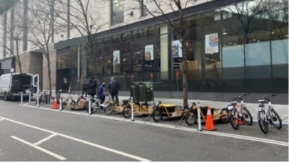
Cargo Bikes Program in NYC
In December 2019, NYC announced a commercial cargo bicycle pilot concentrated in Manhattan’s central business district.
The Commercial Cargo Bike Program (largest in the nation) aims to reduce congestion, enhance safety, and cut greenhouse gas emissions by replacing trucks and vans with cargo bikes.
Cargo bikes can load/unload wherever commercial vehicles can park and are exempt from meter payments, which is a powerful incentive for businesses.
Number of participants has doubled since launch and the number of cargo bikes (over 400 bikes) has quadrupled.
DOT seeks to enroll over 2,500 cargo bikes by 2026 through a permanent program.
Top: Pilot participants at launch event.
Bottom: Warren Street commercial cargo bike corral.
Source: New York City Department of Transportation.
Source: The City of New York. “Commercial Cargo Bike Program.”
Notes:
In December 2019, NYC announced a commercial cargo bicycle pilot concentrated in Manhattan's central business district. In the coming years, DOT expects more companies to use cargo bicycles for last-mile, low-weight and low-volume deliveries.
The Commercial Cargo Bike Program (largest in the nation) aims to reduce congestion, enhance safety, and cut GHG emissions by replacing trucks and vans with cargo bikes. Cargo bicycles are uniquely equipped to achieve all three goals without negatively impacting delivery operations. Though some cargo bikes were already operating legally, this pilot allows the city and businesses to work together to better understand how cargo bikes can successfully fit into the city’s streetscape. Delivery companies in other countries, particularly in Europe, have introduced cargo bicycles for last mile delivery in dense urban areas.
Cargo bikes can load, unload, and stage wherever commercial vehicles can park and are exempt from meter payments which is a powerful incentive for businesses. In exchange, businesses share data metrics from their operations.
Since pilot launch, the number of participants has doubled and the number of cargo bikes (over 400 bikes) has quadrupled. DOT seeks to enroll over 2,500 cargo bikes by 2026 through a permanent program and install 4-5 cargo bike corrals on-street this year.
Each cargo bike covers an average of 20 service miles per day, replacing vans or box trucks on a 2:1 or even 1:1 basis. 20 cargo bike miles per day replace 20 van or box truck miles, resulting in a per bike CO2 savings of approx. 7 tons/year, equivalent to over 100 planted trees, or 15,436 passenger car miles traveled.
80% of cargo bike deliveries are being made to residential addresses, mostly on residential blocks with few or no commercial curb regulations, and cargo bikes are uniquely equipped to make these deliveries.
Largest program in the US.
TSMO and Freight Connection: Urban goods movement/curb space management

Slide 71
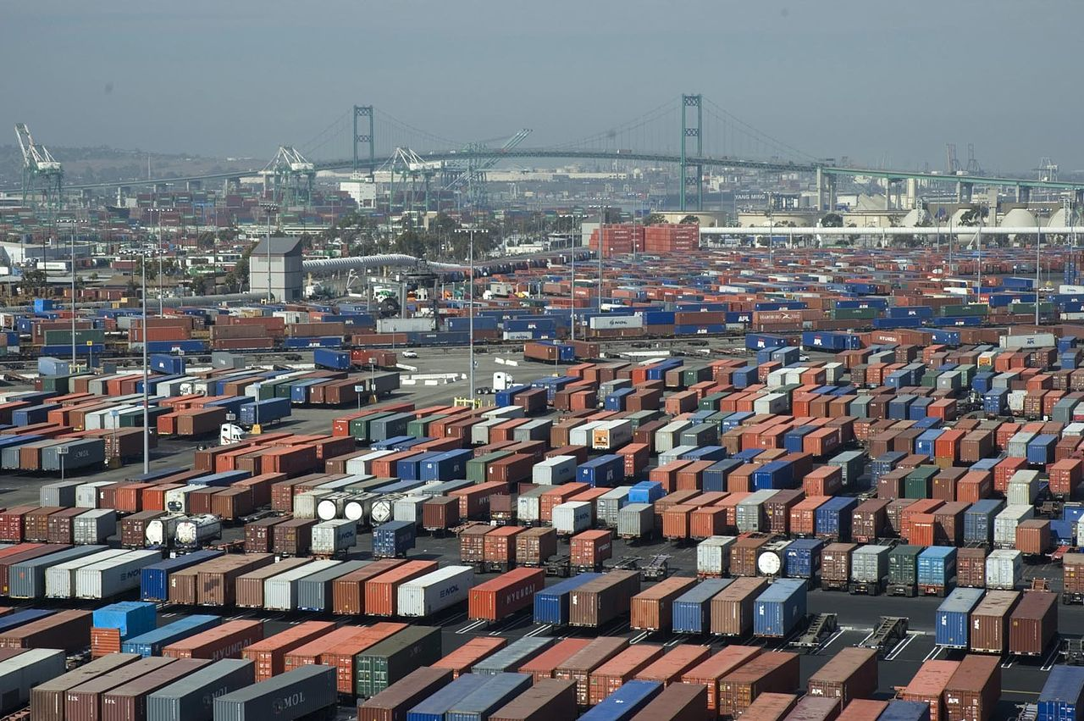
Los Angeles Metro Drayage, Freight, and Logistics Exchange (DrayFLEX)
Provides freight-specific dynamic travel planning information
Improves container movement for the ports of Los Angeles and Long Beach
Uses information from marine terminal operators, trucking companies, and traveler information systems
Integrates trucking dispatch system with terminal appointment systems
Provides updates on container availability and provides best routes to use to and from the ports
Source: Charles Csavossy. Port of Long Beach, California. 2006. Public domain via Wikimedia Commons.
Notes:
At the ports of Los Angeles and Long Beach, the Drayage, Freight, and Logistics Exchange (DrayFLEX) enables drayage carriers to schedule gate time to avoid queuing in long lines for cargo pickup or drop off. The information is provided to the drayage carriers who move the containers to and from the port to warehouses or other modes for further transport. By scheduling appointments, these operators are anticipated to reduce delays at the port, reduce fuel consumption while idling in a queue, and reduce emissions.
TSMO and Freight Connection:
Truck queue management at intermodal facilities and ports
Truck routing for fastest travel time and compliance with route restrictions and bridge capacity

Slide 72
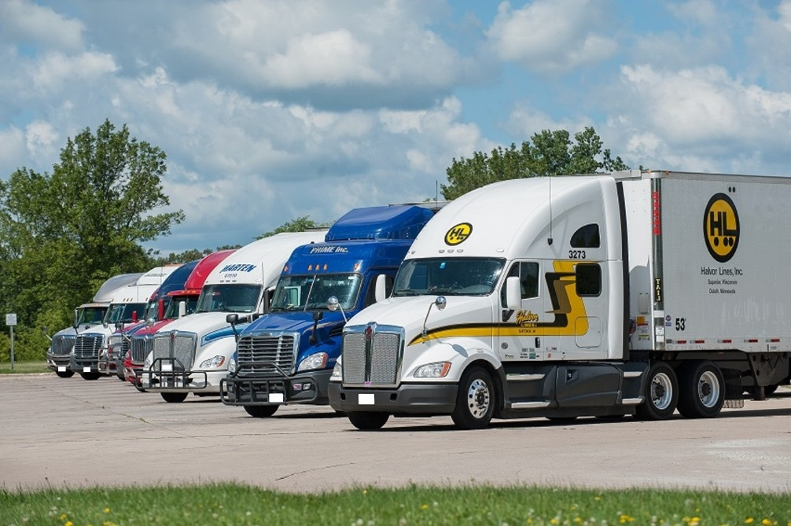
Truck Parking Information Management System (TPIMS)
Mid-America Association of State Transportation Officials (MAASTO) implemented TPIMS to address truck parking safety and efficiency
Reduces time searching for parking; provides safe parking alternatives
Monitors parking availability and provides real-time information to drivers
Provides information through dynamic signs, smartphone applications, and traveler information websites
Provides a safer, more efficient, and competitive freight system
Source: Minnesota Department of Transportation. “Truck Parking in Minnesota.”
Notes:
The Mid-America Association of State Transportation Officials (MAASTO) worked together to provide real-time information on truck parking availability to carriers and drivers so they can find safe and secure parking and avoid searching for available parking or parking illegally. The system uses multiple communication channels so drivers can get the information they need to make the best decision based on their Hours of Service (HOS) limitation and pickup and delivery requirements. This is a multi-State effort that will help long-haul drivers plan their travel times more effectively.
TSMO and Freight Connection: Safe, secure truck parking
Source document for photo: https://www.dot.state.mn.us/ofrw/freight/truckparking/index.html#:~:text=MnDOT%20is%20working%20with%20eight,on%20rest%20areas%20in%20Minnesota.

Slide 73
Florida DOT’s Truck Parking Availability System (TPAS)
In 2013, truck driver survey revealed that 83% of drivers spend more than 30 minutes to find parking, and 39% take more than 1 hour.
This leads to a safety issue with fatigued drivers and unsafe parking
Florida DOT developed a TSMO solution (TPAS) to notify truck drivers about parking availability at public facilities along the interstates including welcome centers, rest areas and weigh stations.
TPAS was deployed in‐ground space detection at the rest areas and welcome centers, and microwave detection for ingress/egress monitoring at the weigh stations to gather real‐time parking availability information.
Uses dynamic message signs, FL511.com and stakeholder engagement through partnerships with the Florida Trucking Association, to successfully provide the information to the commercial vehicle operators.
Notes:
Source: National Operations Center of Excellence, Florida Department of Transportation, Truck Parking Availability System Case Study. Available at: https://transops.s3.amazonaws.com/uploaded_files/Florida%20DOT%20Case%20Study%20-%20Truck%20Parking%20System.pdf.
Excerpts from Case Study:
In October 2013, a survey of nearly 4,000 truck drivers revealed that 83% of the respondents routinely took longer than 30 minutes to find parking. Thirty‐nine percent took longer than one hour leaving many truck drivers resorting to unsafe parking methods on interstate mainline shoulders, on ramps, or in vacant lots.
Because of the lack of identifiable parking locations, truck drivers nearing the end of their allotted Hours of Service (HOS) spend time searching for parking while approaching fatigue limits, presenting a public safety hazard. In addition, non‐necessary driving increases environmental and community impacts through increased emissions and congestion of the roadways.
FDOT developed a TSMO solution to notify truck drivers about parking availability at public facilities along the interstates including welcome centers, rest areas and weigh stations.
TPAS deployed in‐ground space detection at the rest areas and welcome centers, and microwave detection for ingress/egress monitoring at the weigh stations to gather real‐time parking availability information.
While TPAS will improve safety for drivers and dramatically reduce parking search times by providing real-time information, it will also contribute to efficiency of freight movement. Drivers will more easily meet hours of service rest periods and TPAS will allow for staging to meet on‐time pickup and delivery, a key to effective travel time reliability of freight movement.
Traveler information and public communications are major components to the success of the system. The use of DMS, FL511.com and stakeholder engagement through partnerships with the Florida Trucking Association (FTA), were established to successfully provide the information to the commercial vehicle operators.
FDOT’s Regional Transportation Management Centers (RTMCs) integrate and disseminate the TPAS information. The RTMCs are part of a larger system, which includes traffic incident management, integrated corridor management, connected and automated vehicle deployment, among other TSMO strategies. By incorporating active freight management into the RTMC activities, a robust, multimodal solution to traffic management will be developed by combining data from various sources such as ITS, TPAS and traffic monitoring sites communications.
TSMO and Freight Connection: Safe, secure truck parking

Slide 74
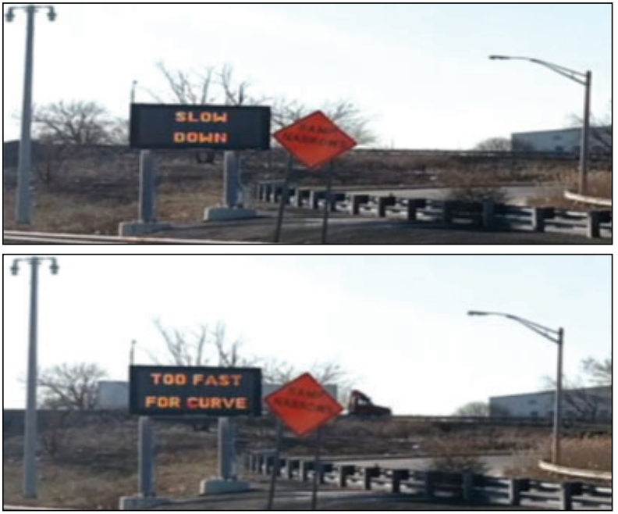
New Jersey Truck Safety Warning System (TSWS)
Is an automated warning system led by the New Jersey DOT
Determines potential tractor trailer rollover conditions based on real-time speed, weight, superelevation, and curvature
Alerts drivers to critical situations using warning signals and messages via variable message sign located just before the ramp’s critical area of curvature
Alerts traffic operations staff to incidents using real-time on-screen alerts with an audio alarm
Source: New Jersey Department of Transportation.
Notes:
Heavy-vehicle dynamics require careful handling to avoid rollovers on curves depending on vehicle speed, radius of the curve, slope of the roadway, and load configuration on the vehicle. New Jersey DOT’s Truck Safety Warning System (TSWS) warns drivers when their speed exceeds a safe speed threshold for the design of the curve in the roadway. If the vehicle is exceeding the safe speed to the point where the probability of a rollover is sufficiently high, the system alerts responders so they are aware of the possibility of an incident involving a heavy vehicle at a specific location.
TSMO and Freight Connection: Safety/crash avoidance/incident response and clearance
Photo from: https://transportationops.org/case-studies/truck-safety-warning-system. Need to confirm source is New Jersey DOT.

Slide 75
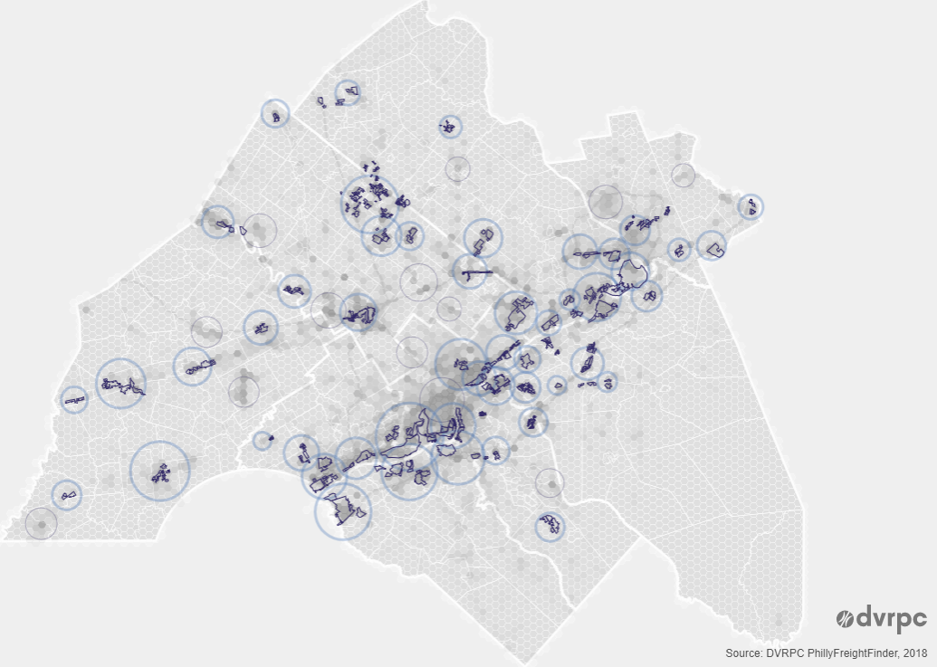
Delaware Valley Regional Planning Commission PhillyFreightFinder
Is a freight data portal for the Delaware Valley that uses data from TSMO sensors
Enables exploring and tracking the regional freight network
Provides interactive graphics and maps of freight infrastructure and freight performance measures (e.g., travel-time reliability) across multiple modes
Shows regional employment and economic impact of freight in the Delaware Valley
Source: Delaware Valley Regional Planning Commission. 2022. “PhillyFreightFinder.”
Notes:
The PhillyFreightFinder uses data provided by TSMO sensors and reporting systems, as well as other sources and models, to provide information to a variety stakeholders with an interest in goods movement in the area. The interactive graphics provide truck travel-time reliability information and other performance measures to the freight community and for regional economic development interests.
TSMO and Freight Connection: Truck travel-time reliability
Image source document: https://www.dvrpc.org/webmaps/phillyfreightfinder/freight-center-story.html#.

Slide 76
Atlanta Regional Commission (ARC) Freight Advisory Task Force (1/3)
Task force characteristics:
Established in 2003 to support regional planning process
Serves as forum for freight community and public sector
Includes representatives from railroads, trucking, airport, chambers of commerce, and others
Source: https://atlantaregional.org/transportation-mobility/freight/freight-advisory-taskforce/.
Notes:
“The Freight Advisory Task Force was established in 2003 as part of the ARC regional planning process. The Task Force meets periodically throughout the year. The general membership of public/private sector freight representatives include railroads, trucking, airport, chambers of commerce, and community improvement districts. The Task Force provides a forum for dialogue between the freight community and the public sector on freight and goods movement issues.
Taskforce Goals
Improve goods and services movement in the region
Improve reliability of goods movement
Minimize the cost of goods movement
Improve characteristics of transportation system for freight movement
Taskforce Objectives
Provide input on policies and improvements for freight mobility
Identify freight mobility characteristics and needs
Highlight the significance of freight to the region
Improve safety of the transportation system
Prioritize freight transportation needs and investments”
TSMO and Freight Connection: Truck travel-time reliability
Source: ARC website: https://atlantaregional.org/transportation-mobility/freight/freight-advisory-taskforce/.

Slide 77
Atlanta Regional Commission (ARC) Freight Advisory Task Force (2/3)
Goals:
Improve goods aSnd services movement in the region
Improve reliability of goods movement
Minimize the cost of goods movement
Improve characteristics of transportation system for freight movement
Source: https://atlantaregional.org/transportation-mobility/freight/freight-advisory-taskforce/.
Notes:
“The Freight Advisory Task Force was established in 2003 as part of the ARC regional planning process. The Task Force meets periodically throughout the year. The general membership of public/private sector freight representatives include railroads, trucking, airport, chambers of commerce, and community improvement districts. The Task Force provides a forum for dialogue between the freight community and the public sector on freight and goods movement issues.
Taskforce Goals
Improve goods and services movement in the region
Improve reliability of goods movement
Minimize the cost of goods movement
Improve characteristics of transportation system for freight movement
Taskforce Objectives
Provide input on policies and improvements for freight mobility
Identify freight mobility characteristics and needs
Highlight the significance of freight to the region
Improve safety of the transportation system
Prioritize freight transportation needs and investments”
TSMO and Freight Connection: Truck travel-time reliability
Source: ARC website: https://atlantaregional.org/transportation-mobility/freight/freight-advisory-taskforce/.

Slide 78
Atlanta Regional Commission (ARC) Freight Advisory Task Force (3/3)
Task Force activities include:
Providing input to ongoing ARC TSMO Plan and intelligent transportation system (ITS) architecture development:
Types of transportation technology to support freight movement
Freight operational needs
Source: Getty Images.
In 2019, ARC began developing “Freight Cluster Plans” focused on local industrial areas and multimodal recommendations, including TSMO and ITS
Notes:
In January 2019, The ARC Freight Advisory Task Force held a regular meeting and received a presentation on the TSMO Plan and ITS Architecture updates that are underway. They were asked to provide input into those plans. This is an important example of an MPO explicitly reaching out to the freight community and including the group’s needs in its TSMO and ITS planning efforts.
The freight cluster plans started in 2019, and the first round of completed plans are available at https://atlantaregional.org/transportation-mobility/freight/transportation-mobility-freight-freight-cluster-plans/. These are local plans focused on industrial areas. Project recommendations from these plans focus on multimodal project and policy recommendations, including TSMO strategies and ITS projects. ARC aims to work the completed ITS Architecture/TSMO Plan concepts into its other planning efforts, and this is how it is currently working them into our freight planning. The freight cluster plans are new for the ARC region. It might be an incremental process as it works TSMO into more of its planning efforts over time.

Slide 79
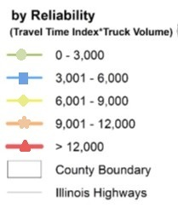
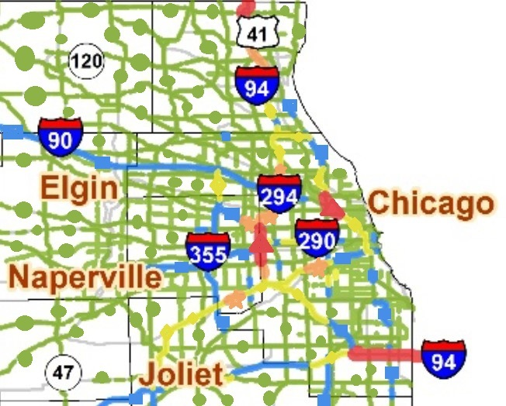
Travel-Time Reliability in the Illinois State Freight Plan (1/2)
National freight crossroads
Plan developed in 2017, amended in 2018
Identified major truck bottlenecks on roads based on unreliability and delay
Used NPMRDS data including trucks instrumented with GPS
Used measures of Average Truck Delay per Segment and Reliability Index (95thTT%/50th TT%) * Truck AADT
Truck Travel Time Unreliability, Northbound and Eastbound
Source: Illinois State Freight Plan.
Notes:
Note: NPMRDS: National Performance Management Research Data Set. The NPMRDS contains field-observed travel-time and speed data collected anonymously from a fleet of probe vehicles (cars and trucks) equipped with mobile devices. Using time and location information from probe vehicles, the NPMRDS generates speed and travel-time data aggregated in 5-minute, 15-minute, or 1-hour increments.
Freight transportation in Illinois is a key driver of the State’s economy and is integral to the global system of trade, despite being in the interior of the continent. Intermodal service is a principal advantage that Illinois brings to supply chain businesses; this advantage helps drive the State’s economy.
The freight plan provides data and analysis on the movement of these goods and also identifies major freight corridors and bottlenecks. Also included is a freight investment plan which shows the projects that will be funded with the freight formula funds provided under the FAST Act. These projects were selected through the Illinois Competitive Freight Program, which allowed stakeholders to submit freight projects for evaluation using a transparent set of eligibility and scoring criteria. The finalized freight plan includes the freight investment plan.
Truck bottleneck identification is a major section in the plan.
The plan helped inform project selection in an ongoing planning processes.
Average delay measure used to describe how much worse travel times are on average relative to free flow. Average truck delay per segment (hour/mile-year) = (Average travel time − 10th percentile travel time)*(Truck AADT)*365/(segment length) Where 10th percentile travel time is taken to represent free flow conditions.
Reliability Index (unitless) = (95th percentile travel time)/(50th percentile travel time) * (Truck AADT) Where: the 95th percentile travel time represents the time that shippers and carriers must consider to arrive on time 95 percent of the time (worst conditions).
Defined bottleneck “as a part of the roadway network that causes a disproportionately high cost in the movement of freight in terms of unreliability and delay.”
Other data sources used include truck volume from FAFv4 (from HPMS), freight flow forecasts, safety, and pavement condition.
TSMO and Freight Connection: Truck travel-time reliability
Website: http://www.idot.illinois.gov/transportation-system/transportation-management/planning/illinois-state-freight-plan
Source: Illinois State Freight Plan http://www.idot.illinois.gov/Assets/uploads/files/Transportation-System/Reports/OP&P/Freight/ILFreightPlan_FINAL.pdf

Slide 80
Travel-Time Reliability in the Illinois State Freight Plan (2/2)
Freight Investment Plan and Priority Projects:
Used competitive program to obligate majority of FAST Act freight formula funds.
Bottleneck reduction (including truck travel-time reliability) one of the scoring criteria for freight projects.
Selected projects include an Illinois DOT Intelligent Truck Parking Availability Information System for more than $14 million
Notes:
Illinois State Freight Plan included a Freight Investment Plan and list of Priority Projects. They developed a competitive freight program to collect and evaluate project proposals to allocate about $157M of FAST Act freight formula funds that were remaining (of a total of $226M) when the plan was developed. They used a list of scoring criteria to evaluate the projects:
Scoring criteria include (organized by goal):
Bottleneck Reduction
o Truck Travel-Time Reliability
o Freight Hours of Delay
o Bottleneck Severity
o Removes a Geometric Barrier
o Improves Reliability of Delay
Improving Commercial Motor Vehicle (CMV) related safety
o Rate of fatalities involving freight vehicles
o Rate of serious injuries involving freight vehicles
o Improves rate of fatalities or serious injuries
o Safer Road Index
Improve intermodal accessibility to/from freight corridors – “last mile”
o Project located within three miles of an intermodal facility
o Increase freight volume
o Facility Gate Count
o Current Hours of Truck Delay
o Rail or Port Project Highway Relief
o Improvement in Truck Travel-Time Reliability or Hours of Delay
Technology Deployment o Improved data transfer/communication
o Signal timing
o Improved traffic flow (weigh in motion)
o Technology application development –
Cross-Cutting Measures
o Truck Volume (AADT)
o Percent Truck
o CRS Rating
o Financial Partnerships
o Cost Effectiveness
o Project Readiness
The list of prioritized projects included several phases for an IDOT Intelligent Truck Parking Availability Information System for $14M (total across lines).

Slide 81
I–10 Corridor Coalition’s Western Connected Freight Corridor Concept of Operations (1/2)
I-10 Corridor Coalition formed in 2016 by:
Arizona
California
New Mexico
Texas
Goal of working together “to create safer and more efficient travel, both commercial and personal, along this corridor stretching from coast to coast.”
Corridor extends from Ports of Long Beach and Los Angeles, CA, to Port of Beaumont, TX.
Notes:
This project developed a concept of operations (or at least a report) that documents five strategies to improve freight movement on the I-10 Corridor: truck parking availability systems, freight traveler information systems, freight technology environment, roadside safety communication, and oversize/overweight permit standardization. Included are functional descriptions of the corridor, stakeholders informed about this study, a synthesis of freight improvement technologies and strategies considered for application, stakeholder engagement, use case scenarios and implementation considerations, and a planning framework for strategy implementation.
Source: Arizona Department of Transportation et al. 2019. I-10 Western Connected Freight Corridor Concept of Operations. Available at: https://www.pooledfund.org/Details/Study/599

Slide 82
I–10 Corridor Coalition’s Western Connected Freight Corridor Concept of Operations (2/2)
Developed a Connected Freight Corridor Concept of Operations from 2016 to 2019 through a pooled-fund study project.
Identified five strategies to improve freight mobility on corridor, use cases, and a planning framework. The strategies are:
Truck parking availability systems
Freight traveler information systems
Freight technology environment
Roadside safety communication
Oversize/overweight permit standardization
Notes:
The five strategies that were expanded on for the I-10 corridor are listed on the slide.
Following the concept of operations, the corridor won a ATCMTD FY2018 grant for I-10 Corridor Coalition Truck Parking Availability System (I-10 Corridor Coalition TPAS) for $6.85M to implement a truck parking availability system across the 4-state corridor.
TSMO and Freight Connection:
Truck size/weight enforcement
Safe, secure truck parking
Truck-specific traveler information (e.g., weather, size/weight restrictions, detours)
Source: Arizona Department of Transportation et al. 2019. I-10 Western Connected Freight Corridor Concept of Operations. Available at: https://www.pooledfund.org/Details/Study/599

Slide 83
Overcoming Challenges
Notes:
Increasing interaction between TSMO and freight is a “natural,” but there are challenges to overcome to advance cooperation and interaction.

Slide 84
Potential Challenges…and Solutions (1/4)
Challenge
Solutions
Limited awareness and understanding of TSMO
Many agencies are already working to increase TSMO awareness. Your TSMO program/champion may be able to help.
Federal TSMO resources: https://ops.fhwa.dot.gov/plan4ops/index.htm
Notes:
Many freight offices primarily focus on the safety, enforcement, and regulatory (e.g., size/weight) aspects of goods movement. They would benefit from greater awareness of how TSMO strategies could benefit goods movement. Most State DOTs have individuals or offices that promote TSMO strategies and can help freight offices learn more about TSMO.

Slide 85
Potential Challenges…and Solutions (2/4)
Challenge
Solutions
TSMO professionals not familiar with freight needs and issues (e.g., economic impacts, driver safety/security, delivery schedules, parking shortages)
Organize an event or “lunch and learn” session with TSMO staff to educate them on freight priorities
Discuss freight programs, objectives, and issues with TSMO staff; identify potential TSMO strategies to address freight needs and concerns
Resources for TSMO staff:
Improving Freight System Performance in Metropolitan Areas: A Planning Guide (http://www.trb.org/Main/Blurbs/172487.aspx)
Trucking 101 (https://onlinepubs.trb.org/onlinepubs/circulars/ec146.pdf)
Notes:
Similarly, many TSMO professionals have little knowledge and experience working with goods movement. They may not have full appreciation for the importance of efficient goods movement and freight operations to the local and regional economy, including decisions companies make about distribution center and manufacturing facility locations.
Efficient freight operations may be the deciding factor in many of these decisions, and TSMO professionals need to understand these relationships. Meetings with freight office professionals can be a great starting point, and there are also many resources to gain an understanding of the basics of goods movement and the freight industry. TSMO professionals need to understand these broader considerations as well as the concerns of carriers and shippers.
Beyond the concerns of carriers and shippers, however, freight issues include those related to markets and coverage areas provided by freight facilities as well as the availability of labor pools to support manufacturing and related distribution activities. Additionally, in some cases, municipalities offer incentives for locating freight generators (e.g., manufacturers, distribution centers, retail outlets) to support economic development.

Slide 86
Potential Challenges…and Solutions (3/4)
Solutions
Challenge
Freight professionals can provide insights to TSMO professionals that are less obvious or do not apply to passenger car drivers, especially on routes that handle high truck traffic volumes.
Well-informed TSMO staff can help reach freight goals and create a greater impact when working with the freight community.
Better understanding of freight needs can lead to reduced congestion and better system operations.
Resources on making the business case for TSMO:
Advancing TSMO: Making the Business Case for Institutional, Organizational, and Procedural Changes (https://ops.fhwa.dot.gov/publications/fhwahop19017/index.htm#toc)
Collaborating can add work for both TSMO and freight professionals. Why do it?
Notes:
While collaboration with other offices and, in some cases, private sector entities can add responsibilities and effort to both TSMO and freight professionals within the DOT, the potential benefits of working together are well worth the effort. Ultimately, it results in a system with fewer problems that each office might have had to address independently.

Slide 87
Potential Challenges…and Solutions (4/4)
Challenge
Solutions
Engaging private sector stakeholders (shippers, carriers, service providers, logistics firms, distribution centers, port authorities) in discussions with public agencies
Identify issues with near-term solutions (often TSMO) that address both public- and private- sector issues
Engage private-sector stakeholders in longer term planning efforts that affect goods movement and related land use and economic issues
Engage State freight advisory committees, which are made up of freight industry stakeholders that advise the DOT.
Notes:
One of the most difficult challenges is engaging private sector stakeholders in future planning and projects. Commercial vehicle operators, shippers, and other businesses are more likely to be concerned about short-term issues and may not be willing to commit to longer term planning. TSMO strategies can offer near-term solutions that lead to immediate improvements, however. These can be the foundation for building longer term relationships needed for planning projects that require greater project development and resources.

Slide 88
Where Do We Go From Here?
Notes:
So how do we get started? What’s next?

Slide 89
Next Steps
Bring TSMO and freight leaders together within your agency to identify areas of common interest and mutual objectives
Find out how TSMO strategies are already supporting freight goals
Discuss how freight goals can be better supported by TSMO
Begin joint initiatives to improve goods movement and operations
Notes:
What’s next?
Start by convening TSMO and freight leaders to begin discussions about common interests and mutual objectives, identify where these activities are already working together, and determine where greater impacts can be achieved.
Look for joint initiatives that can improve operations and goods movement and begin integrating them into project plans and current operations.

Slide 90
Resources
Downtown/Regional Freight Delivery Symposium: Baltimore, MD – March 2017: Executive Summary. Report No. FHWA-HOP-18-046. https://ops.fhwa.dot.gov/publications/fhwahop18046/
Primer for Improved Urban Freight Mobility and Delivery: Operations, Logistics, and Technology Strategies. https://ops.fhwa.dot.gov/publications/fhwahop18020/
National Coalition on Truck Parking: Activity Report, 2015–2016. https://ops.fhwa.dot.gov/publications/fhwahop17026/
Regional Coordination for Truck Network Efficiency: New York, New York. https://ops.fhwa.dot.gov/publications/fhwahop17021/
Notes:
Many resources from the Federal Highway Administration (FHWA) and Transportation Research Board address TSMO and freight. These can help find areas where TSMO and freight can work together to improve operations and goods movement. This is a sample of some of the relevant resources.

Slide 91
Resources (cont’d)
Truck Size and Weight Enforcement Technologies: State of the Practice. https://ops.fhwa.dot.gov/publications/fhwahop09050/
The Cost of Congestion: An Innovative Approach to Utilizing Waybill Data to Support Freight Transportation Planning and Analysis. https://ops.fhwa.dot.gov/publications/fhwahop17013/
Freight Performance Measure Primer. https://ops.fhwa.dot.gov/publications/fhwahop16089/
2015. Improving Freight System Performance in Metropolitan Areas: A Planning Guide. http://www.trb.org/Main/Blurbs/172487.aspx
Notes:
Many resources from the Federal Highway Administration (FHWA) and Transportation Research Board address TSMO and freight. These can help find areas where TSMO and freight can work together to improve operations and goods movement. This is a sample of some of the relevant resources.

Slide 92
Thank you!
For more information please contact:
[INSERT CONTACT INFORMATION]

