Slide 1
Connecting TSMO and Design
DESIGN
Presenter Name
Date
Source: Getty Images.

Slide 2
Disclaimer
The U.S. Government does not endorse products or manufacturers. Trademarks or manufacturers’ names appear in this presentation only because they are considered essential to the objective of the presentation. They are included for informational purposes only and are not intended to reflect a preference, approval, or endorsement of any one product or entity.

Slide 3
Executive Summary (ES)

Slide 4

[ES] Transportation Landscape Is Changing
Limited funds
Advances in technology
Customer needs and expectations
Better understanding of causes of congestion
Source: Missouri Department of Transportation flickr.
Notes:
The transportation landscape is changing and doing business the way it has been done in the past is no longer effective. For example, previously, congestion issues were primarily addressed by funding major capital projects (adding lanes or building new interchanges and roads) to address physical constraints, such as bottlenecks. Operational improvements were typically an afterthought—considered after the new infrastructure was already added to the system. Today, transportation agencies are facing trends that create a growing demand for travel with less funding and space to work with. As a result, we can no longer build our way out of congestion.
Trends we see today include:
Limited funds. Transportation agencies on the federal, State, and local levels have for years been tasked with doing more with limited resources. State departments of transportation (DOT) are always looking for innovative, lower-cost ways to get people and goods to their destinations more safely and reliably.
Advances in technology. Transportation agencies can leverage technology and data to develop solutions to address congestion issues. However, the traveling public expects fast, reliable, and “smart” transportation, given the advancement in consumer technologies (smartphones, applications, global positioning systems), privately owned mobility services, shared mobility, and the availability of more information.
Changing customer needs and expectations. There is a greater demand for accountability for public officials to ensure that public funds are spent to maximize the performance of the transportation system in the most equitable and cost-effective way. This creates a trend toward “performance-based” programs. The traveling public is seeking relief from unexpected delays in their trips. There is also a greater focus on addressing climate change and equity, and offering multimodal transportations options and solutions for the pedestrian, bicyclist, and transit rider.
Better understanding of the causes of congestion. Research has shown that while some congestion may be caused by typical morning and evening rush hours, a significant amount comes from non-recurring events, such as crashes, breakdowns, work zones, weather, and special events.
(Source: https://ops.fhwa.dot.gov/publications/fhwahop19085/fhwahop19085.pdf)
Image – Modot flickr -https://flic.kr/p/QNwCuy

Slide 5
[ES] How Are State Departments of Transportation (DOT) Responding to the Changes?
Transportation systems management and operations (TSMO)
TSMO can help State DOTs get the most performance out of existing and planned transportation facilities.
TSMO uses strategies, technologies, mobility services, and programs to optimize the safety, mobility, and reliability of the existing and planned transportation system.
Designers and those responsible for project development are key players and can embrace the TSMO mindset when shaping project designs.
Notes:
How are State DOT’s adjusting and responding to these changes?
Transportation systems management and operations (TSMO) is a solution.
The goal here is to get the most performance out of the transportation facilities we already have. TSMO is the use of strategies, technologies, mobility services, and programs to optimize the safety, mobility, and reliability of the existing and planned transportation system.
Designers and those responsible for project development are key players and can embrace the TSMO mindset when shaping project designs, and in turn will help support the agency’s overall mission.
“TSMO ultimately involves a mindset to determine the best way to optimize the mobility and reliability of the existing system with limited resources. A TSMO approach offers the ability to start with considering lower cost, less intensive solutions, and then move to using more intensive solutions such as facility expansions where needed. This approach also integrates TSMO throughout agency processes, rather than after major construction has been completed, and needs to include planning, design, people, processes, technology, and data.”
FHWA and AASHTO, Transportation Systems Management and Operations FAQs, https://ops.fhwa.dot.gov/publications/fhwahop19087/index.htm.

Slide 6
[ES] TSMO Is a “Way of Thinking” That Supports State Departments of Transportation (DOTs) Missions
“We provide safe, reliable and cost-effective transportation options to improve communities and economic vitality for people and businesses.”
Washington State DOT (WSDOT) mission¹
“To provide the best multimodal transportation system for Colorado that most effectively and safely moves people, goods, and information.”
Colorado DOT mission²
¹ WSDOT, “Our Strategic Plan,” https://www.wsdot.wa.gov/about/secretary/strategic-plan/
² Colorado DOT, “Mission, Vision & Values,” https://www.codot.gov/about/mission-and-vision.html
Notes:
TSMO leverages technology, a toolbox of strategies, and engineering solutions to maximize system performance; however, TSMO ultimately involves a way of thinking or a mindset focused on determining the best way to optimize the mobility and reliability of the existing system with limited resources.
TSMO can be thought of as a way of thinking and operating in order to get the most performance out of the transportation network while only building as much as is needed.
The principles of TSMO directly support the missions of many State (and local) DOTs, as these examples show.
NOTES:
States can insert their own mission statement here for effect or can leave these in.
Presenters can emphasize the connections between TSMO definition and their specific mission statement, such as safety, reliability, cost-effective, multimodal, customer’s needs/satisfaction, etc.

Slide 7

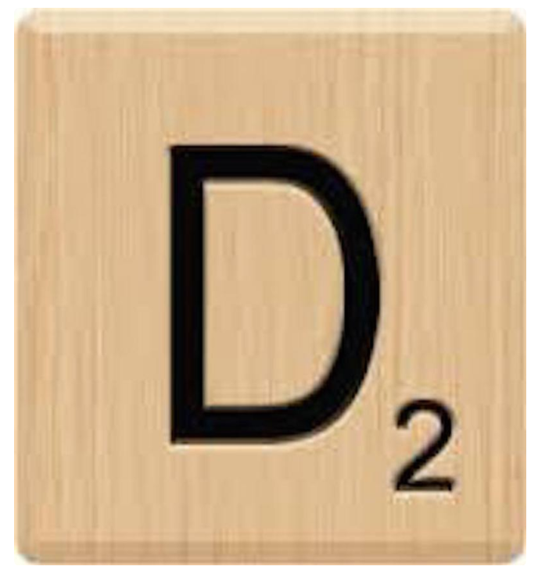







[ES] Consider TSMO Throughout Design
Project Scoping
Preliminary Design
Final Design
Source: ClipartMax.com.
Notes:
TSMO strategies can be implemented at each point in the design process to improve project outcomes and long-term operational efficiency. Agencies benefit from developing formal policies and procedures for including TSMO strategies and making operational considerations throughout the design process.
TSMO solutions can be used in a variety of settings and locations, both urban and rural. Even on already programmed/scoped projects, designers can work with TSMO/operations staff to identify strategies that can save money and make efficient use of the existing system. This saves money, and that money can be put to other needs or areas. Even a small portion of your budget devoted to these strategies can result in an immediate improvement.
Source: FHWA. 2019. Transportation Systems Management and Operations FAQs, FHWA-HOP-19-087. Available at: https://ops.fhwa.dot.gov/publications/fhwahop19087/fhwahop19087.pdf.

Slide 8
[ES] TSMO Supports Design Goals (1/2)
Can offer less expensive alternatives to adding capacity
Preserves capacity and extends the life of the facility
Mitigates substandard or problematic geometrics where feasible
Can offer solutions to reduce or mitigate environmental impacts in the design phase of the project
Offers support and strategies for safe and effective work zones and traffic control design
Notes:
How TSMO can support the goals of design:
TSMO can be an alternative to adding capacity or can reduce the new capacity needed (smaller footprint/less right-of-way; saves money and time)
Future TSMO and technology needs can be incorporated into a capital project design to preserve capacity and extend the functional life of the facility (plan for future signals or intelligent transportation system [ITS] devices, incorporating conduit, etc.; now will be cheaper than doing it later)
TSMO strategies can help mitigate substandard or problematic geometrics (sometimes it’s not feasible, cost-wise, to fix the geometric issue, but TSMO strategy may help mitigate)
As a part of the National Environmental Policy Act (NEPA) process, practitioners must examine and avoid potential impacts to the social and natural environment when considering transportation projects; TSMO can help reduce impacts and be a solution for project development/designers to mitigate environmental and cultural resource effects. Using TSMO strategies (such as managed lanes) may save agencies from expanding the highway and encroaching or building in areas with sensitive environmental aspects or cultural resources.
TSMO/operations staff can support design in designing safe and effective work zones. This includes determining lane closures and timing, decisions on length of work zones, penalties/rewards for contractors, smart work zones, queue detection systems, or other ITS elements. This also means considering all modes, such as pedestrian and bicycle needs and access to transit, early in the process.
Sources:
FHWA. 2018. Enhancing Transportation: Connecting TSMO and Design, FHWA-HOP-18-088. Available at: https://ops.fhwa.dot.gov/publications/fhwahop18088/index.htm.
FHWA. 2013. Designing for Transportation Management and Operations A Primer, FHWA-HOP-13-013. Available at: https://ops.fhwa.dot.gov/publications/fhwahop13013/fhwahop13013.pdf.

Slide 9
[ES] TSMO Supports Design Goals (2/2)
Serves as a useful tool in performance-based practical design (PBPD):
  Can help improves safety, reliability, and cost-effectiveness of PBPD solutions
  Expands design options
  Reduces need for conventional capacity improvements
  Often can be quickly deployed to offer benefits
More information on PBPD:
  Designing for Operations (FHWA Website)
  Performance-Based Practical Design (FHWA Website)
Notes:
One of the most notable ways that TSMO strategies can support design goals is that it can serve as a useful tool in performance-based practical design (PBPD).
PBPD modifies the traditional highway design process by taking a "design up" approach, where transportation decision makers exercise engineering judgment to build up the improvements from existing conditions to meet both project and system objectives.
TSMO strategies can help agencies improve the safety, reliability, and cost‐effectiveness of their PBPD solutions. By considering TSMO strategies in their PBPD processes, designers can expand the variety of available design options and perhaps postpone or reduce the need for conventional capacity improvements. Additionally, many of these operational strategies can be quickly deployed to offer benefits to the travelling public sooner than conventional capacity improvements.
For more information on PBPD, see the following FHWA resources:
https://ops.fhwa.dot.gov/publications/fhwahop18088/index.htm
https://ops.fhwa.dot.gov/publications/fhwahop13013/fhwahop13013.pdf
https://www.fhwa.dot.gov/design/pbpd/

Slide 10
[ES] …And How Can Design Support TSMO?
Impacts from traffic incidents can be reduced by design treatments.
Adverse weather conditions on roads can be mitigated through choices made in design.
Congestion caused by surges in demand can be alleviated using design strategies.
Early planning in design and collaboration with operations/TSMO staff can save money for intelligent transportation system (ITS) strategies.
Considering design options can facilitate access and maintenance for ITS or other operations devices.
Including design features that reduce bottlenecks and conflict points can optimize mobility and safety.
Notes:
Designing for TSMO can reduce the frequency and impacts of temporary transportation system disruptions that cause congestion and unreliable travel times:
Impacts from traffic incidents can be reduced by design treatments. Treatments can decrease the frequency of incidents (e.g., queue warning systems, runaway truck ramps), minimize the number of lanes the incidents block (e.g., crash investigation sites, vehicle turnouts), reduce the amount of time the lanes are blocked (e.g., emergency crossovers, drivable shoulders), and shield incidents from the view of passing drivers (e.g., extra-high median barriers, portable incident screens).
Adverse weather conditions on roads can be mitigated with treatments to prevent snow or sand from blowing across the roadway, limit the accumulation of snow and ice, or increase the efficiency of lane-clearing practices.
Congestion caused by surges in demand can be alleviated by incorporating mechanisms into the design that temporarily increase capacity in the direction of major travel (e.g., reversible lanes, divert demand to alternate routes, and limit freeway entrance and exit options).
Early planning in design and collaboration with operations/TSMO staff can save money for ITS strategies (e.g., planning for near-term or long-term ITS components and systems can save money now).
During the design stage, designers can include design features/options to help facilitate access and maintenance for ITS or other operations devices.
During project development design features can be included that improve traffic flow when based on appropriate site data. Features include the design of ramp merges, the use of auxiliary lanes, effectively siting lane drops, and the use of turn lanes or roundabouts at intersections.
FHWA. 2018. Enhancing Transportation: Connecting TSMO and Design, FHWA-HOP-18-088. Available at: https://ops.fhwa.dot.gov/publications/fhwahop18088/index.htm.

Slide 11

[ES] Opportunities to Connect Design and TSMO
TSMO and design benefit from connecting at all points
in the design process, from project scoping to final design.
Areas of opportunity to connect design and TSMO include:
  PBPD
  Geometric design elements
  Multimodal transportation solutions
  Work zones and traffic control plans
Ways to help take advantage of these opportunities include:
  Updating design-related policies, practices, and manuals to include TSMO considerations
  Including both TSMO and design staff in project core team communications
Source: ClipartMax.com.
Notes:
There are several areas of opportunity for TSMO and design to connect including policies, work zones, performance-based practical design. TSMO and design benefit from connecting at all points in the design process, from project scoping to final design.
Some examples of areas of opportunity for connection include:
PBPD decisions - By considering TSMO strategies in their PBPD processes, designers can expand the variety of available design options and perhaps postpone or reduce the need for conventional capacity improvements.
Geometric design elements – During the design process, designers are evaluating the different alternatives and geometric design elements that meet the project needs and TSMO staff can assist by providing data to help determine the best options.
Multimodal transportation solutions - Multimodal systems, services, and projects are considered TSMO. It’s important for designers to consider multimodal systems, services, and projects early on in project scoping or there may not be budget for them later.
Work zones and traffic control plans - TSMO/operations staff can support design in designing safe and effective work zones; this includes determining lane closures and timing, decisions on length of work zones, penalties/rewards for contractors, smart work zones, queue detection systems, or other ITS elements
Ways agencies can help take advantage of these opportunities include:
Updating design-related policies, practices, and manuals with TSMO strategies and considerations to more fully integrate TSMO into the design process
Including both TSMO and design staff in open and regular communication among core members of the project design team and management establishes how operational practices will be considered during the design process

Slide 12
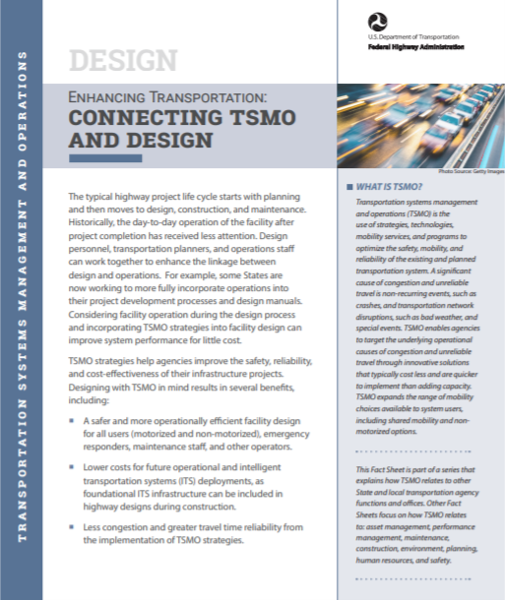
[ES] Take Action
Bring TSMO and design leaders together to identify areas of common interest and mutual objectives
Find out how TSMO strategies are already supporting design goals
Discuss where TSMO can make an even greater impact on design goals
Begin joint efforts to improve the TSMO and design connection
Learn more:
Enhancing Transportation: Connecting TSMO and Design
Source: Federal Highway Administration.
Notes:
Next steps to consider when looking to connect TSMO and design include:
Bring TSMO and design leaders together to identify areas of common interest and mutual objectives
Find out how TSMO strategies are already supporting design goals
Discuss where TSMO can make an even greater impact on design goals
Begin joint efforts to improve the TSMO and design connection
The FHWA fact sheet shown on the slide complements this presentation and can be used to inform your colleagues.

Slide 13
End of Executive Summary

Slide 14
Goals of This Presentation
Increase awareness of transportation systems management and operations (TSMO)
Demonstrate the alignment between TSMO and design goals
Provide examples of how TSMO can benefit design activities and vice versa
Discuss ways TSMO and design programs can collaborate
Notes:
The overall goals of the presentation are listed on this slide.

Slide 15
Presentation Overview
What Is TSMO?
Connecting TSMO and Design Overview
Opportunities for Collaboration
Examples of Collaboration Between TSMO and Design
Overcoming Challenges
Next Steps
Notes:
We begin this presentation by describing transportation systems management and operations, or TSMO.
We’ll then discuss reasons for connecting TSMO and design; and why TSMO matters for design. Then we will identify areas for collaboration and review specific examples.
Next we’ll conclude by reviewing the challenges and next steps in connecting TSMO and design.

Slide 16
What Is TSMO?

Slide 17
Definition of TSMO
Integrated [set of] strategies to optimize the performance of existing infrastructure through the implementation of multimodal and intermodal, cross-jurisdictional systems, services, and projects designed to preserve capacity and improve security, safety, and reliability of the transportation system.^{1, 2}
¹Definitions and Declarations of Policy, Title 23 of the U.S. Code § 101 (a)(30)(A).
²Federal Highway Administration (FHWA). “What Is TSMO?” website: https://ops.fhwa.dot.gov/tsmo/
Notes:
Before going further, it is important to define TSMO for new audiences:
TSMO is an integrated set of strategies to optimize the performance of existing infrastructure through the implementation of multimodal and multi-jurisdictional systems, services, and projects designed to preserve capacity and improve security, safety, and reliability of the transportation system.
The goal here is to get the most performance out of the transportation facilities we already have. TSMO is the use of strategies, technologies, mobility services, and programs to optimize the safety, mobility, and reliability of the existing and planned transportation system.

Slide 18
Characteristics of TSMO
Offers an integrated set of strategies to optimize operational performance of the existing transportation system
Approaches performance from a systems perspective (e.g. spans corridors, facilitates, jurisdictions, modes, and agencies)
Helps agencies balance supply and demand on the system and provide flexible solutions to manage dynamic conditions
Can complement capacity projects, or in some cases can provide lower cost, faster alternatives
Notes:
TSMO is an integrated set of strategies to optimize the operational performance of the existing transportation system.
Note: The definition at the top of the slide is an abridged version of the Federal Highway Administration’s (FHWA) TSMO definition found here: https://ops.fhwa.dot.gov/tsmo and at 23 USC 101 (a) (30).
TSMO approaches performance from a systems perspective.
Spans corridors, facilities, jurisdictions, modes, and agencies
TSMO takes a holistic approach to managing performance that looks beyond a single corridor (e.g., are changes to a specific corridor causing a mobility issue nearby?), jurisdiction (e.g., are management systems coordinated across jurisdictional boundaries?), mode (e.g., are we using all modes optimally to meet our performance goals?), and agency (e.g., how can we improve collaboration with law enforcement or transit agencies to improve performance?).
Helps agencies balance supply and demand on the system and provide flexible solutions to manage dynamic conditions.
Example TSMO strategies include ramp metering, managed lanes, and congestion pricing.
TSMO can complement capacity projects or can provide lower-cost, faster alternatives in some cases.
TSMO seeks to provide lower-cost alternatives to capacity projects when operational strategies may produce equal or better results – or when operational strategies may be able to produce results faster. It does not seek to eliminate capacity projects in cases where a capacity project is the best solution. Rather, TSMO provides agencies with more options.

Slide 19
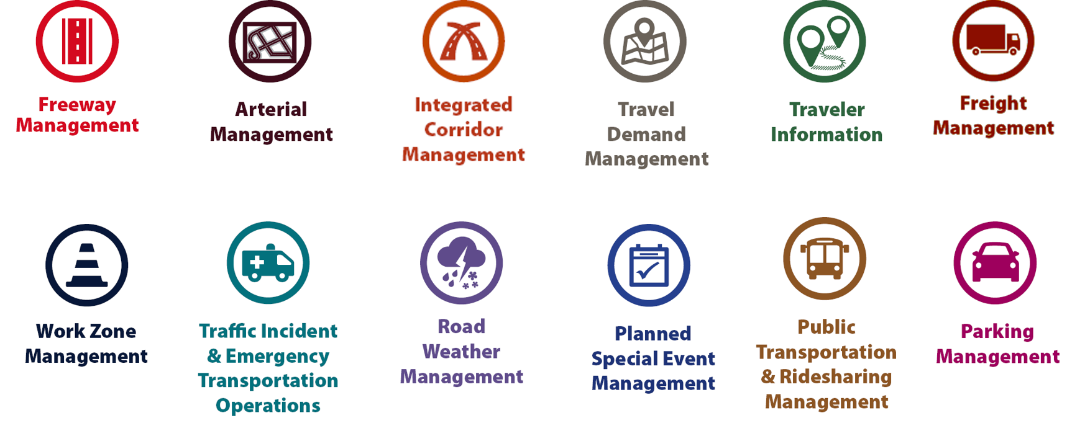
Examples of TSMO Strategies
Source: Federal Highway Administration
Notes:
This slide illustrates the array of operational strategies that fall under the TSMO umbrella that can be used individually or in combination with each other. This list is not exhaustive, but it highlights the key buckets of strategies that are priorities for many agencies.
Examples of other TSMO strategies include:
Traffic signal coordination
Transit signal priority
Special event management
Congestion pricing
Active transportation and demand management
Connected/automated vehicles
Completing multimodal networks
Intelligent transportation systems (ITS) components can support all these TSMO strategies. ITS covers a variety of technologies to monitor, evaluate, and manage transportation systems to enhance efficiency and safety. It should be noted that TSMO does not equate to ITS; many strategies support TSMO that do not involve an ITS component.
TSMO strategies can be categorized into three overarching areas: incident or event management, traffic management, and demand management strategies. The next three slides highlight strategies in each of these areas.

Slide 20
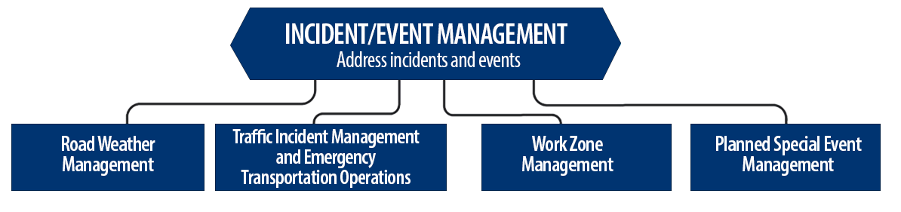
Incident/Event Management Strategies
Source: Federal Highway Administration.
Notes:
Incident and event management includes several strategies that address major sources of travel-time unreliability.
Incident and event management strategies include road weather management, traffic incident management and emergency transportation operations, work zone management, and planned special event management.
Road weather management activities include creating hazardous weather traffic operations response plans, implementing variable speed limits, detecting hazardous weather conditions, disseminating weather and warnings to travelers through dynamic signs and systems, providing emergency truck and parking facilities and emergency parking information, and implementing vehicle restrictions.
Traffic incident management and emergency transportation operations activities include establishing traffic incident management teams, conducting after action reviews, staging tow trucks in strategic areas, providing roadway safety patrols, integrating computer-aided dispatch into transportation management centers, pre-establishing towing service agreements, co-locating dispatching units, developing quick clearance goals, pre-planning detour routes, implementing shoulder running, deploying adaptive ramp metering, providing variable speed limits, implementing dynamic lane-use controls, deploying network surveillance cameras or detectors, implementing incident traffic signal timing plans, enacting legislation, and integrating traffic management centers with law enforcement dispatch and emergency centers.
Work zone management activities include coordinating maintenance and construction activities, implementing queue length detection, deploying network surveillance cameras or detectors, implementing variable speed limits, supporting dynamic lane merging, implementing dynamic lane-use controls, deploying temporary ramp metering, and implementing dynamic warning systems.
Planned special event management activities include activating special event timing plans, deploying adaptive ramp metering, implementing variable speed limits, using hard shoulder running, activating dynamic transit fare reduction, implementing reversible lanes, supporting dynamic lane-use controls, establishing dynamic pricing, deploying network surveillance cameras or detectors, activating dynamic wayfinding, and conducting after action reviews.
Source: FHWA, Integrating Travel Time Reliability into Transportation System Management: Final Technical Memorandum
https://ops.fhwa.dot.gov/publications/fhwahop19035/index.htm

Slide 21
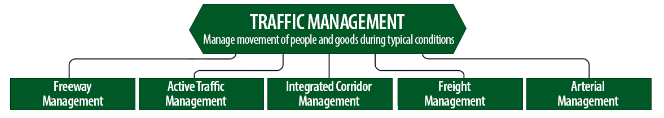
Traffic Management Strategies
Source: Federal Highway Administration.
Notes:
While incident or event management strategies address atypical events that cause travel-time unreliability, traffic management strategies manage the movement of people and goods during everyday conditions. Even during typical conditions, fluctuations in travel demand can lead to unreliable travel conditions. Traffic management strategies allow the transportation network to adapt to unreliability, including variations in travel demand.
Traffic management strategies include freeway management, active traffic management, integrated corridor management, freight management, and arterial management.
Freeway management activities include implementing traffic surveillance cameras or detectors, using high-occupancy lanes, implementing adaptive ramp metering, deploying hard shoulder running, implementing variable speed limits, deploying dynamic lane-use controls, and constructing physical operations improvements such as overpass widening, curve corrections, or adding auxiliary lanes.
Active traffic management activities include adopting adaptive ramp metering, implementing adaptive traffic signal control, using dynamic lane reversal, implementing dynamic lane-use controls, deploying dynamic merge control, implementing temporary shoulder running, using variable speed limits, deploying queue length detection, providing transit signal priority, and implementing dynamic warning signs.
Integrated corridor management activities include implementing network surveillance cameras or detectors, conducting access management and driveway access controls, implementing adaptive ramp metering, deploying adaptive signal control, deploying transit signal priority, installing queue jumping lanes, providing traveler information for alternative modes, and deploying emergency vehicle preemption.
Freight management activities include implementing roadside truck electronic screening and clearance, implementing truck signal priority, using truck parking management systems, installing truck climbing lanes, and implementing freight loading zone policies.
Arterial management activities include installing queue jumping lanes, deploying transit signal priority, supporting emergency vehicle preemption, implementing network surveillance cameras or detectors, implementing access management and driveway access controls, providing enhanced bicycle and pedestrian crossings, establishing a transportation management center, deploying enhanced traffic signal operations, implementing transit-only lanes, implementing truck traffic signal priority, designing for complete streets, adding capacity for critical movements, reducing travel speeds, providing automated enforcement, and conducting operations asset management.
Source: FHWA, Integrating Travel Time Reliability into Transportation System Management: Final Technical Memorandum
https://ops.fhwa.dot.gov/publications/fhwahop19035/index.htm

Slide 22
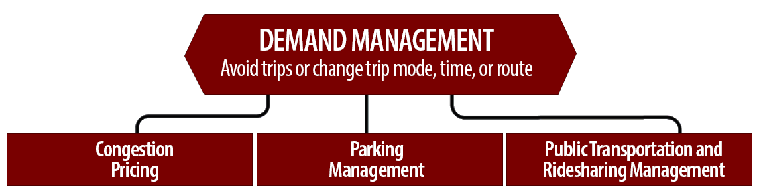
Demand Management Strategies
Source: Federal Highway Administration.
Notes:
Demand management strategies reduce underlying demand by helping travelers avoid trips or change the mode, timing, or route of trips. This makes nonrecurring congestion less likely to occur and improves travel-time reliability.
Demand management strategies include congestion pricing, parking management, and public transportation and rideshare management.
Congestion pricing activities include implementing dynamic pricing, variable pricing by lane, segment, and time of day or day of week; establishing dynamic transit fare reductions; and deploying managed lanes for high occupancy.
Parking management activities include deploying dynamically priced parking; implementing dynamic parking, wayfinding, reservations, and capacity; deploying dynamic overflow transit parking; implementing electronic payment systems and shared-use parking; and providing incentives to use underutilized parking facilities.
Public transportation and ridesharing management activities include implementing dynamic ridesharing, implementing transit signal priority, using queue-jump lanes at signalized intersections, deploying electronic fare collection and integration, and implementing dynamic surveillance and security.
Source: FHWA, Integrating Travel Time Reliability into Transportation System Management: Final Technical Memorandum
https://ops.fhwa.dot.gov/publications/fhwahop19035/index.htm

Slide 23
TSMO Is a “Way of Thinking” That Supports Transportation Agency Missions
“We provide safe, reliable and cost-effective transportation options to improve communities and economic vitality for people and businesses.”
Washington State DOT (WSDOT) mission¹
“To provide the best multi-modal transportation system for Colorado that most effectively and safely moves people, goods, and information.”
Colorado DOT mission²
¹ WSDOT, “Our Strategic Plan,” https://www.wsdot.wa.gov/about/secretary/strategic-plan/
² Colorado DOT, “Mission, Vision & Values,” https://www.codot.gov/about/mission-and-vision.html
Notes:
TSMO leverages technology, a toolbox of strategies, and engineering solutions to maximize system performance; however, TSMO ultimately involves a way of thinking or a mindset focused on determining the best way to optimize the mobility and reliability of the existing system with limited resources.
TSMO can be thought of as a way of thinking and operating in order to get the most performance out of the transportation network while only building as much as is needed.
The principles of TSMO directly support the missions of many State and local DOTs, as these examples show.
NOTES:
Agencies can insert their own mission statement here for effect or can leave these in.
Presenters can emphasize the connections between TSMO definition and their specific mission statement, such as safety, reliability, cost-effective, multimodal, customer’s needs/satisfaction, etc.

Slide 24
TSMO Supports Many
State and Local DOT Goals
Reduced congestion
Smoother and more reliable traffic flow
Improved safety
Cleaner air and less wasted fuel
More efficient use of resources and existing facilities
Increased economic vitality
Improved quality of life
Notes:
Here are some common goals in state and local transportation agencies that TSMO strategies support. This list is not exhaustive, but intended to show that TSMO support a range of mission-critical goals. Examples of how TSMO supports these goals are shown on the next slide.

Slide 25
Example TSMO Strategies That Support Transportation Agency Goals
TSMO Strategy | Goal
Traffic signal coordination, congestion pricing, demand management | Reduced congestion
Manage nonrecurring events (incidents, weather), managed lanes, traveler information | Smoother and more reliable traffic flow
Utilize the full system—coordinate all modes, transit signal priority | More efficient use of resources and existing facilities
Notes:
TSMO strategies that support some common transportation agency goals are shown here. Many of these strategies support more than one goal, but here are some key examples.

Slide 26
TSMO State of the Practice
Application of TSMO has accelerated in agencies across the country over the past 5–10 years
Recognition of TSMO’s value has grown, leading to a variety of approaches for advancing TSMO in agencies. For example:
  Establishing a TSMO division or office
  Formalizing a TSMO program
  Integrating TSMO throughout the agency
  Establishing a TSMO committee
  Identifying TSMO champions or liaisons
  Conducting a TSMO capability maturity model (CMM) self-assessment
  Developing a TSMO program plan
Notes:
TSMO as a more formal discipline has gained momentum in recent years. Recognition of the importance of TSMO has accelerated in the past five to ten years (as of year of publication of this presentation, 2022).
Key focus areas for agencies during this time have been adapting their culture, processes, expertise, and, in some cases, organizational structures to promote TSMO and a more operationally focused mindset. Agencies approach this differently depending on their unique context and needs. Several examples of key strategies agencies have used to advance TSMO within their organizations are shown here.
Central to all of these organizational approaches is 1) strong support from senior leadership, 2) a champion or champions who understand and promote TSMO throughout the agency, and 3) an openness to learning and cooperation among functions or divisions within an agency.
A TSMO capability maturity model self assessment is a framework developed to help agencies evaluate their current capabilities in the area of TSMO and identify steps for improving their TSMO capabilities. The self-assessment can be accessed at: http://aashtotsmoguidance.org/. There are also other capability maturity frameworks that FHWA has developed to support the implementation of TSMO. More can be learned about those frameworks at: https://ops.fhwa.dot.gov/tsmoframeworktool/index.htm.

Slide 27
Resources on TSMO
What Is TSMO? (frequently asked questions) https://ops.fhwa.dot.gov/tsmo
Organizing and Planning for Operations web page https://ops.fhwa.dot.gov/plan4ops
Communicating TSMO web page https://ops.fhwa.dot.gov/plan4ops/focus_areas/communicating_tsmo.htm
National Operations Center of Excellence NOCoE website https://www.transportationops.org/
Enhancing Transportation: Connecting TSMO and Performance Management, https://ops.fhwa.dot.gov/publications/fhwahop18095
Notes:
While these slides provide a comprehensive, high-level summary of TSMO, participants who are looking for more details and information to share with their staff can visit these virtual resources.

Slide 28
Connecting TSMO and Design Overview

Slide 29
The Transportation Landscape Is Changing
Limited funds
Advances in technology
Customer needs and expectations
Better understanding of causes of congestion
Source: Missouri Department of Transportation flickr.
Notes:
The transportation landscape is changing, and doing business the way it has been done in the past is no longer effective. For example, previously, congestion issues were primarily addressed by funding major capital projects (adding lanes or building new interchanges and roads) to address physical constraints, such as bottlenecks. Operational improvements were typically an afterthought—considered after the new infrastructure was already added to the system. Today, transportation agencies are facing trends that create a growing demand for travel with less funding and space to work with. As a result, we can no longer build our way out of congestion.
Trends we see today include:
Limited funds. Transportation agencies on the federal, State, and local levels have for years been tasked with doing more with limited resources. State departments of transportation (DOT) are always looking for innovative, lower-cost ways to get people and goods to their destinations more safely and reliably.
Advances in technology. Transportation agencies can leverage technology and data to develop solutions to address congestion issues. However, the traveling public expects fast, reliable, and “smart” transportation, given the advancement in consumer technologies (smartphones, applications, global positioning systems), privately owned mobility services, shared mobility, and the availability of more information.
Changing customer needs and expectations. There is a greater demand for accountability for public officials to ensure that public funds are spent to maximize the performance of the transportation system in the most equitable and cost-effective way. This creates a trend toward “performance-based” programs. The traveling public is seeking relief from unexpected delays in their trips. There is also a greater focus on addressing climate change and equity, and offering multimodal transportations options and solutions for the pedestrian, bicyclist, and transit rider.
Better understanding of the causes of congestion. Research has shown that while some congestion may be caused by typical morning and evening rush hours, a significant amount comes from non-recurring events, such as crashes, breakdowns, work zones, weather, and special events.
Source: https://ops.fhwa.dot.gov/publications/fhwahop19085/fhwahop19085.pdf
Image – Modot flickr -https://flic.kr/p/QNwCuy

Slide 30

Transportation Agencies Are Changing
Doing more with less
Maximizing existing infrastructure; using what you have better
Shifting toward moving people and goods rather than cars and trucks
Thinking differently, holistically, and big picture
Planning, collaborating, evaluating, and repeating
And adopting TSMO to respond to the changing transportation landscape
Source: Unsplash.
Notes:
State DOTs and other public agencies are making a transformational shift in the way they conduct business by:
Doing more with less
Maximizing operational capacity of existing infrastructure
Shifting toward moving people and goods rather than cars and trucks
Changing organizational culture/mindset to think more holistically and “big picture“
Planning, collaborating, evaluating, and repeating
Transportation agencies are adopting TSMO to respond to the changes in the transportation landscape. Designers play an important role in the success of TSMO and vice versa.
Other points to make:
State DOTs are increasingly realizing the importance to plan, think ahead, and think big picture; for example:
Planning for complete multimodal networks and considering transportation equity and environmental impacts
Adopting performance measures such as reducing vehicle miles traveled
To be successful, disciplines are collaborating and working together even more.
Collaboration/solutions include other stakeholders outside the DOT.
Photo - https://unsplash.com/photos/Yy6aBfhOwJc

Slide 31
What Is Meant by Design?
Developing and evaluating alternatives for transportation projects
Producing plans, specifications, and estimates for transportation projects
Applying policies, procedures, training, and standards to design of highways, bridges, and other structures
Using performance-based practical design (PBPD) and value engineering
Developing, maintaining, and editing States’ design-related policies, procedures, and standards (often in central office/headquarters of State DOT)
Notes:
What do we mean when we are talking about design? It is staff involved in the following:
Developing and evaluating alternatives for transportation projects
Producing plans, specifications, and estimates for transportation projects
Applying policies, procedures, training, standards to the design of highways, bridges, and other structures
Using PBPD and value engineering
Developing, maintaining, and editing States’ design-related policies, procedures, and standards (often in central office/headquarters of State DOT)
(Definition of PBPD, if needed):
PBPD modifies the traditional highway design process by taking a "design up" approach, where transportation decision makers exercise engineering judgment to build up the improvements from existing conditions to meet both project and system objectives. By taking into account TSMO strategies during the PBPD process, designers can expand the variety of available design options and perhaps postpone or reduce the need for conventional capacity improvements.

Slide 32
Example Design Goals
Meet the purpose and need for the project
Optimize traffic operations, mobility, and safety for all modes
Minimize cost and maintain budget
Prevent or limit damage to environmental and cultural resources
Consider and balance landowner, public, and political inputs
Develop plans that mitigate or prevent potential issues that may occur during and after construction
A designer has many competing priorities to handle.
Notes:
A designer’s job can be challenging, with having to juggle competing priorities.
Below are typical goals of design staff; as you can see, there is a lot to consider and balance during project/plan development:
Meet the purpose and need for the project
Optimize traffic operations, mobility, and safety
Minimize cost and maintain budget
Prevent or limit damage to environmental and cultural resources
Consider and balance landowner, public, and political inputs
Develop plans that mitigate or prevent any potential issues that may occur during and after construction
The goals of TSMO and the goals of design are not that far apart; in fact, they really are very similar, which makes them very good partners.

Slide 33
How Can TSMO Support Design Goals? (1/2)
Can offer less expensive alternatives to adding capacity
Mitigates substandard or problematic geometrics where feasible
Can offer solutions to reduce or mitigate environmental impacts in the design phase of a project
Offers support and strategies for safe and effective work zones and traffic control design
Notes:
How TSMO can support the goals of design:
TSMO can be an alternative to adding capacity or can reduce the new capacity needed (smaller footprint/less right-of-way; saves money and time)
Future TSMO and technology needs can be incorporated into a capital project design to preserve capacity and extend the functional life of the facility (plan for future signals or intelligent transportation system [ITS] devices, incorporating conduit, etc.; now will be cheaper than doing it later)
TSMO strategies can help mitigate substandard or problematic geometrics (sometimes it’s not feasible, cost-wise, to fix the geometric issue, but TSMO strategy may help mitigate)
As a part of the National Environmental Policy Act (NEPA) process, practitioners must examine and avoid potential impacts to the social and natural environment when considering transportation projects; TSMO can help reduce impacts and be a solution for project development/designers to mitigate environmental and cultural resource effects
TSMO/operations staff can support design in designing safe and effective work zones; this includes determining lane closures and timing, decisions on length of work zones, penalties/rewards for contractors, smart work zones, queue detection systems, or other ITS elements
Sources:
https://ops.fhwa.dot.gov/publications/fhwahop18088/index.htm
https://ops.fhwa.dot.gov/publications/fhwahop13013/fhwahop13013.pdf

Slide 34
How Can TSMO Support Design Goals? (2/2)
Serves as a useful tool in PBPD:
  Can help improve safety, reliability, and cost-effectiveness of PBPD solutions
  Expands design options
  Reduces need for conventional capacity improvements
  Often can be quickly deployed to offer benefits
More information on PBPD:
  “Designing for Operations https://ops.fhwa.dot.gov/plan4ops/designing_ops.htm
  “Performance-Based Practical design” https://www.fhwa.dot.gov/design/pbpd/
Notes:
One of the most notable ways that TSMO strategies can support design goals is that it can serve as a useful tool in PBPD.
PBPD modifies the traditional highway design process by taking a "design up" approach, where transportation decision makers exercise engineering judgment to build up the improvements from existing conditions to meet both project and system objectives.
TSMO strategies can help agencies improve the safety, reliability, and cost‐effectiveness of their PBPD solutions. By considering TSMO strategies in their PBPD processes, designers can expand the variety of available design options and perhaps postpone or reduce the need for conventional capacity improvements. Additionally, many of these operational strategies can be quickly deployed to offer benefits to the travelling public sooner than conventional capacity improvements.
Information sources:
https://ops.fhwa.dot.gov/publications/fhwahop18088/index.htm
https://ops.fhwa.dot.gov/publications/fhwahop13013/fhwahop13013.pdf
https://www.fhwa.dot.gov/design/pbpd/

Slide 35
…And How Can Design Support TSMO? (1/3)
Impacts from traffic incidents can be reduced by design treatments:
  Queue warning systems and runaway truck ramps decrease frequency of incidents
  Vehicle turnouts and crash investigation sites minimize number of lanes blocked
  Emergency crossovers and drivable shoulders reduce the amount of time lanes are blocked
  Extra-high median barriers shield incidents from passing drivers
Safe and efficient movement of pedestrians, bicyclists, and other nonmotorized modes can be improved by design considerations:
  When constructing or upgrading sidewalks, consider pedestrian access and adding countdown pedestrian signals, pedestrian ramps, and associated hardware and conduit for these treatments
  Consider additional right-of-way to create bike-only lanes
Notes:
Designing for TSMO can reduce the frequency and impacts of temporary transportation system disruptions that cause congestion and unreliable travel times:
Impacts from traffic incidents can be reduced by design treatments. Treatments can decrease the frequency of incidents (e.g., queue warning systems, runaway truck ramps), minimize the number of lanes the incidents block (e.g., crash investigation sites, vehicle turnouts), reduce the amount of time the lanes are blocked (e.g., emergency crossovers, drivable shoulders), and shield incidents from the view of passing drivers (e.g., extra-high median barriers, portable incident screens). Consider pedestrian and cyclists’ safety when designing drivable shoulders in an urban environment as they may encourage higher speeds.
Design considerations can also support the safe and efficient movement of pedestrians, bicyclists, and other non-motorized modes.
When constructing or upgrading sidewalks, consider pedestrian access and adding countdown pedestrian signals, pedestrian ramps, and associated hardware and conduit for these treatments.
Consider additional right-of-way to create bike-only lanes.
https://ops.fhwa.dot.gov/publications/fhwahop18088/index.htm

Slide 36
…And How Can Design Support TSMO? (2/3)
Adverse weather conditions on roads can be mitigated with design choices:
  Fences can prevent snow or sand from blowing across road
  Some intelligent transportation system (ITS) devices can pretreat roadway to prevent icing
  Some geometric designs can increase speed efficiency of lane-clearing practices
Congestion caused by demand surges or fluctuations can be alleviated using design strategies such as: reversible lanes, diversion of demand to alternate routes, limit of freeway entrance and exit options.
Notes:
Driver behavior changes when weather conditions change. Rain and snow can cause slick pavement that may increase the frequency of crashes and may slow traffic. Fog, heavy rain or snow, and blowing snow or sand can reduce visibility, which also increases the frequency of crashes and can slow traffic. Heavy snow may cover the roadway, hiding lane delineations and significantly reducing the capacity of the roadway.
Adverse weather conditions on roads can be mitigated with design treatments to prevent snow or sand from blowing across the roadway, limit the accumulation of snow and ice, or increase the efficiency of lane-clearing practices.
Special events tend to create large demand surges during short periods of time, usually just before the event begins and just after it ends. Another example is when seasonal and weekend spikes in demand occur near vacation destinations.
Congestion caused by surges in demand or demand fluctuations can be alleviated by incorporating mechanisms into the design that temporarily increase capacity in the direction of major travel (e.g., reversible lanes, divert demand to alternate routes, and limit freeway entrance and exit options).
https://ops.fhwa.dot.gov/publications/fhwahop18088/index.htm

Slide 37
…And How Can Design Support TSMO? (3/3)
Plan early in design and collaboration with operations/TSMO staff can save money for ITS strategies
Consider design options to facilitate easy and safe access for maintenance of ITS or other operations devices
Include design features that optimize mobility, reduce bottlenecks (auxiliary, merge, turn lanes, bike lanes, reversible lanes), and protect the safety of all modes (pedestrians, bicyclists, etc.)
Work with TSMO staff to design safe and effective work zones
Coordinate with transit agencies early and often to ensure safe and accessible routes to transit stops
Notes:
Early planning in design and collaboration with operations/TSMO staff can save money for ITS strategies (for example, planning for near-term or long-term ITS components and systems can save money now).
During the design stage, designers can include features to help facilitate easy and safe access to and maintenance of ITS or other operations devices.
During project development, design features can be considered and included that optimize mobility and alleviate bottlenecks, such as auxiliary, merge, and turn lanes, and protect the safety of all users (e.g., pedestrians, bicyclists).
As previously mentioned, work zones are a major area where TSMO and design support each other.
Design treatments aimed at reducing the impact of work zones typically accomplish one of three things:
Minimize the capacity lost due to the work zone. This can be done by providing shoulder areas or pulloff locations, “borrowing” capacity from the other direction of travel during work zone hours, and employing practices that allow work to be accomplished on one lane at a time.
Reduce the time duration of work-zone lane closures. Depending on the work zone, this could be done by limiting lane closures to off-peak periods or by accelerating work schedules to finish the work as quickly as possible.
Reduce the number of incidents in the work zone. Safe practices for managing entrances and exits of work equipment from the work zone may limit work zone–related crashes. In addition, providing locations for vehicles to move in the case of a crash or breakdown may reduce secondary crashes and rubbernecking in the work zone.
Designers may also consider how transit routes will be impacted by the proposed work, coordinate with the transit agency early and often, look for accessible temporary stops and accessible routes to those stops, etc.
Finally, designers may want to consider design features that reduce bottlenecks and confli
Many treatments for minimizing the impact of work zones on congestion are operational, but may require geometric design considerations to implement. For example, the acceleration of a work zone schedule may require that alternative routes are improved or that separate express lanes are built to handle traffic while the existing facility is completely closed.
https://ops.fhwa.dot.gov/publications/fhwahop18088/index.htm

Slide 38
Benefits from Collaboration Between Design and TSMO
Safe and efficient facility design:
  Motorists, pedestrians, bicyclists, transit riders
  Emergency responders
  Maintenance and construction staff
Lower costs
Less congestion
Greater travel time reliability
Notes:
Because design and TSMO have many goals in common, everyone benefits from collaboration:
A safer and more operationally efficient facility design for all users (motorized and non-motorized), emergency responders, maintenance staff, construction workers, and other operators
Lower costs for projects and for future operational and ITS deployments, as foundational ITS infrastructure can be included in highway designs during construction
Less congestion and greater travel time reliability from the implementation of TSMO strategies

Slide 39
Opportunities for Collaboration

Slide 40
Consider TSMO Through It All
Project Scoping
Preliminary Design
Final Design
Source: ClipartMax.com.
Notes:
Ideally, TSMO should be considered in the project scoping stage. This ensures enough budget is planned for the strategies to be effectively implemented.
TSMO strategies can be implemented at each point in the design process to improve project outcomes and long-term operational efficiency. Agencies benefit from developing formal policies and procedures to include TSMO strategies and from making operational considerations throughout the design process.
TSMO solutions can be used in a variety of settings and locations, both urban and rural. Even on projects already programmed/scoped, designers can work with TSMO/operations staff to identify strategies that can save money and make efficient use of the existing system. This saves money, and that money can be put to other needs or areas. Even a small portion of your budget devoted to these strategies can result in an immediate improvement.
How does connecting TSMO and design work in practice?
The next slides present examples of how design can start making those connections with operations/TSMO staff and begin “thinking TSMO.”
https://ops.fhwa.dot.gov/publications/fhwahop19087/fhwahop19087.pdf

Slide 41
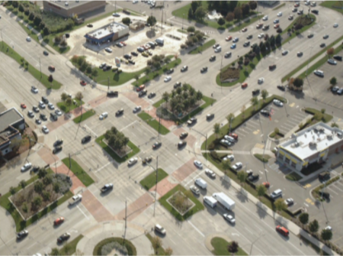
Access Management and Driveway Access Controls
Preserves traffic flow
Requires a combination of policies and strategies
Improves safety, mobility, accessibility, and economic vitality
Source: Federal Highway Administration.
Notes:
As mentioned earlier, TSMO strategies are not always ITS strategies.
We are starting off with some practices that can be considered TSMO that designers are probably already doing.
How is this TSMO?
Managing access preserves the flow of people and freight and enables safe access to businesses and neighborhoods using a combination of policies and strategies. These include closing, consolidating, or improving driveways, median openings, and intersections; adding appropriate turn lanes at intersections; adding or redesigning medians; and planned spacing of intersections, median openings, and driveways.
Access management along a corridor has been shown to improve safety, mobility, accessibility, and even economic vitality.
https://ops.fhwa.dot.gov/access_mgmt/
https://safety.fhwa.dot.gov/intersection/other_topics/corridor/
Sources of images: FHWA

Slide 42
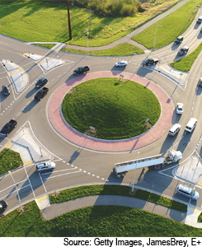
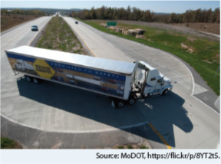
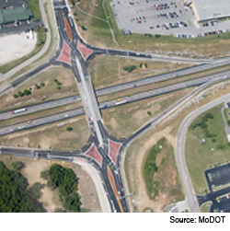
Choosing Optimal Intersection and Interchange Designs
Source: Missouri Department of Transportation flickr.
Source: Missouri Department of Transportation flickr.
Source: Getty Images, JamesBrey, E+.
Notes:
Related to access management, different intersection and interchange designs offer various operational and safety benefits depending on the location and traffic patterns.
When completing a project, designers are evaluating the different alternatives that meet the project needs and determining the best options for improving safety, reducing congestion, multimodal enhancement, etc.
TSMO staff can further assist designers by providing traffic data to help make those decisions.
They can work together to use intersection control evaluation tools and policies, which are data-driven, performance-based frameworks to screen intersection alternatives and identify an optimal solution.
Roundabout image source: Getty Images, Credit: JamesBrey Creative #: 965529604 License type: Royalty-free Collection: E+ Location: United States Release info: No release required
MoDOT flickr:
https://flic.kr/p/6Dykf8
https://flic.kr/p/8YTsuN

Slide 43
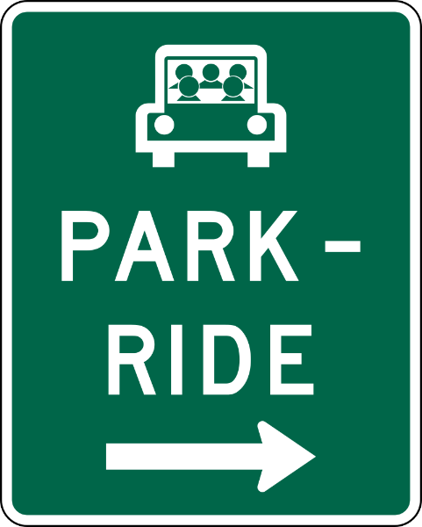
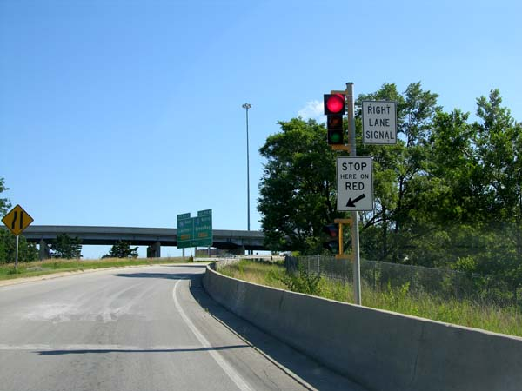
Designing Intersections and Interchanges
When designing intersections and interchanges, consider:
Turn lanes
Bus stops
Ramp meters
Ramp restrictions
Ramp closure
Park-and-ride facilities
Queue jump lanes
Pedestrian and bicycle facilities
Source: Wikipedia Commons.
Source: Wikipedia Commons.
Notes:
When designing a new intersection/interchange or assessing an existing one, designers make decisions on the optimal type of traffic control, adding turn lanes, whether to restrict turning movements, or even ramp closures. But they can also consider other complementary TSMO strategies.
For example, whether an interchange should be designed to accommodate ramp metering or include a park-n-ride facility, or whether an intersection should include provision for bus stops or queue jump lane, are all relevant and important. Such strategies can not only improve safety, mobility, and reliability, but can also facilitate multimodal integration.
(Definition of queue jump lane: this could be a separate lane developed for buses only, or it could involve allowing buses to use a right-turn lane as a through lane. On a roadway with existing shoulders, a queue jump or bypass lane treatment can be developed assuming the shoulder width and pavement design can accommodate bus traffic.)
Pedestrians and bicyclists should also be considered at intersections and at interchange ramp termini with the crossroad. Major intersections/interchanges are often barriers to travel by these modes if people don’t feel safe crossing these facilities.
Photo sources
Https://en.wikipedia.org/wiki/File:Ramp_meter_from_Miller_Park_Way_to_I-94_east_in_Milwaukee.jpg
https://en.wikipedia.org/wiki/Park_and_ride#/media/File:MUTCD_D4-2.svg

Slide 44
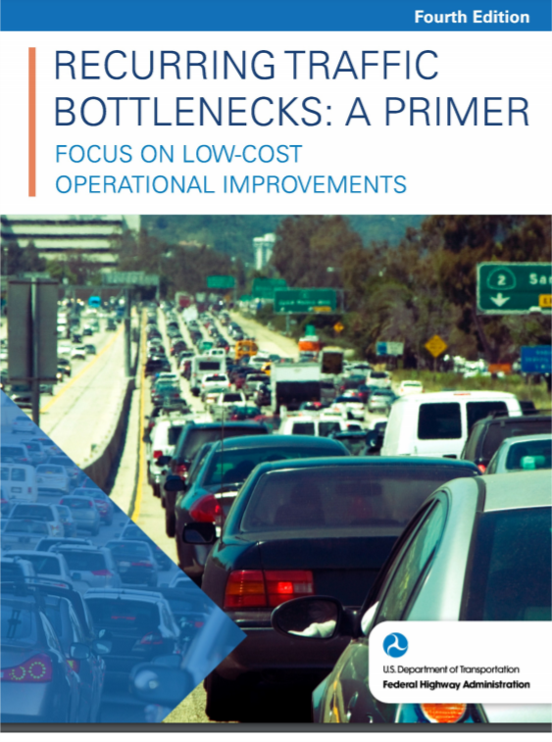
Bottleneck Solutions
Specific locations where roadway cannot handle traffic demand, resulting in localized, recurring congestion
Highly cost effective, improve safety, often low impact on environment
Can be incorporated into upcoming projects:
  Shoulder conversions
  Restriping
  Minor interchange and/or ramp modifications
  Lane width reductions
  Modified weaving areas
  Improved traffic signal timing
Source: Federal Highway Administration.
Notes:
Bottlenecks are specific locations on the highway system where the physical layout of the roadway routinely cannot handle the traffic that wants to use it and results in localized, recurring congestion.
There is a significant opportunity to apply more operational and low-cost infrastructure solutions to provide relief for localized, recurring congestion at bottlenecks. Such solutions can meet project needs in a way that is more cost-effective than adding lanes.
Low-cost bottleneck mitigations have several advantages, such as:
Highly cost-effective
Low cost translates into being able to address more locations
Positive safety impacts
Often low impact on physical and human environments
Typically require little to no right-of-way
Operations/TSMO staff can help designers identify existing bottlenecks (identified through use of data or operator observations) that may be present in upcoming projects. They can work together to determine if low-cost solutions can be incorporated into the projects.
Just some of the low-cost bottleneck strategies are listed here. You may notice that some of these strategies may also be repeated on some other slides within this presentation.
For more information, check out FHWA’s Recurring Traffic Bottlenecks: A Primer, Focus on Low-Cost Operational Improvements https://ops.fhwa.dot.gov/publications/fhwahop18013/fhwahop18013.pdf

Slide 45
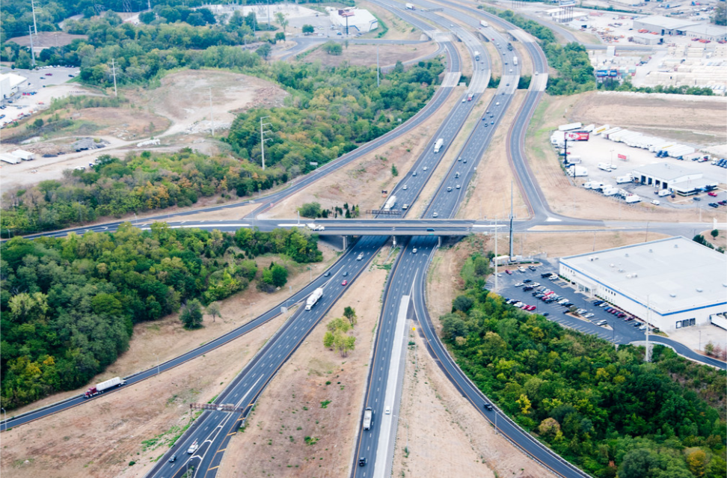
Interstate System Access Requests
TSMO may be considered as an alternative to modifying access to the interstate system
May also be incorporated within new/modified access requests
TSMO may help to accommodate nonmotorized travel demand as part of the request
Source: Missouri Department of Transportation flickr.
Notes:
Designers considering modifications to existing interchanges or building new ones may examine TSMO strategies for alternatives or as companion strategies for changes to interstate access.
Although State DOTs own and operate the interstate system, FHWA is required to approve all new access or changes in access points, pursuant to 23 U.S.C. 111. Such approval must be preceded by a NEPA action on the project. As part of the NEPA process, project alternatives should be evaluated. One alternative could be a TSMO alternative, evaluating whether existing interchanges to the interstate, or local roads and streets in the corridor, could be reasonably improved to provide the desired access. TSMO improvements might include access control along surface streets, improving traffic control, modifying ramp terminals and intersection, or adding turn bays or lengthening storage.
The request to modify access should include an evaluation of how the proposed design will serve nonmotorized travel modes.
Source:
https://www.fhwa.dot.gov/design/interstate/pubs/access/access.pdf
Photo:
https://flic.kr/p/d2DCk1

Slide 46
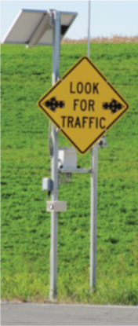
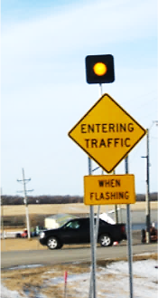
Intersection Conflict Warning Systems
Warn drivers at stop-controlled approaches of the presence of traffic on the through lanes
Improve safety
Address sight distance issues
Are useful when realignment not feasible
Source: Minnesota Department of Transportation.
Notes:
Designers may also come across a situation where realignment or relocation of a side road is not feasible, but there is a need to address a safety issue.
Shown here is an ITS solution that can help reduce crashes between vehicles at intersections using real-time communication. Intersection conflict warning systems warn drivers on the through road of the presence of traffic at stop-controlled cross streets. The systems warn drivers at stop-controlled approaches of the presence of traffic on the through lanes.
This is an example that State DOTs are likely to use to solve a safety issue rather than a mobility issue. The systems are often used where there are sight distance issues and realignment or relocation of a side street is not feasible. This strategy is a cost-effective solution that improves safety as well as reducing the risk for crashes, thus decreasing the likelihood of non-recurring events. Fewer non-recurring events results in improved reliability.
Minnesota DOT has deployed intersection conflict warning systems in rural areas across the state to aid motorists to safely cross thru-STOP intersections.
https://www.fhwa.dot.gov/publications/research/safety/16061/16061.pdf
https://www.dot.state.mn.us/trafficeng/signals/conflictwarning.html
https://safety.fhwa.dot.gov/intersection/conventional/unsignalized/fhwasa11023/fhwasa11023.pdf
http://enterprise.prog.org/Projects/2010_Present/developingconsistencyIWS/iws_relateddocuments.html
Photos
https://www.dot.state.mn.us/trafficeng/signals/conflictwarning.html

Slide 47
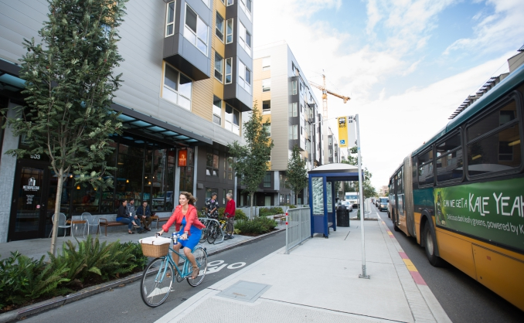
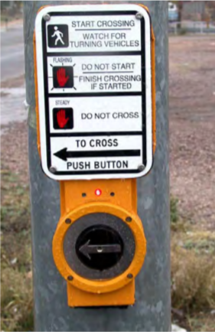
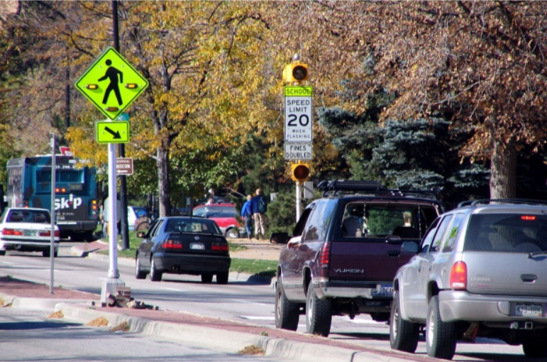
Multimodal Transportation Solutions
Pedestrian and bicycle facilities
Transit lanes and bus pullouts
Complete streets
Road Diets
Source: pedbikeimages/Adam Coppola Photography.
Source: National Academies of Sciences, Engineering, and Medicine. NCHRP Web-Only Document 117A.
Source: pedbikeimages/Dan Burden.
Notes:
Multimodal systems, services, and projects can often benefit from collaboration between designers and TSMO professionals. Multimodal solutions can better utilize non-auto modes, thus resulting in a more effective distribution of demand and greater performance of the overall transportation system.
Designers may have projects dedicated to these solutions or they may also have opportunities to include these multimodal strategies within other projects.
It’s important to consider multimodal systems, services, and projects early on in project scoping or there may not be budget for them later.
Providing safe facilities for bicyclists can induce more travel by bicycle and reduce congestion caused by vehicular traffic.
Refuge islands improve safety for pedestrians. Other pedestrian safety features, such as pedestrian hybrid beacons, rectangular rapid flashing beacons, and accessible pedestrian signals, may also be good options for accommodating pedestrian mobility and safety.
Including accessible shoulders in designs can help accommodate pedestrians and bicyclists, even in more rural areas.
Dedicated transit lanes and bus pullouts can increase transit ridership.
Complete streets concepts and road diets help to use the existing roadway to best serve the community’s safety, mobility, and livability needs.
Photo sources:
http://onlinepubs.trb.org/onlinepubs/nchrp/nchrp_w117a.pdf
https://www.pedbikeimages.org/details.php?picid=2241
https://www.pedbikeimages.org/details.php?picid=272

Slide 48
Curbside Management
Parking restrictions
Loading or delivery zones
Transit stops
Bicycle lanes
The Institute for Transportation Engineers developed Curbside Management Practitioners Guide for local jurisdictions on how to inventory, assess, enhance, and prioritize curb spaces to meet multimodal demands at the curb safely and efficiently.
Notes:
When it comes to the curb, there is a lot to consider to meet the multimodal demands in a safe and efficient way.
Designers can work with operations and planning staff to determine the best use of space and optimum design. System users, businesses, traffic, and overall context of the area are helpful to be taken into account.
The Institute for Transportation Engineers developed the Curbside Management Practitioners Guide for local jurisdictions on how to inventory, assess, enhance, and prioritize curb spaces.
Resources:
https://www.ite.org/technical-resources/topics/complete-streets/curbside-management-resources/
https://www.ite.org/pub/?id=C75A6B8B-E210-5EB3-F4A6-A2FDDA8AE4AA

Slide 49
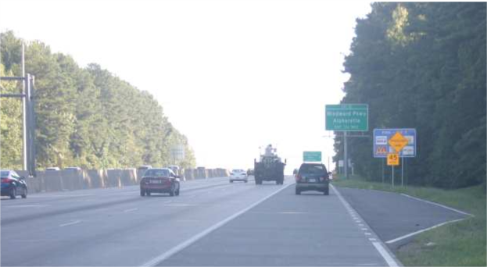
Emergency and Incident Response
Emergency median crossovers
Barrier types (moveable, gated, or extra height)
Mountable/traversable medians
Turnouts
Crash investigation sites
Reference location signs
Roadside call boxes
Source: Georgia Department of Transportation.
Notes:
Designers can consider operational improvements in projects that will assist with traffic incident management and emergency response efforts. Such improvements can lower the safety risk of the first responders on the scene while improving travel time reliability for the travelers on the system. It is important to think about these strategies early in the project scoping phase to ensure there is budget to successfully implement the strategies.
For example:
Most are probably familiar with emergency crossovers in the median; these save time for law enforcement or other emergency response vehicles when responding to an issue or incident.
Many roadways now have concrete or other median barriers in place; designers should consider including provisions for a gated median barrier to create more accessible crossing points; this allows first responders and/or maintenance personnel to easily and more quickly go through the barrier wall.
Other options are movable traffic barriers or movable cable median barriers, as well as mountable or traversable medians. Extra-height barriers can shield potential incidents/crashes from opposing direction traffic, which may improve mobility and reduce rubbernecking.
Turnouts can be constructed as refuge spaces for disabled vehicles; turnouts should be large enough to accommodate a tow truck and the broken-down vehicle.
Crash investigation sites are improved areas off the freeway mainline that are specifically designated and signed. They provide a safe area for motorists with partially disabled vehicles, law enforcement, fire-rescue, and other public service vehicles to temporarily relocate. These sites are generally identified by signs and sometimes pavement markings. They have sufficient space to park multiple vehicles, lighting to ensure personal safety, and access to phone service.
Reference location signs and roadside call boxes also provide benefits for mobility and incident response. The reference location signs provide a means to identify the location of an incident/crash and can aid in highway maintenance and servicing. Roadside call boxes provide an important service for motorists who don’t have cellular phones, and in areas with unreliable cellular reception.
Photo:
Emergency Turnout, Georgia. (Source: Georgia Department of Transportation)
https://ops.fhwa.dot.gov/publications/fhwahop15023/ch7.htm

Slide 50
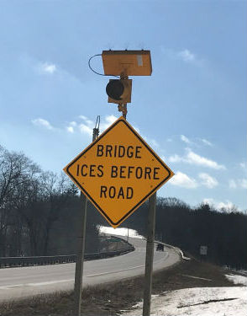
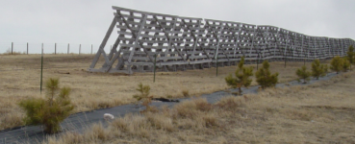
Road Weather Management
Snow fences
Dynamic message or ITS signs
Road weather information systems
Source: Michigan Department of Transportation.
Source: Wyoming Department of Transportation.
Notes:
Weather-related TSMO strategies can improve safety and travel time reliability since they can reduce the impact of bad weather to the travelers. Such strategies that designers may not typically think of follow.
Snow fences are barriers that can be used to minimize the snowdrift accumulation on roads, helping to keep roads open and traffic moving in severe weather.
There may also be ITS road weather-related strategies to consider within projects as they are being designed. Examples include message signs that detect and warn travelers of road and weather conditions and during various weather events (e.g., fog, flooding, high winds, dust storms, ice storms, blizzards).
A road weather information system is comprised of environmental sensor stations (ESS) in the field, a communication system for data transfer, and central systems to collect field data from numerous ESS. These stations measure atmospheric, pavement, and water level conditions. Depending on the project location, these systems may improve safety or operations on the roadway by detecting slick pavement, foggy conditions, or flooding. Road weather information system data can be used by road operators and maintainers to support decision-making.
Photos:
http://www.dot.state.wy.us/files/live/sites/wydot/files/shared/Winter_Research/snow%20fence%20brochure%202009.pdf
https://www.michigan.gov/mdot/0,4616,7-151-9620_11057-468321--m_2018_3,00.html

Slide 51
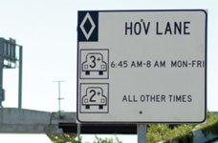
Managed Lanes
Contraflow lanes
High-occupancy vehicle lanes
High-occupancy toll lanes
Reversible lanes
Source: Federal Highway Administration.
Notes:
Managed lanes are certain freeway lanes set aside for a variety of operating strategies that move traffic more efficiently in those lanes.
A contraflow lane is a freeway lane in the off-peak direction of flow (normally adjacent to the median) designated for high-occupancy vehicles (HOV) traveling in the direction of peak flow for at least a portion of the day. Contraflow lanes may also be used during major evacuations. Normally the contraflow lane is separated from the off-peak (or opposite) flow by insertable cones, pylons, or movable concrete barriers.
Another form of managed lanes is the dedication of lanes to HOVs. These vehicles are defined as a motor vehicle with at least two or more persons, including carpools, vanpools, and buses. Individual HOV facilities may require different vehicle occupancy levels. Priority treatments for HOVs have proven to be one of the most flexible, cost-effective alternatives for increasing the person-moving capacity of congested metropolitan transportation systems. This "lane management" concept emphasizes person movement rather than traditional vehicle movement. It offers multi-person vehicles the opportunity to travel in reserved lanes that preserve higher operating speeds and more reliable travel times.
A related strategy is that of high-occupancy toll (HOT) lanes. HOT lanes combine HOV and pricing strategies by allowing vehicles that don't meet passenger occupancy requirements to gain access to HOV lanes by paying a toll.
To best use existing facilities, several jurisdictions have instituted reversible-lane flow. Reversible lanes change the directional capacity of a freeway to accommodate peak directional traffic demands. To warrant reversible lanes, peak-period traffic volumes should exhibit, or be anticipated to exhibit, significant directional imbalance. If warranted, reversible lanes can use right-of-way more efficiently and economically.
Sources:
https://ops.fhwa.dot.gov/freewaymgmt/publications/frwy_mgmt_handbook/
https://ops.fhwa.dot.gov/publications/managelanes_primer/
Photo source – found in: https://ops.fhwa.dot.gov/publications/managelanes_primer/ (in the Managed Lane Success Stories section)

Slide 52
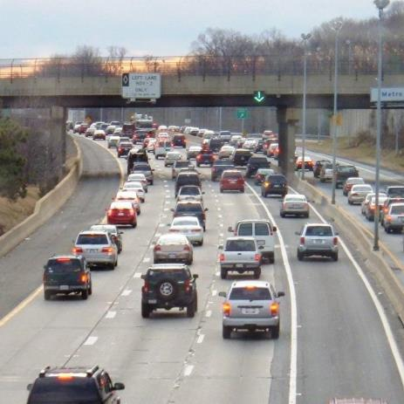
Many Uses of Shoulders
Accessible shoulders
Drivable shoulders:
  During work zones or incidents
  Part-time shoulder running
Bus on shoulder
Source: Virginia Department of Transportation.
Notes:
The shoulders on the roadway can provide opportunities to implement TSMO strategies for certain conditions. Such strategies can provide relief for both recurring and non-recurring congestion as well as maximize multimodal use.
Accessible shoulders – Paved shoulders on the edge of roadways can be enhanced to serve as a functional space for bicyclists and pedestrians to travel in the absence of other facilities with more separation.
Driveable shoulders – If shoulders are designed to withstand traffic, shoulders can be used to handle traffic during peak periods, work zones, or incidents.
Part-time shoulder use or “shoulder running” – Involves use of the left or right shoulder of an existing roadway for temporary travel during certain hours of the day. Part-time shoulder use has primarily been used in locations where there is recurring congestion due to lack of peak-period capacity through the corridor, particularly where other alternatives to peak-period operations are infeasible or cost-prohibitive (at least in the near term).
Bus on shoulder – A low-cost strategy allowing buses to travel at or near free-flow speeds through congested arterial and freeway routes.
Photo - Source: Virginia Department of Transportation, found at: https://ops.fhwa.dot.gov/publications/fhwahop15023/ch1.htm

Slide 53
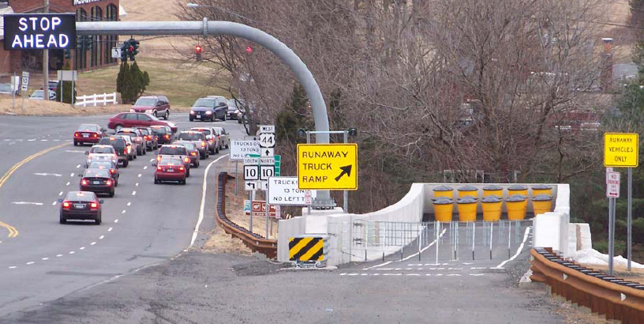
Runaway Truck Ramps
Are useful in areas that have severe weather and steep grades
Mitigate major incidents caused by braking issues
Source: Wikipedia Commons.
Notes:
For areas that experience severe weather and/or have steep grades, incorporating runaway truck ramps can prevent incidents when vehicles are experiencing braking problems. The photo shown is a mechanical-arrestor truck ramp at Avon, Connecticut; it has an electrically heated pavement surface to prevent snow and ice accumulation.
Photo:
https://en.wikipedia.org/wiki/Runaway_truck_ramp#/media/File:TER_US_44_Westbound_Avon,_CT,_USA.png

Slide 54
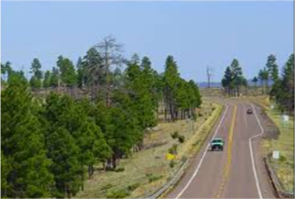
Truck Climbing Lanes and Passing Lanes
Helpful where grade, traffic volume, and heavy vehicle volume degrade traffic operations
Reduce delays
Improve safety
Source: Arizona Department of Transportation.
Notes:
Truck climbing lanes or passing lanes can improve safety and mobility where the grade, traffic volume, and heavy vehicle volume combine to degrade traffic operations.
Benefits of incorporating passing and climbing lanes on highways include:
Reduced delays and overall improved traffic operations
Improved safety by reducing the need for passing vehicles to travel in the opposing lane
Photos:
https://images.app.goo.gl/ixruPsh6t3FmA5GQA (Arizona DOT, Climbing and Passing Lane Prioritization Study)

Slide 55
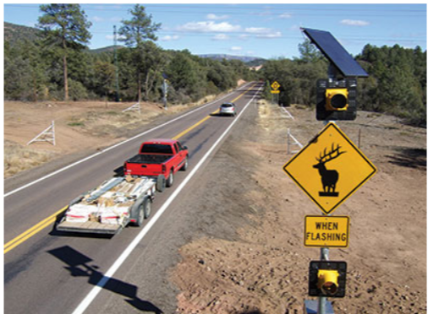
Wildlife Fencing, Crossings, and Detection Systems
May be useful in remote, rural areas with limited emergency response resources
Improve safety
Source: Federal Highway Administration.
Notes:
Wildlife crosses roads frequently in some rural areas. This can affect traffic safety, especially in remote areas where emergency response resources may be far away. Overpass and underpass structures can be a solution, along with installation of fencing to restrict animals to using those structures and avoiding other segments of roadway. There are also detection system technologies available. Wildlife fencing, crossings, and detection systems can reduce the risk of incidents, thus improving safety and travel time reliability.
https://www.fhwa.dot.gov/publications/publicroads/09septoct/03.cfm
Photos
Copied from https://www.fhwa.dot.gov/publications/publicroads/09septoct/03.cfm

Slide 56
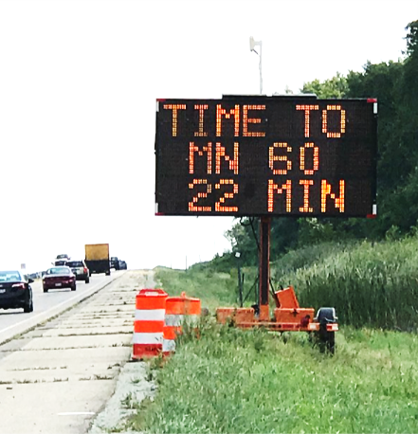
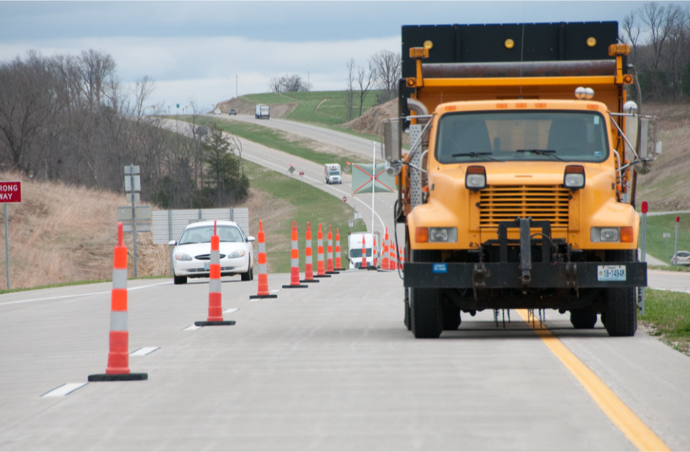
Work Zones and Traffic Control Plans
Geometric strategies
Contract/job special provisions
ITS/smart work zones
Communication
Coordination with other projects and agencies
Source: Wikipedia Commons.
Source: Missouri Department of Transportation flickr.
Notes:
Work zones can trigger network disruptions and unexpected travel delays. These delays reduce the reliability of travel and can have a major impact on emergency responders and freight mobility. Work zones also need to be designed as safe as possible for both the workers and the travelling public. TSMO is integral to effective work zone management. This starts with design, when traffic control plans are initially developed.
Designers can consider many TSMO strategies, such as:
Keep traffic moving safety and smoothly by choosing appropriate work zone strategies: reducing lane closures, using shoulders to maintain number of lanes, using alternate routes, or full closures; investigate ITS/smart work zone solutions such as dynamic message signs, variable speed limits, dynamic lane merge systems, queue detection/warning systems, and temporary ramp meters.
Consider other nearby projects/work zones and coordinate strategies as appropriate.
Bicyclists and pedestrians should be considered during work zone design; pedestrians should be offered an accessible alternate route.
Incorporate pullout areas for law enforcement and/or emergency responders within the work zone.
Incorporate appropriate provisions, incentives, or disincentives into the contract; this may include restricting work hours, providing bonuses for early completion, or reducing pay for late completion or for not following the contract.
Communicate with appropriate local agencies and entities that the work zone/project will be affecting and involve the traffic management center (TMC) or public affairs/communications teams to inform the public of upcoming work zones.
Communicate and work with other disciplines; for example, traffic engineers may be able to implement alternative signal timing to be used during the work zone.
This is by no means a complete list; there are many ways TSMO concepts and strategies can be considered and incorporated into developing effective work zone plans.
Photos:
https://en.wikipedia.org/wiki/Smart_work_zone#/media/File:Travel_Time_System.jpg
https://flic.kr/p/9xJBty

Slide 57
Examples of Collaboration Between TSMO and Design

Slide 58
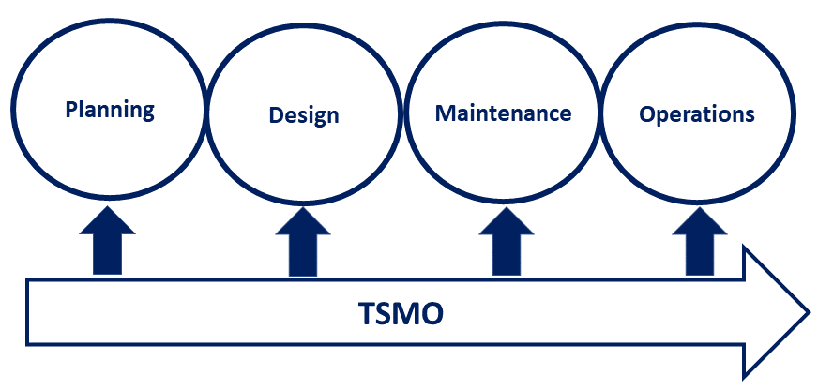
Pennsylvania DOT
Design and Project Development Manuals
Creating guidance documents and integrating TSMO concepts throughout the project life cycle
Ensuring engineers consider solutions systemically
Providing examples and questions to consider
Project Life Cycle - Ideal
Source: Adapted from Pennsylvania Department of Transportation.
Notes:
Policies and practices are essential to help nurture and grow and expand the TSMO way of thinking throughout the organization.
Do the design and project development-focused manuals and guidance incorporate TSMO strategies and concepts within it?
Pennsylvania DOT is currently doing that now, and it is looking at improving other guidance within the organization. Pennsylvania DOT is developing a four-part TSMO guidebook on how to integrate TSMO into planning, design, maintenance, and operations (as shown in the figure on the slide). Pennsylvania DOT has released the first part of the guidebook, which is on TSMO in planning: http://www.dot.state.pa.us/public/PubsForms/Publications/PUB%20851.pdf.
In 2021, the Pennsylvania DOT published its TSMO Design and Integration Guidelines for District 6. The focus of this guide was to support contractors and system integrators on what to be considered during the phases of a Pennsylvania DOT ITS design project. This is available at: https://www.penndot.gov/ProjectAndPrograms/operations/Documents/D-6%20TSMO%20Design%20and%20Integration%20Guidelines.pdf.
Updating design manuals may be something to look into and see if there’s room for improvement. It’s likely that designers aren’t intentionally ignoring TSMO; they just may be unaware of all the different strategies and things to think about when it comes to the topic. They don’t need to be an expert in all things TSMO or strategies. Including examples, topics, and questions to consider in the manuals will help get them thinking about future operations and how their project on paper will effectively operate once it’s built. They will be reminded to check with other experts in their office in order to help develop the optimum project plan/solutions.
Figure: Adapted from Pennsylvania DOT. TSMO Program Plan for Pennsylvania, May 2018. Available at: https://www.penndot.gov/ProjectAndPrograms/operations/Documents/PA%20TSMO%20Program%20Plan.pdf.

Slide 59
Colorado DOT TSMO Evaluation Approach
Tracks safety, traffic operations, and ITS analyses throughout the project development process integration with CDOT project management information system software
Integrates TSMO approaches into project guidance documents, such as Project Development Manual and Operations Evaluation Tools Guidance
Includes safety, operations, and ITS assessments
Evaluating adding freight, access management, resiliency, other analyses in future phases
Ensures a consistent and interdisciplinary approach throughout the project life cycle
Ensures recommendations are recorded, tracked, designed, and constructed
Notes:
Beginning in 2016, Colorado DOT began requiring a TSMO evaluation for projects. It also incorporated operations into the CDOT Project Development Manual as a specialty area to ensure that operations will be evaluated throughout the project development process.
The TSMO evaluation consists of three parts: a safety assessment, an operations assessment, and an ITS assessment.
The purpose of the TSMO evaluation is to ensure a consistent and interdisciplinary approach between maintenance, access, regions, operations, safety, ITS, and the FHWA. The goal is to identify operational elements that are conscientiously considered early in the project lifecycle. It provides the ability for increased cross-functional collaboration and knowledge sharing among involved parties.
The reason for including these assessments as part of the project design phase is to ensure the best solutions are provided in the most effective and efficient way possible. By considering safety, operations, and ITS elements early and throughout the design process, CDOT works to optimize its limited resources to make the right decisions for transportation improvements and build public trust by delivering the best projects possible.
https://www.codot.gov/programs/operations/tsmo-evaluation

Slide 60

Missouri DOT Core Project Teams
Design, planning, construction, traffic operations and safety, right-of-way, public outreach, permits, and other stakeholders
Each one communicates the impact of the current design direction on their respective discipline area, shaping the project’s direction
Allows all disciplines to help identify potential operational issues and solutions
Source: Unsplash.
Notes:
Open and regular communication among core members of the project design team and management establishes how operational practices will be considered during the design process.
Missouri DOT has long established the use of core teams. Missouri DOT has a policy for collaboration among those with different areas of expertise during project development. Missouri DOT uses a “core team” concept that establishes regularly occurring project development meetings for each project. The meeting is comprised of representatives from design, planning, construction, maintenance, traffic operations and safety, right-of-way, public outreach, and permits.
Representatives communicate the impact the current design direction will have on their respective discipline areas. The group works together to decide which strategies and design considerations are ultimately implemented and constructed. This ensures everyone has a voice at the table, and it helps educate and inform others on the team—not just design—on what to think about relating to TSMO. It allows all disciplines to help identify potential operational issues and innovative solutions throughout project design.
Photo: https://unsplash.com/photos/MnPF-0DTQ5c

Slide 61
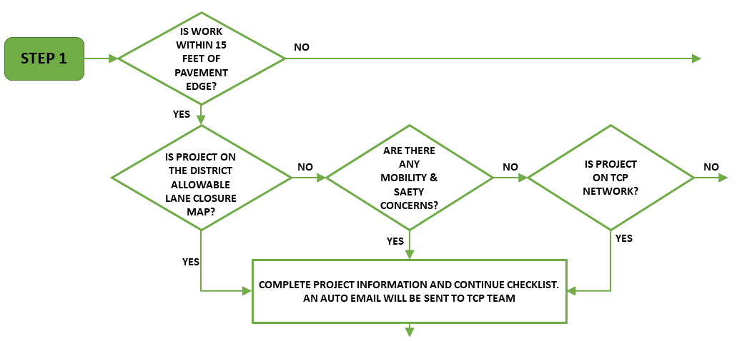
Iowa DOT Traffic Critical Projects Program—Helping Plan Work Zones
Identifies key projects that may cause significant safety or mobility issues
Designers complete a checklist for any project that falls on the colored roadways
Lane closure planning tool helps select work zone times with minimal impact
Program supplements typical traffic control plans
Source: Iowa Department of Transportation.
Notes:
The Traffic Critical Projects (TCP) program identifies key construction projects across Iowa that may cause significant safety or mobility issues to the traveling public. Using various mitigation methods, the TCP program works to reduce or eliminate any potential safety or mobility concerns.
TCP program supplements typical traffic control plans. This program is intended to reduce crashes and keep traffic flowing through construction projects by providing real-time work zone traffic performance information and addressing traffic incident management planning needs on Iowa’s highest demand roadways.
The program is included in the “Traffic Control” chapter of Iowa DOT’s Design Manual. This ensures TCP projects are identified during planning and design and various mitigation strategies are applied. Designers complete the TCP checklist for any project located on a highlighted/colored roadway shown in the map within their design manual. (Note: the colors on the map denote the type of roadway—interstate, freeway/non interstate, expressways above 60 miles per hour, expressways 55 miles per hour or less, primary roads.) This checklist identifies key construction projects as traffic critical projects that may cause significant safety or mobility issues to the traveling public. The checklist includes the lane closure planning tool, which aids in selecting times when work zones can be present with minimal impact on mobility and safety.
The following traffic mitigation strategies are employed for a TCP:
Intelligent work zones
Traffic incident management plans
Work day restrictions (day of week/seasonal)
Night work/limited work hours
Innovative contract provisions such as lane rental
Source: https://iowadot.gov/design/dmanual/09e-01.pdf. The checklist and LCPT can be accessed at: https://webapps.srfconsulting.com/idottcp/

Slide 62

Utah DOT TSMO Checklists and Operations Reviews
Making strides to explain TSMO and how it applies to various groups
Variety of TSMO checklists available
Operations reviews:
  Existing operations elements
  Planned operations elements
  Traffic and safety items
  Multimodal considerations
  Maintenance considerations
  Partner considerations
Source: Clipart Library.
Notes:
Utah DOT has developed individual TSMO checklists for various groups throughout Utah DOT that help explain what TSMO is, how it applies to their jobs, and specific things individuals and groups can do to advance TSMO within their current responsibilities.
Utah has also started doing operations reviews for projects.
Operations review encourages an early assessment of the operations needs of a project during the concept phase so that scopes, schedules, and budgets of all elements of the project are accounted for ensuring effective project delivery.
The review team will typically consist of between four and six individuals. Ideally the team will consist of the region designer or other individual responsible for completing the project concept report, the region ITS project manager, a region traffic and safety individual, a traffic performance engineer, pre-construction engineer, and the region planner. Other individuals, such as a district engineer, maintenance engineer, telecommunications manager, or region signals engineer (if traffic signals are potentially involved in the project) may be included on the team as needed.
They assess the following items through a formal checklist:
Existing operations elements
Planned operations elements
Traffic and safety items
Multimodal considerations
Maintenance considerations
Partner considerations

Slide 63
Overcoming Challenges

Slide 64
Potential Challenges…and Solutions (1/3)
Challenge
Limited awareness and understanding of TSMO among designers
Solutions
Include TSMO staff in project core teams and project scoping
Update design manuals with TSMO concepts and strategies
Increase TSMO awareness through training, work groups, conferences—your TSMO program/champion may be able to help
Federal TSMO resources: https://ops.fhwa.dot.gov/plan4ops/
Notes:
Designers may have little awareness of TSMO. To help resolve that, include TSMO staff in project teams with designers, update design manuals with TSMO concepts, and other ideas mentioned on the slide.

Slide 65
Potential Challenges…and Solutions (2/3)
Challenge
Starting to collaborate can temporarily add work—why do it?
Solutions
TSMO can help design achieve
goals and result in innovative and
cost-effective solutions.
Benefit-cost resources can help make the business case for TSMO. (https://www.itskrs.its.dot.gov/benefits/goals/energy-environment)
Notes:
It can be hard to get past the mindset that this will add to my workload. It may actually save time in the end (reduce redoing designs) and can help the DOT produce innovative solutions for meeting goals.

Slide 66
Potential Challenges…and Solutions (3/3)
Challenge
TSMO professionals not familiar with upcoming and active design projects
Solutions
Involve TSMO staff in project scoping
Educate before upcoming round of projects
Use core teams for projects with disciplines represented
Designate a liaison between TSMO and design project team
Notes:
TSMO professionals may not know much about what is happening in the area of design at your DOT. Education, inclusion on project teams, and liaisons can help alleviate this.

Slide 67
Next Steps

Slide 68
Potential Short-Term Actions
Start a conversation between design and operations/TSMO staff
Set up multidisciplinary teams for projects
Coordinate an informal training or presentation session
Share TSMO websites and webinars with design staff:
  National Operations Center of Excellence: https://www.transportationops.org/
  FHWA, “What Is TSMO?” https://ops.fhwa.dot.gov/tsmo/
Notes:
How can you get started with connecting TSMO and design? This slide has some ideas, such as just beginning the conversation, setting up multidisciplinary teams, or sharing some informational materials from FHWA or NOCoE. What are other short-term actions to better connect TSMO and design in your agency?

Slide 69
Potential Long-Term Actions
Look into updating manuals, guidance, and practices to integrate TSMO concepts and strategies
Institute more formal training for designers that includes TSMO concepts and strategies
Share operations data with designers during project development
Make it a practice for TSMO/operations staff to provide feedback to designers once the project is constructed
Other ideas?
Notes:
Over the long-term, you may be interested in how to formalize the connections between TSMO and design through updated guidance, practices, and training. Any other ideas?
Other ideas may include:
• Evaluate TSMO options to support performance-based practical design
• Include TSMO strategies in capacity projects to maximize investments
• Incorporate TSMO assets in infrastructure design
• Incorporate TSMO elements in design manuals
Reference:
“Mainstreaming TSMO: Examples of Integrating TSMO Across a Transportation Agency” (FHWA)
https://ops.fhwa.dot.gov/publications/fhwahop21041/index.htm

Slide 70
FHWA Resources
Designing for Transportation Management and Operations: A Primer, https://ops.fhwa.dot.gov/publications/fhwahop13013
Enhancing Transportation: Connecting TSMO and Design Factsheet, https://ops.fhwa.dot.gov/publications/fhwahop18088
Designing for Operations web page, https://ops.fhwa.dot.gov/plan4ops/designing_ops.htm
Performance-Based Practical Design web page, https://www.fhwa.dot.gov/design/pbpd/
SHRP Reliability Products Listing: Design Guide for Addressing Non-Recurrent Congestion, https://ops.fhwa.dot.gov/shrp2/products.htm#design
Notes:
This slide provides FHWA websites and materials that offer a deeper understanding of how design and TSMO can be connected. The fact sheet provides a snapshot of how and why to connect. The FHWA Designing for Operations web page has links to many other resources. There is also a primer available that FHWA created in 2013 that provides information on how designers can better incorporate operational considerations into design. Finally, FHWA’s materials on its PBPD web page can help connect TSMO and design.

Slide 71
Thank you!
For more information please contact:
[Add speaker’s information]

