Slide 1
Connecting TSMO and Transportation
Performance Management
TRANSPORTATION PERFORMANCE MANAGEMENT
Presenter Name
Date
Source: @Getty Images.

Slide 2
Disclaimer
The U.S. Government does not endorse products or manufacturers. Trademarks or manufacturers’ names appear in this presentation only because they are considered essential to the objective of the presentation. They are included for informational purposes only and are not intended to reflect a preference, approval, or endorsement of any one product or entity.
2

Slide 3
Executive Summary
Notes:
This is a short executive summary to be used with higher level decisionmakers and managers within an agency.

Slide 4

Transportation Landscape Is Changing
Advances in technology, data, computing power, and analytics
Customer needs and expectations
Limited funds and tighter budgets
Performance measures, target setting, and monitoring requirements
Source: Getty Images.
Notes:
The transportation landscape is changing, and doing business the way it was done in the past is no longer as effective.
Key changes in the landscape are:
Advances in technology, data, and analytics. New transportation technologies, more powerful computers, decision support systems, and private-company data sources provide increased potential to understand and monitor transportation systems in more detail and in real time. This creates the opportunity to make strategic and tactical decisions for TSMO using data. Given these advances, there are also many innovative decision-support techniques and tools being developed for analytical purposes.
Evolving customer needs and expectations. There is a greater demand for accountability and transparency for public officials to ensure that public funds are spent to maximize the performance of the transportation system in the most cost-effective way. This creates a trend toward “performance-based” programs. Travelers today expect real-time, accurate traveler information and options for how they travel. They expect to know about delays ahead of time and ways to avoid them.
Limited funds and tighter budgets. Transportation agencies on the Federal, State, and local levels have for years been tasked with doing more with limited resources. State DOTs are always looking for innovative, lower cost ways to get people and goods to their destinations more safely and reliably. Operational solutions that are identified and implemented through a framework of performance management can make the best use of limited funds.
Performance measures, target setting, and monitoring requirements. Seven National goals were defined in Moving Ahead for Progress in the 21st Century Act (MAP-21), in accordance with 23 USC 150(b). FHWA defined 17 performance measures to assess performance/condition in carrying out performance-based Federal-aid highway programs. State DOTs and metropolitan planning organizations (MPO) are required to set targets and report progress at regular intervals. Several of the performance measures relate to TSMO and operations, including “percentage of the person-miles traveled on the Interstate that are reliable.” This will be covered more later.
Changes in the context or landscape in which transportation exists have increased the opportunity and need for strategically managing the transportation system through transportation systems management and operations (TSMO).

Slide 5
What Is Transportation Systems Management and Operations (TSMO)?
Offers an integrated set of strategies to optimize operational performance of the existing transportation system
Approaches performance from a systems perspective that spans corridors, facilities, jurisdictions, modes, and agencies
Helps agencies balance supply and demand on the system and provide flexible solutions to manage dynamic conditions
Can complement capacity projects, or in some cases can provide lower cost, faster alternatives
Notes:
TSMO is becoming an increasingly popular approach in DOTs to make the most of the existing transportation infrastructure. It optimizes system capacity, improves safety, and enhances system performance through strategies that can be applied in the near term for less money than major construction.
Offers an integrated set of strategies to optimize operational performance of the existing transportation system
Approaches performance from a systems perspective; it spans corridors, facilities, jurisdictions, modes, and agencies:
Holistic approach to managing performance that looks beyond a single corridor (i.e., are changes to a specific corridor causing a mobility issue nearby?), jurisdiction (i.e., are management systems coordinated across jurisdictional boundaries?), mode (i.e., are we using all modes optimally to meet our performance goals?), and agency (i.e., how can we improve collaboration with law enforcement or transit agencies to improve performance?)
Balances supply and demand on the system and provides flexible solutions to manage dynamic conditions:
Examples: ramp metering, managed lanes, and congestion pricing
Complements capacity projects (or, in some cases, provides lower cost, faster alternatives):
Seeks to provide lower cost alternatives to capacity projects when operational strategies may produce equal or better results – or when operational strategies can produce results faster. It does not eliminate capacity projects in cases where a capacity project is the best solution; rather, TSMO provides agencies with more options.
Note: The definition at the top of the slide is an abridged version of the Federal Highway Administration (FHWA) TSMO definition found here: https://ops.fhwa.dot.gov/tsmo/

Slide 6
Increased Need To Collaborate
TSMO and transportation performance management (TPM) share common goals that can be better achieved through collaboration.
TSMO and TPM programs seek to:
Enhance system performance with strategic use of resources
Leverage data to plan and operate smarter
Establish measurable objectives for improving performance
Track performance and align investments
Communicate improvements and demonstrate an effective use of taxpayer resources
Notes:
Changes in the transportation landscape are driving a more performance-based approach to TSMO. Transportation performance management (TPM) and TSMO share common goals, including a data-driven, performance-based approach to decisions and system performance outcomes.
TSMO and TPM programs seek to:
Enhance system performance by the strategic use of resources
Leverage data to plan and operate smarter
Establish measurable objectives for improving performance
Track performance and align investments
Communicate improvements and promote effective use of taxpayer resources

Slide 7
How TSMO Supports TPM
TSMO strategies can provide cost-effective solutions to quickly improve performance and support national performance measures such as reliability and safety.
TSMO technologies provide a rich source of data for understanding, assessing, and monitoring performance of the transportation system in realtime.
TSMO reinforces the same objectives-driven, performance-based approach to improve and predict transportation system performance TPM uses.
TSMO provides levers (e.g., signal timing, hard-shoulder running) that enable agencies to actively manage the system in real time to improve performance.
Notes:
TSMO can support TPM in several ways, including:
TSMO strategies can provide cost-effective solutions to quickly improve performance and support national performance measures such as reliability and safety.
TSMO technologies provide a rich source of data for understanding, assessing, and monitoring performance of the transportation system in real time.
TSMO provides levers (e.g., signal timing, traveler information, hard-shoulder running) for agencies to actively manage the system in real time to improve performance.
TSMO reinforces the same objectives-driven, performance-based approach to improve and predict transportation system performance, which is used by TPM.

Slide 8
TSMO Can Help Agencies Move the
Needle on National Performance Measures
TSMO supports improvements along the National Performance Measures for System Performance:
  Percent of person-miles traveled on the interstate that are reliable
  Percent of person-miles traveled on the noninterstate National Highway System that are reliable
  Truck Travel Time Reliability (TTTR) Index
  Annual hours for peak hour excessive delay per capita
  Percent of nonsingle-occupancy vehicle travel
  Total emissions reduction
TSMO can also positively impact National Performance Measures for Safety.
Notes:
Congress established seven National Federal-aid Highway Program performance goals in accordance with 23 USC 150(b). FHWA then defined 17 National Performance Measures to assess performance/condition in carrying out performance-based Federal-aid highway programs.
TSMO can help agencies make improvements along the National Performance Measures for System Performance. Those measures are:
Percent of person-miles traveled on the Interstate that are reliable
Percent of person-miles traveled on the non-Interstate NHS that are reliable
Truck Travel Time Reliability (TTTR) Index
Annual Hours for Peak Hour Excessive Delay Per Capita
Percent of Non-Single Occupancy Vehicle Travel
Total Emissions Reduction
TSMO can also support safety improvements and positively impact the National Performance Measures for Safety. Those measures include the number and rate of fatalities and serious injuries.

Slide 9
How TPM Supports TSMO
TPM offers an overarching framework to manage operational performance of the transportation system.
Data and analytics used in TPM can help agencies evaluate and select TSMO strategies to meet internal and external objectives.
Measuring and reporting on quantitative impacts of TSMO strategies can provide the business case for additional funding for TSMO.
TPM helps identify issues in operational performance.
Notes:
Likewise, TPM can benefit TSMO efforts, such as:
Providing an overarching framework to manage operational performance of the transportation system
Offering data and analytics can help agencies evaluate and select TSMO strategies to meet internal and external objectives
Measuring quantitative impacts of TSMO strategies to provide the business case for additional funding for TSMO
Helping identify issues in operational performance

Slide 10
Opportunities for TSMO and TPM Collaboration
Setting performance targets for
operations-related performance measures
Developing TSMO program plans or strategic plans
Managing TSMO assets
Sharing data
Creating project prioritization methods
Making the business case for TSMO
Others?
Notes:
Six opportunities are shown on this slide. Can you think of any other opportunities?
Other possible areas for use in discussion:
Evaluating strategy effectiveness
Improving predictive model calibration and validation
Showing return on investment (TSMO often has a strong benefit/cost ratio)

Slide 11
Next Steps
Bring TSMO and TPM leaders together within your agency to identify areas of common interest and mutual objectives
Determine if/how TSMO strategies are supporting agency TPM goals
Discuss where TSMO can make an even greater impact on TPM goals
Identify TSMO and TPM data sources and opportunities to share data
Notes:
This slide provides next steps to begin or enhance the connection between TPM and TSMO in the agency.
Note: there are additional resources at the end of this presentation, including a fact sheet on connected TSMO and performance management: https://ops.fhwa.dot.gov/publications/fhwahop18095/index.htm

Slide 12
End of Executive Summary

Slide 13
Goals of This Presentation
Increase awareness of transportation systems management and operations (TSMO) strategies and goals
Demonstrate alignment between TSMO and transportation performance management (TPM)
Describe potential benefits of TSMO and TPM collaboration
Identify opportunities for TSMO and TPM to collaborate
Highlight examples of TSMO and TPM connections
Discuss challenges and how to overcome them
Present next steps
Notes:
This presentation aims to:
Create or increase awareness of TSMO strategies and goals
Demonstrate alignment between TSMO and TPM
Describe the potential benefits of TSMO and TPM collaboration
Identify opportunities for TSMO and TPM to collaborate
Highlight examples of TSMO and TPM connections in State departments of transportation (DOT) across the Nation
Discuss challenges to connecting TSMO and TPM and how to overcome them
Present next steps to start or enhance the connection

Slide 14
Presentation Overview
What is TSMO?
What is TPM?
Why Connect TSMO and TPM?
Opportunities for Collaboration
Examples of Collaboration Between TSMO and TPM
Overcoming Challenges to Collaboration
Next Steps for Connecting TSMO and TPM

Slide 15
What Is TSMO?
Notes:
This section will describe TSMO.

Slide 16
Definition of TSMO
Integrated [set of] strategies to optimize the performance of existing infrastructure through the implementation of multimodal and intermodal, cross-jurisdictional systems, services, and projects designed to preserve capacity and improve security, safety, and reliability of the transportation system.*,**
*Title 23 of the U.S. Code (USC) § 101 (a)(30)(A) Definitions and Declarations of Policy, 2011
**Federal Highway Administration (FHWA) website: https://ops.fhwa.dot.gov/tsmo/
Notes:
Before going further, it is important to define TSMO for new audiences:
TSMO is an integrated set of strategies to optimize the performance of existing infrastructure through the implementation of multimodal and multi-jurisdictional systems, services, and projects designed to preserve capacity and improve security, safety, and reliability of the transportation system.
The goal here is to get the most performance out of the transportation facilities we already have. TSMO is the use of strategies, technologies, mobility services, and programs to optimize the safety, mobility, and reliability of the existing and planned transportation system.

Slide 17
Characteristics of TSMO
Offers an integrated set of strategies to optimize operational performance of the existing transportation system
Approaches performance from a systems perspective that spans corridors, facilities, jurisdictions, modes, and agencies
Helps agencies balance supply and demand on the system and provide flexible solutions to manage dynamic conditions
Can complement capacity projects, or in some cases can provide lower cost, faster alternatives
Notes:
TSMO is an integrated set of strategies to optimize the operational performance of the existing transportation system.
Note: The definition at the top of the slide is an abridged version of the Federal Highway Administration’s (FHWA) TSMO definition found here: https://ops.fhwa.dot.gov/tsmo and at 23 USC 101 (a) (30).
TSMO approaches performance from a systems perspective.
Spans corridors, facilities, jurisdictions, modes, and agencies
TSMO takes a holistic approach to managing performance that looks beyond a single corridor (e.g., are changes to a specific corridor causing a mobility issue nearby?), jurisdiction (e.g., are management systems coordinated across jurisdictional boundaries?), mode (e.g., are we using all modes optimally to meet our performance goals?), and agency (e.g., how can we improve collaboration with law enforcement or transit agencies to improve performance?).
Helps agencies balance supply and demand on the system and provide flexible solutions to manage dynamic conditions.
Example TSMO strategies include ramp metering, managed lanes, and congestion pricing.
TSMO can complement capacity projects or can provide lower-cost, faster alternatives in some cases.
TSMO seeks to provide lower-cost alternatives to capacity projects when operational strategies may produce equal or better results – or when operational strategies may be able to produce results faster. It does not seek to eliminate capacity projects in cases where a capacity project is the best solution. Rather, TSMO provides agencies with more options.

Slide 18
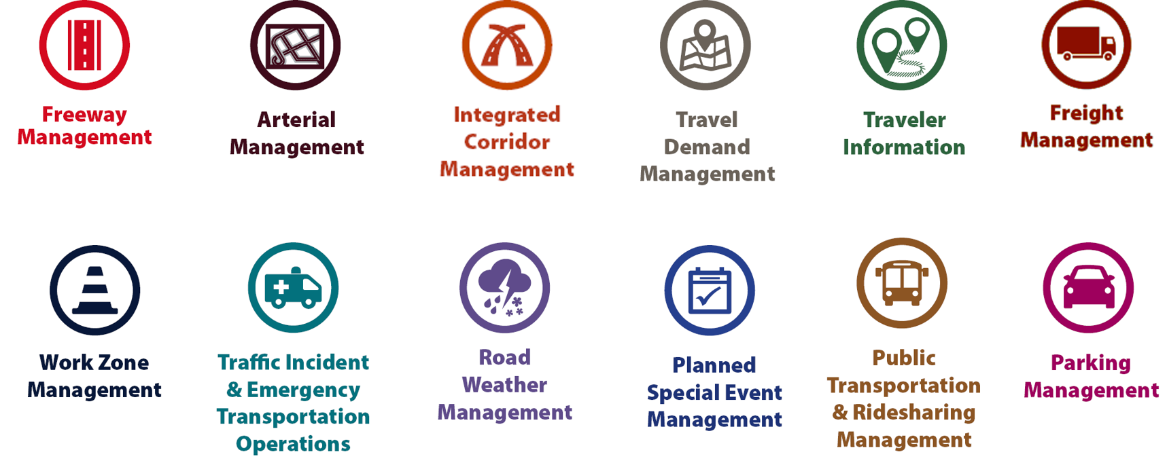
Examples of TSMO Strategies
Source: Federal Highway Administration
Notes:
This slide illustrates the array of operational strategies that fall under the TSMO umbrella that can be used individually or in combination with each other. This list is not exhaustive, but it highlights the key buckets of strategies that are priorities for many agencies.
Examples of other TSMO strategies include:
Traffic signal coordination
Transit signal priority
Special event management
Congestion pricing
Active transportation and demand management
Connected/automated vehicles
Completing multimodal networks
Intelligent transportation systems (ITS) components can support all these TSMO strategies. ITS covers a variety of technologies to monitor, evaluate, and manage transportation systems to enhance efficiency and safety. It should be noted that TSMO does not equate to ITS; many strategies support TSMO that do not involve an ITS component.
TSMO strategies can be categorized into three overarching areas: incident or event management, traffic management, and demand management strategies. The next three slides highlight strategies in each of these areas.

Slide 19
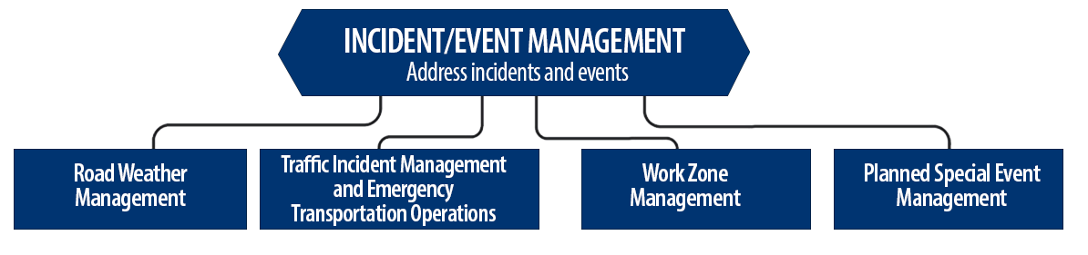
Incident/Event Management Strategies
Source: Federal Highway Administration.
Notes:
Incident and event management includes several strategies that address major sources of travel-time unreliability.
Incident and event management strategies include road weather management, traffic incident management and emergency transportation operations, work zone management, and planned special event management.
Road weather management activities include creating hazardous weather traffic operations response plans, implementing variable speed limits, detecting hazardous weather conditions, disseminating weather and warnings to travelers through dynamic signs and systems, providing emergency truck and parking facilities and emergency parking information, and implementing vehicle restrictions.
Traffic incident management and emergency transportation operations activities include establishing traffic incident management teams, conducting after action reviews, staging tow trucks in strategic areas, providing roadway safety patrols, integrating computer-aided dispatch into transportation management centers, pre-establishing towing service agreements, co-locating dispatching units, developing quick clearance goals, pre-planning detour routes, implementing shoulder running, deploying adaptive ramp metering, providing variable speed limits, implementing dynamic lane-use controls, deploying network surveillance cameras or detectors, implementing incident traffic signal timing plans, enacting legislation, and integrating traffic management centers with law enforcement dispatch and emergency centers.
Work zone management activities include coordinating maintenance and construction activities, implementing queue length detection, deploying network surveillance cameras or detectors, implementing variable speed limits, supporting dynamic lane merging, implementing dynamic lane-use controls, deploying temporary ramp metering, and implementing dynamic warning systems.
Planned special event management activities include activating special event timing plans, deploying adaptive ramp metering, implementing variable speed limits, using hard shoulder running, activating dynamic transit fare reduction, implementing reversible lanes, supporting dynamic lane-use controls, establishing dynamic pricing, deploying network surveillance cameras or detectors, activating dynamic wayfinding, and conducting after action reviews.
Source: FHWA, Integrating Travel Time Reliability into Transportation System Management: Final Technical Memorandum
https://ops.fhwa.dot.gov/publications/fhwahop19035/index.htm

Slide 20
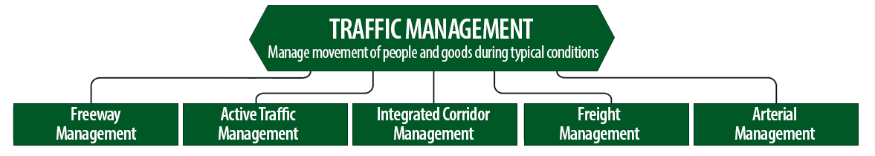
Traffic Management Strategies
Source: Federal Highway Administration.
Notes:
While incident or event management strategies address atypical events that cause travel-time unreliability, traffic management strategies manage the movement of people and goods during everyday conditions. Even during typical conditions, fluctuations in travel demand can lead to unreliable travel conditions. Traffic management strategies allow the transportation network to adapt to unreliability, including variations in travel demand.
Traffic management strategies include freeway management, active traffic management, integrated corridor management, freight management, and arterial management.
Freeway management activities include implementing traffic surveillance cameras or detectors, using high-occupancy lanes, implementing adaptive ramp metering, deploying hard shoulder running, implementing variable speed limits, deploying dynamic lane-use controls, and constructing physical operations improvements such as overpass widening, curve corrections, or adding auxiliary lanes.
Active traffic management activities include adopting adaptive ramp metering, implementing adaptive traffic signal control, using dynamic lane reversal, implementing dynamic lane-use controls, deploying dynamic merge control, implementing temporary shoulder running, using variable speed limits, deploying queue length detection, providing transit signal priority, and implementing dynamic warning signs.
Integrated corridor management activities include implementing network surveillance cameras or detectors, conducting access management and driveway access controls, implementing adaptive ramp metering, deploying adaptive signal control, deploying transit signal priority, installing queue jumping lanes, providing traveler information for alternative modes, and deploying emergency vehicle preemption.
Freight management activities include implementing roadside truck electronic screening and clearance, implementing truck signal priority, using truck parking management systems, installing truck climbing lanes, and implementing freight loading zone policies.
Arterial management activities include installing queue jumping lanes, deploying transit signal priority, supporting emergency vehicle preemption, implementing network surveillance cameras or detectors, implementing access management and driveway access controls, providing enhanced bicycle and pedestrian crossings, establishing a transportation management center, deploying enhanced traffic signal operations, implementing transit-only lanes, implementing truck traffic signal priority, designing for complete streets, adding capacity for critical movements, reducing travel speeds, providing automated enforcement, and conducting operations asset management.
Source: FHWA, Integrating Travel Time Reliability into Transportation System Management: Final Technical Memorandum
https://ops.fhwa.dot.gov/publications/fhwahop19035/index.htm

Slide 21
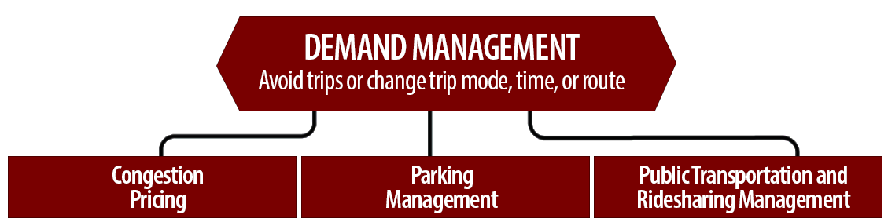
Demand Management Strategies
Source: Federal Highway Administration.
Notes:
Demand management strategies reduce underlying demand by helping travelers avoid trips or change the mode, timing, or route of trips. This makes nonrecurring congestion less likely to occur and improves travel-time reliability.
Demand management strategies include congestion pricing, parking management, and public transportation and rideshare management.
Congestion pricing activities include implementing dynamic pricing, variable pricing by lane, segment, and time of day or day of week; establishing dynamic transit fare reductions; and deploying managed lanes for high occupancy.
Parking management activities include deploying dynamically priced parking; implementing dynamic parking, wayfinding, reservations, and capacity; deploying dynamic overflow transit parking; implementing electronic payment systems and shared-use parking; and providing incentives to use underutilized parking facilities.
Public transportation and ridesharing management activities include implementing dynamic ridesharing, implementing transit signal priority, using queue-jump lanes at signalized intersections, deploying electronic fare collection and integration, and implementing dynamic surveillance and security.
Source: FHWA, Integrating Travel Time Reliability into Transportation System Management: Final Technical Memorandum
https://ops.fhwa.dot.gov/publications/fhwahop19035/index.htm

Slide 22
TSMO Is a “Way of Thinking” That Supports State Departments of Transportation (DOTs) Missions
“We provide safe, reliable and cost-effective transportation options to improve communities and economic vitality for people and businesses.”
Washington State DOT (WSDOT) mission¹
“To provide the best multimodal transportation system for Colorado that most effectively and safely moves people, goods, and information.”
Colorado DOT mission²
¹ WSDOT, “Strategic Plan,” https://www.wsdot.wa.gov/about/secretary/strategic-plan/
² Colorado DOT, “Mission, Vision & Values,” https://www.codot.gov/about/mission-and-vision.html
Notes:
TSMO leverages technology, a toolbox of strategies, and engineering solutions to maximize system performance; however, TSMO ultimately involves a way of thinking or a mindset focused on determining the best way to optimize the mobility and reliability of the existing system with limited resources.
TSMO can be thought of as a way of thinking and operating in order to get the most performance out of the transportation network while only building as much as is needed.
The principles of TSMO directly support the missions of many State DOTs, as these examples show.
NOTES:
States or local agencies can insert their own mission statement here for effect or can leave these in.
Presenters can emphasize the connections between TSMO definition and their specific Mission statement, such as safety, reliability, cost-effective, multimodal, customer’s needs/satisfaction, etc.

Slide 23
TSMO Supports Many
State and Local DOT Goals
Reduced congestion
Smoother and more reliable traffic flow
Improved safety
Cleaner air and less wasted fuel
More efficient use of resources and existing facilities
Increased economic vitality
Improved quality of life
Notes:
Here are some common goals in state and local transportation agencies that TSMO strategies support. This list is not exhaustive, but intended to show that TSMO support a range of mission-critical goals. Examples of how TSMO supports these goals are shown on the next slide.

Slide 24
Example TSMO Strategies That Support Transportation Agency Goals
TSMO Strategies |  | Goals
Traffic signal coordination, congestion pricing, demand management |  | Reduced congestion
Manage nonrecurring events (incidents, weather), managed lanes, traveler information |  | Smoother and more reliable traffic flow
Utilize the full system—coordinate all modes, transit signal priority |  | More efficient use of resources and existing facilities
Notes:
TSMO strategies that support some common transportation agency goals are shown here. Many of these strategies support more than one goal, but here are some key examples.

Slide 25
TSMO State of the Practice
Application of TSMO has accelerated in agencies across the country over the past 5–10 years
Recognition of TSMO’s value has grown, leading to a variety of approaches for advancing TSMO in agencies. For example:
  Establishing a TSMO division or office
  Formalizing a TSMO program
  Integrating TSMO throughout the agency
  Establishing a TSMO committee
  Identifying TSMO champions or liaisons
  Conducting a TSMO capability maturity model (CMM) self-assessment
  Developing a TSMO program plan
Notes:
TSMO as a more formal discipline has gained momentum in recent years. Recognition of the importance of TSMO has accelerated in the past five to ten years (as of year of publication of this presentation, 2022).
Key focus areas for agencies during this time have been adapting their culture, processes, expertise, and, in some cases, organizational structures to promote TSMO and a more operationally focused mindset. Agencies approach this differently depending on their unique context and needs. Several examples of key strategies agencies have used to advance TSMO within their organizations are shown here.
Central to all of these organizational approaches is 1) strong support from senior leadership, 2) a champion or champions who understand and promote TSMO throughout the agency, and 3) an openness to learning and cooperation among functions or divisions within an agency.
A TSMO capability maturity model self assessment is a framework developed to help agencies evaluate their current capabilities in the area of TSMO and identify steps for improving their TSMO capabilities. The self-assessment can be accessed at: http://aashtotsmoguidance.org/. There are also other capability maturity frameworks that FHWA has developed to support the implementation of TSMO. More can be learned about those frameworks at: https://ops.fhwa.dot.gov/tsmoframeworktool/index.htm.

Slide 26
Resources on TSMO
What Is TSMO? (frequently asked questions) https://ops.fhwa.dot.gov/tsmo
Organizing and Planning for Operations web page https://ops.fhwa.dot.gov/plan4ops
Communicating TSMO web page https://ops.fhwa.dot.gov/plan4ops/focus_areas/communicating_tsmo.htm
National Operations Center of Excellence (NOCoE) website https://www.transportationops.org/
Enhancing Transportation: Connecting TSMO and Performance Management, https://ops.fhwa.dot.gov/publications/fhwahop18095
Notes:
While these slides provide a comprehensive, high-level summary of TSMO, participants who are looking for more details and information to share with their staff can visit these virtual resources.

Slide 27
What Is TPM?
Notes:
This section will describe transportation performance management (TPM).

Slide 28
TPM Overview
Overarching framework for performance management
“…a strategic approach that uses system information to make investment and policy decisions to achieve national performance goals”
Regular, ongoing process that is systematically applied
Source: FHWA, “What Is TPM?”, https://www.fhwa.dot.gov/tpm/about/tpm.cfm
Notes:
As defined by FHWA, TPM is an overarching framework for performance management.
It is a strategic approach that uses system information to make investment and policy decisions to achieve national performance goals.
TPM is characterized by a regular, ongoing process that is systematically applied

Slide 29
Why TPM Is Important
Provides key information to help decisionmakers understand consequences of investment decisions across transportation assets or modes
Improves communications among decisionmakers, stakeholders, and the traveling public
Ensures targets and measures are developed in cooperative partnerships and based on data and objective information
Source: FHWA, “What Is TPM?”, https://www.fhwa.dot.gov/tpm/about/tpm.cfm
Notes:
TPM is important because it:
Provides information to help decisionmakers understand the consequences of investment decisions across transportation assets or modes
Improves communications between decisionmakers, stakeholders, and the traveling public
Ensures targets and measures are developed in cooperative partnerships and based on data and objective information

Slide 30
TPM—National Performance Goals
Safety
Infrastructure condition
Congestion reduction
System reliability
Freight movement and economic vitality
Environmental sustainability
Reduced project delivery delays
Sources: 23 USC 150(b) National Goals and Performance Management Measurements, 2016
https://www.fhwa.dot.gov/tpm/about/regulations.cfm
Notes:
MAP-21 defined seven national goals in accordance with 23 USC 150(b). [23 USC 150(b)] These goals are the first element of TPM, and include:
1. For safety, to achieve a significant reduction in traffic fatalities and serious injuries on all public roads.
2. For infrastructure condition, to maintain the highway infrastructure asset system in a state of good repair.
3. For congestion reduction, to achieve a significant reduction in congestion on the National Highway System.
4. For system reliability, to improve the efficiency of the surface transportation system.
5. For freight movement and economic vitality, to improve the national freight network, strengthen the ability of rural communities to access national and international trade markets and support regional economic development.
6. For environmental sustainability, to enhance the performance of the transportation system while protecting and enhancing the natural environment.
7. For reduced project delivery delays, to reduce project costs, promote jobs and the economy and expedite the movement of people and goods by accelerating project completion through eliminating delays in the project development and delivery process, including reducing regulatory burdens and improving agencies’ work practices.
National goals should be primarily achieved through the performance-based planning and programming processes. After the seven national goals were established, FHWA developed 17 performance measures in areas of safety, infrastructure, and system performance. State DOTs and MPOs set targets annually for the safety performance measure

Slide 31
Why Connect TSMO and TPM?
Notes:
Why is it important to connect TSMO and TPM? This section will help explain.

Slide 32
The Transportation Landscape Is Changing
Advances in technology, data, computing power, and analytics
Customer needs and expectations
Limited funds and tighter budgets
Performance measures, target setting, and monitoring requirements
Source: Getty Images.
Notes:
The transportation landscape is changing, and doing business the way it was done in the past is no longer as effective.
Key changes in the landscape are:
Advances in technology, data, and analytics. New transportation technologies, more powerful computers, decision support systems, and private-company data sources provide increased potential to understand and monitor transportation systems in more detail and in real time. This creates the opportunity to make strategic and tactical decisions for TSMO using data. Given these advances, there are also many innovative decision-support techniques and tools being developed for analytical purposes.
Evolving customer needs and expectations. There is a greater demand for accountability and transparency for public officials to ensure that public funds are spent to maximize the performance of the transportation system in the most cost-effective way. This creates a trend toward “performance-based” programs. Travelers today expect real-time, accurate traveler information and options for how they travel. They expect to know about delays ahead of time and ways to avoid them.
Limited funds and tighter budgets. Transportation agencies on the Federal, State, and local levels have for years been tasked with doing more with limited resources. State DOTs are always looking for innovative, lower cost ways to get people and goods to their destinations more safely and reliably. Operational solutions that are identified and implemented through a framework of performance management can make the best use of limited funds.
Performance measures, target setting, and monitoring requirements. Seven National goals were defined in Moving Ahead for Progress in the 21st Century Act (MAP-21), in accordance with 23 USC 150(b). FHWA defined 17 performance measures to assess performance/condition in carrying out performance-based Federal-aid highway programs. State DOTs and metropolitan planning organizations (MPO) are required to set targets and report progress at regular intervals. Several of the performance measures relate to TSMO and operations, including “percentage of the person-miles traveled on the Interstate that are reliable.” This will be covered more later.
Changes in the context or landscape in which transportation exists have increased the opportunity and need for strategically managing the transportation system through transportation systems management and operations (TSMO).

Slide 33
An Increased Need To Collaborate
TSMO and TPM share common goals that can be better achieved through collaboration. TSMO and TPM programs seek to:
Enhance system performance with strategic use of resources
Leverage data to plan and operate smarter
Establish measurable objectives for improving performance
Track performance and align investments
Communicate improvements and promote effective use of taxpayer resources
Notes:
Changes in the transportation landscape are driving a more performance-based approach to TSMO. TPM and TSMO share common goals, including a data-driven, performance-based approach to decisions and system performance outcomes. TSMO supports reaching several of the National goals.
TSMO and TPM programs seek to:
Enhance system performance by the strategic use of resources
Leverage data to plan and operate smarter
Establish measurable objectives for improving performance
Track performance and align investments

Slide 34
Mutual Benefits of Collaboration
Coordinating TSMO and TPM efforts enables shared goals to be achieved more efficiently.
Example TSMO Goals:
Reduce congestion and improve reliability
Leverage all modes to improve mobility
Get more out of existing infrastructure
Use data for decisionmaking
Example TPM Goals:
Meet delay and reliability performance targets
Reduce total emissions
Maximize use of resources
Use performance-based data for decisions
Notes:
Collaboration benefits both TSMO and TPM programs because their goals are aligned. TSMO programs can help meet TPM goals in reliability, delay, safety, and environment. This slide shows that several TSMO goals are directly aligned with several goals for TPM.

Slide 35
How TSMO Can Support TPM
TSMO strategies can provide cost-effective solutions to quickly improve performance and support national performance measures such as reliability and safety.
TSMO technologies provide a rich source of data for understanding, assessing, and monitoring performance of the transportation system in realtime.
TSMO reinforces the same objectives-driven, performance-based approach to improving and predicting transportation system performance used by TPM.
TSMO provides levers (e.g., signal timing, hard-shoulder running) that enable agencies to actively manage the system in realtime to improve performance.
Notes:
TSMO can support TPM in several ways, including:
TSMO strategies can provide cost-effective solutions to quickly improve performance and support national performance measures such as reliability and safety
TSMO technologies provide a rich source of data for understanding, assessing, and monitoring performance of the transportation system in real time
TSMO provides levers (e.g., signal timing, traveler information, hard-shoulder running) for agencies to actively manage the system in real time to improve performance
TSMO reinforces the same objectives-driven, performance-based approach to improve and predict transportation system performance, which is used by TPM.

Slide 36
TSMO Can Help Agencies Move the Needle on the National Performance Measures
TSMO supports improvements along the national performance measures for system performance:
  Percent of person-miles traveled on the interstate that are reliable
  Percent of person-miles traveled on the noninterstate NHS that are reliable
  Truck Travel Time Reliability (TTTR) Index
  Annual hours for peak hour excessive delay per capita
  Percent of nonsingle occupancy vehicle travel
  Total emissions reduction
TSMO can also positively impact national performance measures for safety.
Notes:
Congress established seven National Federal-aid Highway Program performance goals in accordance with 23 USC 150(b). FHWA then defined 17 National Performance Measures to assess performance/condition in carrying out performance-based Federal-aid highway programs.
TSMO can help agencies make improvements along the National Performance Measures for System Performance. Those measures are:
Percent of person-miles traveled on the Interstate that are reliable
Percent of person-miles traveled on the non-Interstate NHS that are reliable
Truck Travel Time Reliability (TTTR) Index
Annual Hours for Peak Hour Excessive Delay Per Capita
Percent of Non-Single Occupancy Vehicle Travel
Total Emissions Reduction
TSMO can also support safety improvements and positively impact the National Performance Measures for Safety. Those measures include the number and rate of fatalities and serious injuries.

Slide 37
How TPM Can Support TSMO
TPM offers an overarching framework to manage operational performance of the transportation system.
Data and analytics used in TPM can help evaluate and select TSMO strategies to meet internal and external objectives.
Measuring and reporting on quantitative impacts of TSMO strategies can provide the business case for additional funding for TSMO.
TPM can identify issues in operational performance.
Notes:
Likewise, TPM can benefit TSMO efforts, such as:
Providing an overarching framework to manage operational performance of the transportation system
Offering data and analytics that can help to evaluate and select TSMO strategies to meet internal and external objectives
Measuring quantitative impacts of TSMO strategies to provide the business case for additional funding for TSMO
Identifying issues in operational performance

Slide 38
Opportunities for Collaboration
Notes:
These are areas where TSMO and TPM can work together and capture new benefits from the collaboration.

Slide 39
Opportunities for Collaboration
Between TSMO and TPM
Setting performance targets for
operations-related performance measures
Developing TSMO program plans or strategic plans
Managing TSMO assets
Sharing data
Creating project prioritization methods
Making the business case for TSMO
Others?
Notes:
Six opportunities are shown on this slide. Can you think of any other opportunities?
Other possible areas for use in discussion:
Evaluating strategy effectiveness
Improving predictive model calibration and validation.
Showing return on investment (TSMO often has a strong benefit-cost ratio.)

Slide 40

Setting Performance Targets
Agency staff can combine expertise to identify realistic performance targets.
Targets should be based on historical data, likely future conditions, and impacts of future TSMO investments.
TPM staff can offer data, analysis, and information on broader trends.
TSMO staff can provide input on setting targets for federally required performance measures in areas of system performance.
Source: Getty Images.
Notes:
TSMO and TPM staff can collaborate on setting system performance targets – either for a TSMO program plan, TSMO strategic plan, or federally required performance measures.
TPM and TSMO staff can combine their expertise to identify realistic performance targets for operations-related measures; TSMO staff can provide insights into how much TSMO strategies may be able to move the needle on some of the performance measures
Targets should be based on historical data, an understanding of likely future conditions, and estimated impacts of future TSMO investments
TPM staff can offer data, analysis, and information on broader transportation trends
TSMO staff can provide input on setting targets for Federally-required performance measures in areas of system performance

Slide 41
Developing TSMO Plans
TSMO strategic and program plans often contain goals, objectives, performance measures, and targets to provide direction for the TSMO effort.
Collaboration with TPM during development of these plans is important for:
  Gathering necessary data
  Understanding baseline conditions
  Helping ensure TSMO efforts support agency TPM goals
Notes:
Related to the previous slide, TPM staff can work with TSMO staff in developing TSMO strategic or programmatic plans. TPM staff can support the effort through the overarching performance management framework and identifying goals, performance measures, and targets based on available data.
Collaboration with TPM during development of these plans is important for:
Gathering necessary data
Understanding baseline conditions
Aligning TSMO goals, objectives, measures, and targets with any that have been developed through the TPM program/staff

Slide 42

Managing TSMO Assets
TPM can offer a performance management framework to support
lifecycle planning for TSMO assets
and maximize their useful life.
TSMO strategies often require equipment, technology, and communications systems.
The service life of TSMO assets varies.
Maintenance, replacement, and upgrade costs need to be planned.
Source: Getty Images.
Notes:
Another important area for collaboration is the performance-based management of TSMO assets, such as road weather information systems, communications systems, signals, and closed-circuit television cameras.
TSMO strategies often require technology or equipment, but the service life of TSMO assets varies and may be difficult to track. Maintenance, replacement, and upgrade costs need to be planned for and budgeted to sustain traveler confidence. TPM can offer a performance management framework to support life-cycle planning for TSMO assets and maximize their useful life. TPM personnel can support TSMO staff in the application of a performance management framework to manage TSMO assets.

Slide 43

Sharing Data Among TSMO and TPM Programs
TPM staff work with a variety of datasets that may be helpful for TSMO programs.
TSMO and TPM programs may exchange staff expertise in National Performance Management Research Data Set (NPMRDS) and vehicle probe data for speed and travel time performance measures.
TSMO programs generate a large amount of system performance data helpful for TPM, such as incident, weather, crowdsourced travel time/incident reporting, work zone, special event, video, computer-aided dispatch (CAD), volume, and speed data.
Source: Getty Images.
Notes:
Sharing data is an opportunity for both TSMO and TPM programs to benefit.
TSMO and TPM programs both have access to performance data that may be useful to the other program:
TPM staff work with a variety of data sets that may be helpful for TSMO programs.
The programs may exchange staff expertise in working with the National Performance Management Research Data Set (NPMRDS) data and vehicle probe data that support speed and travel-time performance measures.
TSMO programs often generate a large amount of system performance data, including incidents, weather, crowdsourced travel time/incident reporting, work zones, special events, volume, and speed as well as data sourced from video and CAD. These data may be helpful to TPM staff in understanding the context for meeting federally required measures.

Slide 44

Creating Project Prioritization Methods
Agencies are beginning to develop performance-based methods for TSMO project prioritization.
The methods are typically based on system performance measures, cost-benefit analyses, and anticipated outcomes
Data-driven investment decisionmaking is an essential part of the TPM framework.
TPM staff can advise on available data, performance measures, and creating a quantitative prioritization system.
Source: Federal Highway Administration.
Notes:
As shown in the case examples later in the presentation, one of the active performance management areas for TSMO is the creation of a performance-based system for screening and prioritizing projects. The methods are typically based on system performance measures, cost-benefit analyses, and anticipated outcomes. Since data-driven investment decisionmaking is an essential part of the TPM framework, this would be an apparent area for collaboration. TPM staff can advise on available data, performance measures, and creating a quantitative prioritization system.

Slide 45

Making the Business Case for TSMO
Collaborate to tell the agency’s story about the value of TSMO
Use performance measures and data to communicate the return on investment and business case for investing in TSMO
Source: Getty Images.
Notes:
One of the most valuable areas of collaboration may be using data to tell a compelling story about the value of TSMO.
TSMO and TPM staff can use performance measures and data to effectively communicate the return on investment and business case for investing in TSMO. Some agencies, such as Maryland DOT, are using performance data and a cost/benefit analysis to justify investment in its incident management program.

Slide 46
Examples of Collaboration Between TSMO and TPM
Notes:
This section will highlight several examples of State DOTs connecting TSMO and TPM in areas of project prioritization, performance monitoring, and TSMO project and program evaluation.

Slide 47
WSDOT: Connecting TPM and TSMO (1/2)
“Performance management and TSMO are intrinsically linked. All DOT functions that use data-based decisionmaking to maximize investments are linked to TPM.”
– Daniela Bremmer, Cooperative Automated Transportation Development WSDOT
WSDOT’s performance management program unit aims to create comprehensive and streamlined performance management efforts that inform decisionmaking at all levels of the DOT.
Notes:
Unlike many state DOTs, the Washington State DOT has a performance management unit. Daniela Bremmer, the head of WSDOT’s Cooperative Automated Transportation Development program, views performance management and TSMO is intrinsically linked. She views all DOT functions that entail data-based decisionmaking as being linked to TPM.
The goals of performance management within WSDOT include comprehensive and streamlined performance management efforts that inform decisionmaking at all levels of State DOT efforts or deliverables. The desired outcome of its performance management effort is that performance-based data is the foundation for decisionmaking.
Source: FHWA Connecting TSMO and TPM Listening Session on April 12, 2021 with Daniela Bremmer, WSDOT.

Slide 48
WSDOT: Connecting TPM and TSMO (2/2)
TPM for operational strategies has been part of TSMO for nearly two decades.
TSMO has already benefited from connecting TSMO and TPM at WSDOT at many different levels:
  For example, after reporting regularly on incident response (IR) program performance results, the legislature significantly increased IR funding.
Assistant Director of Performance Management serves on WSDOT’s new
cross-disciplinary TSMO Steering Committee that developed its TSMO program plan.
WSDOT is working to include more TPM action items within its new TSMO plan:
  Develop a specific TSMO performance management plan.
  Develop and deploy TSMO performance management system.
Notes:
WSDOT is developing its first TSMO program plan with a cross disciplinary steering committee that has drawn in managers and staff from a variety of disciplines across the agency. The assistant director of performance management serves on this committee. The committee is working to include transportation performance management action items within the TSMO plan. Example action items include the following:
“Develop TSMO performance management plan. Identify and establish policy, accountability, and reporting for systems operational performance to support real-time decisionmaking and long-term policy. Work also includes identifying existing metrics and data sources and defining new metrics and related data needs (including private sector sources).”
“Develop and deploy TSMO performance management system to track statewide and regional operations activity in real-time. Allow for short- and long-term trend analysis to provide intelligence that allows for change in TSMO strategies and tactics.”
One of the benefits of connecting TSMO and TPM for WSDOT is that after WSDOT began including performance reporting on incident response, WSDOT leaders were able to convince the legislature to double the funding for the incident response program.

Slide 49
North Carolina DOT: Linking TSMO and TPM (1/2)
The TSMO unit works with the North Carolina DOT (NCDOT) central performance office to:
  Decide what performance measures the TSMO unit should report
  Set up the data feeds necessary for the TSMO unit to calculate the measures
The TSMO unit measures a few key indicators for internal reports and public-facing dashboards:
  Incident clearance time
  Peak period speeds in urban areas
  Related measures required by Moving Ahead for Progress in the 21st Century Act (MAP-21) (Public Law 112-141, 2012).
Notes:
At NCDOT, the TSMO unit works with the NCDOT central performance office to decide what measures to report and sets up the underlying data feeds to calculate them. The TSMO unit measures a few key indicators: crash clearance, peak hour urban speeds, and the MAP-21 measures on public facing and internal dashboards. The unit also produces monthly and quarterly reports around various TSMO activities.

Slide 50
NCDOT: Linking TSMO and TPM (2/2)
Agency-wide performance management processes originated from a 2007–2009 NCDOT effort to transform agency processes
At NCDOT, TPM and TSMO have common goals of improving safety and decreasing delay.
The TSMO unit is looking to better tie outcome measures to TSMO resource allocation.
Challenges include isolating the contribution of TSMO and outcome-based measures
Notes:
In 2007-2009, NCDOT underwent a major "transformation effort" and performance measures were a major part of it. This transformation included a requirement that all business units in NCDOT report on performance.
At NCDOT, TPM and TSMO have common goals of improving safety and decreasing delay. Looking ahead, the TSMO unit would like to increase the automation of calculating performance measures and better tie outcome measures to TSMO resource allocation. Challenges to achieving these goals include isolating the contribution of TSMO and outcome based measures.
Source: Kelly Wells, Mobility Program Manager, North Carolina DOT, Connecting TSMO and Transportation Performance Management FHWA Listening Session, April 12, 2021.

Slide 51
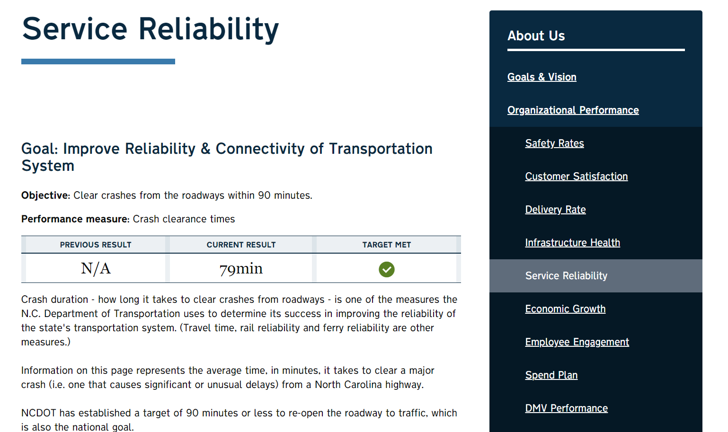
NCDOT Organizational Performance Dashboard
Source: North Carolina Department of Transportation.
Notes:
This slide shows a screenshot of the North Carolina DOT’s Organizational Performance dashboard on the agency’s website. The North Carolina DOT’s goal in the area of service reliability is to improve reliability and connectivity of the transportation system. The objective is to clear crashes from the roadways within 90 minutes. The performance measure associated with that objective is crash clearance times. Currently they are meeting their target.
Source: North Carolina DOT, Service Reliability webpage. Available at:
https://www.ncdot.gov/about-us/our-mission/Performance/Pages/service-reliability.aspx, last accessed September 9, 2021.

Slide 52
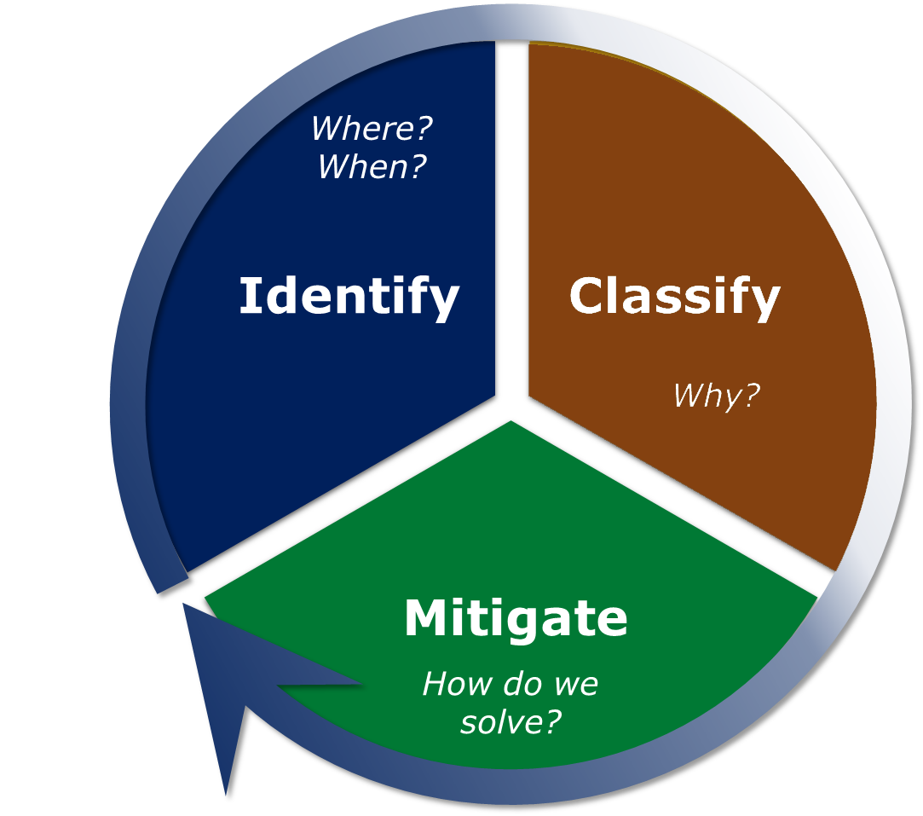
Pennsylvania DOT’s TSMO Program: From Congestion to Relief
Identify:
  PennDOT-specific performance measures
  Federal PM3 measures
Classify:
  Six major causes of congestion
  Process of elimination
Mitigate:
  Toolbox in TSMO Guidebook
  Quantifying benefits of various strategies
Source: Pennsylvania Department of Transportation.
Notes:
TPM is ingrained in Pennsylvania DOT’s (PennDOT) TSMO program. PennDOT’s TSMO program is built on the three-step cycle shown on this slide: Classify, Mitigate, and Identify. To start, PennDOT identifies congestion – where and when is it happening and how severe. Next, PennDOT examines why the congestion is occurring and classifies it according the causes. There are six major causes – work zones, traffic incidents, other incidents, inclement weather, bottlenecks, and undetermined. Sometimes figuring out the cause of congestion is a process of elimination. Finally, PennDOT looks at for tools in its TSMO toolbox to mitigate the congestion. As of the fall of 2021, PennDOT’s effort to quantify the benefits of various strategies is still a work in progress. After PennDOT has applied the congestion mitigation strategies, then it repeats the cycle to identify congestion again.
Source: Pennsylvania DOT, Unpublished Presentation for FHWA PM3 Peer Exchange, April 23, 2021.

Slide 53
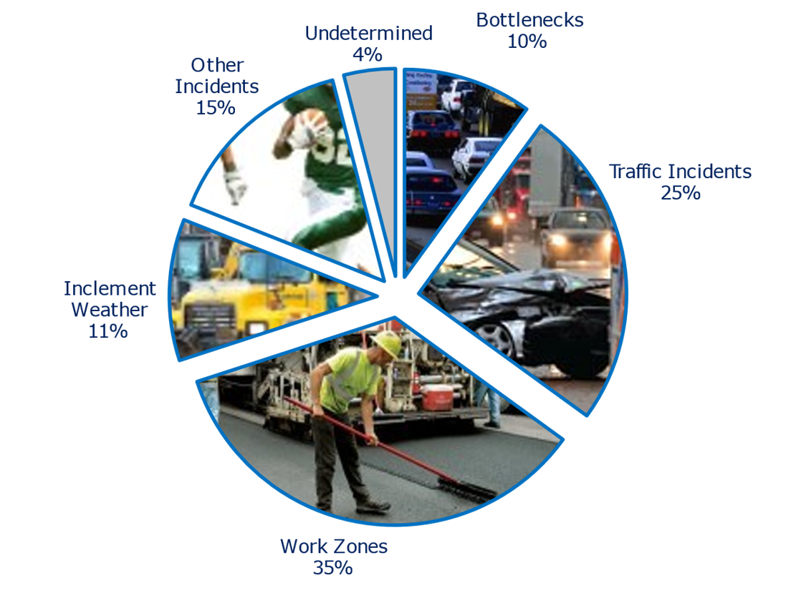
Pennsylvania DOT: Classifying Congestion
Pennsylvania Limited Access Network Causes of Congestion, 2019
Tailored congestion pie charts:
  Statewide
  District-specific
  Segment of roadway
Statewide: 10% of congestion is recurring; 86% is nonrecurring
Rural: 99.5% nonrecurring
Source: Pennsylvania Department of Transportation.
Notes:
PennDOT needed to know why congestion was happening in order to identify effective mitigation strategies. PennDOT’s TSMO Performance Program used traffic, incident, and event data to develop Pennsylvania’s congestion pie charts. The program developed a statewide pie chart for Pennsylvania’s limited access road network, as shown on the slide.
PennDOT also developed a separate pie chart for each district. The district-specific pie charts show that recurring congestion was much greater in urban areas in some eastern (Philadelphia) and western (Pittsburg) districts than in the more rural parts of the State. Roadwork, weather, and incidents created much of the delay in the rural areas.
PennDOT staff can also create pie charts for specific road segments.
They found that only 10% of congestion in Pennsylvania is recurring and that in rural areas, 99.5% of congestion is non-recurring. One clear conclusion PennDOT reached was that eliminating bottlenecks was not going to solve the congestion issues. PennDOT needed to operate the roadways to improve reliability.
Sources:
Pennsylvania DOT, Unpublished Presentation for FHWA PM3 Peer Exchange, April 23, 2021.
Pennsylvania DOT, 2020, TSMO Performance Report, 4th Edition.

Slide 54
Michigan DOT Performance-Based Operations Project Selection (1/2)
Performance-based process to evaluate operational improvements for funding
Scores for the competitive statewide process based on a 100-point total
Supports the achievement of reliability and safety targets
Factor | Points
Benefit-to-cost ratio | 30
Net reliability and operational Improvement | 30
Degree of additional safety benefit of project based on time of return | 20
Project is in a highly congested area (travel time index ≥ 1.5 or level of service E or F) | 10
Project is in an unreliable area (planning time index ≥ 2.0 or level of travel time reliability ≥ 1.5) | 10
Notes:
TSMO project selection is an example of linking performance management principles and TSMO at the Michigan DOT. It is based on points for performance measures/criteria.
Michigan DOT also refers to this as its Operations Template for its Trunkline Program. Michigan DOT considers an operational improvement as “any improvement that results in restoring or optimizing theoretical capacity and/or improves travel reliability and safe flow of traffic on the existing number of permanent, through travel lanes within the corridor.”
The template is a way of providing a fair and transparent method for evaluating and selecting projects for operations. It provides a repeatable and consistent approach. The template includes safety. The Michigan DOT Operations Steering Committee, including regional TSMO champions, coordinates this process.
Source: Michigan DOT, Michigan DOT TSMO Funding Fact Sheet, https://www.transportationops.org/business-cases/michigan-dot-tsmo-funding-fact-sheet.

Slide 55
Michigan DOT Performance-Based Operations Project Selection (2/2)
Funding sources include Federal Surface Transportation Program, National Highway Performance Program, Highway Safety Improvement Program, Congestion Mitigation and Air Quality Program, and State funds.
Examples of Eligible Project Types
Freeway | Nonfreeway
Ramp improvements | Center left-turn lanes
Ramp metering | Indirect left-turns or J-turns
Reversible lanes | Roundabouts
Hard shoulder running | Lane extensions
Interchange improvements | Left- or right-turn lanes
Adding auxiliary/weave/merge lanes | Signal improvements (that add operational element)
Notes:
Depending on type, operational improvements may be eligible for different funding sources as part of this selection process:
Federal Surface Transportation Program
National Highway Performance Program
Highway Safety Improvement Program
Congestion Mitigation and Air Quality Program
State funds ($50 million annually supports these activities via a statewide competitive data driven selection process. Or about 2.5% of our approximate $2 billion annual Capital budget.)
Projects considered under this selection process include freeway operations, non-freeway operations, safety, traffic signals, and ITS. These slides contains examples of eligible freeway and non-freeway projects.

Slide 56
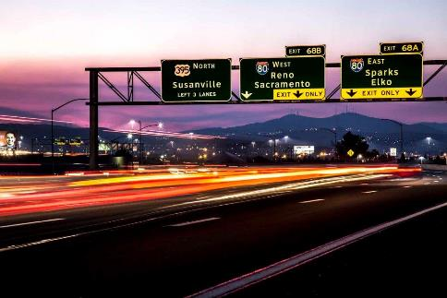
Nevada DOT TSMO Investment Prioritization Tool
Performance-based tool to prioritize TSMO projects according to TSMO strategic goals and objectives
Aligned with statewide transportation priorities
Traffic Operations division uses tool with districts to update and prioritize projects in the Statewide ITS Strategic Deployment Plan
TSMO and performance management staff coordinate and share data at regular meetings.
Source: Nevada Department of Transportation.
Notes:
At Nevada DOT there is a performance analysis program in the planning division, and performance management activities are spread throughout the department. There is a high level of coordination between TSMO and performance management teams. TSMO staff attend performance management meetings and performance management staff attend TSMO meetings. Through these meetings, TSMO and performance analysis staff share ideas and data. These meetings help staff from each discipline understand what’s going on in the other discipline and facilitate the agency getting to the bottom of issues in a collaborative manner.
As part of the TSMO program, Nevada DOT established a business process to align investments in TSMO with the State’s transportation priorities and to ensure investments help achieve TSMO goals and objectives. Nevada developed the TSMO Investment Prioritization Tool to prioritize TSMO projects for investment. It is a spreadsheet-based tool, but Nevada DOT is working to create a web-based version.
The tool is used to update and prioritize projects listed in the Statewide ITS Strategic Deployment Plan (SDP). The criteria used to prioritize the projects are listed on the next slide.
https://www.transportationops.org/case-studies/tsmo-investment-prioritization-tool-ipt
Photo from: https://www.dot.nv.gov/doing-business/about-ndot

Slide 57
Nevada DOT TSMO Investment Prioritization Tool—Prioritization Criteria
Alignment with TSMO strategic goals and objectives:
  Enhance safety—reduce crashes, injuries, and fatalities
  Optimize mobility—maintain system efficiency across all modes
  Enhance reliability—improve economic competitiveness and enhance qualify of life through consistent travel times
  Preserve infrastructure—maintain TSMO assets to preserve investments
Cost
Implementation timeframe
Level of risk and degrees of impactReturn on investment—benefit/cost ratio, strategic value, communication infrastructure needs
Notes:
This slide contains the criteria used to establish a score for each project. Points are assigned for each element and then an overall score is used to prioritize the project.
More information on the tool can be found at https://transops.s3.amazonaws.com/uploaded_files/Nevada%20DOT%20-%20NDOT%20TSMO%20Investment%20Prioritization%20Tool%20%28IPT%29%20-%20NOCoE%20Case%20Study.pdf

Slide 58

Ohio DOT TSMO Project Prioritization and Selection
Traffic Operations Assessment Systems Tool (TOAST): interactive spreadsheet to identify operations needs and support project prioritization
Districts can apply for TSMO funding to address issues based on TOAST through a $5 million/year dedicated budget for TSMO projects
Source: Getty Images.
Additional information: https://www.transportation.ohio.gov/wps/portal/gov/odot/working/data-tools/resources/toast
Notes:
Ohio DOT is another agency where TPM principles have been integrated into the TSMO project prioritization and selection process.
TOAST was developed as recommended in the 2018 TSMO Early Action Implementation Plan. The tool uses an interactive spreadsheet to identify system hotspots and prioritize projects. TOAST data calculations are run on route segments. A total score is calculated for each route to identify routes that can benefit from TSMO strategies.
TOAST reports are generated statewide and by district. The reports indicate the top 25 segments or hotspots using data in the following categories: travel time performance, bottlenecks, TSMO safety, incident clearance, secondary crashes, volume per lane, freight corridors, and safety performance.
The TOAST functions as follows:
Ohio DOT districts can apply for TSMO funding to address issues they have identified using TOAST; there is a $5 million annual budget dedicated to TSMO projects
Ohio DOT’s Project Initiation Package requires project managers for major capital projects to address specific TSMO considerations at the start of their projects
As part of the Project Initiation Package used for most capital projects, project managers must indicate in TOAST whether a project area is a hotspot
Additional information about TOAST can be found at https://www.transportation.ohio.gov/wps/portal/gov/odot/working/data-tools/resources/toast
Photo Source: Getty Images 915447556

Slide 59
Ohio DOT TSMO Project Prioritization and Selection Criteria
TOAST identifies road segments that could benefit from TSMO strategies based on:
Travel-time performance
Bottlenecks
Safety (impact of crashes in corridor)
Incident clearance
Secondary crashes
Volume per lane
Freight corridors
Safety performance (potential for safety improvement based by density)
Weather resilience
Work zone crashes
Signal timing
Notes:
TOAST ranks road segments as high priority for TSMO improvements based on data/measures in these areas:
Travel time performance: percent of time motorists can travel at or near (90 percent) of the reference speed (free-flow speed defined by data provider)
Bottlenecks: a potential bottleneck is detected when speeds on a segment drop to 65 percent of reference speeds and cause at least a 2-minute delay
TSMO safety: the safety performance of a route based on the impact of crashes in the corridor
Incident clearance: the time from reporting of an incident until the entire scene is cleared
Secondary crashes: percent of crashes that occurred as a result of a previous incident
Volume per lane: calculated based on a weighted average for each segment
Freight corridors: weighted average of percentage of trucks (average daily truck volume divided by average daily total volume)
Safety performance: a route’s potential for safety improvement by density based on its peer group
Weather resilience: snow and ice recovery data and route flooding
Work zone delay: hours below 35 miles per hour compared to pre-work zone conditions
Work zone crashes: ratio of crashes during work zone to pre-work zone conditions
Signal timing: percentage of vehicle arrivals on green
Each year, Ohio DOT updates TOAST rankings and provides an online interactive map showing the priorities of road segments on its website: https://www.transportation.ohio.gov/wps/portal/gov/odot/working/data-tools/resources/toast. The map on slideshows that many of the roads around Columbus have a high ranking, meaning that they are more likely to benefit from TSMO strategies.

Slide 60
Missouri DOT Tracker
Tracks department-wide performance in safety, service, and stability
Results are typically updated quarterly on the DOT’s website (https://www.modot.org/tracker-measures-departmental-performance)
TSMO objective “Operating a Reliable Transportation System” is within the service area and tracked with:
  Travel times and reliability on major routes
  Cost and impact of traffic congestion
  Average time to clear traffic incident
  Unplanned incident impacts on major interstate routes
  Work zone delays to the traveling public
  Winter storm operations
Example outcome of tracker is greater investment in work zone mobility
Notes:
The responsibility for performance management is spread across disciplines within Missouri DOT. The agency tracks department-wide performance using a public-facing report. The tracker includes measures of safety, customer service, project delivery, operations, asset management, work force stabilization, and economic prosperity.
Measures are assigned to individual staff members in divisions across the Missouri DOT, and they are responsible for tracking and reporting on their performance measure as well as identifying any potential strategies or initiatives to help influence the outcomes/progress. There are also district-level trackers that are not public that provide additional details at the district level.
The tracker includes formal and informal impacts on investment decisions. One example outcome of this tracker was greater investment in improving work zone mobility after decisionmakers noticed poor performance regarding the delay measure in work zones.

Slide 61
Arizona DOT TSMO Division Scorecard (1/4)
SYSTEMS TECHNOLOGY | Custom Field | Target/ Actual | Target/ Actual for Month
Maintain the average speed of the Phoenix Metro system at 50 mile per hour (MPH) or greater | Quality | Target/ Actual | 50 MPH/ 64.3 (G)
Average Phoenix Metro Travel Time Index | Quality | Target/ Actual | 1.4/ 1.18 (G)
Average Planning Time Index (annual rolling average) for the Phoenix Metro Freeway System during the a.m. peak hours | Quality | Target/ Actual | N.A./1.87 (Y)
Average Planning Time Index (annual rolling average) for the Phoenix Metro Freeway System during the p.m. peak hours | Quality | Target/ Actual | N.A./2.05 (Y)
G = green; Y = yellow
Source: Adapted from the Arizona Department of Transportation.
Notes:
Arizona DOT’s TSMO division developed performance measures and targets across all groups within the division. The measures and targets tie into the agency-wide scorecard for identifying resource needs aligned with agency goals and objectives. The TSMO division holds monthly meetings to track progress and identify countermeasures to address areas where targets are not being met.
The TSMO division has performance measures that feed into the DOT at cabinet level. Managers in the TSMO division report (up to the TSMO director) three to four simple performance measures using green, yellow, and red color‑coding. They are encouraged to report red if there are problems and indicate how they will address those issues. This is instilled in their culture, and managers are not penalized for revealing negative metrics. They focus on positive incentives, such as bonuses and weekly kudos reports instead of penalties.
This is part of the overarching Arizona Management System that was introduced in 2015 to focus on innovation and continuous improvement.

Slide 62
Arizona DOT TSMO Division Scorecard (2/4)
SYSTEMS TECHNOLOGY (Continued) | Custom Field | Target/ Actual | Target/ Actual for Month
Number of wrong-way vehicle mainline entries within the I–17 pilot corridor. | Quality | Target/ Actual | 0/2 (R)
Number of ramp incursions properly detected in the I–17 wrong-way vehicle detection pilot corridor | Quality | Target/ Actual | N.A./18 (R)
R = red
Source: Adapted from the Arizona Department of Transportation.
Notes:
This slide shows additional systems technology performance measures for the Arizona DOT TSMO Division Scorecard.

Slide 63
Arizona DOT TSMO Division Scorecard (3/4)
SYSTEMS MAINTENANCE AND OPERATIONS | Custom Field | Target/ Actual | Target/ Actual for Month
Percent of statewide traffic signals with communications equipment | Quality | Target/ Actual | 100%/63% (Y)
Maintain Phoenix Metro roadway lighting operability at 95% | Quality | Target/ Actual | 95%/93% (G)
Metro Phoenix CCTV camera operability at 100% | Quality | Target/ Actual | 100%/98% (G)
G = green; Y = yellow; CCTV = closed-circuit television
Source: Adapted from the Arizona Department of Transportation.
Notes:
Arizona DOT also applies this performance management approach to its TSMO assets. For example, the agency tracks the status of assets necessary for operations using its TSMO division scorecard. The scorecard is also used to track safety initiatives by the TSMO Safety team.
The metrics shown on the slide include:
Percentage of traffic signals with communications equipment
Maintain Phoenix Metro roadway lighting operability at 95%
Metro Phoenix CCTV camera operability 100%

Slide 64
Arizona DOT TSMO Division Scorecard (4/4)
SYSTEMS MAINTENANCE AND OPERATIONS (continued) | Custom Field | Target/ Actual | Target/ Actual for Month
Maintain Phoenix Metro pump stations at 90% operability (pump stations that dewater the freeway) | Quality | Target/ Actual | 90%/64% (Y)
Perform targeted Road Safety Assessments at 50 high-crash locations in fiscal year 2022 | Quality | Target/ Actual | 50/0 (R)
Implement countermeasures at 25 high-crash locations | Quality | Target/ Actual | 25/3 (Y)
Y = yellow; R = red
Source: Adapted from the Arizona Department of Transportation
Notes:
The metrics shown on the slide include:
Maintain Phoenix Metro pump stations at 90% operability (pump stations that dewater the freeway – fully operational = all pumps at each location are operational)
Perform 50 targeted RSAs at high crash locations each FY
Implement low-cost high impact countermeasures at 25 high crash location per FY

Slide 65
Maryland DOT State Highway Administration (SHA) Coordinated Highways Action Response Team (CHART) –
Maryland DOT SHA analyzes and tracks measurable benefits of CHART each year to justify the program.
Direct benefits to road users and the community are quantified:
  Assistance to drivers
  Reduction in secondary incidents, driver delay time, vehicle operating hours, fuel consumption, and emissions
CHART’s incident management program produced an estimated $1.39 billion in direct user savings in 2019.
Source: Maryland Department of Transportation State Highway Administration.
Notes:
Data analysis and performance monitoring is an initiative within the Maryland DOT State Highway Administration’s Office of Transportation Mobility and Operations. As part of that initiative, Maryland analyzes and tracks the performance of its CHART program each year for measurable benefits. CHART is a statewide, multidisciplinary program that provides traffic monitoring, traffic management, travel information services, and incident response. The University of Maryland is the independent evaluator. The analysis looks at CHART’s response time, average lane closure duration, and differences between when CHART units are on-scene versus not on-scene.
The analysis looks at the events where CHART was present and calculates benefits realized as the reduction in secondary crashes and direct economic benefit to highway users. The full methodology for the study can be found at http://chartinput.umd.edu/
Direct benefits to road users and to the community are quantified in these categories:
Assistance to drivers
Reduction in secondary incidents
Reduction in driver delay time
Reduction in vehicle operating hours
Reduction in fuel consumption
Reduction in emissions
This analysis has been the centerpiece of CHART’S funding justification. It is one of the few State programs with such a high return on investment. In 2019, the TIM program resulted in $1.39 billion in direct user savings. Between its operating and capital programs, CHART runs about $40 million per year in combined Federal and State dollars.
Photo from: CHART 2019 Performance Report

Slide 66
Ohio DOT TSMO Project Evaluation
Collects performance data on TSMO projects to identify impacts on system performance and justify TSMO investments
Developed three case studies highlighting measurable benefits of TSMO solutions
Example: implemented road weather management strategies to improve safety on a 12-mile stretch of Interstate 90 near Lake Erie
Results:
  Before: 138 crashes during 2014–2016 snow events
  After: 83 crashes during 2017–2019 snow events
  Result: 40-percent reduction in crashes while snowing
Source: Ohio DOT, TSMO—Case Study: Project: I–90 Lake County. Available at: https://www.transportation.ohio.gov/programs/tsmo/case-studies/tsmo-case-study-i-90
Notes:
Ohio DOT also uses performance management principles to identify the impacts of TSMO projects.
Ohio DOT collects performance data on its TSMO projects to identify impacts on system performance and justify TSMO investments. It developed three case studies highlighting the measurable benefits of TSMO solutions:
https://www.transportation.ohio.gov/wps/portal/gov/odot/programs/tsmo/case-studies/case-studies
One TSMO solution highlighted was the implementation of road weather management on I-90. Low-visibility and white-out conditions resulting in multivehicle crashes occurred frequently due to lake-effect snow. Ohio DOT monitored weather conditions using cameras and weather sensors and implemented variable speed limit and dynamic message signs. During 2014–2016 snow events, 138 crashes occurred; however, only 83 occurred during snow events from 2017–2019. This represents a 40 percent reduction.

Slide 67
Wisconsin DOT (WisDOT) State Freight Plan
Used NPMRDS freight data to calculate freight performance measures:
  Travel time reliability, average speed, bottleneck duration, bottleneck frequency
NPMRDS used to track truck travel time reliability on interstates and monitor noninterstate reliability performance to
inform funding allocation
Source: Wisconsin Department of Transportation.
Notes:
Wisconsin DOT (WisDOT) developed its first State freight plan in 2018 to guide policy and investments for Wisconsin’s multimodal freight transportation system. The plan defines performance measures to monitor system performance.
NPMRDS freight data was used to calculate freight performance measures for the freight plan: travel time reliability, average speed, bottleneck duration, and bottleneck frequency. NPMRDS was used to track truck travel time reliability on interstates and monitor non-interstate reliability performance to inform funding allocation.
For more information, see:
https://ops.fhwa.dot.gov/publications/fhwahop20012/index.htm
https://wisconsindot.gov/Documents/projects/sfp/plan.pdf

Slide 68
Overcoming Challenges to Collaboration
Notes:
While there are many benefits to collaboration, there are also challenges. This section discusses the challenges that TPM and TSMO staff may encounter and how to overcome them.

Slide 69
Potential Challenges…and Solutions (1/4)
Challenge
Solution
Collaboration takes time and effort.
Keep in mind that:
  While it may add work in the short term, it can reduce effort in the long term.
  TSMO can help reach TPM goals and create a greater impact than working alone.
  TSMO can help TPM maximize use of agency resources.
  TPM can provide data to support TSMO efforts and vice versa.
Notes:
Collaborating takes time and effort. TSMO and TPM staff have a limited amount of time to do their work. It can temporarily add to that load, so why do it? It can quickly reap benefits that make jobs easier. TSMO can help reach TPM goals and create a greater impact than working alone. TSMO can help TPM maximize use of agency resources and TSMO can provide data to support TPM efforts.

Slide 70
Potential Challenges…and Solutions (2/4)
Challenge
Solutions
Limited awareness and understanding of the importance of TSMO among TPM staff and vice versa
Many agencies are already working to increase TSMO awareness. Your TSMO program/champion may be able to help establish lunch-and-learns, or working groups
Build on the overlap between TPM and TSMO
Federal TSMO resources are also available to help assess and advance their TSMO activities: https://ops.fhwa.dot.gov/plan4ops
Notes:
There may be a limited awareness and understanding of the importance of TSMO among TPM staff (and vice versa), which may present a challenge to collaboration. Many agencies are working on increasing awareness of TSMO, and there are likely TSMO champions (perhaps the one giving this presentation) who can help bridge the gap. This could be in the form of presentations/discussions during lunch or working groups. Agencies can highlight the overlap between TPM and TSMO that already exists and build from there. There are also plenty of resources from FHWA that can help get everyone up to speed on TSMO. This is a good site to start out with: https://ops.fhwa.dot.gov/plan4ops.

Slide 71
Potential Challenges…and Solutions (3/4)
Challenge
Solutions
Congestion is low priority for some (primarily rural) States; focus is on other transportation goals
TSMO supports achieving targets for several Federal performance measures, including safety, truck travel-time reliability, and emissions.
Incident, weather, and
event-driven congestion are
issues in rural States that can
be addressed through TSMO.
Notes:
Another challenge for some DOTs is the lack of concern about congestion, particularly in rural States. TPM programs may be more focused on performance measures that differ from travel time.
To address this challenge, it is important to remember that TSMO strategies can impact a variety of performance measures, including safety, truck travel time reliability, and emissions. Many TSMO strategies help to improve roadway safety. For example, traffic incident management supports the safe and quick removal of incidents, thereby reducing the risk of secondary incidents. Other TSMO strategies such as traffic signal coordination idle time of vehicles, thus reducing emissions. Truck travel time reliability can also be improved by TSMO strategies, such as work zone management strategies that help to reduce the time that trucks are caught in traffic around work zones.
Additionally, unpredicted delays caused by incidents, adverse weather, or special events are important to travelers in rural areas and can be addressed through TSMO.

Slide 72
Potential Challenges…and Solutions (4/4)
Challenge
Solution
Uncertainty regarding data quality or reliability may make it difficult to trust data shared between TSMO and TPM programs.
Technologies underlying TSMO strategies generate data or video that can be used to verify other data sources.
Notes:
Trustworthiness of data is a challenge to TPM and a performance-based approach to TSMO. Staff may be uncertain about the quality or reliability of the data they receive from other programs. Data coming from TSMO strategies (including video) can be used to verify, and even improve, the quality of data for decisionmaking.

Slide 73
Next Steps for Connecting
TSMO and TPM
Notes:
This section describes some short-term and long-term next steps that TPM and TSMO staff can take to increase collaboration and connection between TSMO and TPM.

Slide 74
Potential Short-Term Actions
Start a conversation:
  https://ops.fhwa.dot.gov/plan4ops/focus_areas/communicating_tsmo.htm
Establish a forum for continuing education and collaboration between TSMO and TPM staff:
  Lunch-and-learns, working groups, email distribution group for key updates from both sides
Identify a TSMO liaison among TPM staff and a TPM liaison within the TSMO program
Create a common inventory of TSMO and TPM data sources and measures
Identify ways to communicate TSMO outcomes
Notes:
There are several actions that you can take in the near term. This includes starting a conversation with your counterparts in TSMO (or TPM). You can also establish a forum or group to continue education about TPM and TSMO, or identify a TSMO liaison (or TPM liaison) who is responsible for leading the effort to connect. It may also be helpful to create an inventory of data available to TPM and TSMO staff as a basis for beginning to share data. You can also identify readily available ways to communicate outcomes from TSMO.

Slide 75
Potential Long-Term Actions
Create or update operations-related performance measures and targets
Identify common data needs and solutions
Share existing data across programs
Develop a performance-based TSMO project prioritization process
Identify TSMO strategies that can help reach targets for federally required performance measures and other agency measures
Create before-and-after stories based on performance data to make the business case for TSMO
Notes:
For the longer term, there are more actions you or others at your agency can take to increase the connection between TSMO and TPM:
Create or update operations-related performance measures and targets
Identify common data needs and solutions
Share existing data across programs
Develop a performance-based TSMO project prioritization process
Identify TSMO strategies that can help reach targets for federally required performance measures
Create before-and-after stories based on performance data to make the business case for TSMO

Slide 76
Resources
Enhancing Transportation: Connecting TSMO and Performance Management fact sheet https://transops.s3.amazonaws.com/uploaded_files/fhwahop18095.pdf
FHWA website on Organizing and Planning for Operations https://ops.fhwa.dot.gov/plan4ops
Communicating TSMO website https://ops.fhwa.dot.gov/plan4ops/focus_areas/communicating_tsmo.htm
FHWA Transportation Performance Management website https://www.fhwa.dot.gov/tpm
Notes:
For additional information, you can turn to some of these resources.

Slide 77
Thank you!
For more information please contact:
[INSERT CONTACT INFORMATION]
Notes:
Thank you for your participation today.

