Slide 1
Connecting TSMO and Safety
SAFETY
Presenter Name
Date (Month, Date, Year)

Slide 2
Disclaimer
The U.S. Government does not endorse products or manufacturers. Trademarks or manufacturers’ names appear in this presentation only because they are considered essential to the objective of the presentation. They are included for informational purposes only and are not intended to reflect a preference, approval, or endorsement of any one product or entity.

Slide 3
Executive Summary

Slide 4
Transportation Landscape Is Changing
Advances in technology
Emerging modes
Better data
Evolving customer needs and expectations
Limited funds and tighter budgets
Increasing need to address deteriorating infrastructure and improve access and safety for all users
Source: Getty Images.
Notes:
Note to presenter: This slide and the next are intended to ground the audience in “why we are here today.” Changes in the transportation sphere have made the need for transportation systems management and operations (TSMO) more urgent. These changes have also increased the need for collaboration on operational solutions (only focusing on TSMO and safety staff collaboration; see the larger series for information on collaboration with other areas).
The transportation landscape is changing, and doing business the way it was done in the past is no longer as effective. The new transportation landscape introduces and enhances opportunities to deploy operational solutions to address transportation challenges.
Key changes in the landscape—the context in which transportation exists—include:
Advances in technology. Transportation agencies can leverage new technologies to develop operational solutions to manage congestion, reliability, and safety issues. Key emerging technologies in this space include connected and “smart” infrastructure, infrastructure-to-vehicle communications, and advancements in traveler information systems and delivery method.
Emerging modes. New and emerging modes create a more complex transportation network, which has great potential to improve performance when coupled with the right operational strategies. These include: electric and hybrid vehicles, connected and automated vehicles, ride-hailing and ride-sharing services, and e-scooters.
Better data. New technologies and emerging modes come with a lot of new data. This offers the potential to understand and monitor transportation systems in more detail and in real time. These data create the opportunity to deploy advanced management and operations strategies.
Limited funds. Transportation agencies on the Federal, State, and local levels have for years been tasked with doing more with limited resources. State departments of transportation (DOT) are always looking for innovative, lower-cost ways to get people and goods to their destinations more safely and reliably. Operational solutions often meet this challenge.
Increasing need for highway and bridge construction projects to address growing transportation needs and deteriorating infrastructure, while improving overall access and safety of road users. Agencies are considering complete street concepts and embracing the Safe System Approach. The Safe System Approach aims to eliminate fatal and serious injuries for all road users through a holistic view of the road system that anticipates human mistakes and keeps impact energy on the human body at tolerable levels. The key focus is to reduce death and serious injuries through design that accommodates human mistakes and injury tolerances.

Slide 5
Collaboration Is Important
Working together across the transportation enterprise ensures all road users are provided a safe and reliable transportation system.
Transportation systems management and operations (TSMO) uses strategies, technologies, mobility services, and programs to optimize the safety, mobility, and reliability of the existing and planned transportation system.
TSMO and safety often share common goals and seek to improve safety and mobility for the traveling public. These goals can be achieved with the help of TSMO strategies.
Working together will optimize the safety and operational performance of the transportation facilities.
Notes:
Collaboration is integral for transportation agencies to achieve their goals and provide a reliable and safe transportation system for all road users. Disciplines need to work together to approach the evolving transportation landscape from a coordinated perspective.
Transportation systems management and operations (TSMO) uses strategies, technologies, mobility services, and programs to optimize the safety, mobility, and reliability of the existing and planned transportation system.
The TSMO and safety disciplines often share a common purpose. Both seek to improve safety and mobility of the travelling public. Practitioners in these areas understand that crashes affect mobility, and poor mobility (or operations) can reduce safety.
These shared goals can be achieved with the help of TSMO strategies. For staff and stakeholders in these two areas, working together will optimize the safety and operational performance of transportation facilities.

Slide 6
Transportation Systems Management and Operations (TSMO)
Integrated set of strategies to optimize operational performance of the existing transportation system:
Approaches performance from a systems perspective that spans corridors, facilities, jurisdictions, modes, and agencies.
Helps agencies balance supply and demand on the system and provide flexible solutions to manage dynamic conditions
Compliments capacity projects, or in some cases can provide lower cost, faster alternatives
Notes:
TSMO is becoming an increasingly popular approach in DOTs to make the most of the existing transportation infrastructure. It optimizes system capacity, improves safety, and enhances system performance through strategies that can be applied in the near term for less money than major construction. TSMO has a unique set of characteristics, including the following:
Integrated set of strategies to optimize operational performance of the existing transportation system
Approaches performance from a systems perspective; it spans corridors, facilities, jurisdictions, modes, and agencies
TSMO is a holistic approach to managing performance that looks beyond a single corridor (i.e., are changes to a specific corridor causing a mobility issue nearby?), jurisdiction (i.e., are management systems coordinated across jurisdictional boundaries?), mode (i.e., are we using all modes optimally to meet our performance goals?), and agency (i.e., how can we improve collaboration with law enforcement or transit agencies to improve performance?).
Balances supply and demand on the system and provides flexible solutions to manage dynamic conditions
Examples: ramp metering, managed lanes, and congestion pricing
Complements capacity projects (or, in some cases, provides lower cost, faster alternatives)
Seeks to provide lower cost alternatives to capacity projects when operational strategies may produce equal or better results—or when operational strategies can produce results faster. It does not eliminate capacity projects in cases where a capacity project is the best solution; rather, TSMO provides agencies with more options
Note: The definition at the top of the slide is an abridged version of the Federal Highway Administration (FHWA) TSMO definition found here: https://ops.fhwa.dot.gov/tsmo

Slide 7
TSMO Supports Many State and Local Department of Transportation (DOT) Goals
Reduced congestion
Smoother and more reliable traffic flow
Improved safety
Cleaner air and less wasted fuel
More efficient use of resources and existing facilities
Increased economic vitality
Improved quality of life
Notes:
Here are some common goals in state and local transportation agencies that TSMO strategies support. This list is not exhaustive, but intended to show that TSMO support a range of mission-critical goals. Examples of how TSMO supports these goals are shown on the next slide.

Slide 8
TSMO Can Support Safety Goals and Activities
Work zone safety
Intersection safety
Primary and secondary crash prevention
Traveler information and outreach
Speed management
Multimodal safety
Safety in adverse weather
Data-driven decisions
Save Lives!
Notes:
TSMO strategies can directly support many of the goals and activities of safety programs, such as:
Work zone safety, which includes the safety of construction workers and the traveling public as they traverse a construction area. Some TSMO strategy examples that can improve safety in work zones include:
Dynamic lane merge systems – In such systems, large, changeable message signs provide messages based on the conditions of highway traffic flow as to whether to merge early into one lane or to stay in two lanes and conduct a zipper merge (i.e., when motorists use both lanes of traffic until reaching the defined merge area, and then alternating turns in a "zipper" fashion into the open lane.).
Alert systems for workers – If a vehicle encroaches into the work area, the system alerts all workers using a horn and/or on-person alarms so they are aware of the potential danger.
Intersection safety – Different intersection and interchange designs offer various operational and safety benefits depending on the location and traffic patterns. Alternatives should be evaluated to determine the best options for improving safety, reducing congestion, multimodal enhancement, etc. Operations data can be used to help inform decisions, relating to optimal type of traffic control, turn lanes, turning movement restrictions, etc.
The intersection conflict warning system is an ITS solution that can help reduce crashes at intersections. The system warns drivers on the through road of the presence of traffic at stop-controlled cross streets, and warns drivers at stop-controlled approaches of the presence of traffic on the through lanes. The systems are often used where there are sight distance issues and realignment or relocation of a side street is not feasible. This strategy is a cost-effective solution that improves safety.
Primary and secondary crash reduction, especially serious injury and fatal crashes
Traffic incident management, a TSMO strategy, provides safe, quick clearance of crashes or incidents to prevent secondary crashes
Signal optimization and coordination along a corridor can reduce crash rates, especially rear-end collisions
Traffic management center (TMC) staff can monitor weather, congestion, incidents, crashes, and other potential safety issues and make real-time decisions to address the conditions being observed.
Providing traveler safety information and traffic safety outreach (through the use of TMCs and/or dynamic message signs; e.g., “incident ahead” messages, safety statistic/campaign messages).
Speed management and promoting safe speeds for conditions – Active traffic management strategies such as variable speed limits and dynamic lane control on freeways can harmonize vehicle speeds when congestion is building and reduce erratic flow conditions that lead to crashes.
Ensuring all road users are safe—pedestrians, bicyclists, transit riders, and drivers. For example, signal timing strategies can improve safety for pedestrians, such as leading pedestrian intervals that help reduce conflicts between pedestrians and vehicles. Pedestrian hybrid beacons, another proven safety countermeasure, are a traffic-control device designed to help pedestrians safely cross busy or higher-speed roadways at midblock crossings and uncontrolled intersections. Designating transit lanes and bicycle lanes in selected areas to meet the needs of the users/community can improve both mobility and safety.
Safety of travelers during adverse weather; reduction of weather-related crashes – Road weather management promotes safety by providing timely, accurate, and relevant information about roadway impacts of weather on travelers and transportation agencies, allowing agencies and drivers to make safe decisions during inclement weather. In addition, adaptive signal timing can be used during weather events to accommodate slower speeds and longer stopping distances due to slick pavement and/or visibility issues.
Using data to help inform project investments and decisions – Data collected and provided by TSMO strategies can help safety professionals assess real-time conditions and safety of a corridor, gaining more insight than historical crash data.

Slide 9
TSMO and Safety Connection
“There is a synergy between TSMO and safety.”
Eric Hill, MetroPlan Orlando
“I think there is a great opportunity for us to look at how we can implement operational improvements to save lives and reduce crashes and similarly look at how our safety solutions can be part of an operational strategy as well.”
Tony Kratofil, formerly of Michigan Department of Transportation
Notes:
TSMO and safety are inherently linked. TSMO strategies applied to improve travel efficiency and reliability may affect traffic safety, and, likewise, safety strategies may impact efficient, reliable mobility. By linking safety and TSMO planning, policy, program, and system management decisions, transportation organizations are better positioned to get more value from their transportation investments in both safety and TSMO.
Eric Hill quote from FHWA project interview on June 8, 2021.
Tony Kratofil quote from National Operations Center of Excellence 2020 TSMO Champion video: https://www.youtube.com/watch?v=w_PMXjYfBs0.

Slide 10
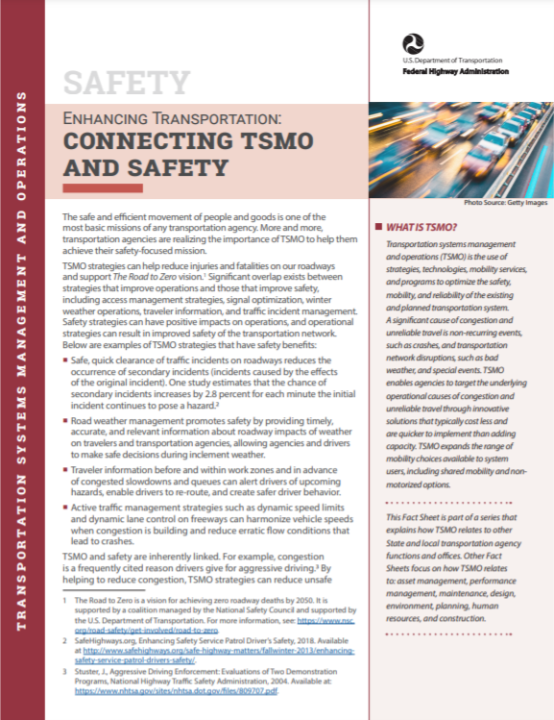
Next Steps
Bring TSMO and safety leaders together to identify areas of common interest and mutual objectives
Find out how TSMO strategies are already supporting safety goals
Discuss where TSMO can make an even greater impact on safety goals
Identify how safety can support TSMO goals
Begin joint efforts to improve the TSMO and safety connection
Learn more with the FHWA TSMO and Safety Factsheet at: https://ops.fhwa.dot.gov/publications/fhwahop18091/fhwahop18091.pdf
Notes:
Note: there are additional resources listed at the end of this presentation, including a fact sheet on connecting TSMO and safety:
https://ops.fhwa.dot.gov/publications/fhwahop18091/fhwahop18091.pdf

Slide 11
Thank you!
For more information, please contact:
[INSERT CONTACT INFORMATION]

Slide 12
End of Executive Summary

Slide 13
Goals of the Presentation
Increase awareness and understanding of transportation systems management and operations (TSMO)
Explore how TSMO and safety can support each other
Provide examples of coordination between TSMO and safety
Discuss opportunities to enhance collaboration between TSMO and safety
Notes:
This presentation is intended to increase the awareness and understanding of TSMO among State DOT personnel working in the safety discipline. It explores how TSMO and safety complement each other in terms of shared goals and activities, and provides examples of how State DOTs have worked together use TSMO strategies to improve safety.

Slide 14
Presentation Overview
What is TSMO?
Connecting TSMO and Safety Overview
Examples of Collaboration Between TSMO and Safety
Overcoming Challenges
Next Steps for Connecting TSMO and Safety
Notes:
Listed here are the sections or content of the presentation.

Slide 15
What Is TSMO?

Slide 16
Definition of TSMO
Integrated [set of] strategies to optimize the performance of existing infrastructure through implementation multimodal and intermodal, cross-jurisdictional systems, services, and projects designed to preserve capacity and improve security, safety, and reliability of the transportation system.*
* Title 23 of the U.S. Code § 101 (a)(30)(A) and FHWA website: https://ops.fhwa.dot.gov/tsmo/
Notes:
Before going further, it is important to define TSMO for new audiences:
TSMO is an integrated set of strategies to optimize the performance of existing infrastructure through the implementation of multimodal and multi-jurisdictional systems, services, and projects designed to preserve capacity and improve security, safety, and reliability of the transportation system.
The goal here is to get the most performance out of the transportation facilities we already have. TSMO is the use of strategies, technologies, mobility services, and programs to optimize the safety, mobility, and reliability of the existing and planned transportation system.

Slide 17
Characteristics of Transportation Systems Management and Operations (TSMO)
Offers an integrated set of strategies to optimize operational performance of the existing transportation system
Approaches performance from a systems perspective:
Spans corridors, facilities, jurisdictions, modes, and agencies
Helps agencies balance supply and demand on the system and provide flexible solutions to manage dynamic conditions
Complements capacity projects, or in some cases can provide lower cost, faster alternatives
Notes:
TSMO is an integrated set of strategies to optimize the operational performance of the existing transportation system.
Note: The definition at the top of the slide is an abridged version of the Federal Highway Administration’s (FHWA) TSMO definition found here: https://ops.fhwa.dot.gov/tsmo and at 23 USC 101 (a) (30).
TSMO approaches performance from a systems perspective.
Spans corridors, facilities, jurisdictions, modes, and agencies
TSMO takes a holistic approach to managing performance that looks beyond a single corridor (e.g., are changes to a specific corridor causing a mobility issue nearby?), jurisdiction (e.g., are management systems coordinated across jurisdictional boundaries?), mode (e.g., are we using all modes optimally to meet our performance goals?), and agency (e.g., how can we improve collaboration with law enforcement or transit agencies to improve performance?).
Helps agencies balance supply and demand on the system and provide flexible solutions to manage dynamic conditions.
Example TSMO strategies include ramp metering, managed lanes, and congestion pricing.
TSMO can complement capacity projects or can provide lower-cost, faster alternatives in some cases.
TSMO seeks to provide lower-cost alternatives to capacity projects when operational strategies may produce equal or better results – or when operational strategies may be able to produce results faster. It does not seek to eliminate capacity projects in cases where a capacity project is the best solution. Rather, TSMO provides agencies with more options.

Slide 18
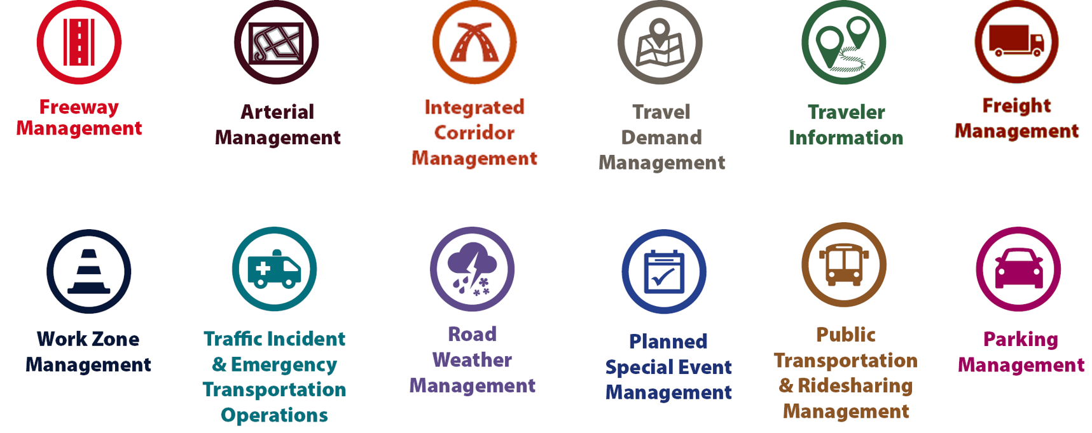
Examples of TSMO Strategies
Source: Federal Highway Administration.
Notes:
This slide illustrates the array of operational strategies that fall under the TSMO umbrella that can be used individually or in combination with each other. This list is not exhaustive, but it highlights the key buckets of strategies that are priorities for many agencies.
Examples of other TSMO strategies include:
Traffic signal coordination
Transit signal priority
Special event management
Congestion pricing
Active transportation and demand management
Connected/automated vehicles
Completing multimodal networks
Intelligent transportation systems (ITS) components can support all these TSMO strategies. ITS covers a variety of technologies to monitor, evaluate, and manage transportation systems to enhance efficiency and safety. It should be noted that TSMO does not equate to ITS; many strategies support TSMO that do not involve an ITS component.
TSMO strategies can be categorized into three overarching areas: incident or event management, traffic management, and demand management strategies. The next three slides highlight strategies in each of these areas.

Slide 19
Incident/Event Management Strategies
Source: Federal Highway Administration.
Notes:
Incident and event management includes several strategies that address major sources of travel-time unreliability.
Incident and event management strategies include road weather management, traffic incident management and emergency transportation operations, work zone management, and planned special event management.
Road weather management activities include creating hazardous weather traffic operations response plans, implementing variable speed limits, detecting hazardous weather conditions, disseminating weather and warnings to travelers through dynamic signs and systems, providing emergency truck and parking facilities and emergency parking information, and implementing vehicle restrictions.
Traffic incident management and emergency transportation operations activities include establishing traffic incident management teams, conducting after action reviews, staging tow trucks in strategic areas, providing roadway safety patrols, integrating computer-aided dispatch into transportation management centers, pre-establishing towing service agreements, co-locating dispatching units, developing quick clearance goals, pre-planning detour routes, implementing shoulder running, deploying adaptive ramp metering, providing variable speed limits, implementing dynamic lane-use controls, deploying network surveillance cameras or detectors, implementing incident traffic signal timing plans, enacting legislation, and integrating traffic management centers with law enforcement dispatch and emergency centers.
Work zone management activities include coordinating maintenance and construction activities, implementing queue length detection, deploying network surveillance cameras or detectors, implementing variable speed limits, supporting dynamic lane merging, implementing dynamic lane-use controls, deploying temporary ramp metering, and implementing dynamic warning systems.
Planned special event management activities include activating special event timing plans, deploying adaptive ramp metering, implementing variable speed limits, using hard shoulder running, activating dynamic transit fare reduction, implementing reversible lanes, supporting dynamic lane-use controls, establishing dynamic pricing, deploying network surveillance cameras or detectors, activating dynamic wayfinding, and conducting after action reviews.
Source: FHWA, Integrating Travel Time Reliability into Transportation System Management: Final Technical Memorandum
https://ops.fhwa.dot.gov/publications/fhwahop19035/index.htm

Slide 20
Traffic Management Strategies
Source: Federal Highway Administration.
Notes:
While incident or event management strategies address atypical events that cause travel-time unreliability, traffic management strategies manage the movement of people and goods during everyday conditions. Even during typical conditions, fluctuations in travel demand can lead to unreliable travel conditions. Traffic management strategies allow the transportation network to adapt to unreliability, including variations in travel demand.
Traffic management strategies include freeway management, active traffic management, integrated corridor management, freight management, and arterial management.
Freeway management activities include implementing traffic surveillance cameras or detectors, using high-occupancy lanes, implementing adaptive ramp metering, deploying hard shoulder running, implementing variable speed limits, deploying dynamic lane-use controls, and constructing physical operations improvements such as overpass widening, curve corrections, or adding auxiliary lanes.
Active traffic management activities include adopting adaptive ramp metering, implementing adaptive traffic signal control, using dynamic lane reversal, implementing dynamic lane-use controls, deploying dynamic merge control, implementing temporary shoulder running, using variable speed limits, deploying queue length detection, providing transit signal priority, and implementing dynamic warning signs.
Integrated corridor management activities include implementing network surveillance cameras or detectors, conducting access management and driveway access controls, implementing adaptive ramp metering, deploying adaptive signal control, deploying transit signal priority, installing queue jumping lanes, providing traveler information for alternative modes, and deploying emergency vehicle preemption.
Freight management activities include implementing roadside truck electronic screening and clearance, implementing truck signal priority, using truck parking management systems, installing truck climbing lanes, and implementing freight loading zone policies.
Arterial management activities include installing queue jumping lanes, deploying transit signal priority, supporting emergency vehicle preemption, implementing network surveillance cameras or detectors, implementing access management and driveway access controls, providing enhanced bicycle and pedestrian crossings, establishing a transportation management center, deploying enhanced traffic signal operations, implementing transit-only lanes, implementing truck traffic signal priority, designing for complete streets, adding capacity for critical movements, reducing travel speeds, providing automated enforcement, and conducting operations asset management.
Source: FHWA, Integrating Travel Time Reliability into Transportation System Management: Final Technical Memorandum
https://ops.fhwa.dot.gov/publications/fhwahop19035/index.htm

Slide 21
Demand Management Strategies
Source: Federal Highway Administration.
Notes:
Demand management strategies reduce underlying demand by helping travelers avoid trips or change the mode, timing, or route of trips. This makes nonrecurring congestion less likely to occur and improves travel-time reliability.
Demand management strategies include congestion pricing, parking management, and public transportation and rideshare management.
Congestion pricing activities include implementing dynamic pricing, variable pricing by lane, segment, and time of day or day of week; establishing dynamic transit fare reductions; and deploying managed lanes for high occupancy.
Parking management activities include deploying dynamically priced parking; implementing dynamic parking, wayfinding, reservations, and capacity; deploying dynamic overflow transit parking; implementing electronic payment systems and shared-use parking; and providing incentives to use underutilized parking facilities.
Public transportation and ridesharing management activities include implementing dynamic ridesharing, implementing transit signal priority, using queue-jump lanes at signalized intersections, deploying electronic fare collection and integration, and implementing dynamic surveillance and security.
Source: FHWA, Integrating Travel Time Reliability into Transportation System Management: Final Technical Memorandum
https://ops.fhwa.dot.gov/publications/fhwahop19035/index.htm

Slide 22
TSMO Is a “Way of Thinking” That Supports State Departments of Transportation (DOTs) Missions
“We provide safe, reliable, and cost-effective transportation options to improve communities and economic vitality for people and businesses.”
Washington State DOT mission, Our Strategic Plan, https://wsdot.wa.gov/about/secretary-transportation/our-strategic-plan
“To provide the best multimodal transportation system for Colorado that most effectively and safely moves people, goods, and information.”
Colorado DOT mission, About CDOT, https://www.codot.gov/about/mission-vision
Notes:
TSMO leverages technology, a toolbox of strategies, and engineering solutions to maximize system performance; however, TSMO ultimately involves a way of thinking or a mindset focused on determining the best way to optimize the mobility and reliability of the existing system with limited resources.
TSMO can be thought of as a way of thinking and operating in order to get the most performance out of the transportation network while only building as much as is needed.
The principles of TSMO directly support the missions of many State DOTs, as these examples show.
NOTES:
States can insert their own mission statement here for effect or can leave these in.
Presenters can emphasize the connections between TSMO definition and their specific Mission statement, such as safety, reliability, cost-effective, multimodal, customer’s needs/satisfaction, etc.

Slide 23
TSMO Supports Many DOT Goals
Reduced congestion
Smoother and more reliable traffic flow
Improved safety
Cleaner air and less wasted fuel
More efficient use of resources and existing facilities
Increased economic vitality
Improved quality of life
Notes:
Here are some common goals in state and local transportation agencies that TSMO strategies support. This list is not exhaustive, but intended to show that TSMO support a range of mission-critical goals. Examples of how TSMO supports these goals are shown on the next slide.

Slide 24
Example TSMO Strategies That Support DOT Goals
TSMO Strategies |  | Goals
Alternate routes, smart work zones, real-time traffic control, work zone traffic incident management (TIM) Traffic signal coordination, congestion pricing, demand management |  | Improved traveler and worker safety Reduced congestion
Traveler information, multimodal coordination, peak-period variable lane use |  | Smoother and more reliable traffic flow
Notes:
TSMO strategies that support some common DOT agency goals are shown here. Many of these strategies support more than one goal, but here are some key examples.

Slide 25
TSMO State of the Practice
Application of TSMO has accelerated in agencies across the country over the past 5–10 years
Recognition of TSMO’s value has grown, leading to a variety of approaches for advancing TSMO in agencies. For example:
Establishing a TSMO division or office
Formalizing a TSMO program
Integrating TSMO throughout the agency
Establishing a TSMO committee
Identifying TSMO champions or liaisons
Conducting a TSMO capability maturity model (CMM) self-assessment
Developing a TSMO program plan
Notes:
TSMO as a more formal discipline has gained momentum in recent years. Recognition of the importance of TSMO has accelerated in the past five to ten years (as of year of publication of this presentation, 2022).
Key focus areas for agencies during this time have been adapting their culture, processes, expertise, and, in some cases, organizational structures to promote TSMO and a more operationally focused mindset. Agencies approach this differently depending on their unique context and needs. Several examples of key strategies agencies have used to advance TSMO within their organizations are shown here.
Central to all of these organizational approaches is 1) strong support from senior leadership, 2) a champion or champions who understand and promote TSMO throughout the agency, and 3) an openness to learning and cooperation among functions or divisions within an agency.
A TSMO capability maturity model self assessment is a framework developed to help agencies evaluate their current capabilities in the area of TSMO and identify steps for improving their TSMO capabilities. The self-assessment can be accessed at: http://aashtotsmoguidance.org/. There are also other capability maturity frameworks that FHWA has developed to support the implementation of TSMO. More can be learned about those frameworks at: https://ops.fhwa.dot.gov/tsmoframeworktool/index.htm.

Slide 26
Resources on TSMO
What is TSMO? (frequently asked questions): https://ops.fhwa.dot.gov/tsmo
Organizing and Planning for Operations web page: https://ops.fhwa.dot.gov/plan4ops
Communicating TSMO web page: https://ops.fhwa.dot.gov/plan4ops/focus_areas/communicating_tsmo.htm
National Operations Center of Excellence (NOCoE) website: https://www.transportationops.org/
Enhancing Transportation: Connecting TSMO and Construction, factsheet: https://ops.fhwa.dot.gov/publications/fhwahop18092
Notes:
While these slides provide a comprehensive, high-level summary of TSMO, participants who are looking for more details and information to share with their staff can visit these virtual resources.

Slide 27
Connecting TSMO and Safety Overview

Slide 28
Common Safety Program Elements
State DOT safety program activities under the “four E's” of highway safety:
Engineering
Education
Enforcement
Emergency medical services
Areas of interest:
Strategic Highway Safety Plan (SHSP)
Highway Safety Improvement Program
Vision Zero (or similar initiative)
Safe System Approach
Roadway and crash data and analysis
Safety countermeasures and crash modification factors
Road user behavioral safety
Notes:
This is a list of common safety program elements. It provides a general context for what we are talking about when we use the term safety in this presentation.
Safety refers to programs and activities falling under the “four E’s” of highway safety: engineering, education, enforcement, and emergency medical services.
Examples include: the Strategic Highway Safety Plan, Highway Safety Improvement Program, Vision Zero (or similar initiatives), Safe System Approach, roadway and crash data and analysis, safety countermeasures and crash modification factors, and road user behavioral safety.
Is there anything else to consider when discussing safety?

Slide 29
TSMO Can Support Safety Goals
Work zone safety
Intersection safety
Primary and secondary crash prevention
Traveler information and outreach
Speed management
Multimodal safety
Safety in adverse weather
Data-driven decisions
Save Lives!
Notes:
TSMO strategies can directly support many of the goals and activities of safety programs in a variety of contexts, such as:
Work zone safety, which includes the safety of construction workers and the traveling public as they traverse a construction area. Some TSMO strategy examples that can improve safety in work zones include:
Dynamic lane merge systems – In such systems, large, changeable message signs provide messages based on the conditions of highway traffic flow as to whether to merge early into one lane or to stay in two lanes and conduct a zipper merge (i.e., when motorists use both lanes of traffic until reaching the defined merge area, and then alternating turns in a "zipper" fashion into the open lane.).
Alert systems for workers – If a vehicle encroaches into the work area, the system alerts all workers using a horn and/or on-person alarms so they are aware of the potential danger.
Intersection safety – Different intersection and interchange designs offer various operational and safety benefits depending on the location and traffic patterns. Alternatives should be evaluated to determine the best options for improving safety, reducing congestion, multimodal enhancement, etc. Operations data can be used to help inform decisions, relating to optimal type of traffic control, turn lanes, turning movement restrictions, etc.
The intersection conflict warning system is an ITS solution that can help reduce crashes at intersections. The system warns drivers on the through road of the presence of traffic at stop-controlled cross streets, and warns drivers at stop-controlled approaches of the presence of traffic on the through lanes. The systems are often used where there are sight distance issues and realignment or relocation of a side street is not feasible. This strategy is a cost-effective solution that improves safety.
Primary and secondary crash reduction, especially serious injury and fatal crashes
Traffic incident management, a TSMO strategy, provides safe, quick clearance of crashes or incidents to prevent secondary crashes
Signal optimization and coordination along a corridor can reduce crash rates, especially rear-end collisions
Traffic management center (TMC) staff can monitor weather, congestion, incidents, crashes, and other potential safety issues and make real-time decisions to address the conditions being observed.
Ensuring all road users are safe—pedestrians, bicyclists, transit riders, and drivers. For example, signal timing strategies can improve safety for pedestrians, such as leading pedestrian intervals that help reduce conflicts between pedestrians and vehicles. Pedestrian hybrid beacons, another proven safety countermeasure, are a traffic-control device designed to help pedestrians safely cross busy or higher-speed roadways at midblock crossings and uncontrolled intersections. Designating transit lanes and bicycle lanes in selected areas to meet the needs of the users/community can improve both mobility and safety.
Safety of travelers during adverse weather; reduction of weather-related crashes – Road weather management promotes safety by providing timely, accurate, and relevant information about roadway impacts of weather on travelers and transportation agencies, allowing agencies and drivers to make safe decisions during inclement weather. In addition, adaptive signal timing can be used during weather events to accommodate slower speeds and longer stopping distances due to slick pavement and/or visibility issues.
Providing traveler safety information and traffic safety outreach (through the use of TMCs and/or dynamic message signs; e.g., “incident ahead” messages, safety statistic/campaign messages).
Speed management and promoting safe speeds for conditions – Active traffic management strategies such as variable speed limits and dynamic lane control on freeways can harmonize vehicle speeds when congestion is building and reduce erratic flow conditions that lead to crashes.
Using data to help inform project investments and decisions – Data collected and provided by TSMO strategies can help safety professionals assess real-time conditions and safety of a corridor, gaining more insight than historical crash data.

Slide 30
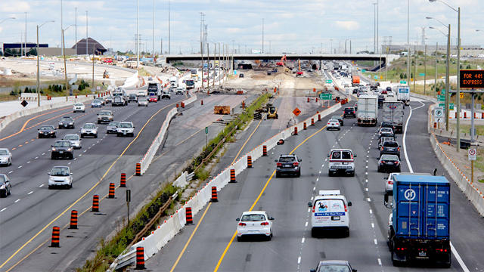
TSMO Can Support Safety in Work Zones
Queue detection and warning
Dynamic lane merge systems
Variable speed limits
TIM
Real-time traveler information
Automated speed enforcement
Alert systems for workers
Source: Unknown author licensed under CC BY-NC-ND.
Notes:
There is a broad range of TSMO technologies aimed at enhancing work zone safety and mobility. This slide covers several TSMO applications for work zones, but they are also used outside of work zones to enhance safety.
Here are some examples of TSMO applications that can enhance safety in and through a work zone area:
Queue detection and warning – Queue detection technology can be used to alert drivers to traffic conditions (e.g., stopped traffic, slowing traffic) ahead using automated work zone monitoring. It can reduce the number and severity of rear-end crashes and eliminates driver surprise at stopped or slowing traffic.
Dynamic lane merge systems – In this system, large, changeable message signs provide messages based on the conditions of highway traffic flow on whether to merge early into one lane or to stay in two lanes and do a zipper merge.
Variable speed limits – These systems enable speed limits to be changed dynamically in response to traffic conditions.
Traffic incident management (TIM) – Managing incidents is important in work zones. If an incident restricts traffic, it can result in major congestion and delays and increase the risk of secondary crashes.
Real-time traveler information – Agencies can provide traveler information using message boards on the roadway, or online through websites and apps.
Automated speed enforcement – These systems enforce reduced speeds using photo and video cameras to identify violators. The infraction is verified by a law enforcement officer, and the system sends a citation in the mail to the vehicle owner.
Alert systems for workers – If a vehicle encroaches into the work area, the system alerts all workers using a horn and/or on-person alarms so they are aware of the potential danger.
Photo by unknown author is licensed under CC BY-NC-ND

Slide 31
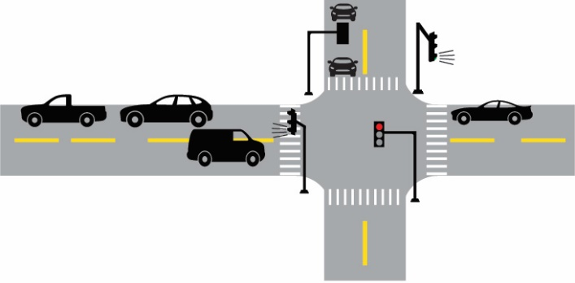
Intersection Safety
Signal optimization and coordination:
Crash rates on intersection approaches decreased by 6.7% after signal coordination.
Studies have found a decrease in crashes from adaptive traffic signal control.
Signal timing strategies for pedestrians:
Leading pedestrian intervals are designated by FHWA as a Proven Safety Countermeasure.
Source: FHWA
Notes:
TSMO supports intersection safety.
Signal optimization and coordination along a corridor can reduce crash rates, especially rear-end collisions:
An Arizona study on the effectiveness of traffic signal coordination concluded that crash rates on intersection approaches decreased 6.7 percent after signal coordination. (Source: Federal Highway Administration. 2008. Signalized Intersection Safety Strategies. Available at: https://safety.fhwa.dot.gov/intersection/ other_topics/fhwasa08008/sa4_Signal_Coordination.pdf.)
Studies have found a decrease in crashes from adaptive traffic signal control
One example - A study of the safety performance effects of adaptive traffic signal control at 47 urban and suburban intersections in Virginia found a statistically significant decrease of 17% in total crashes. (Ma, J., Fontaine, M. D., Zhou, F., Hale, D. K., & Clements, M.O. (2014). Estimation of the Safety Effects of an Adaptive Traffic Signal Control System. Prepared for the Transportation Research Board 94th Annual Meeting.)
Signal timing strategies can improve safety for pedestrians, such as leading pedestrian intervals, which help reduce conflicts between pedestrians and vehicles.
Leading pedestrian intervals are a proven safety countermeasure and have been shown to provide a 13-percent reduction in pedestrian-vehicle crashes at intersections (Source: https://safety.fhwa.dot.gov/provencountermeasures/pdfs/fhwasa17063v2.pdf.).
Image Source: Federal Highway Administration. Transportation Operations Strategies for Safety – Draft Brochure, FHWA-HOP-22-017.

Slide 32
TSMO Can Help Prevent Secondary Crashes through Traffic Incident Management (TIM)
Chance of a secondary incident increases by 2.8% each minute the initial incident continues to pose a hazard
TIM strategies support safe, quick clearance through:
Service patrols, motorist assist, or highway helper programs
Traffic management center monitoring and disseminating traveler information
Traveler alerts to slowdowns and crashes on dynamic message signs
Notes:
TIM provides safe, quick clearance of crashes or incidents to prevent secondary crashes:
One study estimates the chance of secondary incidents increases by 2.8 percent for each minute the initial incident continues to pose a hazard (Source: SafeHighways.org. 2018. Enhancing Safety Service Patrol Driver’s Safety. 2018. Available at: http://www.safehighways.org/safe-highway-matters/fallwinter-2013/enhancingsafety-service-patrol-drivers-safety/)
Related to traffic incident management, service patrols, motorist assists, or highway helper programs (States may name them differently) provide incident response and free assistance to stranded motorists on the roadways
Traffic management center (TMC) staff can monitor weather, congestion, incidents, crashes, and other potential safety issues and make real-time decisions to address the conditions being observed.
Dynamic message signs can be used to notify travelers of slowdowns and crashes.

Slide 33
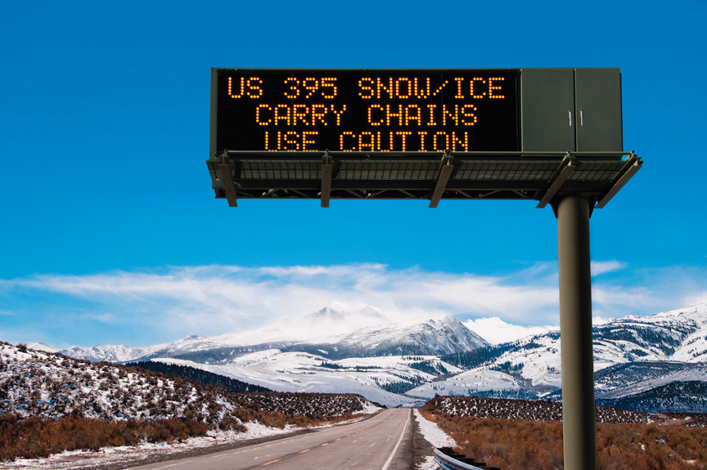
TSMO Can Provide Traveler Safety Information and Outreach
Dynamic message signs relay important safety information to travelers:
Notification of slowdowns, queues, or a crash ahead
Work zone lane closures ahead
Road surface conditions
Source: Getty Images.
Notes:
Dynamic message signs can be used to relay important safety information to travelers, such as notification of slow-downs, queues, or a crash ahead. They can also be used to alert travelers to work zone lane closures or hazardous road conditions.
Image source—Getty Images

Slide 34
TSMO Can Support Speed Management
Active traffic management
Variable speed limits
Dynamic lane control
Queue detection and notification
Source: Nick Fewings on Unsplash.
Notes:
Active traffic management strategies such as variable speed limits and dynamic lane control on freeways can harmonize vehicle speeds when congestion is building and reduce erratic flow conditions that lead to crashes.
Queue detection technology can be used to alert drivers to traffic conditions (e.g., stopped traffic, slowing traffic) ahead using automated work zone monitoring. It can reduce the number and severity of rear-end crashes and eliminates driver surprise at stopped or slowing traffic.
Photo: https://unsplash.com/photos/TyL24M6DpMg

Slide 35
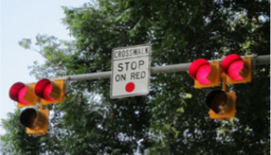
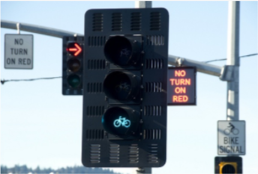
TSMO Can Support Safety for All Users and All Modes of Travel
Emergency vehicle preemption at traffic signals
Pedestrian hybrid beacon
Designated lanes or signal phases for transit or bicycles
Managed lanes
Source: Federal Highway Administration.
Source: Flickr – Oregon Department of Transportation.
Notes:
TSMO can support safety for all users and all modes of travel:
Emergency vehicle preemption at traffic signals can help reduce collisions by providing a green light for emergency vehicles and a red light for other drivers.
Pedestrian hybrid beacons, another proven safety countermeasure, are a traffic-control device designed to help pedestrians safely cross busy or higher speed roadways at midblock crossings and uncontrolled intersections.
Designating transit lanes and bicycle lanes or signal phases in selected areas to meet the needs of the community can improve both mobility and safety.
Agencies can implement managed lanes to keep motorists safety and efficiently moving.
Photo sources:
https://safety.fhwa.dot.gov/provencountermeasures/pdfs/fhwasa17063v2.pdf
https://flic.kr/p/9kLp4t

Slide 36
TSMO Can Support Safety During Adverse Weather
Road weather management supports safety by:
Providing timely, accurate, and relevant information about road weather conditions
Applying effective treatments on roadways during weather events to ensure safety
Initiating adaptive signal timing during weather events
Actuating variable speed limits during adverse weather
Notes:
Road weather management promotes safety by providing timely, accurate, and relevant information about the roadway impacts of weather on travelers and transportation agencies, allowing agencies and drivers to make safe decisions during inclement weather.
Road weather management also involves identifying and applying the effective treatment or strategy for roadways during weather events to ensure safety.
Adaptive signal timing can be used during weather events to accommodate slower speeds and longer stopping distances due to slick pavement and/or visibility issues.
Similar to adaptive signal timing, variable speed limits can be used to slow speeds during adverse weather conditions.

Slide 37
TSMO Can Support Safety With Data-Driven Decisions (1/2)
Availability of data has expanded, and many sources can be used to inform both safety and TSMO decisions. Examples below:
Crash data Annual average daily traffic Assets Demographics Intersection traffic counts Speed | Traffic volume Weather data Traffic incidents Cameras Emergency management Private data companies | Ramp monitoring Truck parking systems Wrong-way driver systems Variable speed limits Signal controllers Connected and automated vehicles
Notes:
The availability of TSMO and safety data, as well as the development of advanced integration and analysis tools, has greatly expanded in recent years. Listed here are examples of datasets from both the public and private sectors that can be used to inform safety and TSMO decisions.

Slide 38
TSMO Can Support Safety With Data-Driven Decisions (2/2)
Data collected as a result of enacting TSMO strategies can help staff assess real-time conditions and safety.
Imagery from traffic cameras and video feeds may help identify crash patterns and support near-miss analyses.
Speed data can help assess potential speeding-related crash issues.
Incident data can be correlated with crash data to understand secondary crash locations.
Vehicle mix data can be used to inform freight safety strategies or intersection designs.
Combinations of data can be used for strategic decisions and project prioritization.
Data can provide additional insights into safety performance.
Notes:
Data collected as a result of enacting TSMO strategies can help safety professionals assess real-time conditions and safety of a corridor, gaining more insight than historical crash data.
Data from ITS devices like cameras or video feeds monitoring highways can be used to identify crash patterns and conduct near-miss analyses.
Speed data from devices or private companies can help inform where there may be speeding-related crash issues.
Incident data correlated with crash data to better understand secondary crash locations.
Vehicle mix data can be used to inform freight safety strategies or intersection designs.
A combination of data can be used for strategic decisions, such as project prioritization and projects under design.
Data from various resources can be used to create dashboards to track and assess safety and operations performance.

Slide 39
Areas for Collaboration Between TSMO and Safety
TSMO and safety often go hand in hand and are cross-cutting areas. Activities where TSMO and safety teams can work together include:
Analyzing transportation-related issues and developing solutions
Sharing operations data to identify crash risks
Participating on review teams for projects in planning and design stages
Preparing transportation management plans for work zones
Developing an effective TIM program
Implementing a speed management program
Ensuring an effective signal timing and coordination program
Disseminating traveler information
Funding projects
Any other areas?
Notes:
TSMO and safety professionals may collaborate in a variety of activities. TSMO and safety often go hand-in-hand and are cross-cutting areas. Actions that improve safety (e.g., reduce crashes) can improve mobility by reducing non-recurring congestion due to incidents. Strategies that improve mobility may also improve safety, such as those that smooth traffic flow.
Listed here are some examples of where TSMO and safety can work together:
Analyzing transportation-related issues and developing solutions—many agencies overlay crashes and congestion data to determine priority projects.
Sharing operations data to identify crash risks—camera feeds and congestion data are examples of data sources that can inform where there may be crash risks.
Participating on review teams for projects in planning and design stages—collaborating during project planning and development can help ensure a balance is achieved for safety and mobility.
Preparing transportation management plans for work zones—both safety and mobility are important in work zones and directly affect each other.
Developing an effective TIM program—TIM can reduce secondary crashes and improve mobility.
Implementing a speed management program—operations and safety staff both benefit if an effective speed management program is implemented.
Ensuring an effective signal timing and coordination program can reduce congestion and crashes.
Disseminating traveler information helps ensure road users are informed of delays and any safety issues.
Funding projects—safety and TSMO staff can collaborate to fund projects that benefit both safety and operations.
There are many more opportunities for TSMO and safety staff to collaborate.
(Ask participants if they agree with the examples provided and if they have any other high-level examples of how TSMO and safety professionals could collaborate?)

Slide 40
Integrating TSMO in Safety
Formally include TSMO strategies in the Strategic Highway Safety Plan (SHSP).
Include TSMO staff in workshops, meetings, or task forces to share benefits and opportunities of TSMO.
Offer TSMO training or webinars to safety staff.
Look for opportunities to use TSMO strategies to help identify and address safety issues.
Conduct safety performance research of TSMO strategies.
Notes:
There are several ways to integrate TSMO into safety activities. Common TSMO strategies that may be appropriate for inclusion into Strategic Highway Safety Plans (SHSP) include:
Improved signal controls to reduce intersection crashes
Use of roundabouts or reduced left turn conflict intersections to significantly reduce the severity and frequency of intersection crashes
Improvements in work zone protection and traffic management
Better coordination and response in TIM
Improvements in access management
Road weather information systems
Use of dynamic message signs to provide more timely and accurate traveler information regarding weather and incidents.
Looking for opportunities to include TSMO and safety staff in each others' workshops, meetings, or task forces is a good strategy for better integration and awareness.
Offer TSMO-related training or webinars to safety staff and try to “think outside the box” using TSMO strategies to help identify/address a safety issue.
NOTE: This would be a good place for interactive discussion on other ideas for integrating TSMO in safety.

Slide 41
Integrating Safety in TSMO
Include safety goals, objectives, and performance measures in operations-focused plans such as TSMO program plans or the congestion management process.
Use crash data to identify potential locations for TSMO strategies to improve both safety and operations.
Incorporate safety performance measures in evaluating TSMO strategy benefits.
Invite safety staff to TSMO committees, task forces, and working groups and add safety-related items to the agenda.
Notes:
Just as TSMO can be integrated into safety activities, safety can be integrated into TSMO program activities. This slide contains several ideas for how TSMO can meaningfully incorporate safety into its program.
Agencies can:
Include safety goals, objectives, and performance measures in their TSMO program plans, ITS strategic plans, congestion management processes, and other operations-oriented plans and processes to formally link safety to TSMO.
Use crash data to identify safety hotspots and overlay them with congestion hotspots. This can help prioritize locations for TSMO strategies that help improve both safety and operations.
Incorporate safety performance measures into evaluations of TSMO strategy benefits for a more complete evaluation.
Invite staff who work in safety to participate in TSMO committees, task forces, and working groups. Include agenda items that focus on the connections between safety and operations.

Slide 42
Examples of Collaboration Between TSMO and Safety

Slide 43
Arizona DOT – Working Together
The Safety Group is within Arizona DOT TSMO Division.
Enables a more comprehensive view of mobility and safety problems
Uses data and resources from both disciplines
Helps advance projects faster through greater coordination and funding options
The Traffic Management unit manages an Incident Response Unit and a weather response program, which jointly improve mobility and safety during incidents and weather events.
All TSMO projects are planned and designed with safety considerations as a top priority.
Notes:
Arizona DOT not only has a high-level TSMO division, but also a safety group within the TSMO division. In this way, Arizona DOT has already deeply recognized the connection between operations and safety and has organizationally integrated and coordinated them. Arizona DOT established a TSMO division in 2015, and its safety functions are within the TSMO division.
Arizona DOT’s TSMO division is able to take a more comprehensive view of mobility and safety problems, pulling on data and resources from both disciplines to more effectively and efficiently improve performance. It is also able to advance projects faster due to greater coordination and a larger number of funding options.
Arizona DOT’s Incident Response Unit patrols hot spots identified by the data. The unit works collaboratively with the Arizona Department of Public Safety and the Traffic Operations Center (TOC).
The Planning to Programming (P2P) process is ADOT’s step between identifying projects in a planning study and getting projects into a 5-year plan for approval. The TSMO Division has safety as a top criteria for ranking projects in the P2P process. All ADOT TSMO projects are designed with safety considerations as a top priority.

Slide 44
Arizona DOT – Operations and Safety Data
Overlays operations and safety data “to paint a more complete picture”
Helps understand incidents in congested areas
Identifies priority segments by overlaying high-congestion locations (bottlenecks) with high-crash locations
Source: Eric Weber on Unsplash.
Notes:
By overlaying operation and safety data, Arizona DOT is painting a more complete picture.
Arizona DOT’s Operational Traffic & Safety group collects the crash data for the whole State. The group also uses a lot of operational data, such as traffic volumes, lane-to-lane volumes, speed, incident data, and construction data.
For example, Arizona DOT uses operational data to complement safety data to help understand incidents in congested areas like Phoenix. Lane volumes and traffic flow can help understand hot spots for sideswipes, ramp back-ups, etc.
And, vice versa, Arizona DOT also uses safety data to complement operations data. For example, by overlaying high congestion locations (bottlenecks) with high crash locations, it helps to identify priority areas for safety assessments.
Photo: https://unsplash.com/photos/GAVSpEx6ooc

Slide 45
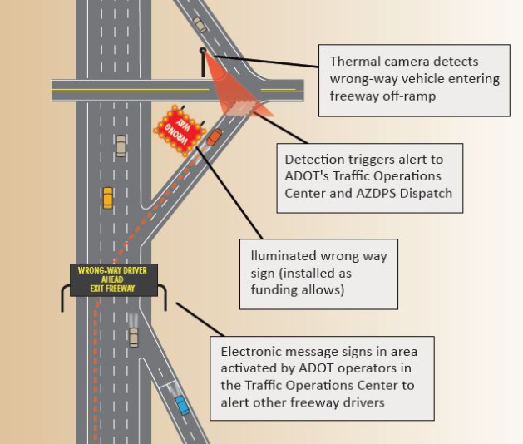
Strategies Improving Safety and Operations in Arizona (1/2)
Adaptive ramp meters
Dust-detection system and variable speed limits
Wrong-way driver system
Incident Response Unit
“Wrong-way detection system wins a 2019 National Roadway Safety Award”
Source: Arizona Department of Transportation.
Note: ADOT = Arizona Department of Transportation; AZDPS = Arizona Department of Public Safety
Notes:
Highlighted here are some examples of TSMO strategies that Arizona DOT is implementing that are improving both safety and operations.
Adaptive ramp meters leverage data to adapt ramp-meter timing to improve overall operations and safety.
The I-10 dust detection system includes dust probes, loop detectors, and a weather radar system; all are tied into a program at the TOC. Arizona DOT then uses the data from these sensors to operate variable speed limit signs and automatically populate messages on the dynamic message signs.
A notable accomplishment is the wrong-way driver system. Arizona DOT began operating the Interstate 17 alert system in January 2018. Thermal cameras were installed to detect wrong way-vehicles and immediately alert ADOT and the Arizona Department of Public Safety. This enables troopers to respond faster than waiting for 911 calls; it also enables TOC operators to quickly post warning messages for other drivers with the push of a button.
ADOT’s TSMO Division contains an Incident Response Unit, which assists with safe and efficient clearance of incidents. The fourteen-member unit patrols are ready to assist State troopers and the public from 5 a.m. to 8 p.m. weekdays.
The patrols respond to crashes, disabled vehicles, and debris, and support road closures. The Incident Response Unit improves both traffic flow and safety by faster incident response times, debris removal, and other activities.
https://azdot.gov/tags/wrong-way-vehicle-system
https://azdot.gov/adot-blog/big-step-forward-adots-wrong-way-detection-and-warning-system
https://azdot.gov/adot-blog/wrong-way-detection-system-receives-national-award
Graphic source: https://azdot.gov/sites/default/files/WrongWaySystemLayout-Urban.JPG

Slide 46
Strategies Improving Safety and Operations in Arizona (2/2)
Sign redesign and lane restriping to improve interchange operations and safety:
Backups eliminated
Reduced speed differentials across lanes
Approximately 70% reduction in crashes overall
Learn more at: https://transportationops.org/case-studies/us-60-and-i-10-interchange-transformation-using-tsmo-signage-and-restripe-capabilities
Notes:
The ADOT TSMO Division took a unique approach to identifying, documenting, engineering, and implementing a lane assignment sign redesign and lane restriping project to greatly improve the system operations and safety of this major interchange.
The effects of the redesign were seen immediately. On the first day using Traffic Operations Center cameras, TSMO staff confirmed that there were no longer backups in the original eastbound I-10 exit ramp lane during peak afternoon hours and that traffic speeds were similar across all lanes. Public feedback was positive, and drivers commented on social media that congestion and crashes were reduced.
Preliminary data comparing the 2 months prior with the 2 months after project completion indicate an approximately 70-percent reduction in crashes overall and an 87-percent reduction in crashes during peak afternoon weekday hours on westbound US-60.

Slide 47
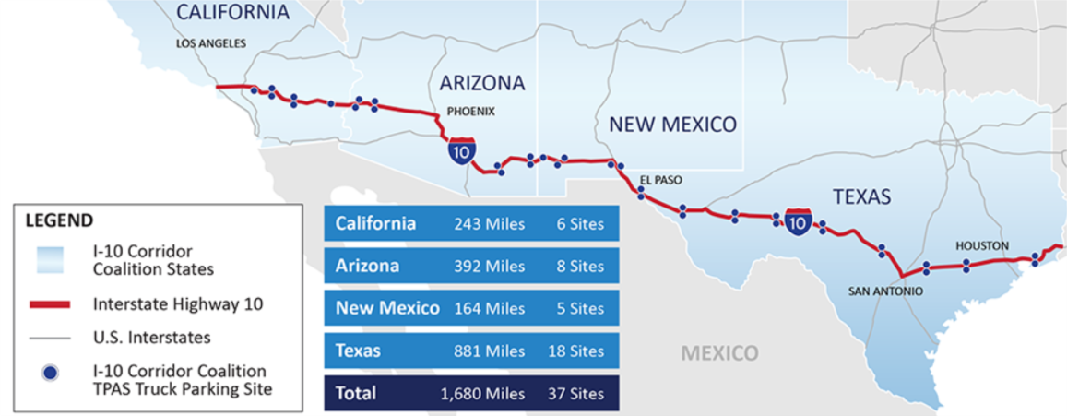
Interstate 10 Corridor Coalition Truck Parking Availability System
Real-time truck parking availability information; roadside dynamic message signs, smartphone and in-cab applications, and websites
Expected to improve safety, efficiency, and mobility and reduce emissions
2023 completion
California 243 Miles 6 Sites
Arizona 392 Miles 8 Sites
New Mexico 164 Miles 5 Sites
Texas 881 Miles 18 Sites
Total 1,680 Miles 37 Sites
Source: I-10 Connects.
Notes:
The I-10 truck parking availability system detects, monitors, and provides real-time truck parking availability information to truck drivers and dispatchers. Parking availability information is conveyed through roadside dynamic message signs, smartphone and in-cab applications, and traveler information websites. Truck drivers and dispatchers can make informed parking decisions, which is expected to improve safety, efficiency, and mobility. It will also reduce emissions along the I-10 corridor. Once fully deployed, it will extend over California, Arizona, New Mexico, and Texas.
https://i10connects.com/overview-tpas
Graphic – https://i10connects.com/sites/default/files/Corridor-Map-Frame-2.png

Slide 48
Florida DOT’s (FDOT’s) Perspective
Strategic message of “Vital Few” priorities:
Improving safety
Enhancing mobility
Inspiring innovation
Fostering talent
All programs and activities are focused on these elements
“We see safety and mobility as directly linked.”
“We do not think they are independent of each other.”
— FHWA interview with FDOT
Notes:
Strong leadership in Florida DOT has led to collaboration among safety, TSMO, and other areas within the department. The strategic message is clear with “Vital Few” priorities, which is documented along with Florida DOT’s mission, vision, and values.
Florida DOT’s TSMO and safety groups are working together in many different efforts. The level of collaboration is very high. For example:
They openly share data to help advance each other’s goals
They work together and coordinate during project development and design stages
TSMO strategies are used to enhance the safety and operations of facilities
They actively seek innovative ways to enhance safety and mobility
Source: https://www.fdot.gov/info/moredot/mvv.shtm

Slide 49
Innovative Research and Tools in Florida (1/2)
Geographic Information System (GIS), such as Florida GIS portal and Central Florida GIS, allows for:
Locations of assets
Overlapping congestion and crash issues
ATTAIN program, including PedSafe, Greenway, SmartCommunity, and SunStore:
PedSafe—ped/bike collision avoidance system using connected vehicle technology
Greenway—technologies that reduce congestion and increase mobility
SmartCommunity—technologies that connect people to places and services
SunStore—data storage initiative
Learn more at https://cflsmartroads.com/projects/ATTAIN-CFL.html
Notes:
Florida DOT and its partners are using a variety of data—in addition to developing innovative tools that bring data together—to help enhance mobility and safety. Florida DOT has invested in developing a robust infrastructure for collecting, maintaining, and analyzing safety and TSMO datasets. The agency has also developed analytical tools that leverage both just-in-time and traditional datasets and uses predictive analysis for network screening. In addition, Florida DOT appears to be at the forefront of integrating TSMO and safety data from connected and autonomous vehicle (CAV) technologies.
Florida DOT is data-driven in its decisions and reports that it is developing a shared data integration space. Some current data platforms in Florida include District 5 SunStore, Florida GIS portal, and Central Florida GIS. Florida DOT uses GIS frequently, from pinpointing the locations of pedestrian hybrid beacons and school zones to identifying sites where congestion and crash issues are overlapping. TSMO data (such as speed) are used to assist in law enforcement safety efforts. Florida DOT’s research goals are to use data to understand where and why the crashes are happening and then identify and map potential countermeasures. Florida DOT believes safety and mobility are directly linked and are not independent of each other.
ATTAIN is a partnership with Florida DOT District 5, MetroPlan Orlando, University of Central Florida (UCF), and local agencies. It provides several programs where safety and TSMO connect, including PedSafe, Greenways, SmartCommunities, and SunStore. The ATTAIN program will deploy smart transportation technologies on roads nearby and inside the main campus of the University of Central Florida (UCF) in Orlando and in other locations throughout Central Florida.
PedSafe – innovative pedestrian and bicycle collision-avoidance system that uses connected vehicle technologies to reduce the occurrence of vehicular collisions with pedestrians and bicycles at high-crash locations
GreenWay – will deploy several advanced traffic management technologies aimed at reducing congestion and increasing mobility throughout the region
SmartCommunity – focuses on new technologies that connect people with places they want to go and services they need
SunStore – stores multiple data sources from the region's transportation systems management and operations to be made available for research purposes

Slide 50
Innovative Research and Tools in Florida (2/2)
Real-time crash risk visualization tool:
Identifies potential safety problems
Evaluates proactive traffic management strategies
TSMO strategic assessment tool:
Quantifies mobility and safety benefits of select TSMO strategies
Ramp metering systems, dynamic message signs, Road Rangers, express lanes, transit signal priority, and adaptive signal control technology
Vehicle-to-everything data platform:
Will use connected and automated vehicle data to make real-time predictive decisions
Notes:
Real-Time Crash Risk Visualization Tools for Traffic Safety Management provides crash-risk visualizations in real-time using integrated tools for traffic safety evaluation and management. Focused on highway safety, the tool will integrate real-time and static data, providing predictive analytics and diagnosing traffic-safety conditions. Users will be able to identify potential road safety problems including potential severe crashes in real-time and evaluate real-time, proactive traffic management strategies to make data-informed intervention decisions.
Source: USDOT, Solving for Safety website, https://www.transportation.gov/solve4safety/university-central-florida
The TSMO Strategic Assessment Tool research focused on quantifying the mobility and safety benefits of the following TSM&O strategies: ramp metering systems, dynamic message signs, Road Rangers, express lanes, transit signal priority, and adaptive signal control technology. The operational performance of the strategies was evaluated using mobility performance measures such as travel time, travel time reliability, average speed adjustment, incident clearance duration, etc. Safety benefits were evaluated using the crash occurrence risk, secondary crash occurrence risk, and crash frequency as the performance measures. The resources from this research will enable FDOT and local agencies to prioritize TSM&O strategies using quantifiable safety and mobility metrics.
(Source: Developing Florida-specific Mobility Enhancement Factors and Crash Modification Factors for TSM&O Strategies, https://fdotwww.blob.core.windows.net/sitefinity/docs/default-source/research/reports/fdot-bdv29-977-46-rpt.pdf)
Vehicle-to-Everything Data Platform is intended to encompass the FDOT’s operational, in development, and planned Connected and Automated Vehicle (CAV) project corridors. The system includes taking CAV data to make real-time and predictive decisions and assist stakeholders in the auto industry, research, traffic engineering, safety, and in other areas. The system will enable FDOT to disseminate real-time CAV information to automobile original equipment manufacturers.
(Source: https://www.fdot.gov/traffic/its/projects-deploy/cv/maplocations/vehicle-to-everything)

Slide 51
FDOT’s Ongoing Efforts
Dashboards:
Tracking safety performance and implementation of ongoing initiatives
Cybersecurity:
Statewide security credential management system and project enrollment
District and project cybersecurity risk assessment
Research project with University of West Florida
Florida’s Regional Advanced Mobility Elements (FRAME) Projects:
Multiregional, multimodal projects that utilize integrated corridor management—I–75 (Gainesville and Ocala), I–4, and U.S. 41
Notes:
Some additional Florida DOT ongoing effort include the development of GIS dashboards that track safety performance and countermeasure performance, cybersecurity, and development of Florida’s Regional Advanced Mobility Elements (FRAME) projects across the state.
Dashboards:
Curve Safety Countermeasure- This dashboard presents implementation status of signing countermeasures at both curves and ramps.
CAV- This dashboard provides a comprehensive view of the CAV initiatives in the state, including both the project corridors and the location of RSUs.
Railroad Crossing Safety- This dashboard provides Railroad Dynamic Envelope (RDE) deployment status and performance of RDE markings at representative crossings.
Smart Work Zone- This dashboard provides status of the project, technologies deployed, and types of Smart Work Zones (SWZ) applications.
Statewide arterial management-This dashboard displays the arterial management-related priority corridors in the state.
Traffic Signal Data User Agreements- This dashboard provides implementation status of vendor data user agreements with local maintaining agencies
Wrong-way Driving Safety Countermeasures- This dashboard provides data on freeway and arterial WWD crashes and countermeasure implementation progress on the State Highway System.”
Cybersecurity:
FDOT has implemented SCMS at its operational CAV projects, i.e., RSUs and OBUs. More details on this can be found here: https://www.fdot.gov/traffic/its/projects-deploy/cv/maplocations/scms
FDOT has developed cybersecurity-focused standard operating guidelines for its Regional Transportation Management Centers
FDOT is going conduct more cybersecurity vulnerability assessments for its CAV projects
FDOT has funded a research project to enhance and enable the continuous improvement of cybersecurity in Florida’s transportation system through security metrics, intelligent analytics, and threat intelligence.
Florida’s Regional Advanced Mobility Elements (FRAME) Projects:
FRAME projects deploy emerging technologies to better manage, operate, and maintain the multi-modal transportation system and create Regional Integrated Corridor Management System (R-ICMS) solutions.
R-ICMS manage its freeways and arterial roadways as one system.
The purpose of R-ICMS is to provide a safer transportation system that ensures the mobility of people
and goods, enhances economic prosperity, and provides real-time traveler information and system reliability.
Through R-ICMS, FDOT can coordinate with individual networks and facilities to create an interconnected transportation system.
Using data collected from both freeways and arterials, R-ICMS allows FDOT to make operational decisions that benefit the entire transportation system while keeping it safe, efficient, and reliable.

Slide 52
Iowa DOT Multidisciplinary Safety Team (MDST)
Coordinated effort among Iowa Local Technical Assistance Program, Iowa DOT, and Iowa Governor’s Traffic Safety Bureau
Wide range of local and State safety participants from various backgrounds
Safety topics, problems, projects, and improvements
MDST Toolbox—includes safety resources, TIM committee and training information, and more
Learn more at: https://www.iowatim.org/
Notes:
Iowa’s Statewide Multidisciplinary Safety Team (MDST) Program is a coordinated effort between the Iowa Local Technical Assistance Program, Iowa Department of Transportation, and the Governor’s Traffic Safety Bureau. This joint effort helps facilitate the development and operation of local multidisciplinary safety teams to help identify and resolve the causes of local crashes and enhance crash-response practices. These teams include local and State safety participants from various backgrounds. These professionals meet on a regular basis to discuss safety topics, problems, projects, and improvements along local roadways within regional areas of Iowa.
The MDST Toolbox website gives stakeholders access to existing MDST groups, the statewide TIM committee, the TIM responder training program, multi-agency collaboration, statewide traffic safety programs, speaker/presentation requests, a calendar of upcoming meetings, and additional online resources.
The teams help build relationships and facilitate communication on upcoming/ongoing projects. Stakeholders discuss any issues/problems, work zones, and alternate routes for traffic incident management (TIM). It's where operations and safety meet. All the E’s (engineering, enforcement, emergency response, education) typically attend. The leaders vary: county engineers, enforcement, county emergency manager, for example. Representatives that may attend are: county sheriffs, motor vehicle enforcements, emergency managers, railroad, etc. Occasionally public health or local county health/health field representative attends.
https://iowaltap.iastate.edu/mdst/#:~:text=Iowa's%20Statewide%20Multidisciplinary%20Safety%20Team,Iowa%20Governor's%20Traffic%20Safety%20Bureau
https://sites.google.com/view/iowaltapmdst/mdst

Slide 53
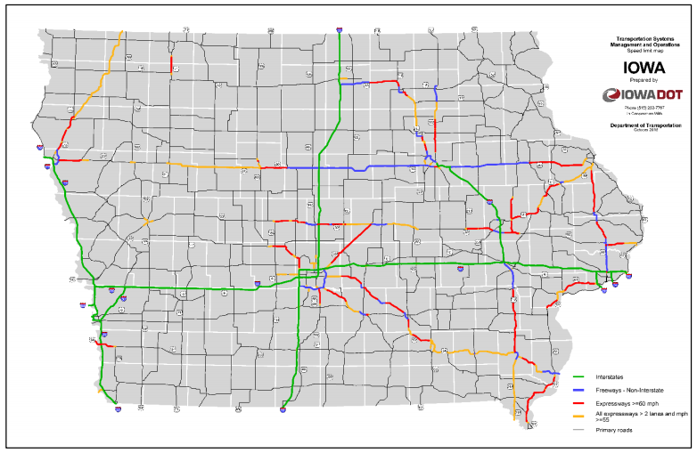
Iowa DOT Traffic Critical Projects (TCP) Program
Program facilitates safety and mobility in construction work zones
Projects identified using a TCP checklist, starting with location in a critical roadway (shown)
TCP mitigation includes TSMO strategies
Performance measures used to evaluate safety and delay
Source: Iowa Department of Transportation.
Notes:
Traffic Critical Projects (TCP) Program—The TCP program facilitates safety and mobility at construction work zones. The TCP program supports Iowa DOT’s TSMO strategic goals of safety, reliability, efficiency, convenience, and coordination.
The TCP program was established to improve safety and mobility in work zones on Iowa highways. The following vision and mission help guide the program:
Vision: Provide safe, reliable, and efficient travel through construction and maintenance work zones throughout Iowa’s highway system.
Mission: To identify and implement traffic-management strategies that address safety and mobility challenges encountered in construction and maintenance work zones.
In support of the TSMO strategic goals of safety, reliability, efficiency, convenience, and coordination, the TCP program’s primary goals include:
Identifying upcoming projects during the planning and design stages that have potential to cause significant safety or mobility impacts
Applying various mitigation strategies to address safety and mobility concerns, including quick recovery from traffic incidents or queueing
Evaluating TCP mitigation efforts to determine if they are reliable, timely, and effective
Developing performance measures that can be used to establish safety goals and travel-time delay targets in Iowa and applying performance measures to quantify the safety and mobility impacts of the TCP program
Developing support throughout Iowa DOT for the TCP program by establishing easily understood and implementable program procedures
Identifying which projects may need intelligent work zone features added to them
The program is included in the “Traffic Control” chapter of Iowa DOT’s Design Manual. This ensures TCP projects are identified during planning and design, and that various mitigation strategies are applied. The Design Manual includes a TCP checklist for projects on interstate and primary highways, available at https://iowadot.gov/design/dmanual/09e-01.pdf.

Slide 54
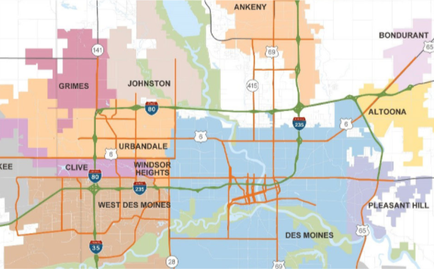
Iowa DOT and Integrated Corridor Management (ICM)
Des Moines, Iowa
ICM strategies
Safety is a major benefit of ICM and important to cities.
Other benefits are reliable travel times, timely incident and detour information, reduced emissions, less fuel consumption.
ICM is less costly than traditional freeway-widening projects.
Source: Iowa Department of Transportation.
Notes:
Des Moines is one of the fastest growing metropolitan areas in the Midwest.
The Iowa Department of Transportation is studying integrated corridor management (ICM) strategies and selected capacity improvements to cost-effectively and proactively manage traffic in the Des Moines metropolitan area. Iowa DOT plans to cooperatively use ICM strategies throughout the area to manage traffic proactively under all types of conditions to deliver improved levels of safety, mobility, reliability, and quality of life for all users.
The ICM concept provides a framework for coordination among all systems within a transportation corridor—ensuring transportation agencies utilize and improve multiple transportation modes and not just freeways. It is a collaboration of multiple agencies working together to improve transportation as a network and not as separate segments or networks.
The benefits of ICM include the following:
Fewer traffic incidents, particularly those that occur as a result of another event, also called secondary incidents
Reduced amount of time an incident has the potential to impact traffic, in turn increasing safety and mobility
More predictable travel times
The ability to more quickly make incident information available on traveler information sources
Increased or more complete information about other routes or travel options if an incident or traffic congestion does occur
Increased use of other routes or travel options to meet the demand of traffic
Reduced vehicle emissions and fuel consumption resulting from congestion
Less costly than traditional freeway widening projects
Source: https://iowadot.gov/desmoinesicm/

Slide 55
Iowa DOT Infrastructure Condition Evaluation-Operations (ICE-Ops) Tool
Melds data sources to support project prioritization
Considers mobility and safety
Provides corridor analysis using criteria such as:
Average annual daily traffic
Bottleneck duration
Incident density
Crash rate
Buffer time index
Event center proximity
Flood event density
Moving toward using safety performance factors
Notes:
The Iowa DOT implemented an initiative to meld data sources together to help support project creation and prioritization.
Beginning with its initial development, the purpose of the ICE-Ops tool was to provide the Iowa DOT with an initial screening and relative prioritization of corridors/segments. It was built as an extension of the original infrastructure condition evaluation (ICE) tool. This process now evaluates Iowa’s Primary Highway system, independent of current financial constraints, using a select group of criteria weighted in terms of their relative significance. The resulting segments highlight areas that may be considered for further study. The tool is meant to provide a detailed analysis for highway corridors using ten different criteria:
Average annual daily traffic
Bottleneck duration
Incident density
Crash rate
Buffer time index
Event center proximity
Flood event density
Winter weather sensitivity
Freight network
Infrastructure analysis score
Currently, the tool uses crash rate, but Iowa DOT is working towards more predictive, proactive way of improving safety. In the past, safety decisions were based on crash frequency and crash rates. Now, Iowa DOT has created safety performance functions for their intersections and is looking at potential crash reductions. They plan to perform the same type of analysis for roadway segments and projects. The goal is to identify whether a project or area is safety critical. Right now, almost every project has a safety element in it, but Iowa is moving towards an emphasis on safety-critical work. Overall, it will be a more systemic approach.
Image – https://iowadot.gov/policies_and_statements/Logos-Guidelines

Slide 56
Ohio DOT (ODOT) Traffic Operation Assessment Systems Tool (TOAST) (1/2)
Traffic Operation Assessment Systems Tool (TOAST): interactive spreadsheet to identify operations needs and support project prioritization
Leverages safety data to inform prioritization
Districts can apply for TSMO funding to address issues based on TOAST through a $5 million/year dedicated budget for TSMO projects
TSMO projects are also eligible for ODOT’s other funding programs.
Learn more at https://www.transportation.ohio.gov/wps/portal/gov/odot/working/data-tools/resources/toast
Notes:
The Ohio DOT TSMO program’s Traffic Operations Assessment Systems Tool (TOAST) is a key example of coordination. This tool prioritizes road segments based on both operational and safety performance measures. TOAST tool leverages safety data to inform prioritization and decisionmaking. In particular, incident clearance and secondary crashes are a big part of the TSMO team’s TOAST rankings.
Ohio DOT developed TOAST as recommended in the 2018 TSMO Early Action Implementation Plan. The tool uses an interactive spreadsheet to identify system hotspots and prioritize projects. TOAST data calculations are run on route segments. A total score is calculated for each route to identify those that can benefit from TSMO strategies.
The TOAST initiative includes the following:
Ohio DOT districts can apply for TSMO funding to address issues they have identified using TOAST; there is a $5 million annual budget dedicated to TSMO projects.
Ohio DOT’s Project Initiation Package requires project managers for major capital projects to address specific TSMO considerations at the start of their projects.
As part of the Project Initiation Package used for most capital projects, the project managers must indicate in TOAST whether a project area is a hotspot.
Additional information: https://www.transportation.ohio.gov/static/Working/data-tools/toast/reference-document.pdf.

Slide 57
ODOT TOAST (2/2)
TOAST identifies road segments that could benefit from TSMO strategies based on:
Bottlenecks
Travel time performance
Travel time index
Safety (impact of crashes in corridor and percentage of total crashes that are rear-end)
Incident clearance time
Secondary crashes
Volume per lane
Freight corridors
Notes:
TOAST reports are generated statewide and by district and indicate the top 25 segments (or hotspots) using a variety of data. TOAST ranks road segments as high priority for TSMO improvements based on data or performance measures in these areas:
Bottlenecks: a potential bottleneck is detected when speeds on a segment drop to 65 percent of reference speeds and cause at least a 2-minute delay
Travel time performance: percentage of time motorists can travel at or near (90 percent) of the reference speed (free-flow speed defined by data provider)
Travel time index: Ratio of travel time during specific time of day to travel time during free flow conditions
Safety: the safety performance of a route based on the impact of crashes in the corridor, and percent of total crashes that are rear-end crashes
Incident clearance: from the time the incident is reported until the entire scene is cleared
Secondary crashes: percentage of crashes that occurred as a result of a previous incident
Volume per lane: calculated based on a weighted average for each segment
Freight corridors: weighted average of the percentage of trucks (average daily truck volume divided by average daily total volume)

Slide 58
Collaboration in Ohio DOT
Data sharing (including in TOAST)
Common committees and teams
TIM
Work zones
Education, outreach, and traveler information efforts
Performances-based practical design support
Safety funding TSMO strategies
Source: Getty Images.
Notes:
Ohio DOT’s TSMO and safety groups collaborate on a variety of fronts:
Data sharing – The safety group incorporates operations data into their work. Likewise, safety data and metrics are an important part of TOAST. Because safety metrics are some of the major factors in the TSMO TOAST list, safety is integral to all TSMO prioritization and funding decisions. Often safety metrics serve as a “tiebreaker” in choosing between priority corridors for the TSMO team. For example, if two corridors have the same congestion problems, the one with greater safety problems will be the priority.
Common committees and teams – TSMO staff are on safety committees, and safety is on the TSMO council, and representatives from the areas are on team meetings frequently. For example, in the monthly District Safety Review Team meetings, part of the agenda is dedicated to reviewing TSMO-related items.
TIM – TIM is a big area for coordination. Ohio DOT also has a statewide TIM committee.

Slide 59
Ohio DOT Interstate 90 Road Weather Management
A 12-mile section of I–90 near Lake Erie in Lake County experienced multivehicle crashes, closures, and long delays due to lake effect snow.
Ohio DOT’s Highway Safety program approved Highway Safety Improvement Program (HSIP) funding to deploy a TSMO solution.
Cameras and weather-sensing stations monitored conditions and variable speed limits and dynamic message signs to manage travel.
Crashes decreased by 40%, and incident clearance times were down from 112 to 81 minutes following implementation.
More information at: Ohio DOT, TSMO Project Case Study: I–90 Lake County. Available at: https://www.transportation.ohio.gov/programs/tsmo/case-studies/tsmo-case-study-i-90.
Notes:
Notes below were taken from an FHWA case study not yet released (FHWA-HOP-22-083).
A 12-mile section of I–90 near Lake Erie in Lake County, OH experiences frequent low visibility and white-out conditions because of lake effect snow, which was causing multivehicle crashes, closures, and long delays.
The Highway Safety program, within the Statewide Planning and Research Office, approved Highway Safety Improvement Program (HSIP) funding for a project was to improve safety along the road. The TSMO solution was to use cameras and weather-sensing stations to monitor weather and road conditions and deploy variable speed limits and dynamic message signs to communicate conditions to motorists.
With deployment of the TSMO solution, crashes were reduced by 40 percent—from 138 snow event crashes during snow events in 2014–2016 to 83 in 2017–2019—after implementation. Additionally, no fatalities or major pileups occurred during the same study period, incident clearance times were reduced from 112 to 81 minutes, and secondary crashes were reduced by 25 percent. The project also significantly reduced travel delay costs from more than $2 million before the project to $364,281 after the project.
More information at: Ohio DOT, TSMO Project Case Study: I–90 Lake County. Available at: https://www.transportation.ohio.gov/programs/tsmo/case-studies/tsmo-case-study-i-90.

Slide 60
Vermont Agency of Transportation (AOT) Safety Data Team
Connects TSMO and safety
Uses data for Vermont AOT products, strategic decisionmaking, project prioritization, project design, and interagency support
Supports monitoring and reporting, including SHSP
Source: Carlos Muza at Unsplash.
Notes:
The data team is one area that the Vermont Agency of Transportation (VTrans) is connecting TSMO and safety. VTrans is working on improving the use of data for products, strategic decision making, project prioritization, project design, and interagency support. VTrans envisions the data team to support monitoring and reporting out more frequently, including measures from the SHSP.
The data team is in early development stage and is a work in progress. The vision is to hold a series of stakeholder needs assessment workshops using data-related products. For example, heat maps may be useful for things like project development. Those products will be coming from the data group, such as fatality data and congestion hotspots.
Photo Source: Carlos Muza on https://unsplash.com/photos/hpjSkU2UYSU.

Slide 61
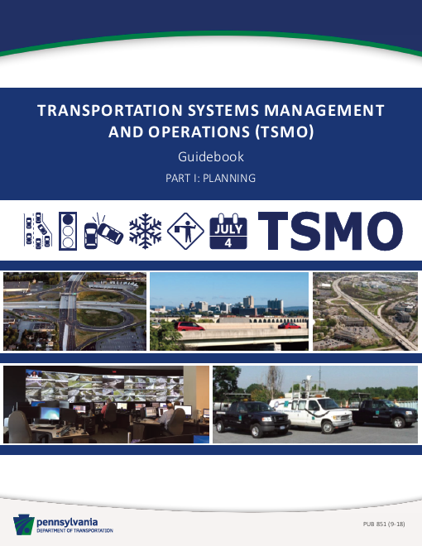
Pennsylvania DOT TSMO Guidebook
TSMO Guidebook Part 1: Planning recognizes safety benefits for a variety of TSMO solutions, such as:
Dynamic curve warning
Flex lanes
Freeway service patrols
Dynamic merge control
Ramp metering
Road weather information systems
TIM teams
Traffic signal enhancements
Variable speed displays
Source: Pennsylvania Department of Transportation.
Notes:
TSMO Guidebook Part 1: Planning recognizes safety benefits for variety of TSMO solutions, such as:
Dynamic curve warning
Flex lanes
Freeway service patrols
Dynamic merge control
Ramp metering
Road weather information systems
TIM teams
Traffic signal enhancements
Variable speed displays
http://www.dot.state.pa.us/public/PubsForms/Publications/PUB%20851.pdf

Slide 62
Overcoming Challenges

Slide 63
Potential Challenges … and Solutions (1/4)
Solutions
Challenge
Limited knowledge relating to TSMO strategies and their benefits
Provide a TSMO overview and explain example strategies to safety personnel
Invite safety staff to TSMO events, committees, meetings, and training, and vice versa
Include safety staff input in TSMO plans and activities
Review Federal TSMO resources: https://ops.fhwa.dot.gov/plan4ops/
Notes:
Safety staff may have limited knowledge relating to TSMO strategies. To help resolve that, there are some ideas listed on the slide.
Some solutions include
Provide a TSMO overview and explain example strategies to safety personnel.
Invite safety staff to TSMO events, committees, meetings, and training, and vice versa.
Include safety staff input in TSMO plans and activities.
There are many TSMO resources available on FHWA’s website shown here on this slide.

Slide 64
Potential Challenges … and Solutions (2/4)
Challenge
Solutions
Minimal data on safety performance and benefit-cost analyses for TSMO strategies
Conduct safety studies for TSMO strategies that your agency has implemented
Collect and compile performance data
Research safety performance effects of TSMO strategies
Review FHWA’s Safety Analysis Needs Assessment for TSMO https://safety.fhwa.dot.gov/rsdp/downloads/fhwssa19041.pdf
Notes:
There may be minimal data on safety performance and benefit-cost analyses for TSMO strategies. This should not stop an agency from considering TSMO strategies to help improve safety. Agencies can
Conduct their own safety studies for TSMO strategies that they have implemented
Collect and compile performance data
Research safety performance effects of TSMO strategies
Review FHWA’s Safety Analysis Needs Assessment for TSMO; this resource may help agencies gain an understanding of the existing knowledge, research, and analyses methods for quantifying the safety performance effects of TSMO.

Slide 65
Potential Challenges … and Solutions (3/4)
Challenge
Solutions
Funding limitations
Collaboration between TSMO and safety staffs may offer opportunities to pool resources for projects that help both safety and mobility
Include TSMO strategies within SHSP
Notes:
Some agencies may have challenges to overcome relating to funding.
TSMO and safety staffs, along with their management, should collaborate and discuss opportunities to pool resources together for projects that help both safety and mobility.
It is also recommended that TSMO strategies be identified and included within the Strategic Highway Safety Plan.

Slide 66
Potential Challenges … and Solutions (4/4)
Challenge
Solutions
Balancing safety and mobility goals in projects
Involve TSMO and safety staffs in project planning and project development
Leverage technology and data for safety and TSMO decisions
Notes:
Balancing safety and mobility goals in projects can be difficult at times. For this reason, it is important for both TSMO and safety staff be involved in project planning and project development. Technology and data can also be leveraged to inform safety and operational decisions.
NOTE: Ask participants if there are others that would impact collaboration.

Slide 67
Next Steps for Connecting TSMO and Safety

Slide 68
Near-Term Opportunities
Do a self-assessment of your agency to determine your strengths and weaknesses in connecting TSMO and safety.
Provide TSMO overview and example strategies to safety personnel.
Invite safety staff to TSMO events and training.
Include safety personnel in TIM training or committees.
Look for ways to include TSMO strategies in the SHSP; and include safety staff input within the TSMO plan.
Share data resources with each other.
Participate in road safety and operations audits for projects.
Conduct joint research projects that evaluate the safety performance of TSMO strategies.
Other ideas for collaboration in the near term?
Notes:
There are several opportunities for near-term collaboration between TSMO and safety staff.
NOTE: Ask participants what other ideas they may have.

Slide 69
Long-Term Opportunities
Learn about the Safe System Approach and how TSMO and safety professionals can work together on this.
Investigate and better leverage technology and big data for safety and operations decisions.
Include both TSMO and safety criteria in project analysis and selection.
Plan for and invest in connected and automated vehicle and infrastructure applications.
Implement strong leadership that recognizes the benefits of collaboration between safety and operations.
Foster a workplace that supports collaboration and being open to new ideas and innovative solutions.
Other ideas for collaboration in the long term?
Notes:
There are also several opportunities for TSMO and safety staff to collaborate in the long term.
NOTE: Ask participants what other ideas they can think of.

Slide 70
Emerging Opportunities for Improving Safety through Operations Data and Tools
Using real-time operations data and dynamic operations strategies to support safety intervention
Using operations tools that can enable more proactive (versus retroactive) safety decisionmaking to address current and impending safety concerns
Potential strategies:
Video analytics for quicker identification of freeway and arterial operations issues
Wrong-way driver detection and notification
Crash risk visualization and prediction tools
Traffic incident and crash prediction systems
Probe data providing information on speed profiles and locations of speeding
Connected vehicle data and connected devices for pedestrians and cyclists insights into high-crash risk locations
Notes:
One of the emerging areas that could provide opportunities to connect TSMO and Safety is the use of real-time operations data and dynamic operations strategies to support safety intervention. This may lead to developing operations tools that can enable more proactive (versus retroactive) safety decision-making to address current and impending safety concerns.
Some strategies may include:
Applications that leverage video analytics to enable quicker identification of freeway and arterial operations issues, such as near misses at signalized intersections
Wrong-way driver detection and notification
Crash risk visualization and prediction tools
Traffic incident and crash prediction systems
Probe data providing information on speed profiles and locations of speeding
Connected vehicle data, which provides insights into high crash risk locations such as hard-braking events, sudden slowdown locations, and windshield wiper status
Connected devices for pedestrians and cyclists to help avoid collisions with other travelers or vehicles at high crash locations
Safety and operations are closely related, complementary disciplines. Through intentional coordination on plans, data, funding, planning process and tools, and project development, agencies can identify more holistic solutions and investments that optimize performance in both areas. Exciting developments in real-time operations data, analytics, artificial intelligence, and connected vehicle and device capabilities hold great promise for shifting the safety analysis paradigm from an ex-post model, where changes are made based on historical crashes and safety outcomes, to an ex-ante model, where predicted crashes and safety issues are proactively addressed.

Slide 71
Resources (1/2)
FHWA frequently asked questions on “What is TSMO?”: https://ops.fhwa.dot.gov/tsmo/index.htm
FHWA factsheet, Enhancing Transportation: Connecting TSMO and Safety: https://ops.fhwa.dot.gov/publications/fhwahop18091
FHWA web page, “Organizing and Planning for Operations”: https://ops.fhwa.dot.gov/plan4ops
FHWA, Communicating TSMO; TSMO case studies: https://ops.fhwa.dot.gov/plan4ops/focus_areas/communicating_tsmo.htm
:National Operations Center of Excellence” website: https://www.transportationops.org/
Notes:
There are multiple sources of information that can help with your understanding of TSMO from FHWA and the National Operations Center of Excellence.

Slide 72
Resources (2/2)
Safety Analysis Needs Assessment for TSMO: https://safety.fhwa.dot.gov/rsdp/downloads/fhwssa19041.pdf
Safety Performance Analysis of TSMO: A Practical Approach for Assessing Traffic Signal Coordination Effects on Crash Probability and Severity: https://safety.fhwa.dot.gov/rsdp/downloads/fhwasa19043.pdf
Safety Performance Analysis of TSMO: A Practical Approach for Assessing Safety Service Patrol Effects on Secondary Crashes: https://safety.fhwa.dot.gov/rsdp/downloads/fhwasa19042.pdf
Notes:
There are multiple sources of information that can help with your understanding of TSMO from FHWA and the National Operations Center of Excellence.

Slide 73
Thank you for your attention!
For more information please contact:
[INSERT CONTACT INFORMATION]

